Slide 1

= Ensure more space between year group rows to help with communion movement
Video the Mass! = onto website?
SANITISER BOTTLES
Mic on Altar for priest
Homily from Lectern
2 double blocks on each side to higher screen
College Banner/Black tape/blutack/ skin candles
Crucifix on offertory table
Drink for Father
No chairs near speakers
DM Intro – welcome all, welcome Father, join in blue text, liturgical colour – then ‘We Gather’ section card

Slide 2
USE NEW VERSIONS
LAMB OF GOD AND HOLY HOLY
= TELL KT/ST

Slide 3



DM = INTRODUCTIONS AND WELCOMES
= Fr. Stephen
= Any guests
= Join in with blue text
DM SAY - SIT DOWN AFTER OPENING HYMN

Slide 4

PENITENTIAL ACT
You were sent to heal the contrite of heart: Lord have mercy.
LORD HAVE MERCY.
You came to call sinners:
Christ have mercy.
CHRIST HAVE MERCY.
You are seated at the right hand of the Father to intercede for us:
Lord have mercy.
LORD HAVE MERCY.
TELL KT/ST
= DO BOTH ACTS IN SAME MASS
CONGREGATION SAY ONE THEN CHOIR SING ONE
= ASK FATHER IF OK…
IF DO BOTH = NO GLORIA

Slide 5
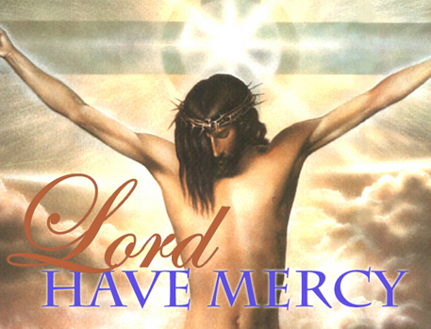
PENETENTIAL ACT
Show mercy to us loving Father.
We have sinned against you, please make us anew.
In your love and your grace, you forgive us.
Lord have mercy, Lord have mercy.
Look not on our failings, Lord Jesus.
We have sinned against you, please make us anew.
By your life and your death, you redeem us,
Christ have mercy, Christ have mercy.
Come fill our hearts, Holy Spirit.
We have sinned against you, please make us anew.
Forgive us and heal us and save us,
Lord have mercy, Lord have mercy.
ONLY SING THE PENETENTIAL RIGHT IN WELCOME MASSES OR END OF YEAR MASSES
= IN FEAST DAY MASSES SING THE GLORIA AND JUS SAY THE LORD HAVE MERCY INSTEAD OF SINGING IT
i.e don’t sing both in a Mass = too long!

Slide 6
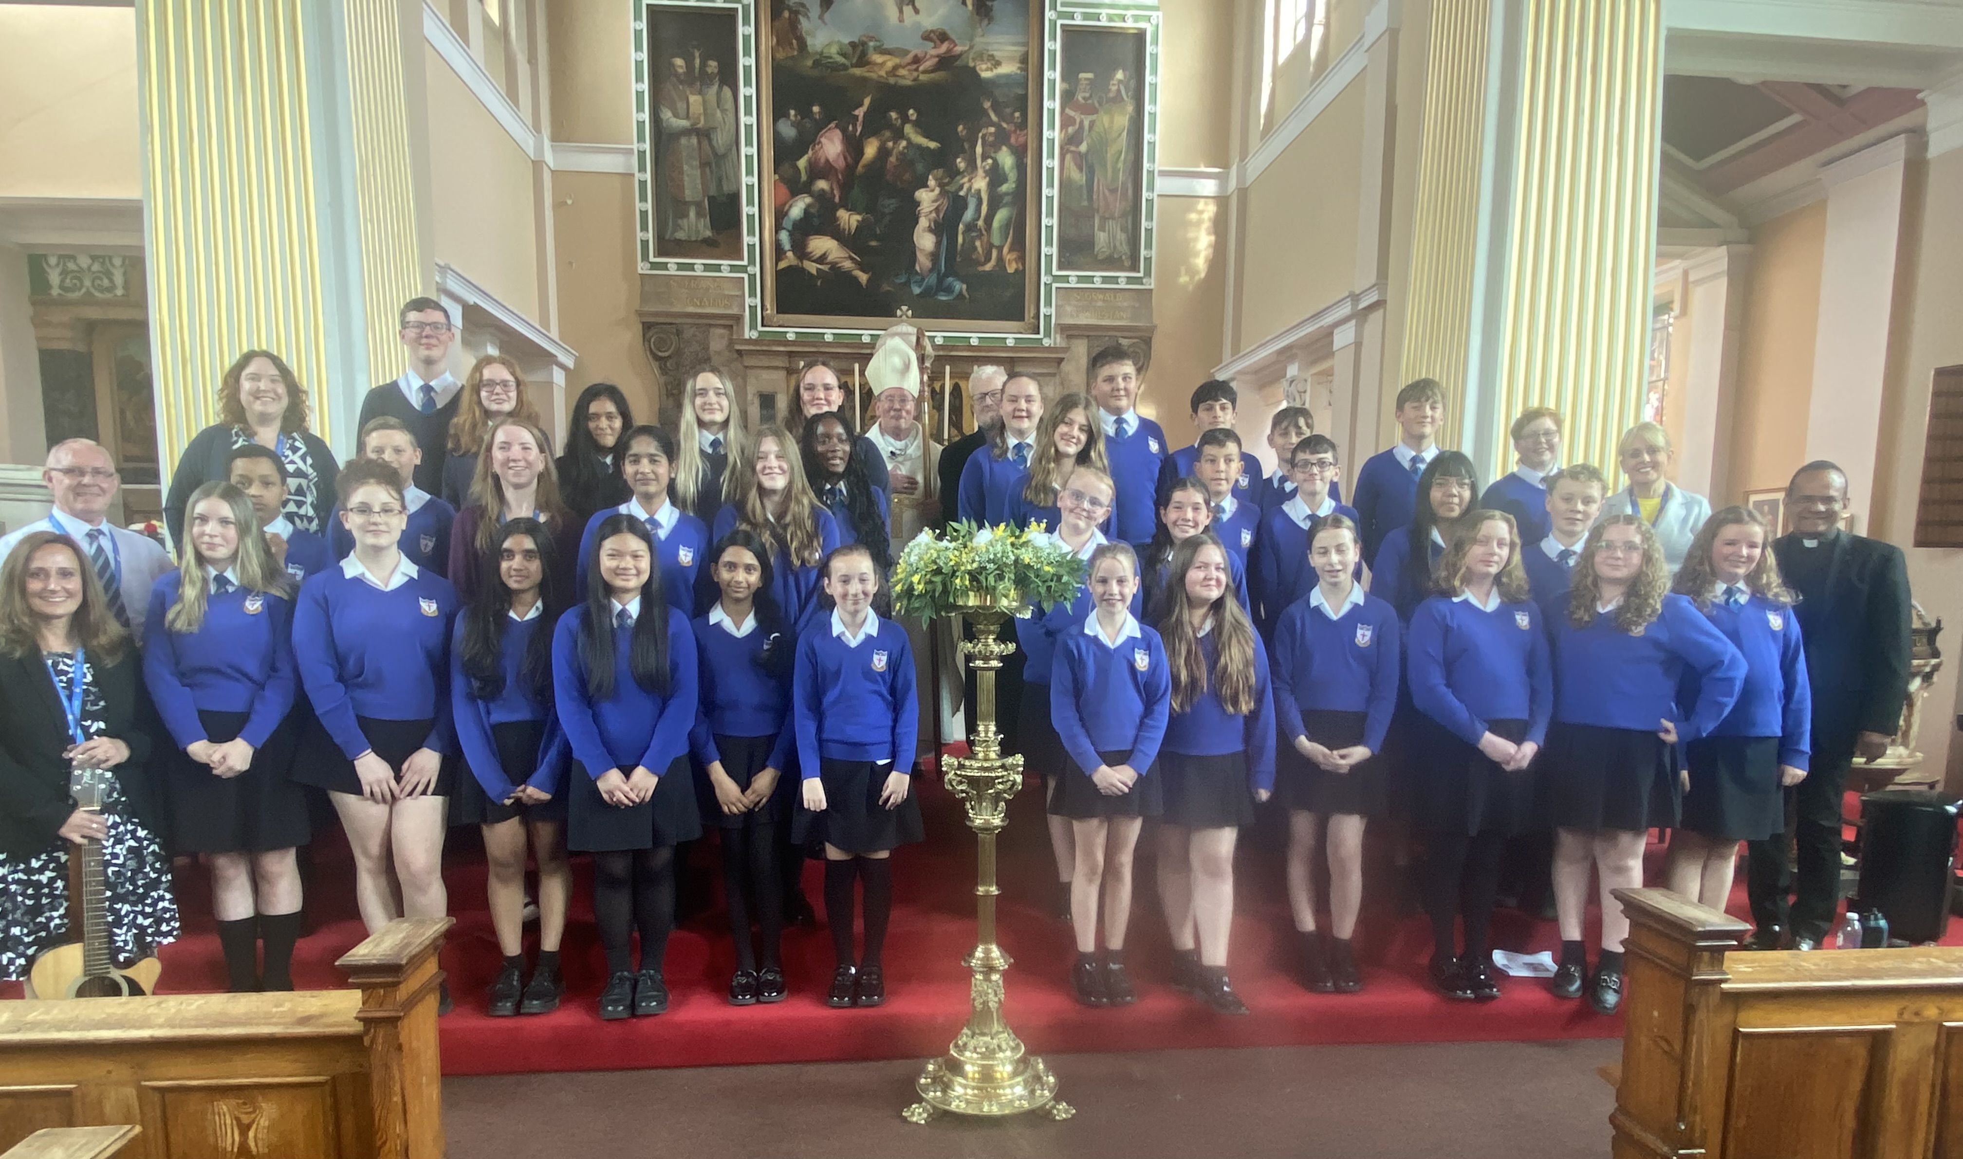


END OF YEAR CELEBRATION MASS
Thursday 17th July 2025
Good Shepherd Mass – 6th June 2025 – Presentation of Lenten Offerings.

Slide 7
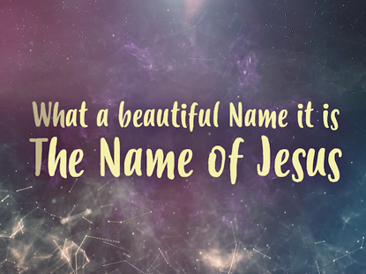

What a beautiful Name it is, what a beautiful Name it is.
The Name of Jesus Christ my King.
What a beautiful Name it is, nothing compares to this,
What a beautiful Name it is, the Name of Jesus.
You were the Word at the beginning.
One with God the Lord Most High.
Your hidden glory in creation,
Now, revealed in You our Christ.
A.M.D.G. – For the Greater Glory of God

Slide 8
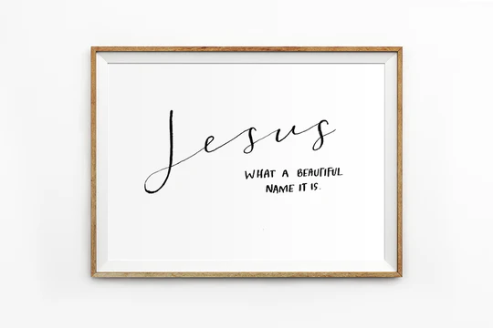
You didn't want heaven without us
So, Jesus, You brought heaven down.
My sin was great, Your love was greater
What could separate us now?
What a wonderful Name it is, what a wonderful Name it is.
The Name of Jesus Christ my King.
What a wonderful Name it is, nothing compares to this,
What a wonderful Name it is, the Name of Jesus.

Slide 9
Death could not hold You, the veil tore before You,
You silenced the boast of sin and grave
The Heavens are roaring, the praise of Your glory
For You are raised to life again.
You have no rival; You have no equal
Now and forever, God, You reign
Yours is the Kingdom, Yours is the Glory
Yours is the Name above all names.

Slide 10
What a powerful Name it is, what a powerful Name it is.
The Name of Jesus Christ my King.
What a powerful Name it is, nothing can stand against,
What a powerful Name it is, the Name of Jesus.

Slide 12


WE GATHER
Welcome to our End of Year Celebration Mass as we prepare ourselves to get closer to God.
As we gather in worship, we are reminded of our unity as God’s chosen people.
We praise and thank God as we celebrate the life of our vibrant community.
We pray that our school will continue to flourish helping to develop people of good character.
A.M.D.G. – For the Greater Glory of God

Slide 13
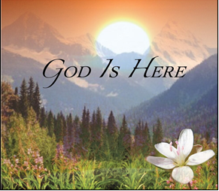
PLEASE STAND
OUR GOD IS HERE
Here in this time, here in this place,
here we are standing face to face.
Here in our hearts, here in our lives,
our God is here.

Slide 14
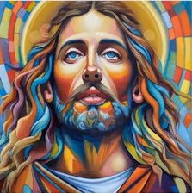
Here for the broken, here for the strong,
here in this temple we belong.
Here in our hearts, here in our lives,
our God is here.
And we cry:
“Holy! Holy! Holy are you!”
We cry: “Holy! Holy! Holy and true!”
Amen, we do believe our God is here.
Our God is here.

Slide 15
Here in the Word, God is revealed,
here where the wounded can be healed.
Here in our hearts, here in our lives,
our God is here.
Here we become what we receive,
here in this Eucharistic feast.
We are his body, living as one;
our God is here.

Slide 16
And we cry:
“Holy! Holy! Holy are you!”
We cry: “Holy! Holy! Holy and true!”
Amen, we do believe our God is here.
Our God is here.

Slide 17
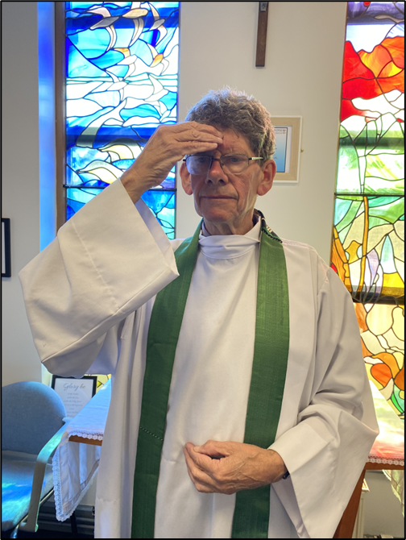

PLEASE SIT DOWN
In the name of the Father, and of the Son, and of the Holy Spirit,
AMEN.

Slide 18
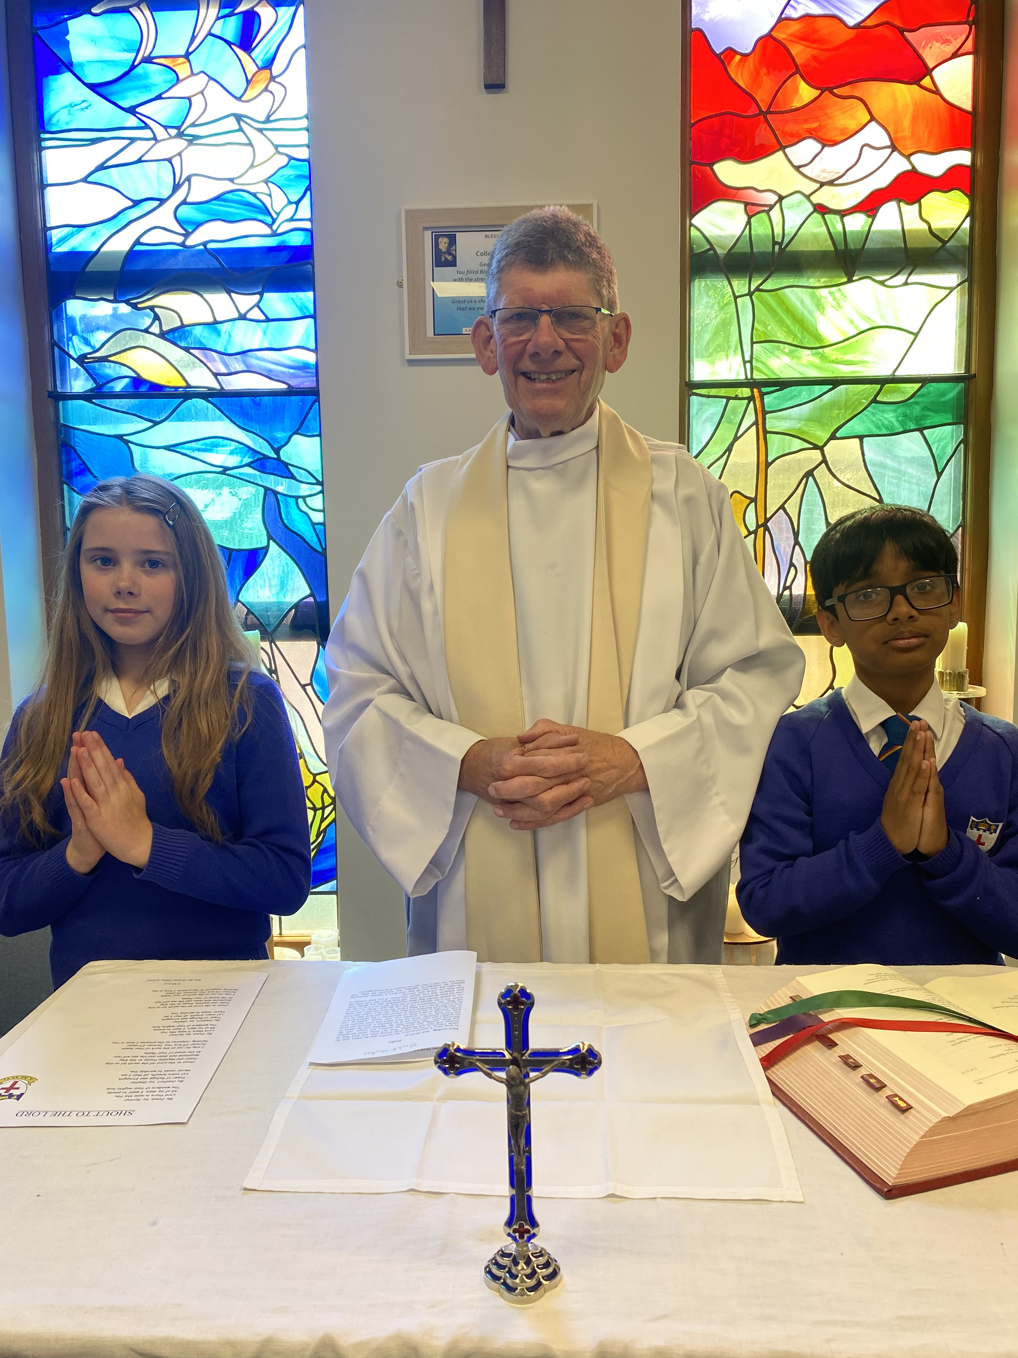

The grace of our Lord Jesus Christ and the Love of God and the communion of the Holy Spirit be with you all.
AND WITH
YOUR SPIRIT.

Slide 19



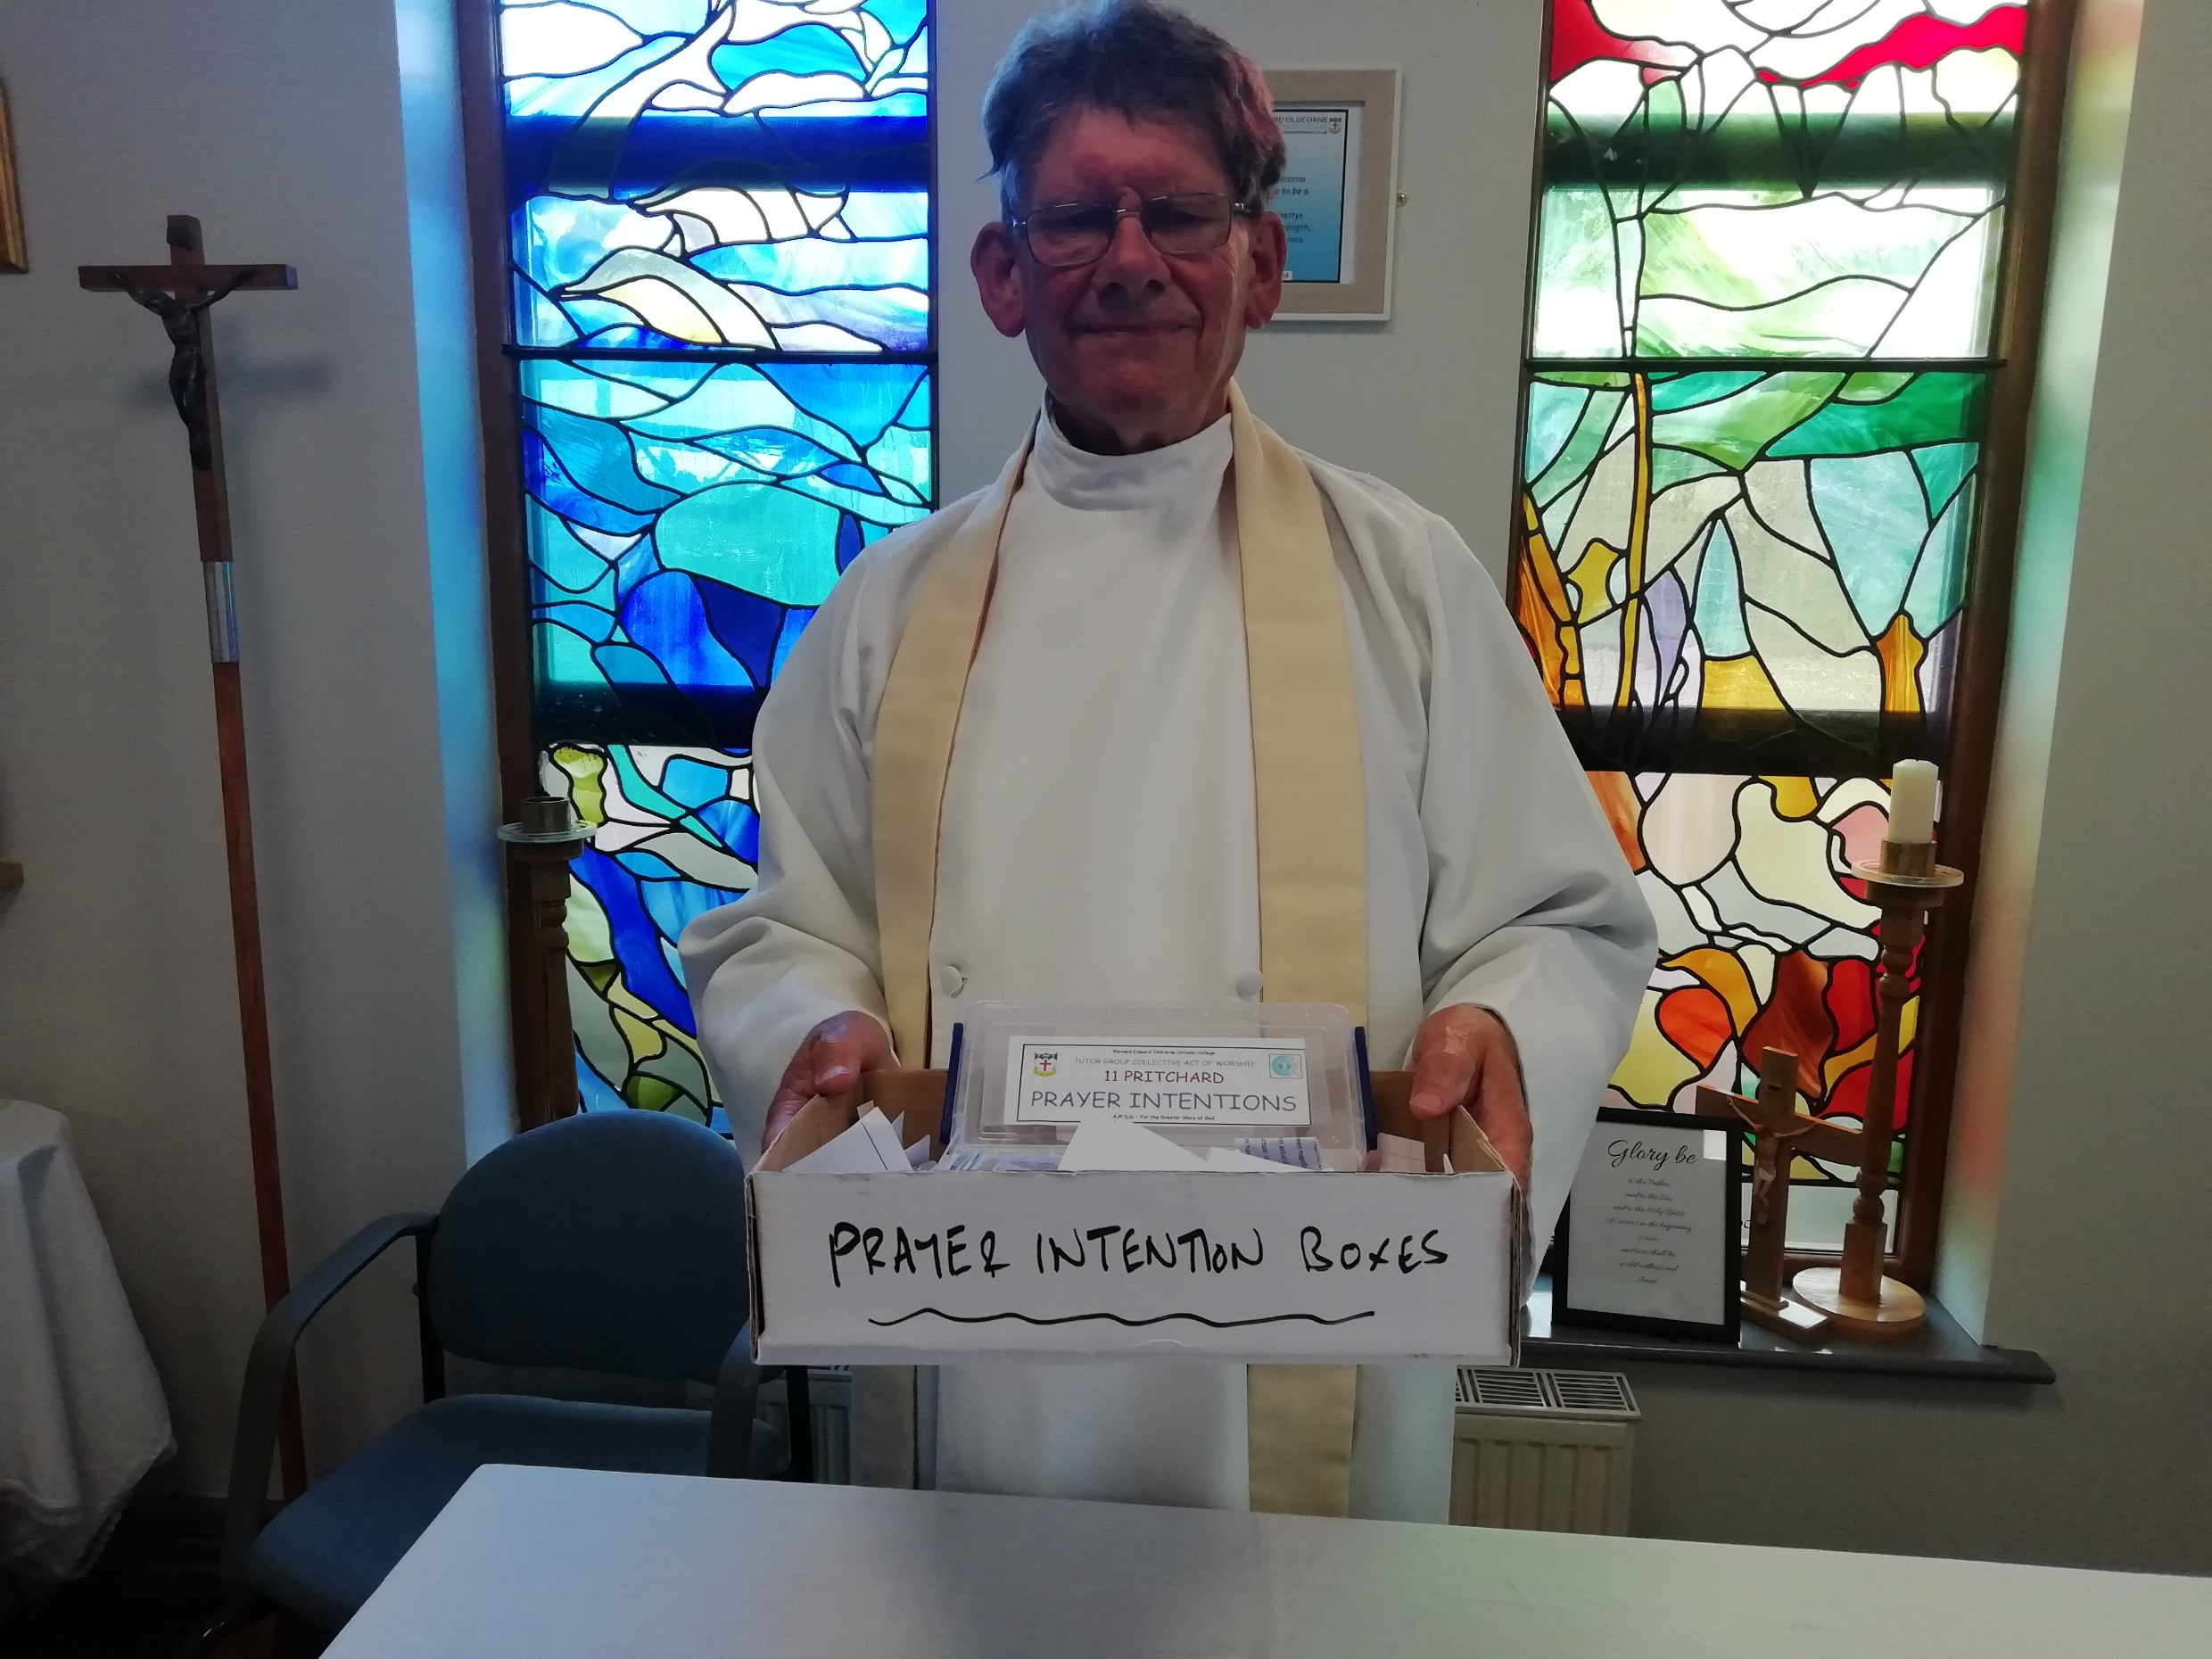
BLESSED EDWARD OLDCORNE CATHOLIC COLLEGE
END OF YEAR CELEBRATION MASS
A.M.D.G. – For the Greater Glory of God

Slide 20
Show mercy to us loving Father.
We have sinned against you, please make us anew.
In your love and your grace, you forgive us.
Lord have mercy,
Lord have mercy.
Look not on our failings, Lord Jesus.
We have sinned against you, please make us anew.
By your life and your death, you redeem us,
Christ have mercy,
Christ have mercy.
Come fill our hearts, Holy Spirit.
We have sinned against you, please make us anew.
Forgive us and heal us and save us,
Lord have mercy,
Lord have mercy.
PENITENTIAL ACT

Slide 21
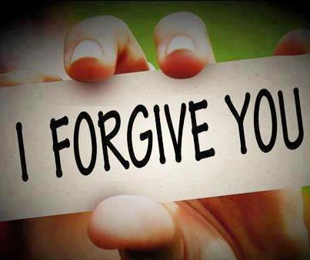
MAY ALMIGHTY GOD HAVE MERCY ON US, FORGIVE US OUR SINS AND BRING US TO EVERLASTING LIFE.
AMEN.

Slide 22
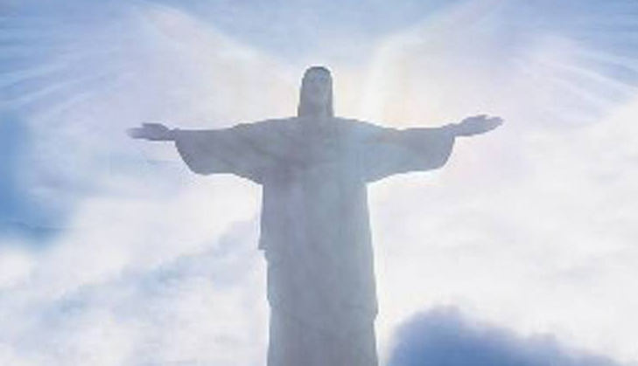
LET US PRAY

Slide 23
THE WORD
WE LISTEN
During the Liturgy of the Word we hear the proclamation of Sacred scripture.
These are not presented as recollections of past events, but as moments in the continuing love story of God and his people.
Our Lord did not just speak then, but also speaks to us now.
PLEASE SIT DOWN
A.M.D.G. – For the Greater Glory of God

Slide 24
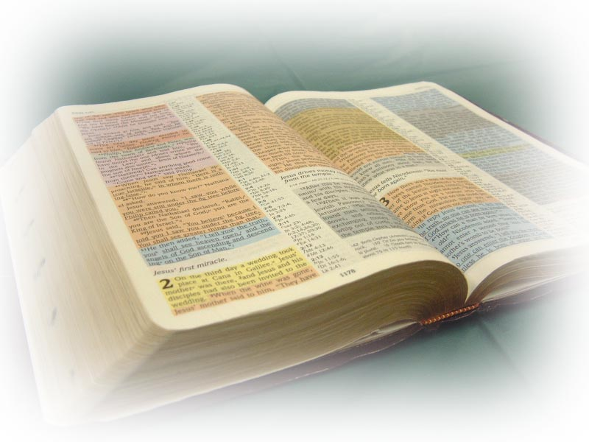
THE LITURGY OF THE WORD
A reading from the Letter of St. Paul to the Romans.
( Corinthians 12: 6-8)

Slide 25

We are to use our different gifts in accordance
with the grace that God has given us.
If our gift is to speak God’s message, we should do
it according to the faith that we have;
if it is to teach, we should teach;
if it is to encourage others, we should do so.
Whoever shares with others should do it generously; whoever has authority should work hard; whoever shows kindness to others should do it cheerfully.
The word of the Lord.
THANKS BE TO GOD.

Slide 26
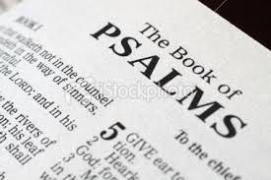
PSALM
Give thanks to the Lord, for he is good.

Slide 27
Give thanks to the Lord because he is good;
His love is eternal.
Who can tell all the great things he
has done?
Who can praise him enough?
Happy are those who obey his commands,
who always do what is right.
Give thanks to the Lord, for he is good.

Slide 28
2. Remember me Lord,
when you help your people;
include me when you save them.
Let me see the prosperity of your people
and share in the happiness of your nation,
in the glad pride of those who belong to you.
Give thanks to the Lord, for he is good.

Slide 29

PLEASE STAND TO GREET THE GOSPEL
Sing Alleluia to the Lord
Sing Alleluia to the Lord
Sing Alleluia
Sing Alleluia
Sing Alleluia to the Lord. x2

Slide 30
I thank you, Lord, with all my heart,
For you have heard my prayer.

Slide 31

The Lord be with you. - AND WITH YOUR SPIRIT.
A reading from the Holy Gospel according to Luke.
GLORY TO YOU, O LORD.

Slide 32
Some people brought their babies to Jesus for him to place his hands on them.
The disciples saw them and scolded them for doing so, but Jesus called the children to him and said, ‘Let the children come to me and do not stop them, because the Kingdom of God belongs to such as these.
Remember this! Whoever does not receive the Kingdom of God like a child will never enter it.’
The Gospel of the Lord.
PRAISE TO YOU, LORD JESUS CHRIST.

Slide 33
Sing Alleluia to the Lord
Sing Alleluia to the Lord
Sing Alleluia
Sing Alleluia
Sing Alleluia to the Lord. x1

Slide 34
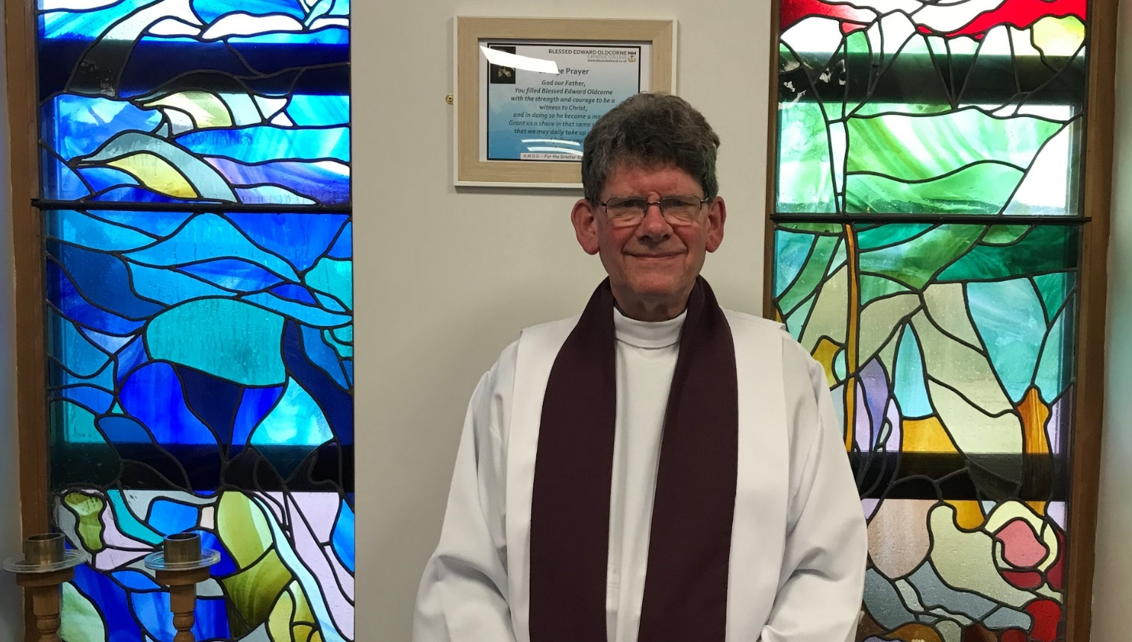
PLEASE SIT DOWN
HOMILY Fr. Stephen
Notes:
34

Slide 35
WE RESPOND
We respond by having a few moments of stillness, reflecting on what we have just heard and how it relates to us.
We sit silently as we prepare to listen to our Prayers of Intention.
We focus on the words of each prayer and ask God to come into our lives.
A.M.D.G. – For the Greater Glory of God

Slide 36
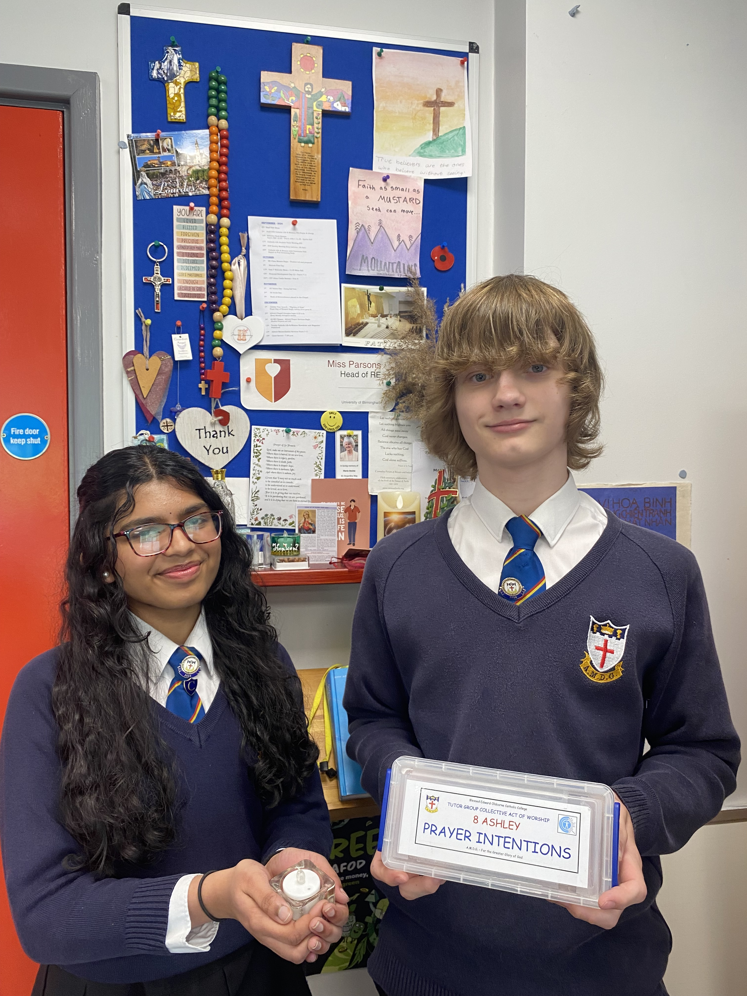
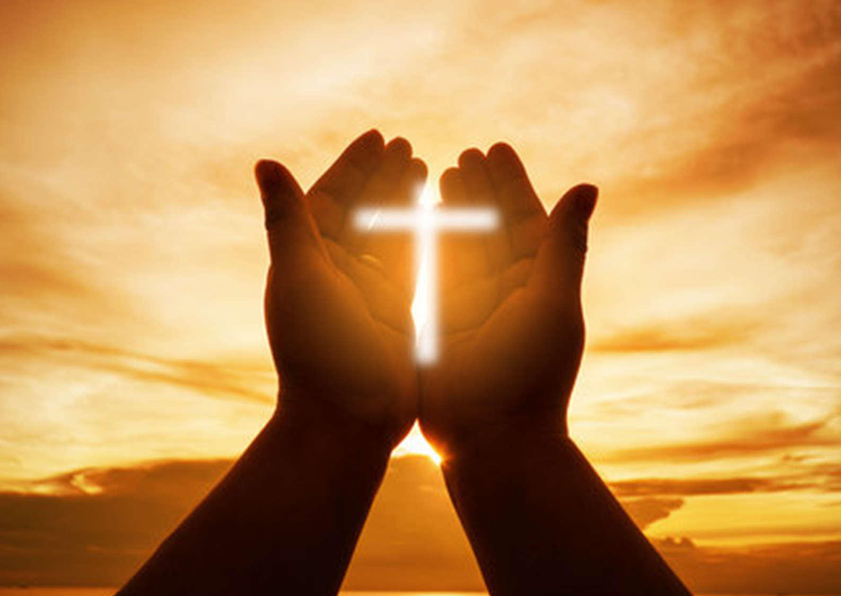
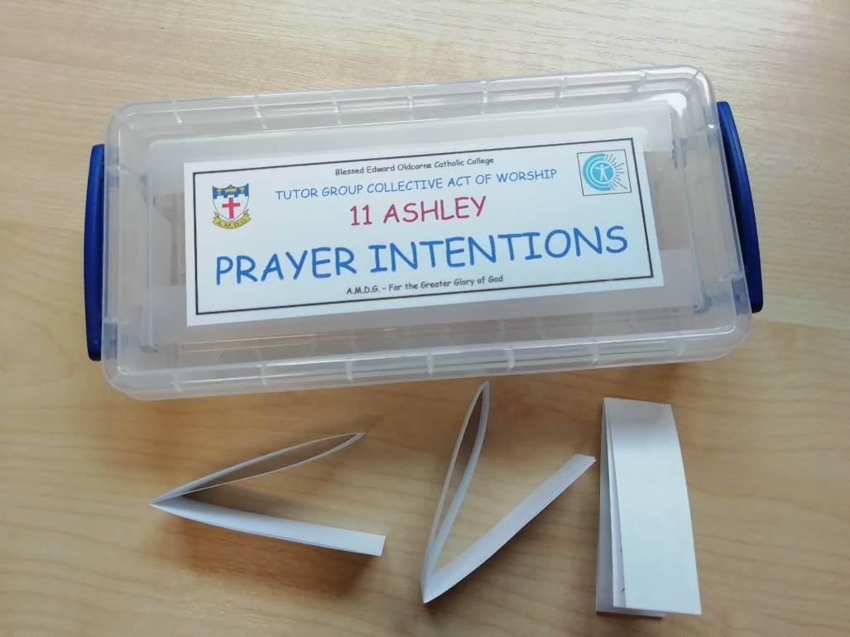
PRAYERS OF INTENTION
BIDDING PRAYERS

Slide 37

We pray for those who lead the Church, especially our recently elected Pope, Leo XIV, whom you chose as successor of St. Peter and shepherd of your flock.
We also pray for Bernard our Archbishop and Fr. Stephen our college chaplain.
Lord hear us
LORD GRACIOUSLY HEAR US

Slide 38
2. We pray to our Father in heaven, that in this Jubilee Year, we may be inspired to renew our faith, increase our hope and ignite our love.
Inspire us to become Pilgrims of Hope, bringing joy and peace to the world.
Lord hear us
LORD GRACIOUSLY HEAR US

Slide 39
3. We pray for the weak and vulnerable, for those who depend on others to care for them.
We pray for the sick and those in despair, especially those caught up in regions of the world experiencing war and unrest.
Help us to be encouragers and advocates for those who can’t speak up for themselves.
Lord hear us
LORD GRACIOUSLY HEAR US

Slide 40
4. We pray for our college community,
and that Jesus Christ,
and the teachings of his Church, may always be at the centre of our school.
We pray that we will be inspired to continue to give witness to our faith and remember that everything we do is for ‘The Greater Glory of God.’
Lord hear us
LORD GRACIOUSLY HEAR US

Slide 41
5. We pray for all the children and adults who have been in our school this academic year.
We pray that our community will continue to be a place of welcome, where all students, staff, parents and visitors feel valued and included.
We ask the Lord to remain with us,
and look after us all during our summer holidays.
Lord hear us
LORD GRACIOUSLY HEAR US

Slide 42

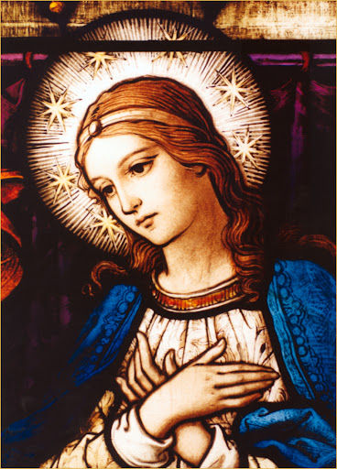
6. We pray for Mary, the Mother of God. Let us never fail to acknowledge the unconditional love that she bestows upon us as we all say together -
Hail Mary, full of grace, The Lord is with thee. Blessed art thou among women, and blessed is the fruit of thy womb, Jesus. Holy Mary, Mother of God, Pray for us sinners, Now and at the hour of our death. Amen.

Slide 43

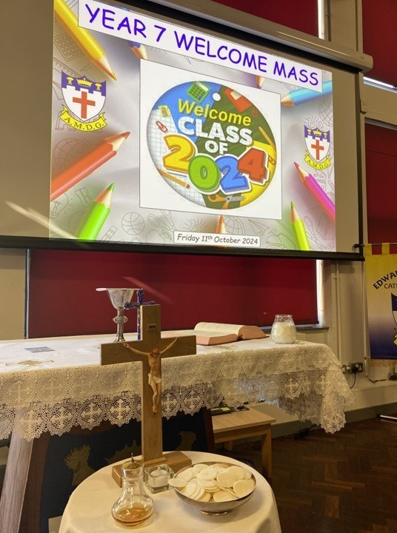

END OF YEAR CELEBRATION MASS

Slide 44
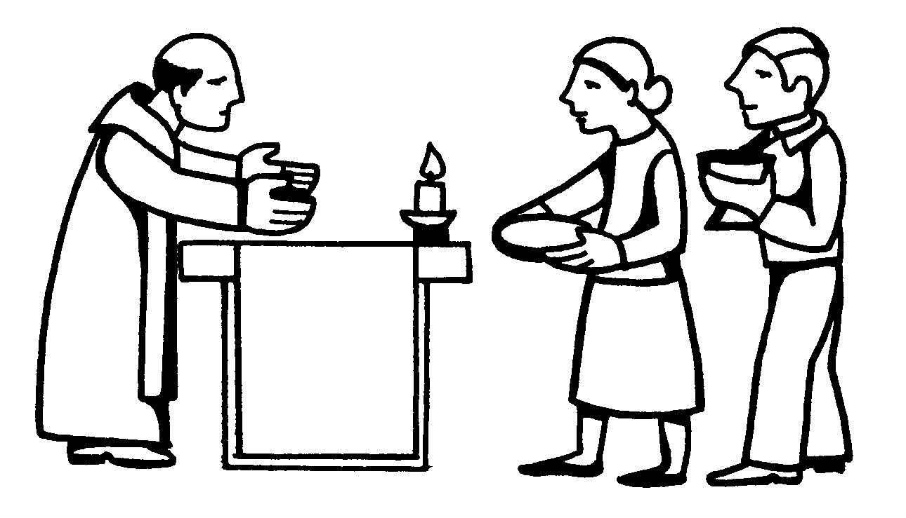
THE OFFERTORY

Slide 45
THE OFFERTORY
The gifts of bread and wine are brought to the altar.
The Priest blesses the bread and wine so that they become the body and blood of Jesus.
Together, we approach Calvary and the Upper Room, we come to Christ’s Real Presence as he comes to us.
A.M.D.G. – For the Greater Glory of God

Slide 46
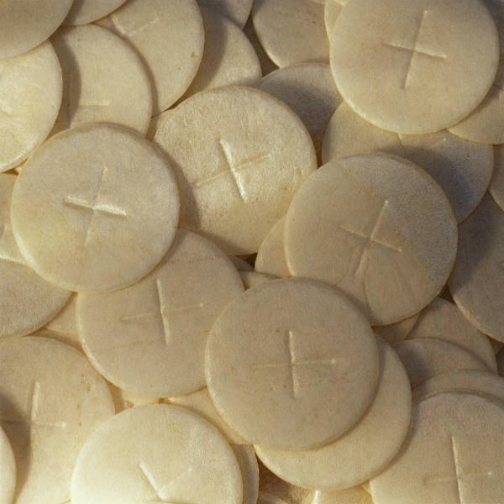
OFFERTORY HYMN
REMEMBRANCE
I take the bread of life
Broken for all my sin
Your body crucified
To make me whole again.
A.M.D.G. – For the Greater Glory of God

Slide 47
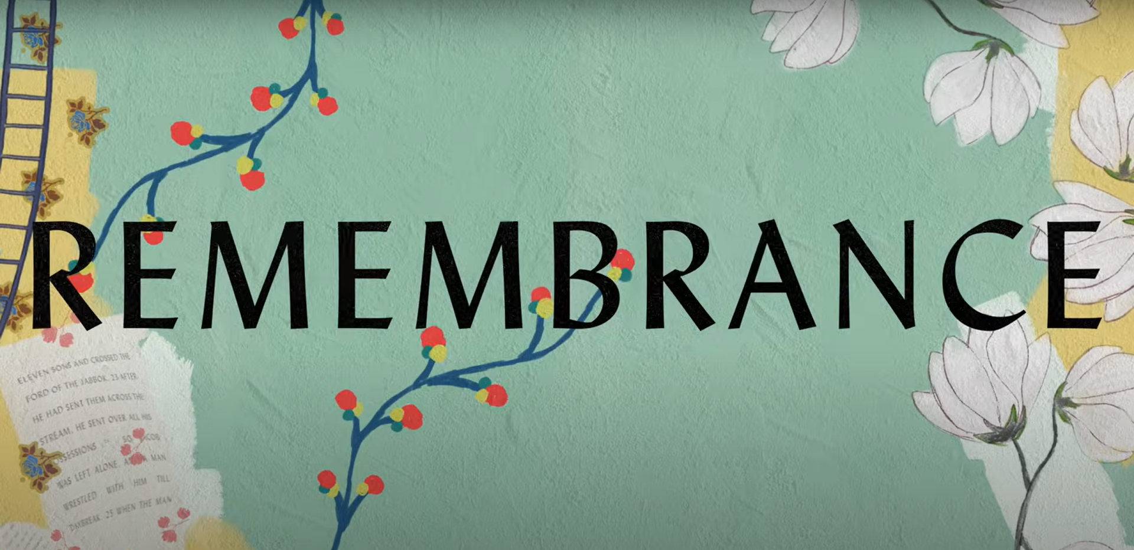
I will recall the cup
Poured out in sacrifice
To trade this sinner's end
For Your new covenant.
A.M.D.G. – For the Greater Glory of God

Slide 48

REMEMBRANCE
Hallelujah
I'll live my life in remembrance
Hallelujah,
Your promise I won't forget.
A.M.D.G. – For the Greater Glory of God

Slide 49
I'll walk salvation's road
With fear and trembling
Your way borne as my own
As Christ is formed in me.
A.M.D.G. – For the Greater Glory of God

Slide 50
REMEMBRANCE
Hallelujah
I'll live my life in remembrance
Hallelujah,
Your promise I won't forget.
A.M.D.G. – For the Greater Glory of God

Slide 51
If ever I should lose my way
If ever I deny Your grace
Remind me of the price You paid
Hallelujah,
I'll live in remembrance.
A.M.D.G. – For the Greater Glory of God

Slide 52
REMEMBRANCE
You've been so, so good to me
You've been so, so good to me
Oh to think where I would be
If not for You
If not for You.
x3
A.M.D.G. – For the Greater Glory of God

Slide 53
As far as heights reach from the depths
As far as east is from the west
So far Your grace has carried me.
A.M.D.G. – For the Greater Glory of God

Slide 54
REMEMBRANCE
Until I see You face to face
Until at last I've won my race
Remind me You're not finished yet.
A.M.D.G. – For the Greater Glory of God

Slide 55
Hallelujah,
Hallelujah,
Hallelujah,
I'll live in remembrance.
A.M.D.G. – For the Greater Glory of God

Slide 56
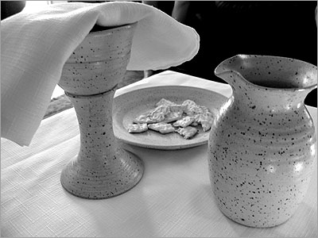
LITURGY OF THE EUCHARIST

Slide 57
Pray my brothers and sisters that my sacrifice and yours may be acceptable to God, the almighty Father.
May the Lord accept the sacrifice at your hands, for the praise and glory of his name, for our good and the good of all his holy Church.

Slide 58
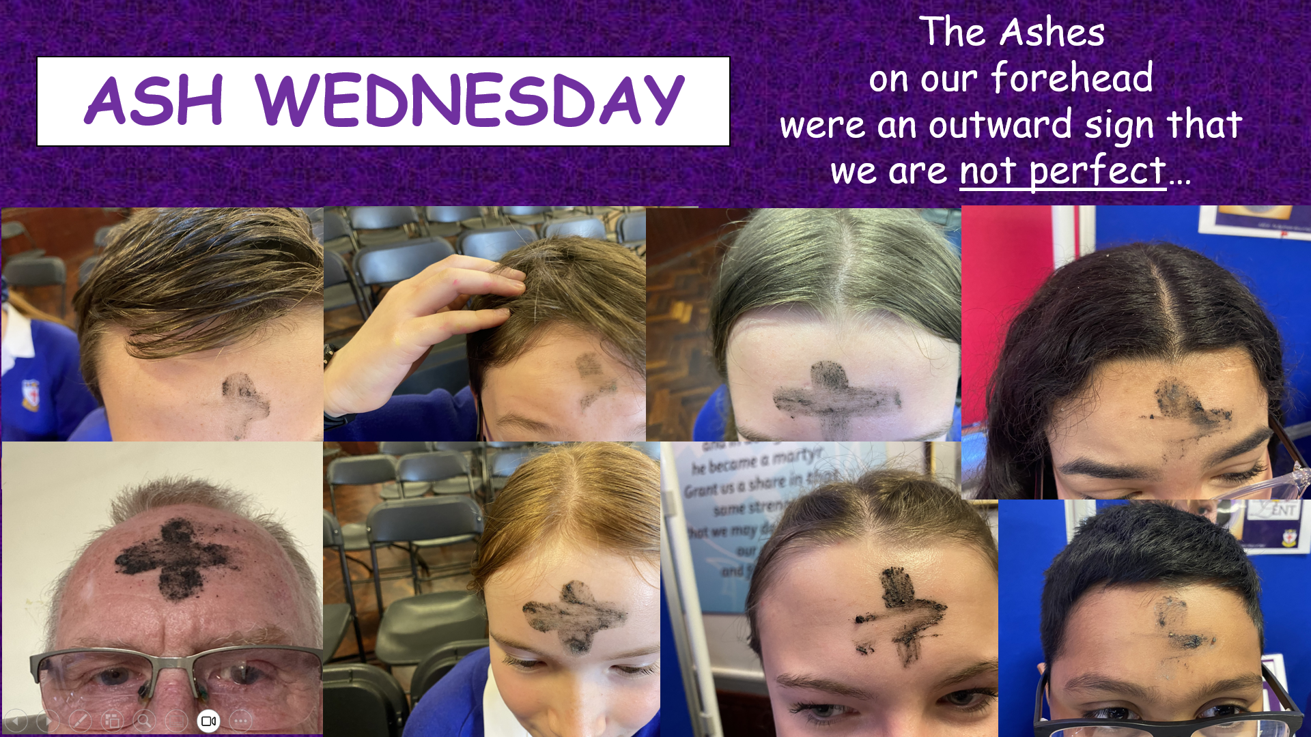
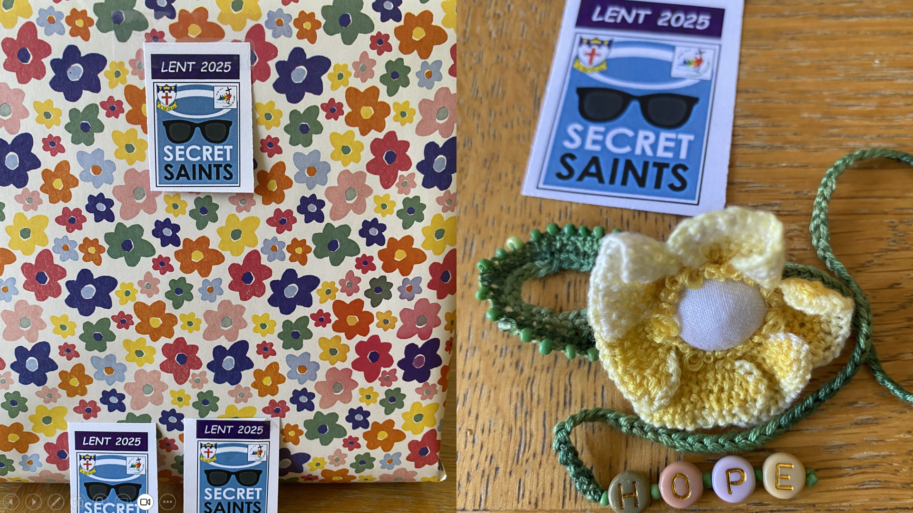
END OF YEAR CELEBRATION MASS

Slide 59
THE EUCHARISTIC PRAYER
The Lord be with you. And with your spirit
Lift up your hearts. We lift them up to the Lord.
Let us give thanks to the Lord our God. It is right and just.

Slide 60

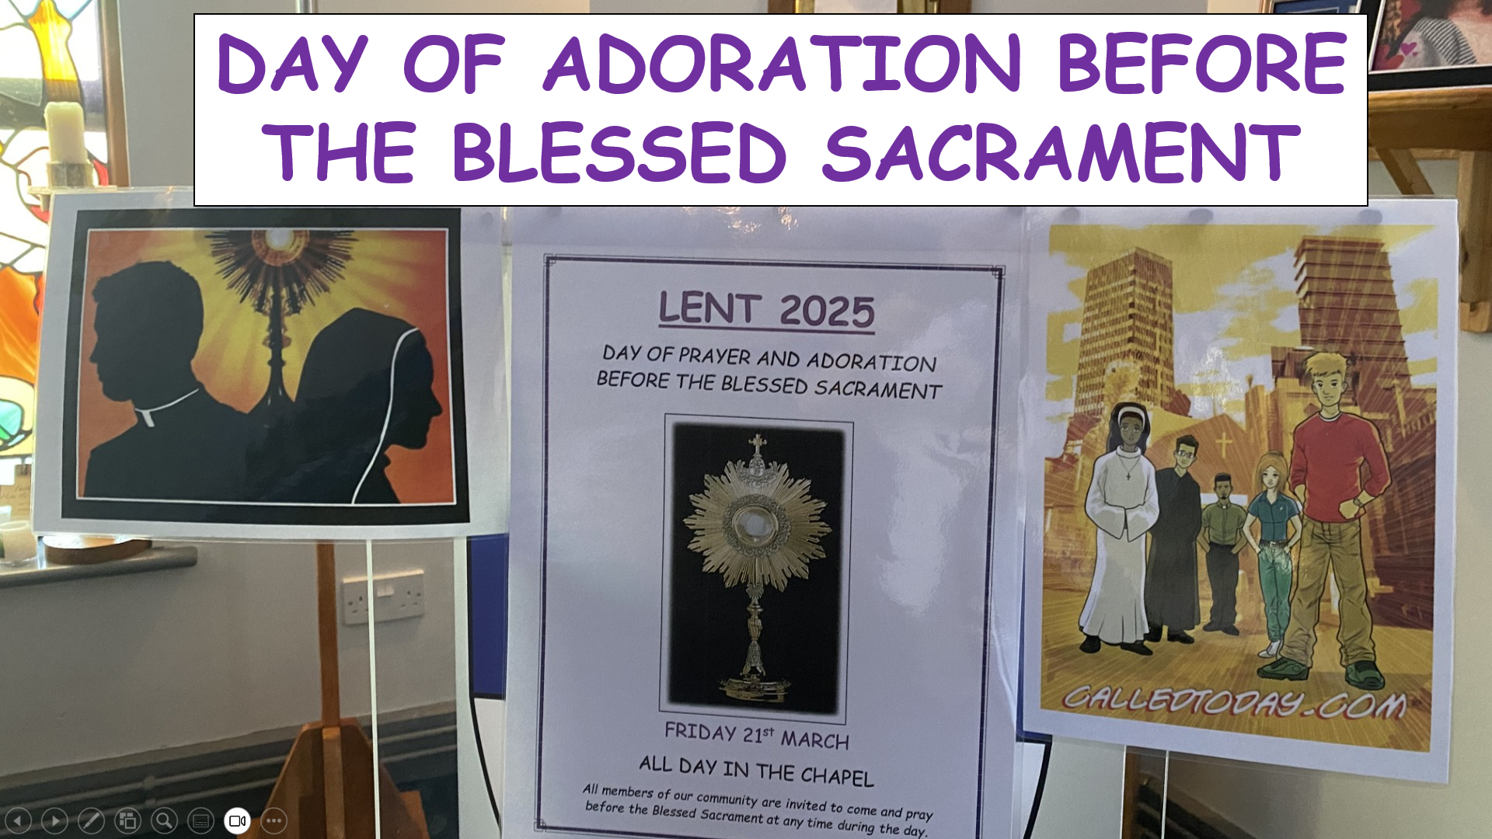
END OF YEAR CELEBRATION MASS
A.M.D.G. For the Greater Glory of God

Slide 61
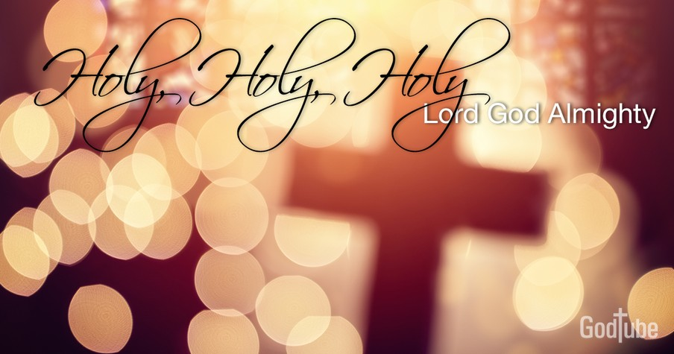
HOLY, HOLY, HOLY IS THE LORD
Holy, holy, holy is the Lord, holy is the Lord God almighty! Holy, holy, holy is the Lord, holy is the Lord God almighty! Who was and is, and is to come; holy, holy, holy is the Lord.

Slide 62
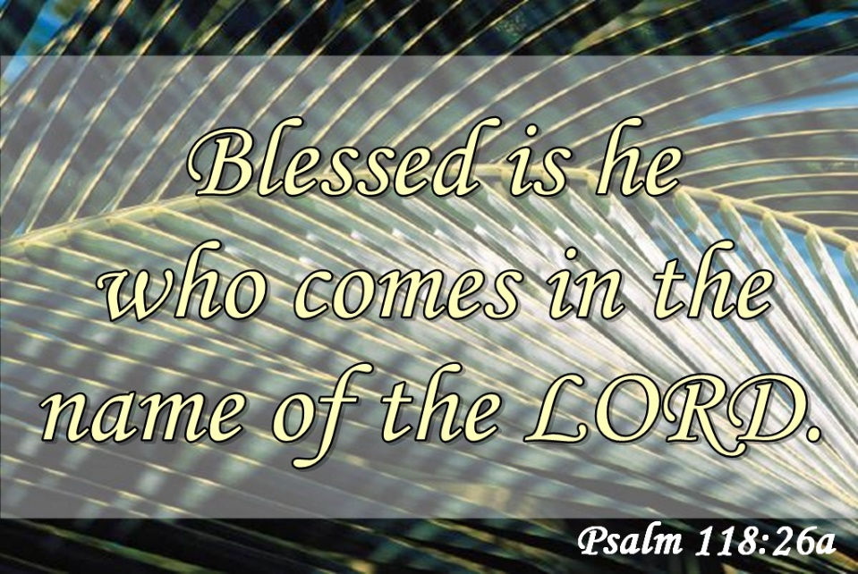
Blessed, blessed, blest is he who comes, Blest is he who comes in the Lord’s name.
Blessed, blessed, blest is he who comes, Blest is he who comes in the Lord’s name.
Hosanna in the heights of heav’n. Blessed, blessed, blessed is the Lord.

Slide 63
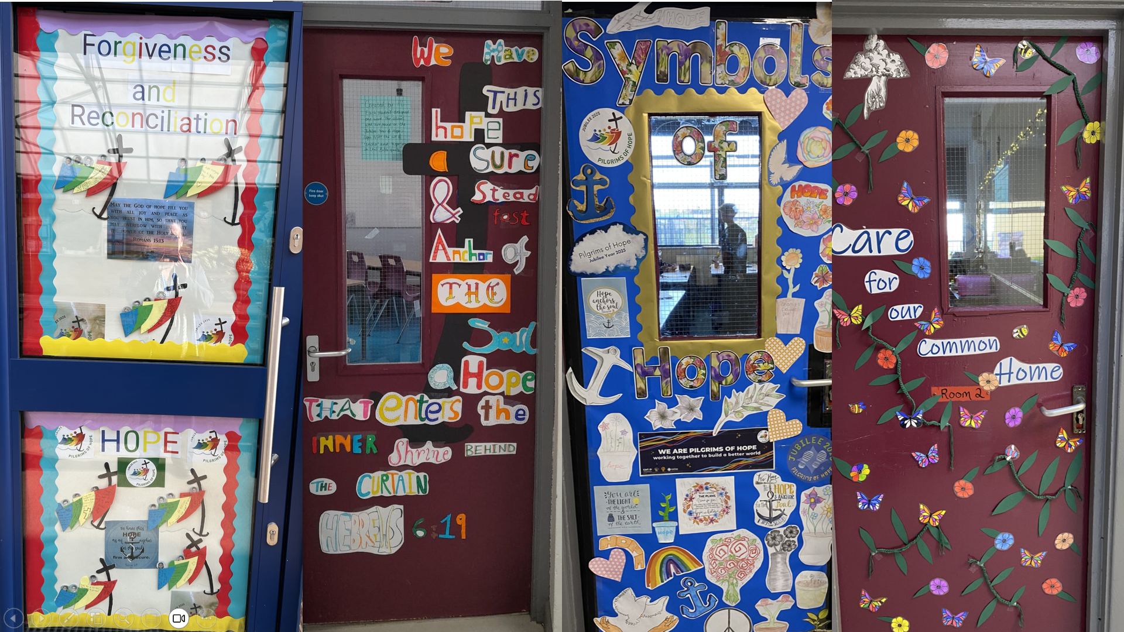
END OF YEAR CELEBRATION MASS

Slide 64
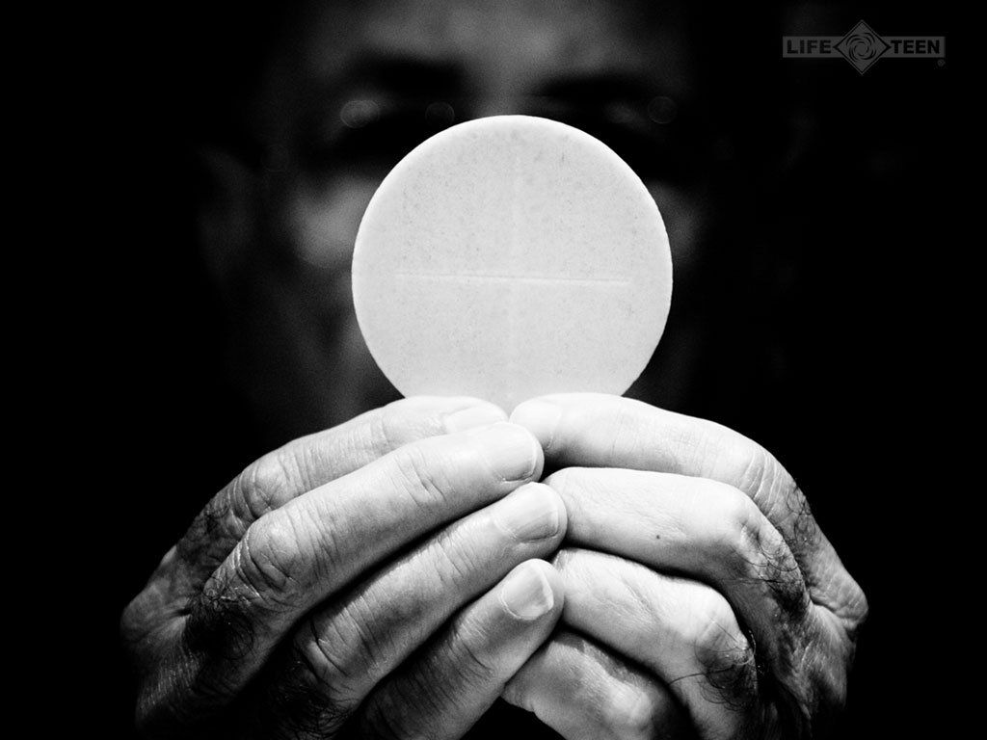
TAKE THIS ALL OF YOU AND EAT OF IT:
FOR THIS IS MY BODY WHICH WILL BE GIVEN UP FOR YOU.

Slide 65
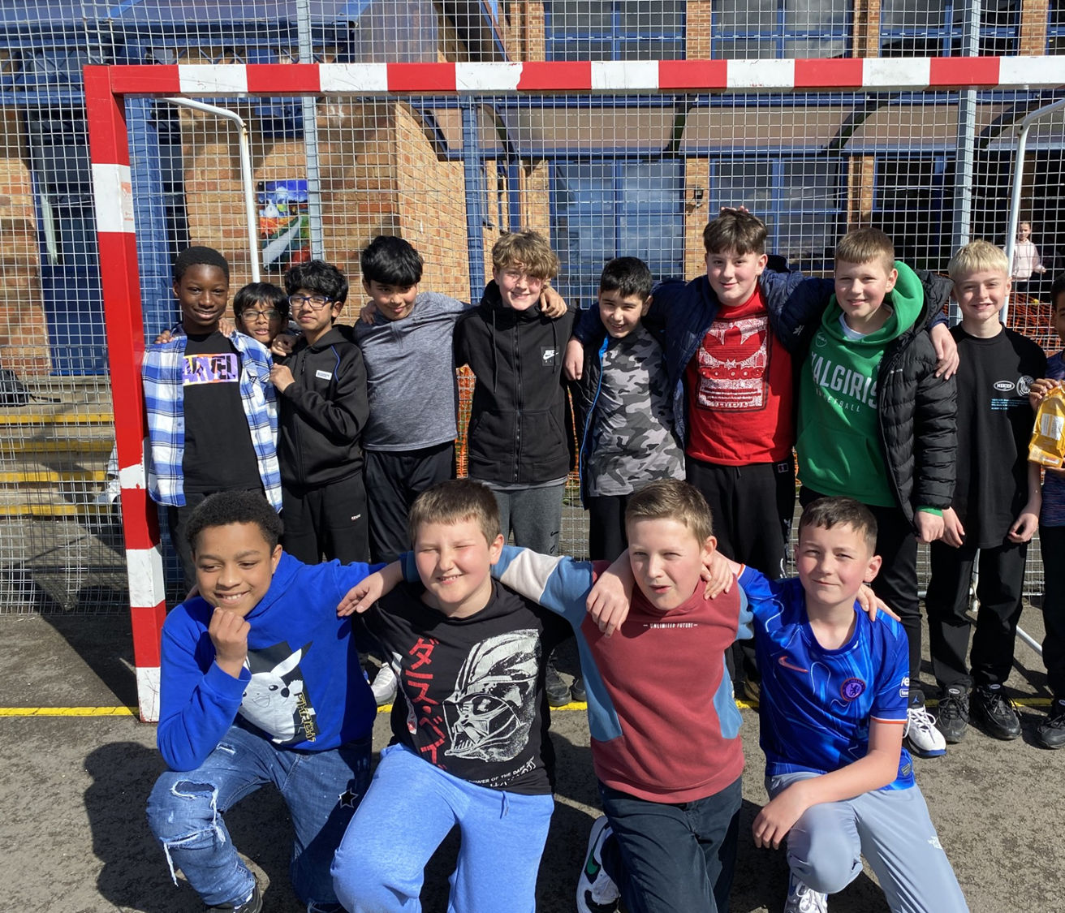
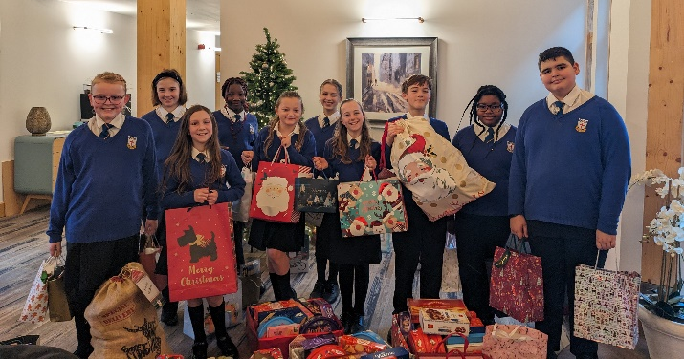
END OF YEAR CELEBRATION MASS
A.M.D.G. - For the Greater Glory of God

Slide 66

Take this all of you and drink from it: For this is the chalice of my blood, the blood of the new and eternal covenant, which will be poured out for you and for many for the forgiveness of sins.
Do this in memory of me.

Slide 67
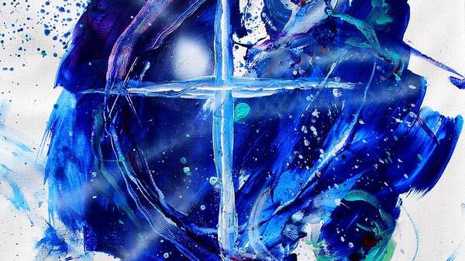
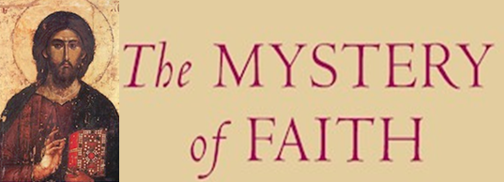
We proclaim your death O Lord and profess your resurrection until you come again, until you come again.
(Repeat)
We proclaim your death O Lord and profess your resurrection until you come again, until you come again.
First verse = solo

Slide 68
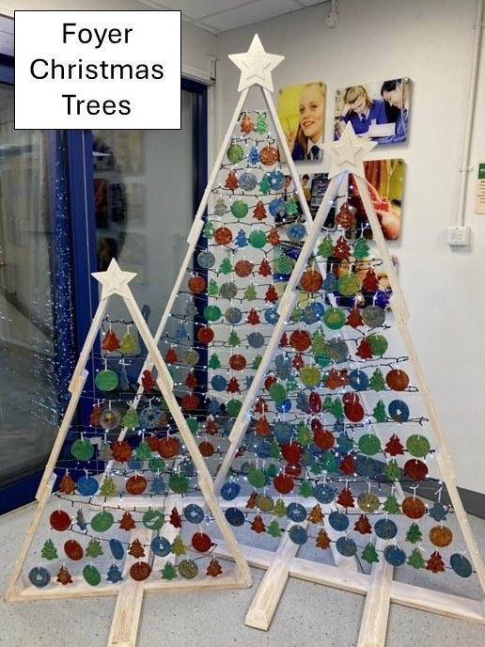
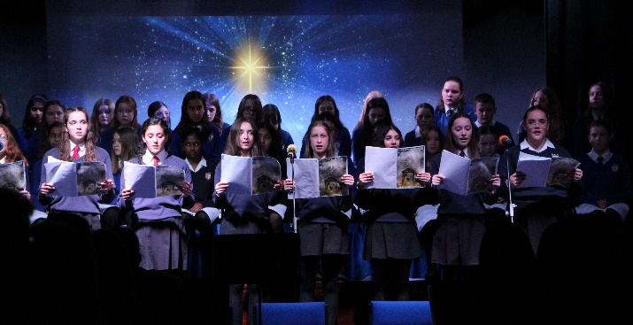
END OF YEAR CELEBRATION MASS

Slide 69
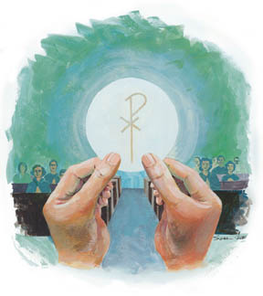
Through him, and with him, and in him, O God, almighty Father, in the unity of the Holy Spirit, all glory and honour is yours, for ever and ever.
SUNG
Amen. We lift our hearts and voices to you, as we sing, Amen, so shall it be forever Amen. (Repeat)

Slide 70
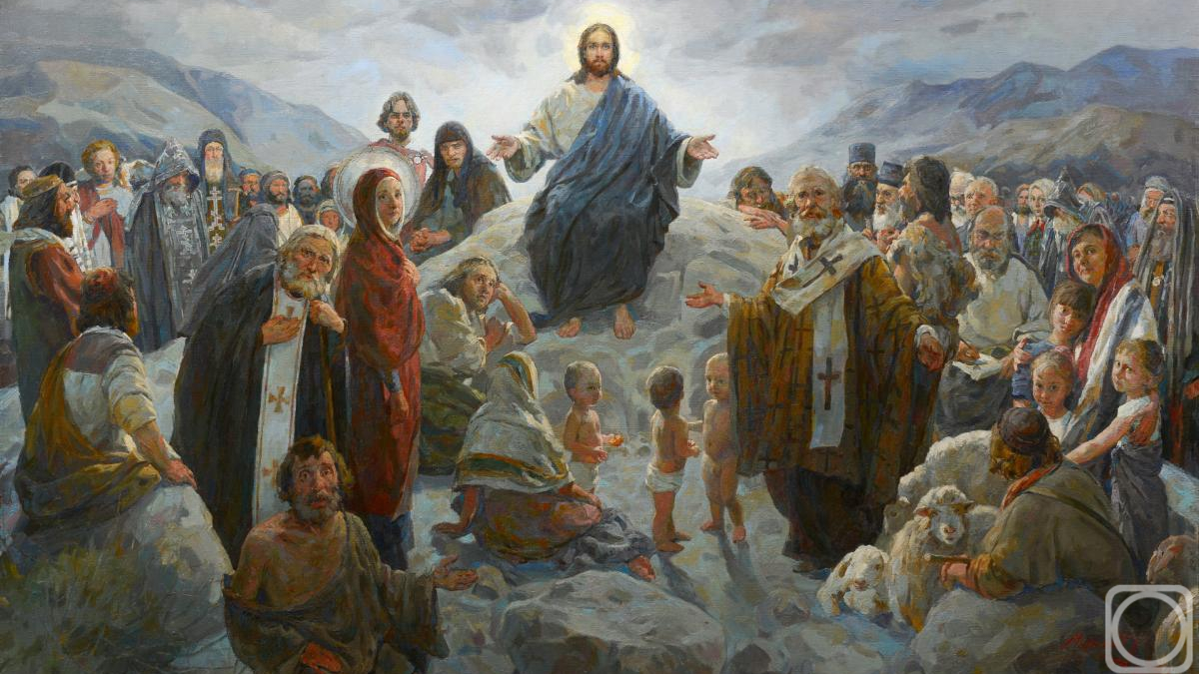
PLEASE STAND
At the Saviour’s command and formed by divine teaching, we dare to say:
Our Father, who art in heaven, hallowed be thy name; thy Kingdom come; thy will be done on earth as it is in heaven. Give us this day our daily bread, and forgive us our trespasses as we forgive those who trespass against us, and lead us not into temptation, but deliver us from evil.

Slide 71

Deliver us Lord, we pray, from every evil, graciously grant peace in our days, that, by the help of your mercy, we may be always free from sin and safe from all distress as we await the blessed hope and the coming of our Saviour, Jesus Christ.
FOR THE KINGDOM,THE POWER AND THE GLORY ARE YOURS, NOW AND FOREVER.

Slide 72

Lord Jesus Christ, who said to your apostles: Peace I leave you, my peace I give you; look not on our sins, but on the faith of your Church and graciously grant her peace and unity in accordance with your will. Who live and reign for ever and ever.
AMEN.

Slide 73

The peace of the Lord be with you always.
AND WITH YOUR SPIRIT.

Slide 74
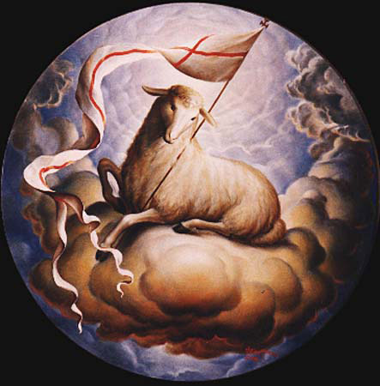
LAMB OF GOD
Lamb of God, Lamb of God,
you take away, you take away,
the sins of all, the sins of all,
the world, the world,
Miserere nobis, miserere nobis.

Slide 75
LAMB OF GOD
Lamb of God, Lamb of God,
you take away, you take away,
the sins of all, the sins of all,
the world, the world,
Miserere nobis, miserere nobis.

Slide 76
LAMB OF GOD
Lamb of God, Lamb of God,
you take away, you take away,
the sins of all, the sins of all,
the world, the world,
Dona Nobis Pacem, Dona Nobis Pacem.

Slide 77
Behold the Lamb of God, behold him who takes away the sins of the world. Blessed are those called to the supper of the Lamb.
Lord, I am not worthy that you should enter under my roof but only say the word and my soul shall be healed.

Slide 78
COMMUNION
We will now share communion together by either receiving the Body of Jesus or a blessing.
This symbolises spiritual nourishment and forgiveness of sins through Christ’s sacrifice.
Mr. McCormack will now outline the arrangements and how we should respond during communion.
PLEASE SIT DOWN
A.M.D.G. – For the Greater Glory of God

Slide 79
Everyone is invited to come forward and receive either Holy Communion or a blessing.

Slide 80
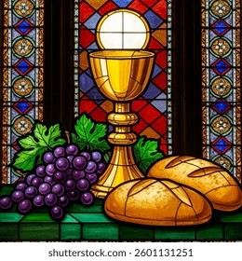
COMMUNION HYMNS
MAKE ME HOLY LORD
THIS COMMUNION

Slide 81
MAKE ME HOLY
Prepare my mind, prepare my soul, prepare my heart and make me whole, prepare me for the awesomeness of you.
Renew in me a spirit strong, remind me Lord of all that’s wrong, create in me complete desire for you.

Slide 82
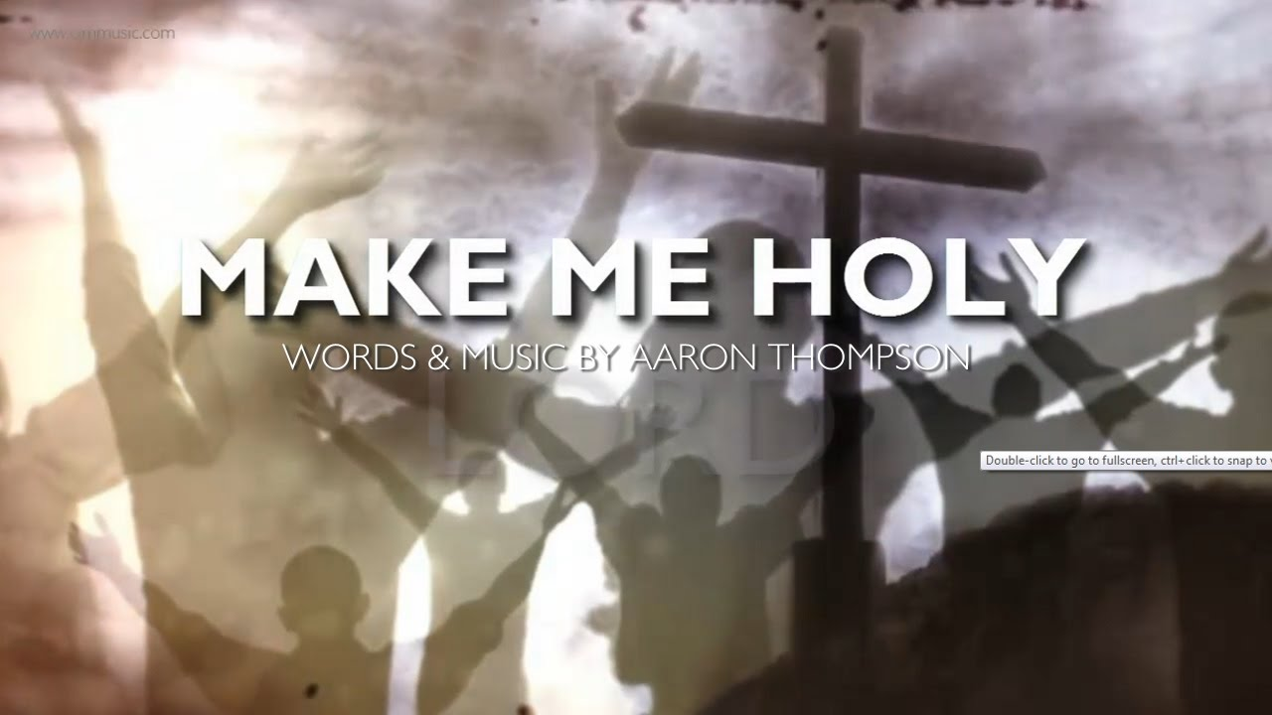
Make me Holy Lord, Make me Holy Lord, Make me Holy Lord, Like you.

Slide 83

Consume my mind, consume my soul, consume my heart and make me whole, consume me with the awesomeness of you.
Destroy the pride, destroy the hate, destroy the things that separate and keep me from returning back to you.

Slide 84
Make me Holy Lord, Make me Holy Lord, Make me Holy Lord, Like you.

Slide 85
Restore my mind Restore my soul, restore my heart and make it whole, restore me with the awesomeness of you.
Redecorate me from within, refurnish me with sacredness, rebuild me with a yearning love for you.

Slide 86
Make me Holy Lord, Make me Holy Lord, Make me Holy Lord, Like you. x2

Slide 87
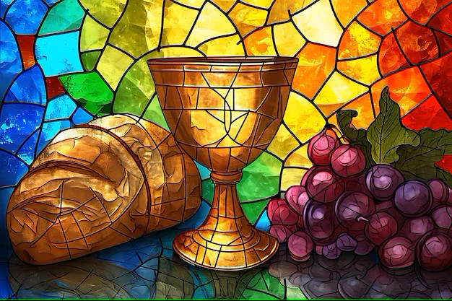
THIS IS COMMUNION
This is communion, Your body broken
The cup we're drinking is bittersweet
The gift of friendship, truest salvation
Borne of Your suffering on Calvary.
We remember the sacrifice of love
We remember the blood poured out for us
We remember the only Son of God upon the cross.

Slide 88
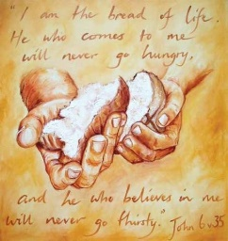
From stained to spotless, from wrath to favour
Through You our Saviour, the work complete.
In full repentance, led by Your kindness
Partake of presence as we receive.
We remember the sacrifice of love
We remember the blood poured out for us
We remember the only Son of God upon the cross
We remember the price You had to pay
We remember the wounds that made a way
We remember the Lamb for all was slain upon the cross.

Slide 89
How can it be, there is a table
For all who would come, for all who would come
Taste now and see, there is a table
For all who would come, for all who would come
How can it be, there is a table (Take of the bread, receive the cup)
For all who would come (For His mercy is enough)
For all who would come (For the many and the one)
(This is communion)

Slide 90
Taste now and see, there is a table (Take it as often as you will)
For all who would come (For His blood has power still)
For all who would come (By His wounds we shall be healed)
This is communion
x3

Slide 91
We remember the sacrifice of love
We remember the blood poured out for us
We remember the only Son of God upon the cross
We remember the price You had to pay
We remember the wounds that made a way
We remember the Lamb for all was slain upon the cross.

Slide 92
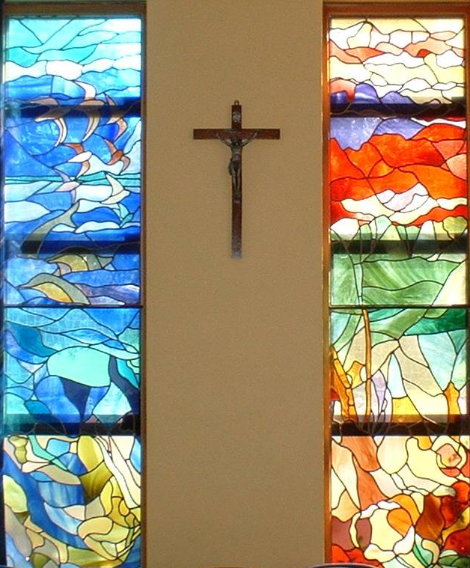
Sit still and pray for your own private intentions
Think of one thing or one person that you would like to pray for…
Notes:
92

Slide 93
MISSION
WE GO FORTH
We thank you Lord for watching over our school community during this past academic year.
We are sent forth from this Mass, taking Christ and his blessing with us into every encounter.
We now look forward to our summer holidays, continuing to do everything we can
‘For the Greater Glory of God’.
A.M.D.G. – For the Greater Glory of God

Slide 94
PLEASE STAND
LET US PRAY

Slide 95
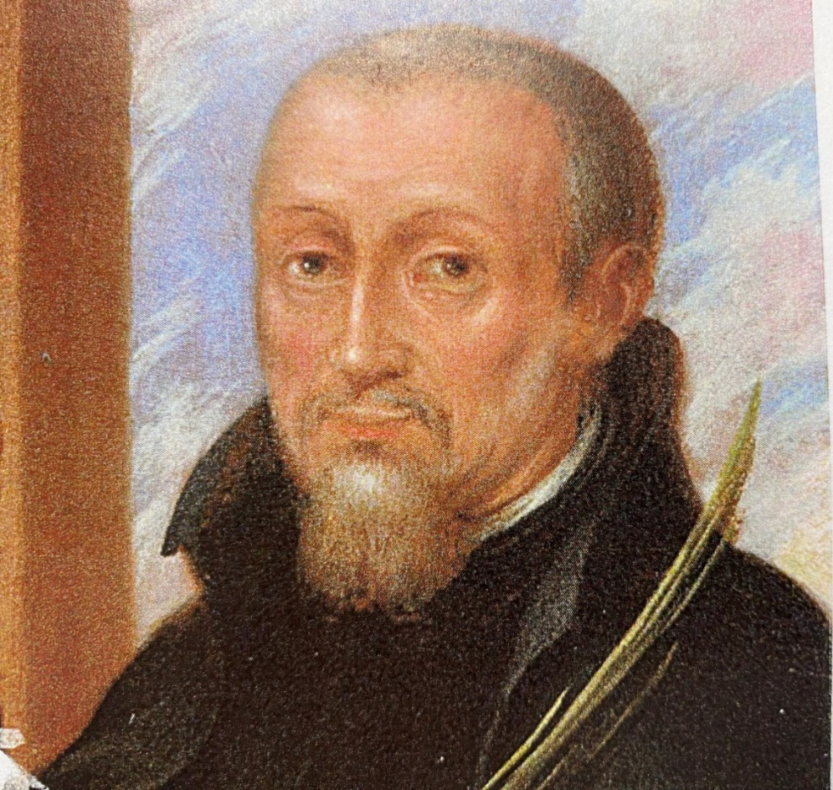
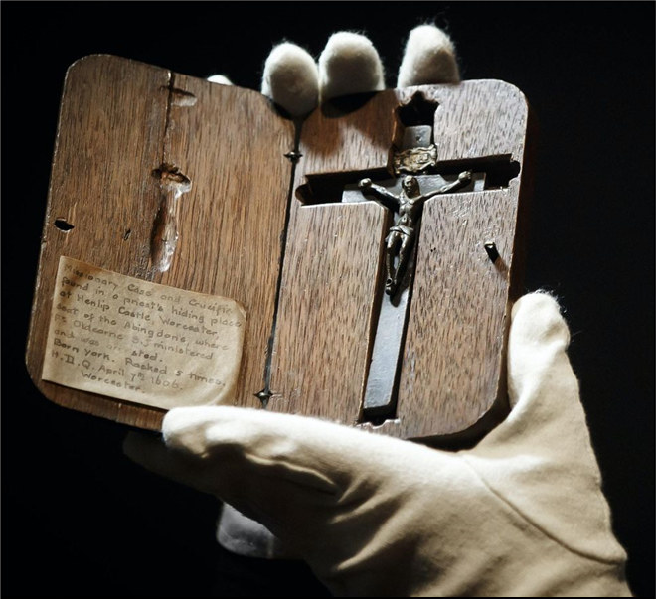
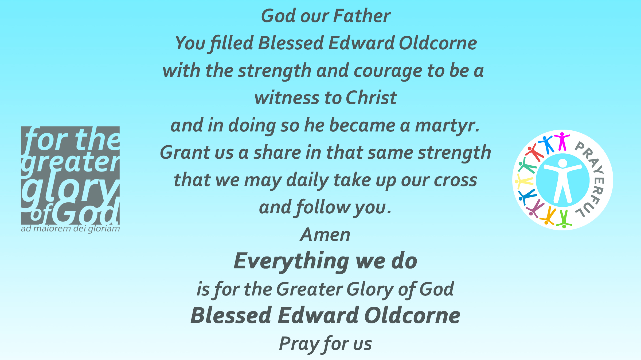
COLLEGE PRAYER

Slide 96

The Lord be with you.
AND WITH YOUR SPIRIT.
May almighty God bless you, the Father, and the Son, and the Holy Spirit.
AMEN.

Slide 97
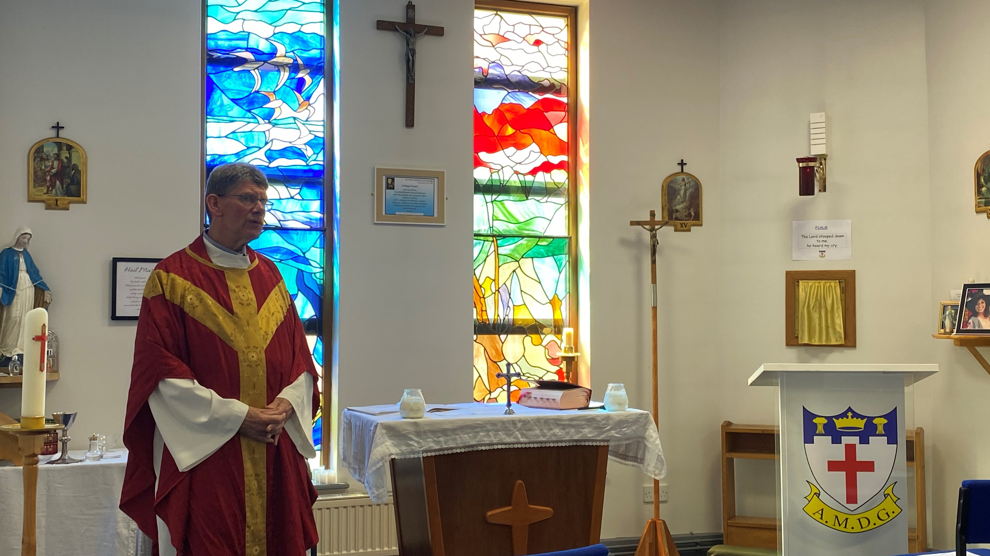
Go in peace, glorifying the Lord by your life.
THANKS BE TO GOD.

Slide 98
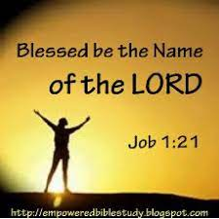
BLESSED BE THE NAME OF THE LORD
Blessed be your name in a land that is plentiful, where your streams of abundance flow, Blessed be your name.
Blessed be your name, when I’m found in the desert place, though I walk through wilderness, Blessed be your name.

Slide 99
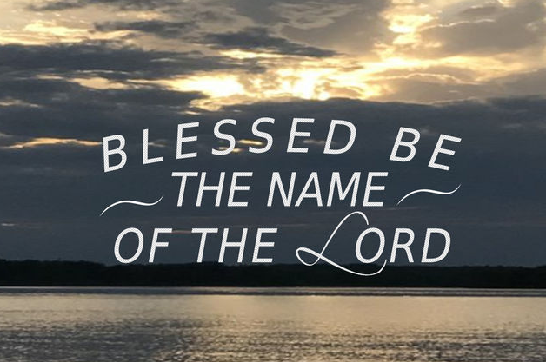
Every blessing you pour out I’ll turn back to praise. When the darkness closes in, Lord, still I will say,
Blessed be the name of the Lord, Blessed be your name Blessed be the name of the Lord Blessed be your glorious name.

Slide 100
Blessed be your name When the sun’s shining down on me When the world’s all as it should be Blessed be your name.
Blessed be your name On the road marked with suffering Though there’s pain in the offering Blessed be your name.

Slide 101
Every blessing you pour out I’ll turn back to praise. When the darkness closes in, Lord, still I will say,
Blessed be the name of the Lord, Blessed be your name Blessed be the name of the Lord Blessed be your glorious name.

Slide 102
You give and take away You give and take away My heart will choose to say Lord blessed be your name. x2
Blessed be the name of the Lord, Blessed be your name Blessed be the name of the Lord Blessed be your glorious name. x2

Slide 103
END OF YEAR CELEBRATION MASS
Thursday 17th July 2025
Good Shepherd Mass – 6th June 2025 – Presentation of Lenten Offerings.

Slide 104

CHOIR
SING AMAZING GRACE
ON EXIT

Slide 105
AMAZING GRACE
All these pieces
Broken and scattered
In mercy gathered
Mended and whole.
Empty-handed
But not forsaken
I've been set free
I've been set free.
Amazing grace
How sweet the sound
That saved a wretch like me,
I once was lost
But now I'm found
Was blind but now I see.
You take our failure
You take our weakness
You set Your treasure
In jars of clay.
So take this heart, Lord
I'll be Your vessel
The world to see
Your life in me.
Oh, I can see it now
Oh, I can see the love in Your eyes
Laying yourself down
Raising up the broken to life.

Slide 107
I BELIEVE
Our Judge and our Defender
Suffered and crucified
Forgiveness is in You
Descended into darkness
You rose in glorious life
Forever seated high
I believe in God our Father
I believe in Christ the Son
I believe in the Holy Spirit
Our God is three in one
I believe in the resurrection
That we will rise again
For I believe in the name of Jesus.
I believe in the name of Jesus.
I believe in the name of Jesus.
LAST 2 LINES ADDED TO FINISH
= Not cut!!!
ST sang all of it….

Slide 108

1. We pray for all those who lead the Church, especially our Holy Father Pope Francis, our Archbishop Bernard, and Fr. Stephen our college chaplain. We also pray for Fr. Brian who now leaves us to take up his new role as Dean of St. Chad’s Cathedral, and we thank him for his 18 wonderful years of service at our college.
May they be enflamed by the heroic example of Blessed Edward Oldcorne and become both kindly shepherds and inspiring preachers of the Word.
Lord hear us
LORD GRACIOUSLY HEAR US

Slide 110
AMAZING GRACE – BROKEN VESSELS
3.
All these pieces
Broken and scattered
In mercy gathered
Mended and whole.
Empty-handed
But not forsaken
I've been set free
I've been set free.
Amazing grace
How sweet the sound
That saved a wretch like me,
I once was lost
But now I'm found
Was blind but now I see.
You take our failure
You take our weakness
You set Your treasure
In jars of clay.
So take this heart, Lord
I'll be Your vessel
The world to see
Your life in me.
Oh, I can see it now
Oh, I can see the love in Your eyes
Laying yourself down
Raising up the broken to life.

Slide 111

COME LET US GO, UP TO THE MOUNTAIN OF THE LORD
Come let us go, up to the mountain of the Lord
to the temple of His Holy Spirit.
Come let us go up to the mountain of the Lord
and Glorify His Holy name.
Through noise and confusion,
Our witness shall be heard.
We raise our voices,
to proclaim your holy Word.

Slide 112

Come let us go, up to the mountain of the Lord
to the temple of His Holy Spirit.
Come let us go up to the mountain of the Lord
and Glorify His Holy name.
Heavenly Father,
Receive my brokenness.
Change me re-arrange me,
Restore my worthiness.
Come let us go…

Slide 113
2. We pray for all those involved in education, especially those who have contributed so generously to the life of our school during the past 60 years.
May they continue to be guided by the Holy Spirit and become inspirational role models for our students.
Lord hear us
LORD GRACIOUSLY HEAR US

Slide 114
END OF YEAR CELEBRATION MASS
Thursday 18th July 2024
BREATHE
This is the air I breathe
This is the air I breathe
Your holy presence
Living in me.
This is my daily bread
This is my daily bread
Your very word
Spoken to me.
And I ... I'm desperate for you
And I ... I'm lost without you.
A.M.D.G. For the Greater Glory of God

Slide 115


Need a shorter hymn at the beginning
= standing too long

Slide 116
PLEASE STAND
I BELIEVE – THE CREED
Our Father everlasting
The all creating One
God Almighty
Through Your Holy Spirit
Conceiving Christ the Son
Jesus our Saviour
I believe in God our Father
I believe in Christ the Son
I believe in the Holy Spirit
Our God is three in one
I believe in the resurrection
That we will rise again
For I believe in the name of Jesus.

Slide 117

I BELIEVE
Our Judge and our Defender
Suffered and crucified
Forgiveness is in You
Descended into darkness
You rose in glorious life
Forever seated high
I believe in God our Father
I believe in Christ the Son
I believe in the Holy Spirit
Our God is three in one
I believe in the resurrection
That we will rise again
For I believe in the name of Jesus.

Slide 118
I BELIEVE
I believe in You,
I believe You rose again,
I believe that Jesus Christ is Lord. x2

Slide 119
I BELIEVE – THE CREED
I believe in God our Father
I believe in Christ the Son
I believe in the Holy Spirit
Our God is three in one
I believe in the resurrection
That we will rise again
For I believe in the name of Jesus.

Slide 120


PLEASE STAND
LIGHT OF THE WORLD
Light of the World
You stepped down into darkness
Opened my eyes
Let me see.
Beauty that made
This heart adore You
Hope of a life
Spent with You.

Slide 121
Here I am to worship
Here I am to bow down
Here I am to say that You're my God
You're altogether lovely
Altogether worthy
Altogether wonderful to me.
King of all days
Oh, so highly exalted
Glorious in Heaven above
Humbly You came
To the earth You created
All for love's sake became poor.

Slide 122
Here I am to worship
Here I am to bow down
Here I am to say that You're my God
You're altogether lovely
Altogether worthy
Altogether wonderful to me.
I'll never know how much it cost
To see my sin upon that cross.
I'll never know how much it cost
To see my sin upon that cross.

Slide 123
Here I am to worship
Here I am to bow down
Here I am to say that You're my God
You're altogether lovely
Altogether worthy
Altogether wonderful to me.

Slide 124


PLEASE SIT DOWN
HOMILY Fr. Brian
Notes:
124

Slide 125

GLORIA
Glory to God in the highest and on earth peace to people of good will.
Glory to God in the highest and on earth peace to people of good will.
NO GLORIA IN THIS MASS = SANG PENETENTIAL ACT
= TOO LONG IF DO BOTH
= DO GLORIA IN FEAST DAY MASSES

Slide 126
We praise you, we bless you, we adore you, we glorify you, we give you thanks for your great glory.
Lord God, heavenly King, O God, almighty Father, we give you thanks for your great glory.

Slide 127
Glory to God in the highest and on earth peace to people of good will.
Glory to God in the highest and on earth peace to people of good will.

Slide 128

PRAYERS OF INTENTION

Slide 129
NEW WINE
In the crushing, in the pressing
You are making new wine.
In the soil, I now surrender
You are breaking new ground.
So I yield to You and to Your careful hand
When I trust You I don't need to understand.
A.M.D.G. – For the Greater Glory of God

Slide 130

Make me Your vessel, make me an offering
Make me whatever You want me to be.
I came here with nothing but all You have given me,
Jesus, bring new wine out of me.
A.M.D.G. – For the Greater Glory of God

Slide 131

In the crushing, in the pressing
You are making new wine.
In the soil, I now surrender
You are breaking new ground,
You are breaking new ground.
A.M.D.G. – For the Greater Glory of God

Slide 132

So make me Your vessel, make me an offering
Make me whatever You want me to be.
I came here with nothing but all You have given me,
Jesus, bring new wine out of me,
Jesus, bring new wine out of me,
Jesus, bring new wine out of me.
A.M.D.G. – For the Greater Glory of God

Slide 133
‘Cause where there is new wine
There is new power.
There is new freedom
The Kingdom is here.
I lay down my old flames
To carry Your new fire today. (x2)
A.M.D.G. – For the Greater Glory of God

Slide 134

So make me Your vessel, make me an offering
Make me whatever You want me to be.
God I came here with nothing but all You have given me,
Jesus, bring new wine out of me,
Jesus, bring new wine out of me,
Jesus, bring new wine out of me. (x2)

Slide 135

I BELIEVE – THE CREED
Our Father everlasting
The all creating One
God Almighty
Through Your Holy Spirit
Conceiving Christ the Son
Jesus our Saviour
I believe in God our Father
I believe in Christ the Son
I believe in the Holy Spirit
Our God is three in one
I believe in the resurrection
That we will rise again
For I believe in the name of Jesus.

Slide 136
I BELIEVE
Our Judge and our Defender
Suffered and crucified
Forgiveness is in You
Descended into darkness
You rose in glorious life
Forever seated high
I believe in God our Father
I believe in Christ the Son
I believe in the Holy Spirit
Our God is three in one
I believe in the resurrection
That we will rise again
For I believe in the name of Jesus.

Slide 137
I BELIEVE – THE CREED
I believe in God our Father
I believe in Christ the Son
I believe in the Holy Spirit
Our God is three in one
I believe in the resurrection
That we will rise again
For I believe in the name of Jesus.

Slide 138
I BELIEVE
I believe in You,
I believe You rose again,
I believe that Jesus Christ is Lord. x2

Slide 139

END OF YEAR CELEBRATION MASS
Thursday 18th July 2024
A.M.D.G. – For the Greater Glory of God

Slide 140
PLEASE SIT DOWN
HOMILY Fr. Stephen
Notes:
140

Slide 141

HOLY, HOLY.
Holy, Holy, Holy, Lord God of hosts. Heaven and earth are full of your glory. Hosanna in the highest. Hosanna in the highest.
First verse = solo

Slide 142

HOLY, HOLY.
Blessed, blessed, blessed is he who comes in the name of the Lord. Hosanna in the highest. Hosanna in the highest.

Slide 143

Lamb of God,
you take away
the sins of the world, have mercy on us.
LAMB OF GOD
First verse = solo
Lamb of God,
you take away
the sins of the world, have mercy on us.
Lamb of God,
you take away
the sins of the world, have mercy on us.
Grant us peace.

Slide 144
PENITENTIAL ACT
You were sent to heal the contrite of heart: Lord have mercy.
LORD HAVE MERCY.
You came to call sinners:
Christ have mercy.
CHRIST HAVE MERCY.
You are seated at the right hand of the Father to intercede for us:
Lord have mercy.
LORD HAVE MERCY.

