Slide 1




YEAR 7 WELCOME MASS
Friday 17th October 2025

Slide 2
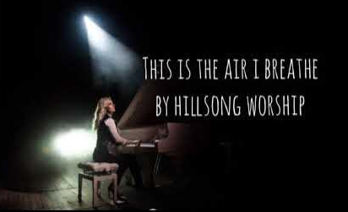

GATHERING HYMN
THIS IS THE AIR I BREATHE
This is the air I breathe.
This is the air I breathe.
Your holy presence
living in me.
This is my daily bread.
This is my daily bread.
Your very word,
spoken to me.
And I ... I'm desperate for you
And I ... I'm lost without you.
A.M.D.G. – For the Greater Glory of God

Slide 3



Slide 4


WE GATHER
Welcome to our Year 7 Welcome Mass, as we prepare ourselves to get closer to God.
As we gather in worship, we are reminded of our unity as God’s chosen people.
We praise and thank God as we celebrate the life of our vibrant community.
We pray that our school will continue to flourish helping to develop people of good character.
A.M.D.G. – For the Greater Glory of God

Slide 5
WE GATHER
We also gather today, to mark the beginning of a New School Year.
We celebrate the uniqueness and vitality of all children and pray that Jesus, our Lord, will guide and protect us throughout the coming academic year.
May God’s blessings fall upon all who are part of our school community as we celebrate this Eucharist.
A.M.D.G. – For the Greater Glory of God

Slide 6

PLEASE STAND
OUR GOD IS HERE
Here in this time, here in this place,
here we are standing face to face.
Here in our hearts, here in our lives,
our God is here.

Slide 7
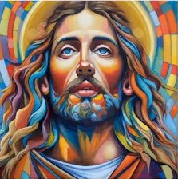
Here for the broken, here for the strong,
here in this temple we belong.
Here in our hearts, here in our lives,
our God is here.
And we cry:
“Holy! Holy! Holy are you!”
We cry: “Holy! Holy! Holy and true!”
Amen, we do believe our God is here.
Our God is here.

Slide 8
Here in the Word, God is revealed,
here where the wounded can be healed.
Here in our hearts, here in our lives,
our God is here.
Here we become what we receive,
here in this Eucharistic feast.
We are his body, living as one;
our God is here.

Slide 9
And we cry:
“Holy! Holy! Holy are you!”
We cry: “Holy! Holy! Holy and true!”
Amen, we do believe our God is here.
Our God is here.

Slide 10
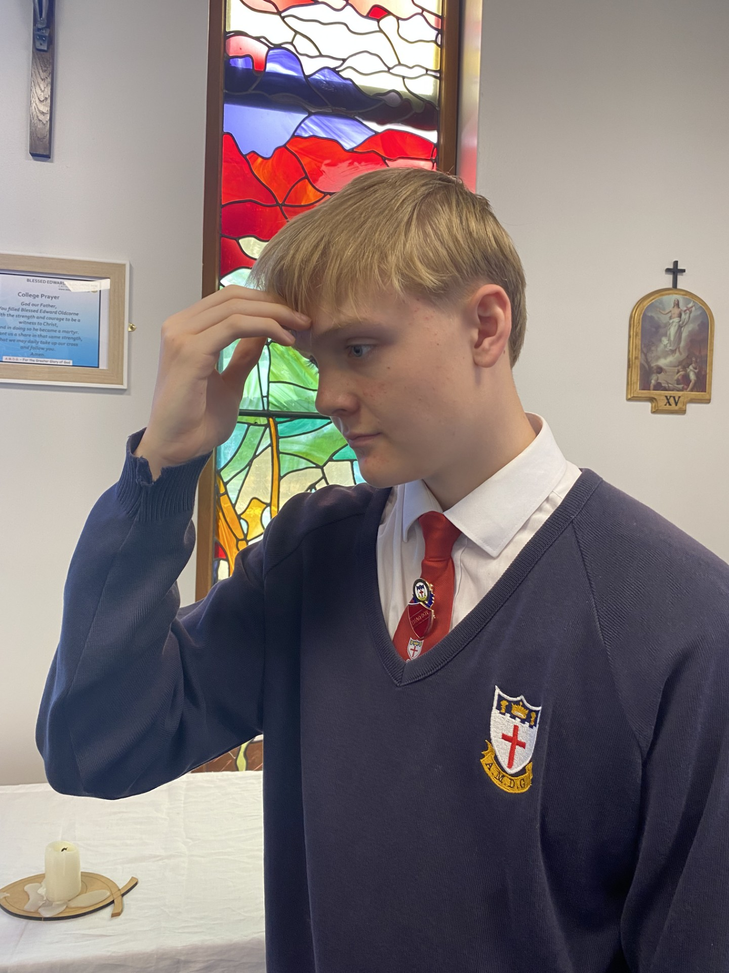

Ronan Guppy - Head Boy
In the name of the Father, and of the Son, and of the Holy Spirit,
AMEN.

Slide 11
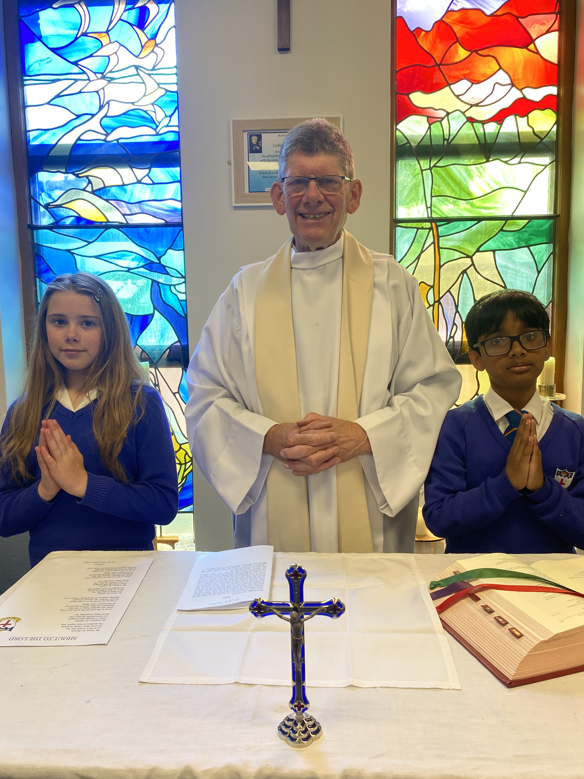

The grace of our Lord Jesus Christ and the Love of God and the communion of the Holy Spirit be with you all.
AND WITH
YOUR SPIRIT.

Slide 12


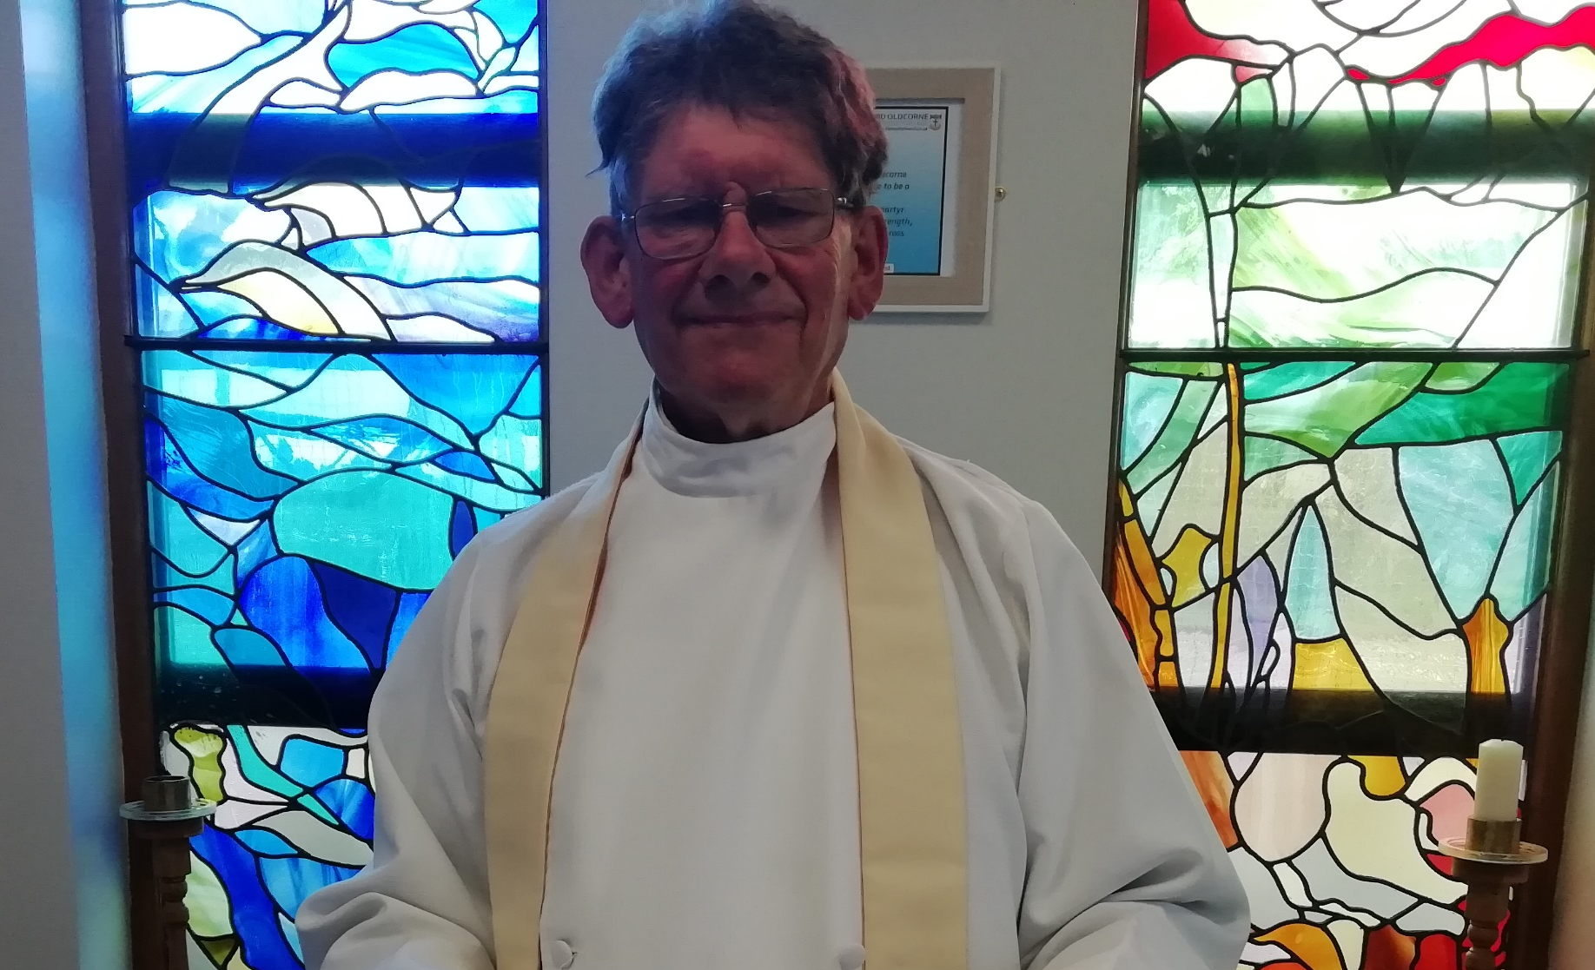
WELCOME
PLEASE SIT DOWN

Slide 13


Show mercy to us loving Father.
We have sinned against you, please make us anew.
In your love and your grace, you forgive us.
Lord have mercy,
Lord have mercy.
Look not on our failings, Lord Jesus.
We have sinned against you, please make us anew.
By your life and your death, you redeem us,
Christ have mercy,
Christ have mercy.
Come fill our hearts, Holy Spirit.
We have sinned against you, please make us anew.
Forgive us and heal us and save us,
Lord have mercy,
Lord have mercy.
PENITENTIAL ACT

Slide 14
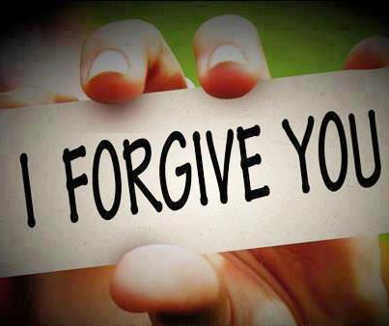
MAY ALMIGHTY GOD HAVE MERCY ON US, FORGIVE US OUR SINS AND BRING US TO EVERLASTING LIFE.
AMEN.

Slide 15
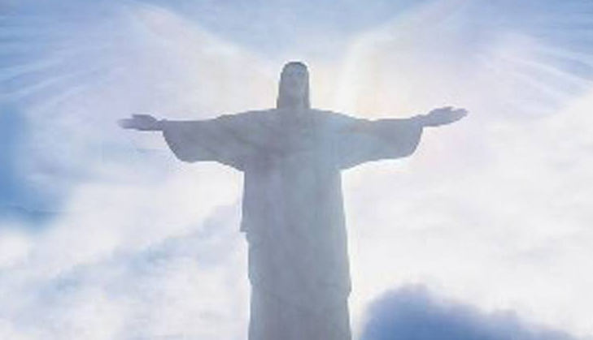
LET US PRAY

Slide 16
THE WORD
WE LISTEN
During the Liturgy of the Word we hear the proclamation of Sacred scripture.
These are not presented as recollections of past events, but as moments in the continuing love story of God and his people.
Our Lord did not just speak then, but also speaks to us now.
A.M.D.G. – For the Greater Glory of God

Slide 17
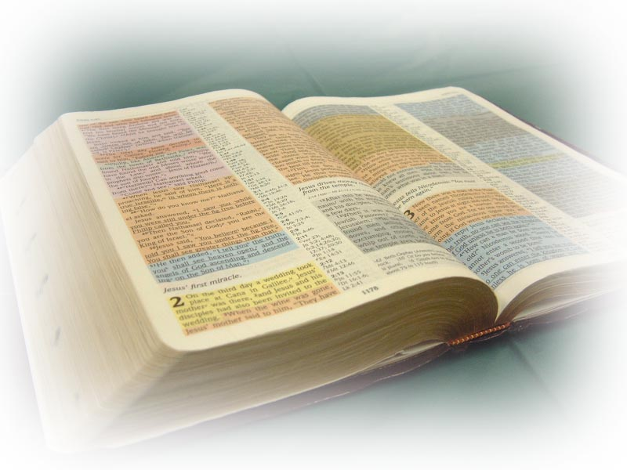
THE LITURGY OF THE WORD
A reading from the prophet Isaiah.

Slide 18

I want to tell the whole wide world - ‘God has been good to me!’
I want to tell the whole wide world- ‘God is wonderful!’
I want to sing and to shout because I am so happy, for God has come to me and he is great!
The word of the Lord.
THANKS BE TO GOD.

Slide 19
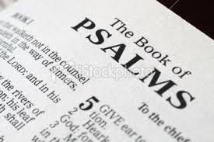
PSALM
Be our help, Lord God, in the days to come.

Slide 20


1.
If you trust in the Lord and do good, Then you will live in the land and be secure. If you find your delight in the Lord,
he will grant your heart’s desire.
Be our help Lord God, in the days to come.

Slide 21
2.
Commit your life to the Lord, Trust in him and he will act, so that your justice breaks forth like the light, and your cause like the noon day sun.
Be our help Lord God, in the days to come.

Slide 22

PLEASE STAND TO GREET THE GOSPEL
Sing Alleluia to the Lord
Sing Alleluia to the Lord
Sing Alleluia
Sing Alleluia
Sing Alleluia to the Lord. x2

Slide 23
Alleluia, Alleluia!
Speak Lord, your servant is listening. You have the message of eternal life.
Alleluia.

Slide 24
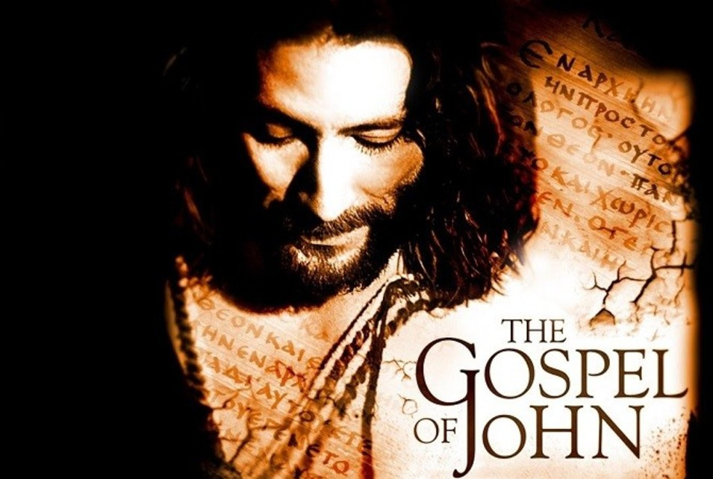
The Lord be with you.
AND WITH YOUR SPIRIT.
A reading from the Holy Gospel according to John.
GLORY TO YOU, O LORD.

Slide 25
One day Jesus said:
‘I don’t want you just to work for me and do as you’re told. I want you to be my friends and be happy with me.
‘But remember, you did not choose me; I chose you to be my friends, and I want you to be friends with each other.
The Gospel of the Lord.
PRAISE TO YOU, LORD JESUS CHRIST.

Slide 26
Sing Alleluia to the Lord
Sing Alleluia to the Lord
Sing Alleluia
Sing Alleluia
Sing Alleluia to the Lord. x1

Slide 27
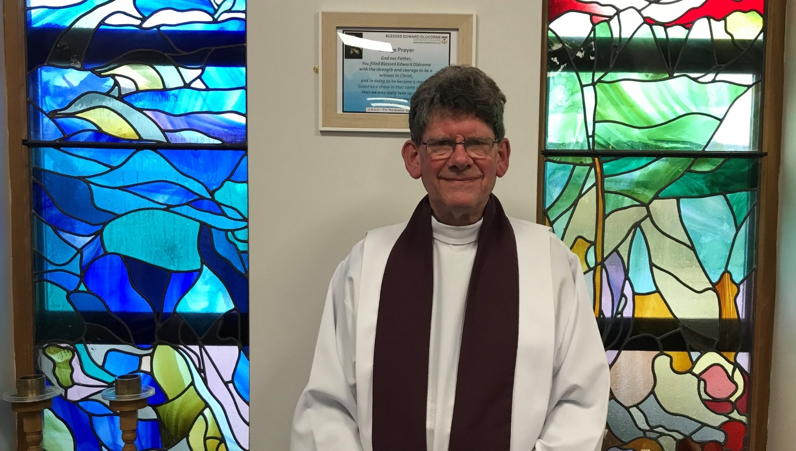
PLEASE SIT DOWN
HOMILY Fr. Stephen
Notes:
27

Slide 28
WE RESPOND
We respond by having a few moments of stillness, reflecting on what we have just heard and how it relates to us.
We sit silently as we prepare to listen to our Prayers of Intention.
We focus on the words of each prayer and ask God to come into our lives.
A.M.D.G. – For the Greater Glory of God

Slide 29
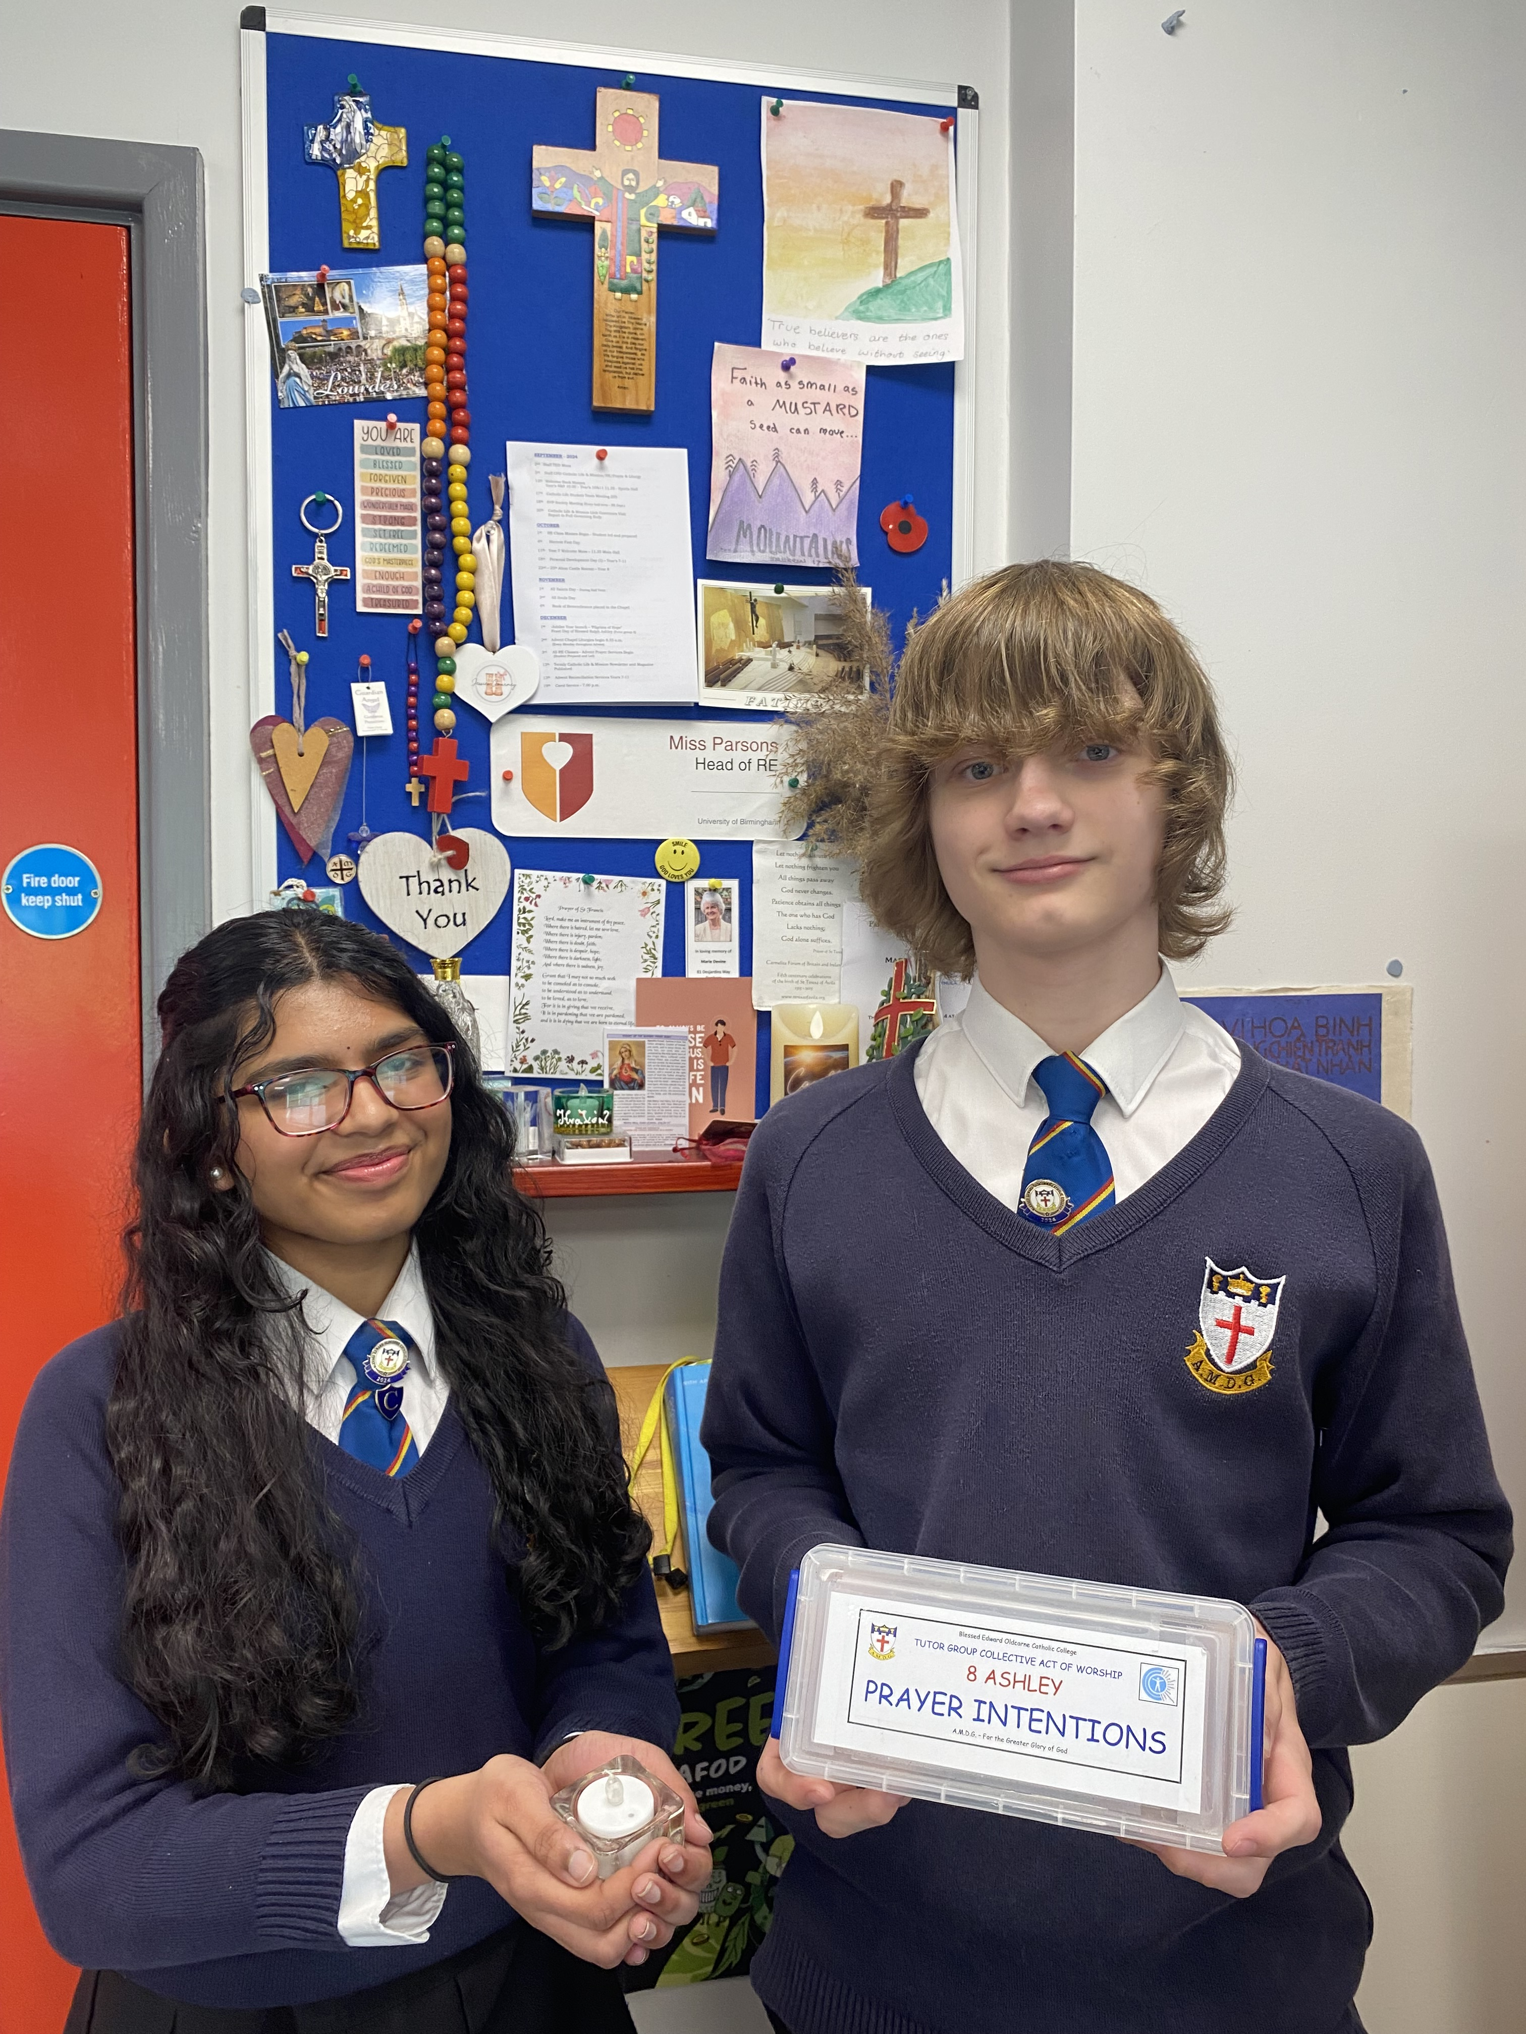
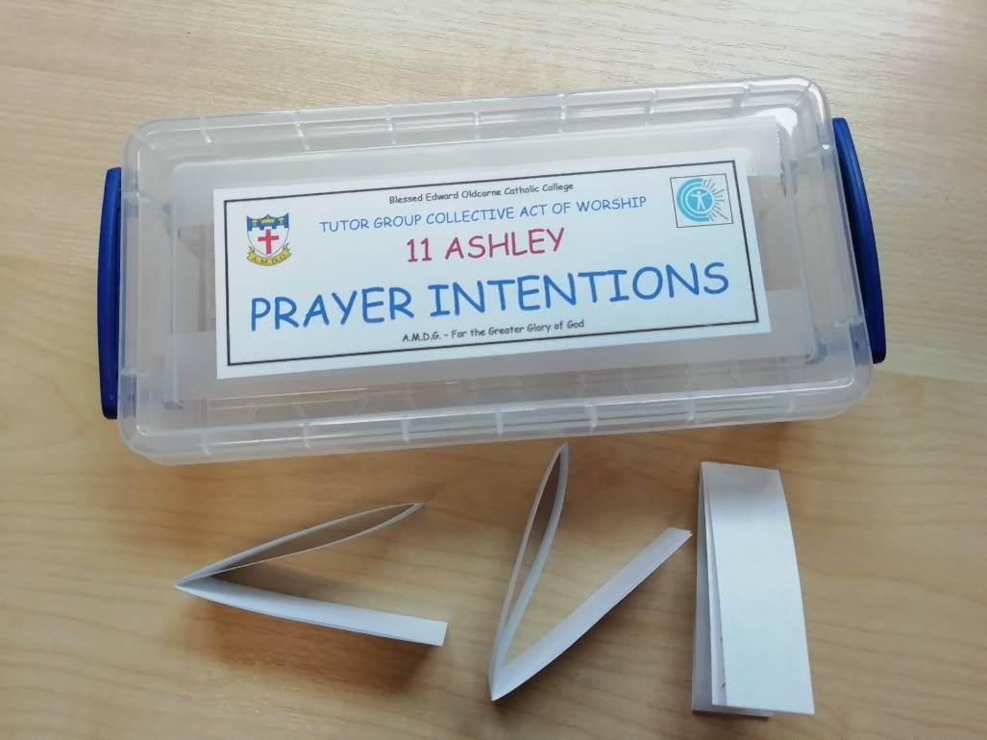
PRAYERS OF INTENTION
BIDDING PRAYERS

Slide 30

We pray for those who lead the Church, especially our Pope, Leo, whom you chose as successor of St. Peter and shepherd of your flock.
We also pray for Bernard our Archbishop and Fr. Stephen our college chaplain.
Lord hear us
LORD GRACIOUSLY HEAR US

Slide 31

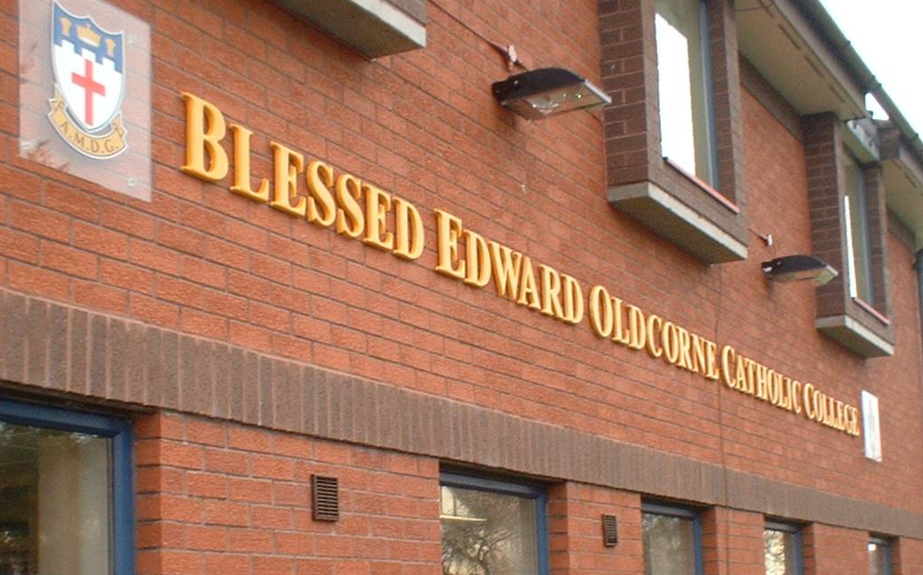
2.
We pray for all our new Year 7 students and any new members of staff who have joined our community this academic year.
May they all continue to grow in faith and follow Jesus’ command to love one another.
Lord hear us
LORD GRACIOUSLY HEAR US

Slide 32
3. We pray to our Father in heaven, that in this Jubilee Year, we may be inspired to renew our faith, increase our hope and ignite our love.
Encourage us to become Pilgrims of Hope, bringing joy and peace to the world.
Lord hear us
LORD GRACIOUSLY HEAR US

Slide 33
4. We pray for the weak and vulnerable, for those who depend on others to care for them.
We pray for the sick and those in despair, especially those caught up in regions of the world experiencing war and unrest.
Help us to be encouragers and advocates for those who can’t speak up for themselves.
Lord hear us
LORD GRACIOUSLY HEAR US

Slide 34
5. We pray for our college community,
and that Jesus Christ,
and the teachings of his Church, may always be at the centre of our school.
We pray that we will be inspired to continue to give witness to our faith and remember that everything we do is for ‘The Greater Glory of God.’
Lord hear us
LORD GRACIOUSLY HEAR US

Slide 35

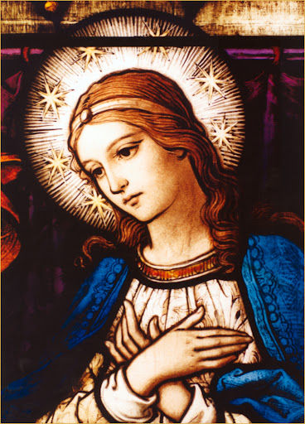
6. We pray for Mary, the Mother of God. Let us never fail to acknowledge the unconditional love that she bestows upon us as we all say together -
Hail Mary, full of grace, The Lord is with thee. Blessed art thou among women, and blessed is the fruit of thy womb, Jesus. Holy Mary, Mother of God, Pray for us sinners, Now and at the hour of our death. Amen.

Slide 36

WELCOME MASS

Slide 37
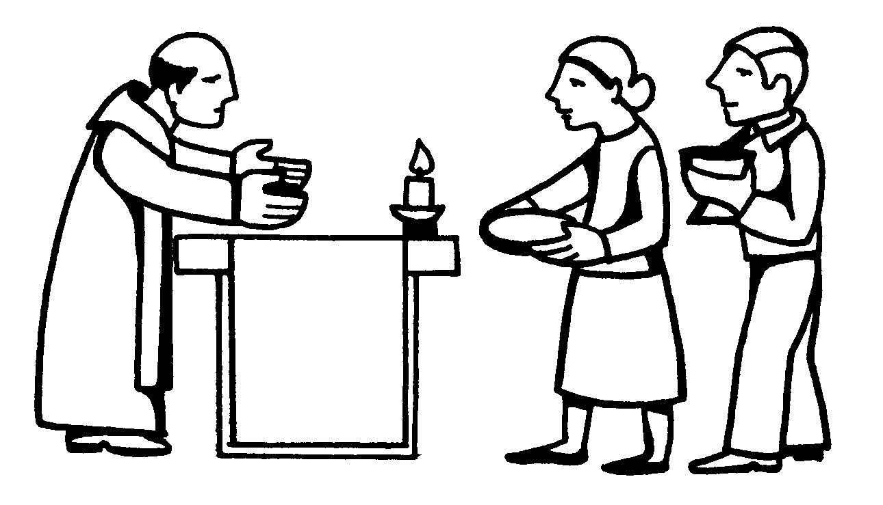

THE OFFERTORY

Slide 38
THE OFFERTORY
The gifts of bread and wine are brought to the altar.
The Priest blesses the bread and wine so that they become the body and blood of Jesus.
Together, we approach Calvary and the Upper Room, we come to Christ’s Real Presence, as he comes to us.
A.M.D.G. – For the Greater Glory of God

Slide 39
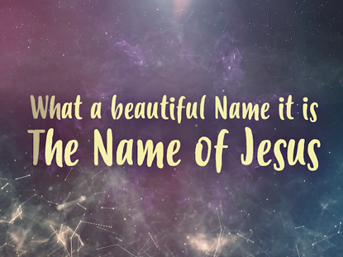
OFFERTORY HYMN
What a beautiful Name it is, what a beautiful Name it is.
The Name of Jesus Christ my King.
What a beautiful Name it is, nothing compares to this,
What a beautiful Name it is, the Name of Jesus.
You were the Word at the beginning.
One with God the Lord Most High.
Your hidden glory in creation,
Now, revealed in You our Christ.
A.M.D.G. – For the Greater Glory of God

Slide 40

You didn't want heaven without us
So, Jesus, You brought heaven down.
My sin was great, Your love was greater
What could separate us now?
What a wonderful Name it is, what a wonderful Name it is.
The Name of Jesus Christ my King.
What a wonderful Name it is, nothing compares to this,
What a wonderful Name it is, the Name of Jesus.

Slide 41
Death could not hold You, the veil tore before You,
You silenced the boast of sin and grave
The Heavens are roaring, the praise of Your glory
For You are raised to life again.
You have no rival; You have no equal
Now and forever, God, You reign
Yours is the Kingdom, Yours is the Glory
Yours is the Name above all names.

Slide 42
What a powerful Name it is, what a powerful Name it is.
The Name of Jesus Christ my King.
What a powerful Name it is, nothing can stand against,
What a powerful Name it is, the Name of Jesus.

Slide 43
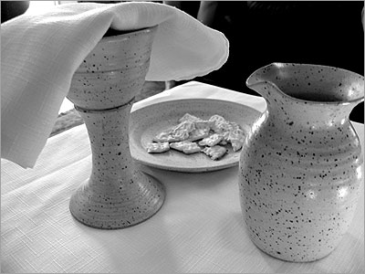
LITURGY OF THE EUCHARIST

Slide 44
Pray my brothers and sisters that my sacrifice and yours may be acceptable to God, the almighty Father.
May the Lord accept the sacrifice at your hands, for the praise and glory of his name, for our good and the good of all his holy Church.

Slide 45

YEAR 7 WELCOME MASS

Slide 46
THE EUCHARISTIC PRAYER
The Lord be with you. And with your spirit
Lift up your hearts. We lift them up to the Lord.
Let us give thanks to the Lord our God. It is right and just.

Slide 47
YEAR 7 WELCOME MASS
A.M.D.G. For the Greater Glory of God

Slide 48

HOLY, HOLY, HOLY IS THE LORD
Holy, holy, holy is the Lord, holy is the Lord God almighty! Holy, holy, holy is the Lord, holy is the Lord God almighty! Who was and is, and is to come; holy, holy, holy is the Lord.

Slide 49
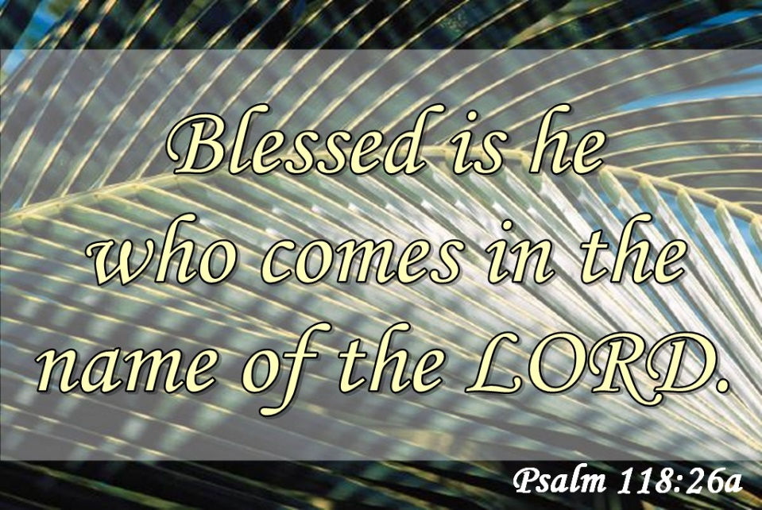
Blessed, blessed, blest is he who comes, Blest is he who comes in the Lord’s name.
Blessed, blessed, blest is he who comes, Blest is he who comes in the Lord’s name.
Hosanna in the heights of heav’n. Blessed, blessed, blessed is the Lord.

Slide 50
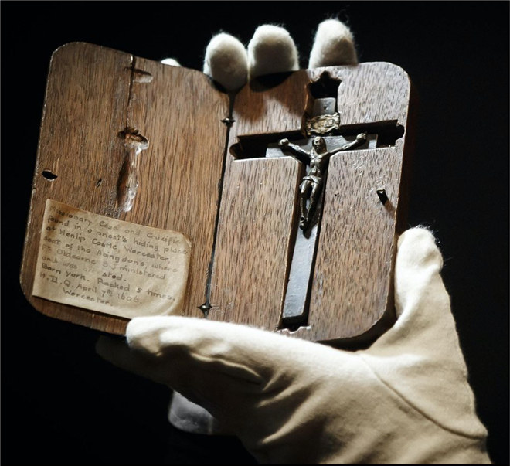
YEAR 7 WELCOME MASS

Slide 51
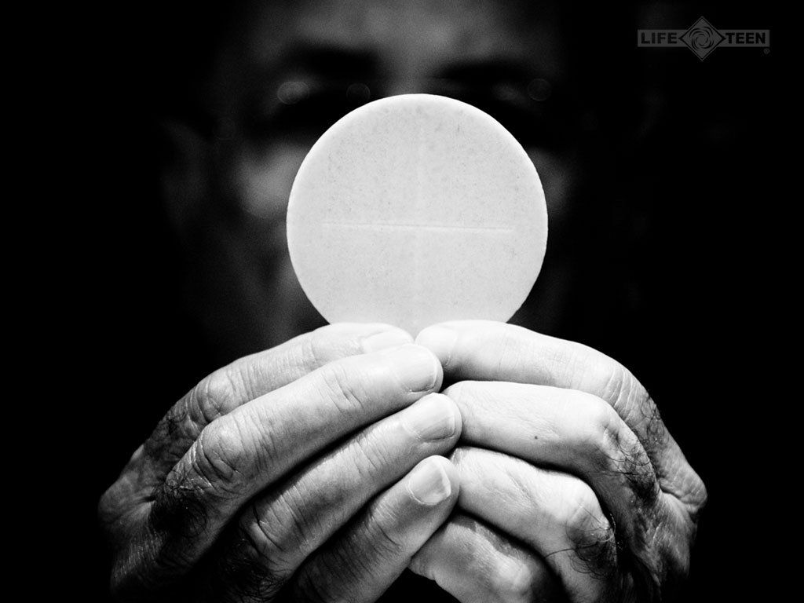
TAKE THIS ALL OF YOU AND EAT OF IT:
FOR THIS IS MY BODY WHICH WILL BE GIVEN UP FOR YOU.

Slide 52
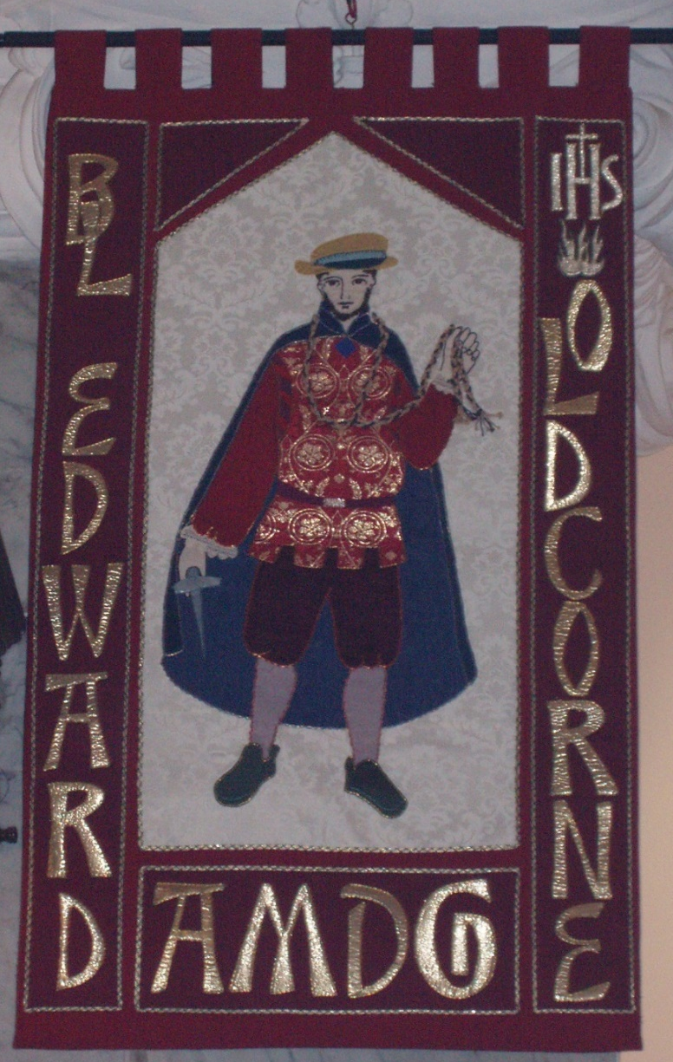
YEAR 7 WELCOME MASS
A.M.D.G. - For the Greater Glory of God

Slide 53

Take this all of you and drink from it: For this is the chalice of my blood, the blood of the new and eternal covenant, which will be poured out for you and for many for the forgiveness of sins.
Do this in memory of me.

Slide 54
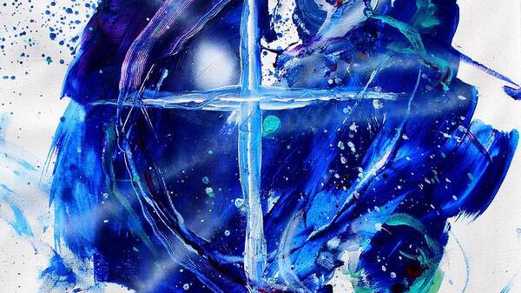

We proclaim your death O Lord and profess your resurrection until you come again, until you come again.
(Repeat)
We proclaim your death O Lord and profess your resurrection until you come again, until you come again.
First verse = solo

Slide 55
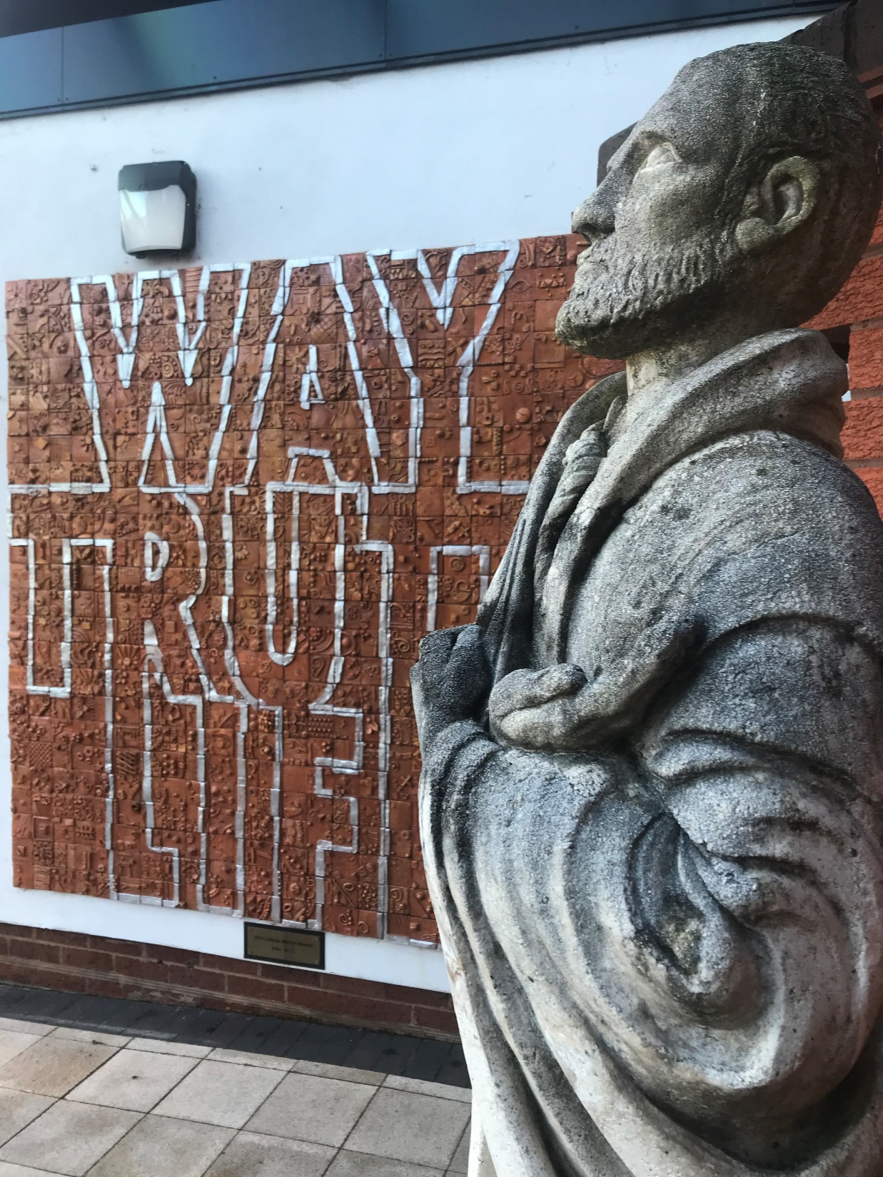
YEAR 7 WELCOME MASS
A.M.D.G. - For the Greater Glory of God

Slide 56
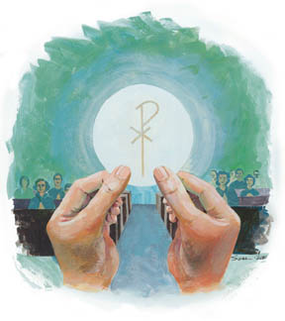
Through him, and with him, and in him, O God, almighty Father, in the unity of the Holy Spirit, all glory and honour is yours, for ever and ever.
SUNG
Amen. We lift our hearts and voices to you, as we sing, Amen, so shall it be forever Amen. (Repeat)

Slide 57
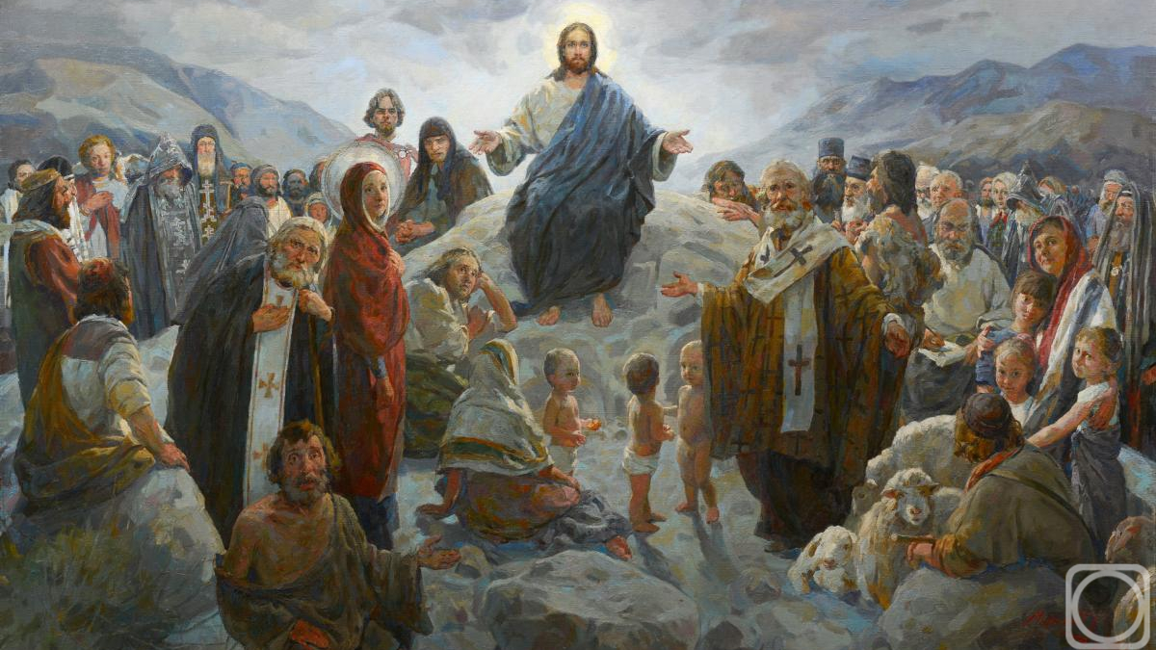
PLEASE STAND
At the Saviour’s command and formed by divine teaching, we dare to say:
Our Father, who art in heaven, hallowed be thy name; thy Kingdom come; thy will be done on earth as it is in heaven. Give us this day our daily bread, and forgive us our trespasses as we forgive those who trespass against us, and lead us not into temptation, but deliver us from evil.

Slide 58

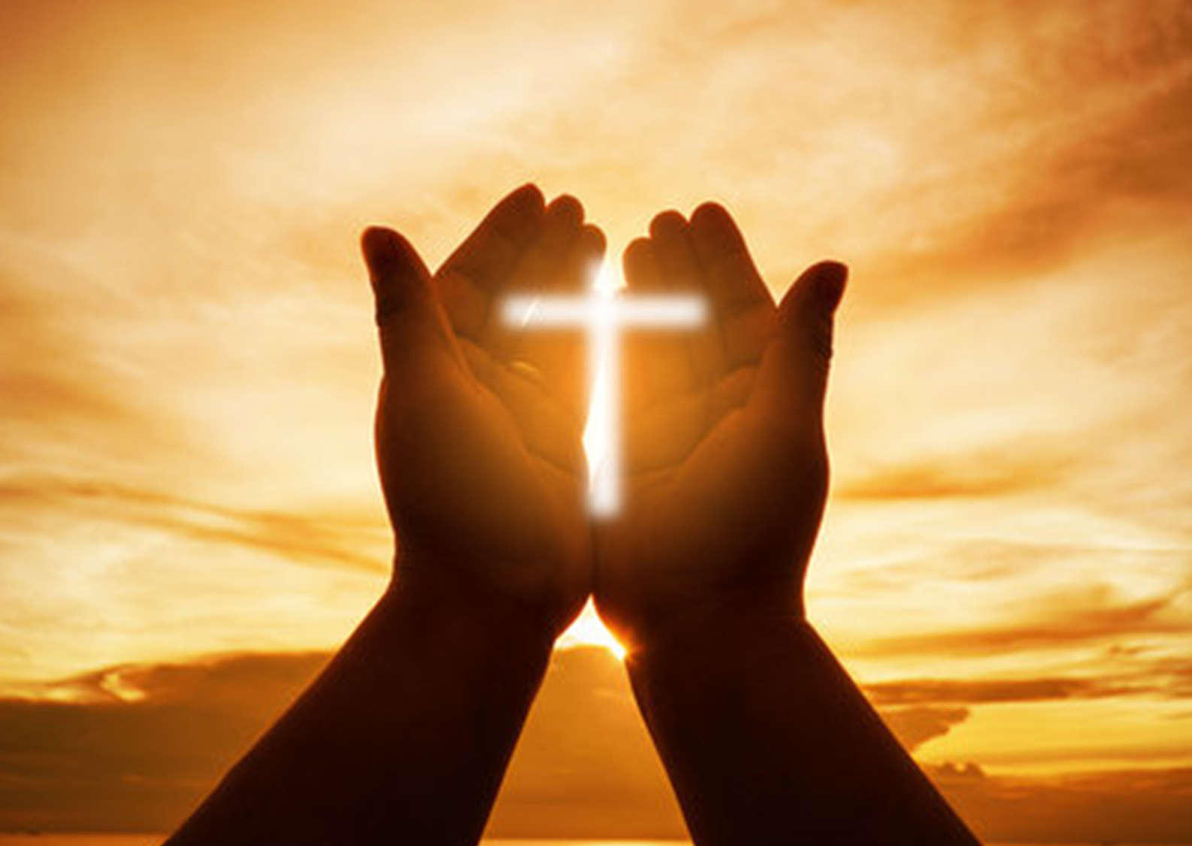
Deliver us Lord, we pray, from every evil, graciously grant peace in our days, that, by the help of your mercy, we may be always free from sin and safe from all distress as we await the blessed hope and the coming of our Saviour, Jesus Christ.
FOR THE KINGDOM,THE POWER AND THE GLORY ARE YOURS, NOW AND FOREVER.

Slide 59

Lord Jesus Christ, who said to your apostles: Peace I leave you, my peace I give you; look not on our sins, but on the faith of your Church and graciously grant her peace and unity in accordance with your will. Who live and reign for ever and ever.
AMEN.

Slide 60

The peace of the Lord be with you always.
AND WITH YOUR SPIRIT.

Slide 61
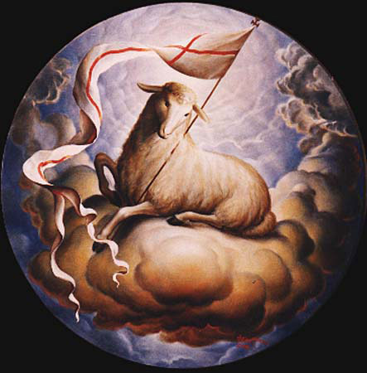
LAMB OF GOD
Lamb of God, Lamb of God,
you take away, you take away,
the sins of all, the sins of all,
the world, the world,
Miserere nobis, miserere nobis.

Slide 62
LAMB OF GOD
Lamb of God, Lamb of God,
you take away, you take away,
the sins of all, the sins of all,
the world, the world,
Miserere nobis, miserere nobis.

Slide 63
LAMB OF GOD
Lamb of God, Lamb of God,
you take away, you take away,
the sins of all, the sins of all,
the world, the world,
Dona Nobis Pacem, Dona Nobis Pacem, Dona Nobis Pacem.

Slide 64
Behold the Lamb of God, behold him who takes away the sins of the world. Blessed are those called to the supper of the Lamb.
Lord, I am not worthy that you should enter under my roof but only say the word and my soul shall be healed.

Slide 65
COMMUNION
We will now share communion together by either receiving the Body of Jesus or a blessing.
This symbolises spiritual nourishment and forgiveness of sins through Christ’s sacrifice.
Mr. McCormack will now outline the arrangements and how we should respond during communion.
PLEASE SIT DOWN
A.M.D.G. – For the Greater Glory of God

Slide 66
Everyone is invited to come forward and receive either Holy Communion or a blessing.

Slide 67
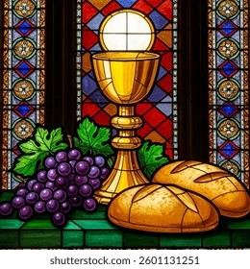
COMMUNION HYMNS
MAKE ME HOLY LORD
OCEANS

Slide 68
MAKE ME HOLY
Prepare my mind, prepare my soul, prepare my heart and make me whole, prepare me for the awesomeness of you.
Renew in me a spirit strong, remind me Lord of all that’s wrong, create in me complete desire for you.

Slide 69
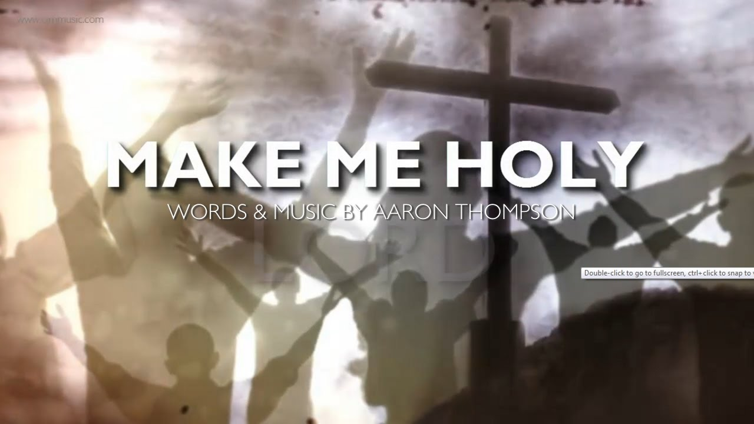
Make me Holy Lord, Make me Holy Lord, Make me Holy Lord, Like you.

Slide 70

Consume my mind, consume my soul, consume my heart and make me whole, consume me with the awesomeness of you.
Destroy the pride, destroy the hate, destroy the things that separate and keep me from returning back to you.

Slide 71
Make me Holy Lord, Make me Holy Lord, Make me Holy Lord, Like you.

Slide 72
Restore my mind Restore my soul, restore my heart and make it whole, restore me with the awesomeness of you.
Redecorate me from within, refurnish me with sacredness, rebuild me with a yearning love for you.

Slide 73
Make me Holy Lord, Make me Holy Lord, Make me Holy Lord, Like you. x2

Slide 74

You call me out upon the waters, the great unknown where feet may fail.
And there I find you in the mystery, in Oceans deep, my faith will stand

Slide 75
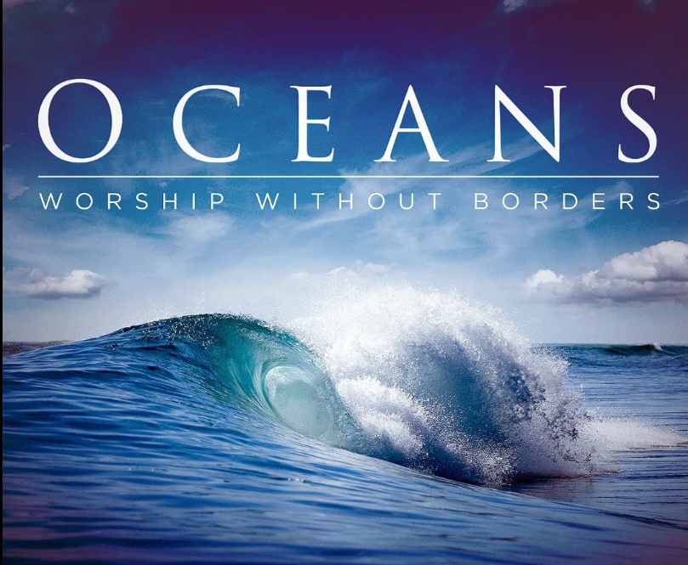
And I will call upon your name, and keep my eyes above the waves,
When oceans rise, my soul will rest in your embrace, for I am yours, and you are mine.

Slide 76
Your grace abounds in deepest waters, your sovereign hand will be my guide.
Where feet may fail and fear surrounds me, you never failed, and you won’t start now.

Slide 77
So I will call upon your name, and keep my eyes above the waves,
When oceans rise, my soul will rest in your embrace, for I am yours, and you are mine.

Slide 78
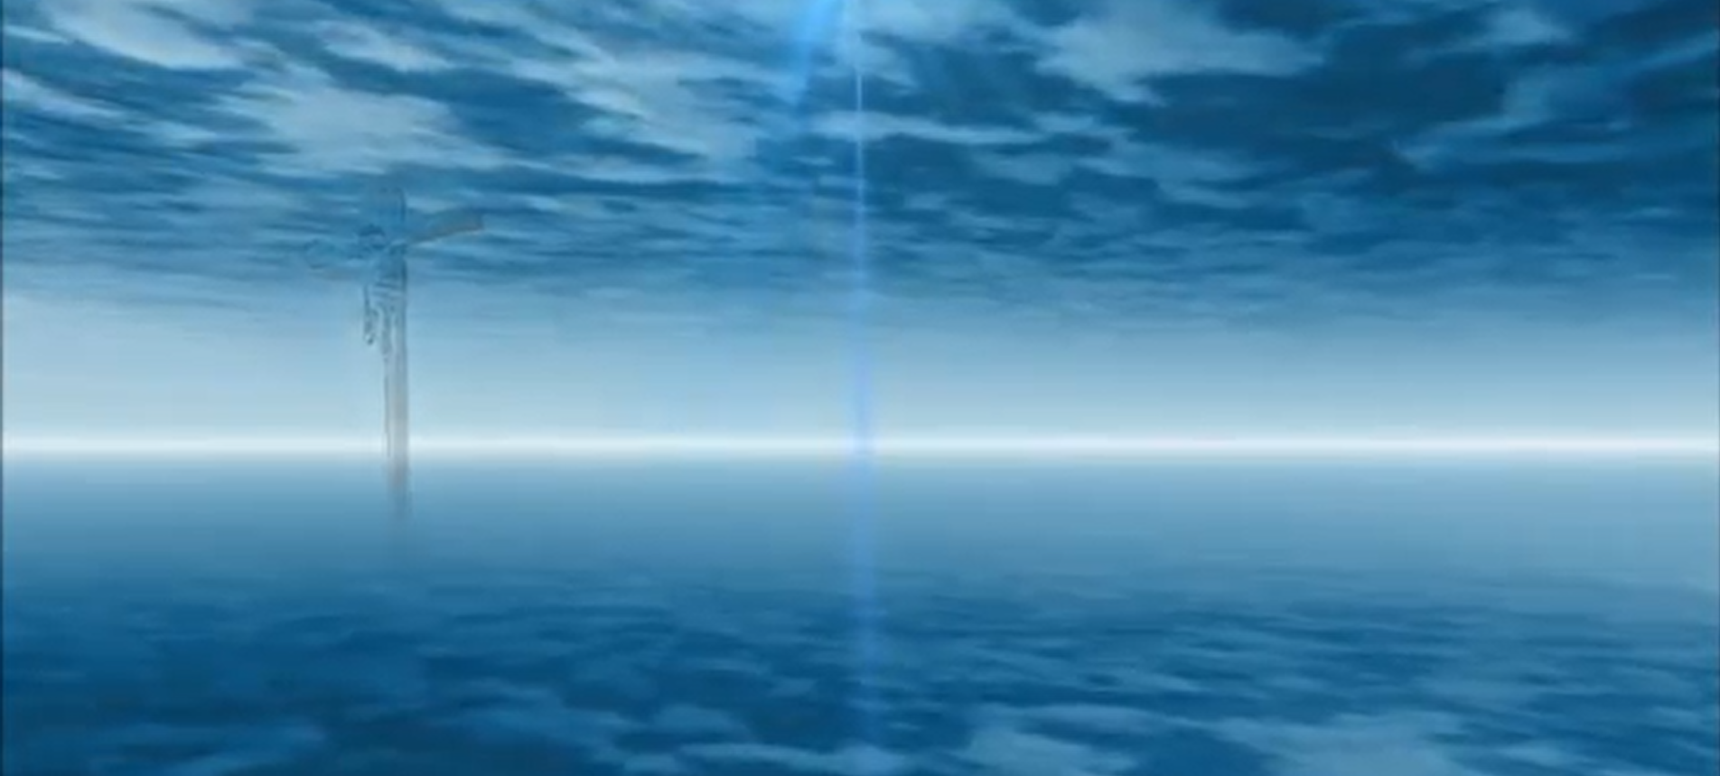
Spirit lead me where my trust is without borders, let me walk upon the waters wherever you would call me.
Take me deeper than my feet could ever wander, and my faith will be made stronger, in the presence of my saviour. x6

Slide 79
And I will call upon your name, and keep my eyes above the waves,
When oceans rise, my soul will rest in your embrace, for I am yours, and you are mine.

Slide 80
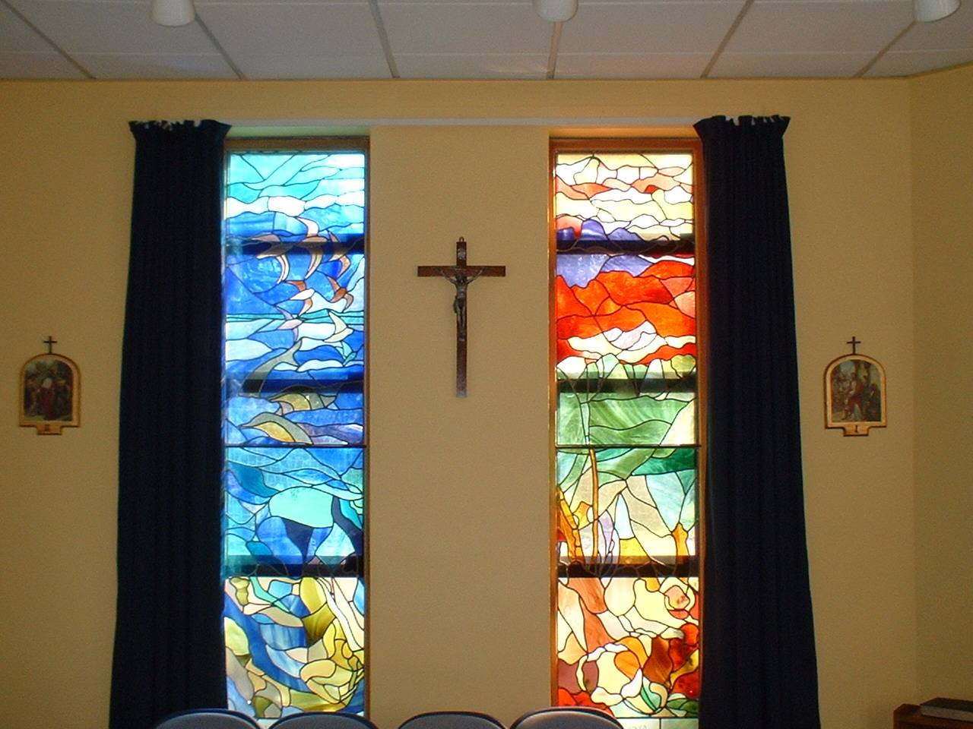
Sit still and pray for your own private intentions
Think of one thing or one person that you would like to pray for…
Notes:
80

Slide 81
MISSION
WE GO FORTH
As we experience our first year at Blessed Edward’s, we remind ourselves that everything we do is for the Greater Glory of God.
During this academic year, gift us with open hearts to seek you and proclaim your word.
We are sent forth from this Mass, taking Christ and his blessing with us into every encounter.
A.M.D.G. – For the Greater Glory of God

Slide 82
PLEASE STAND
LET US PRAY

Slide 83
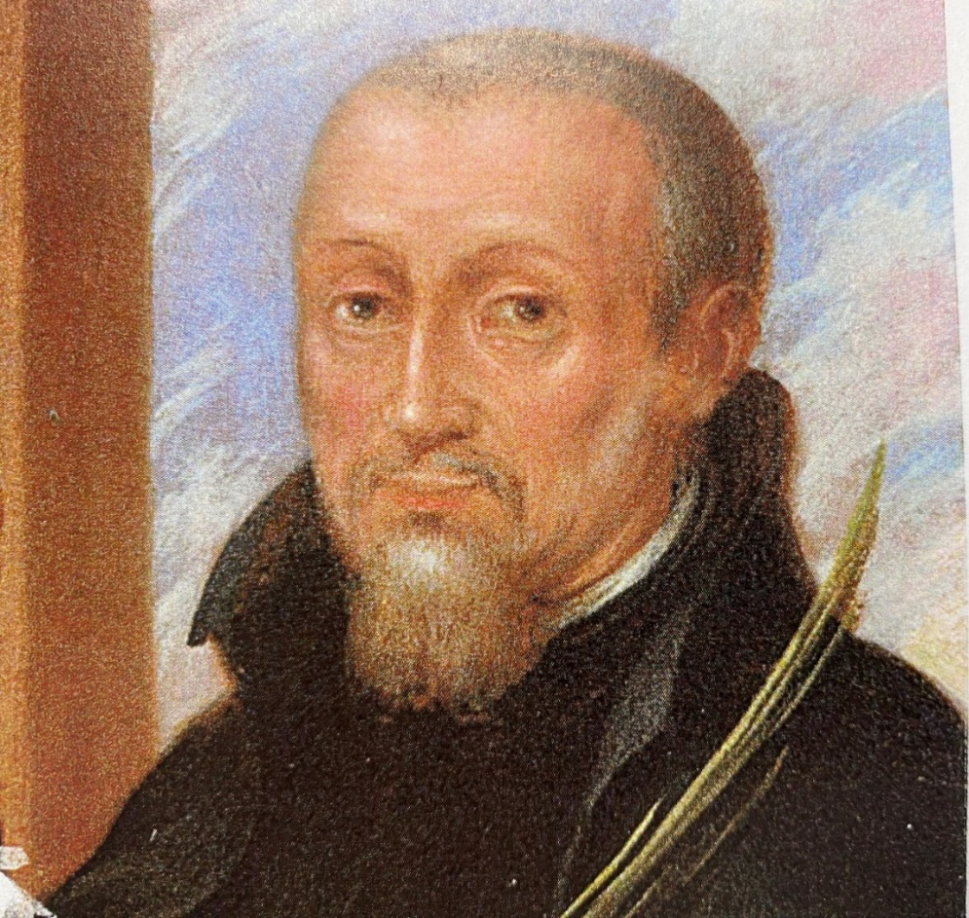

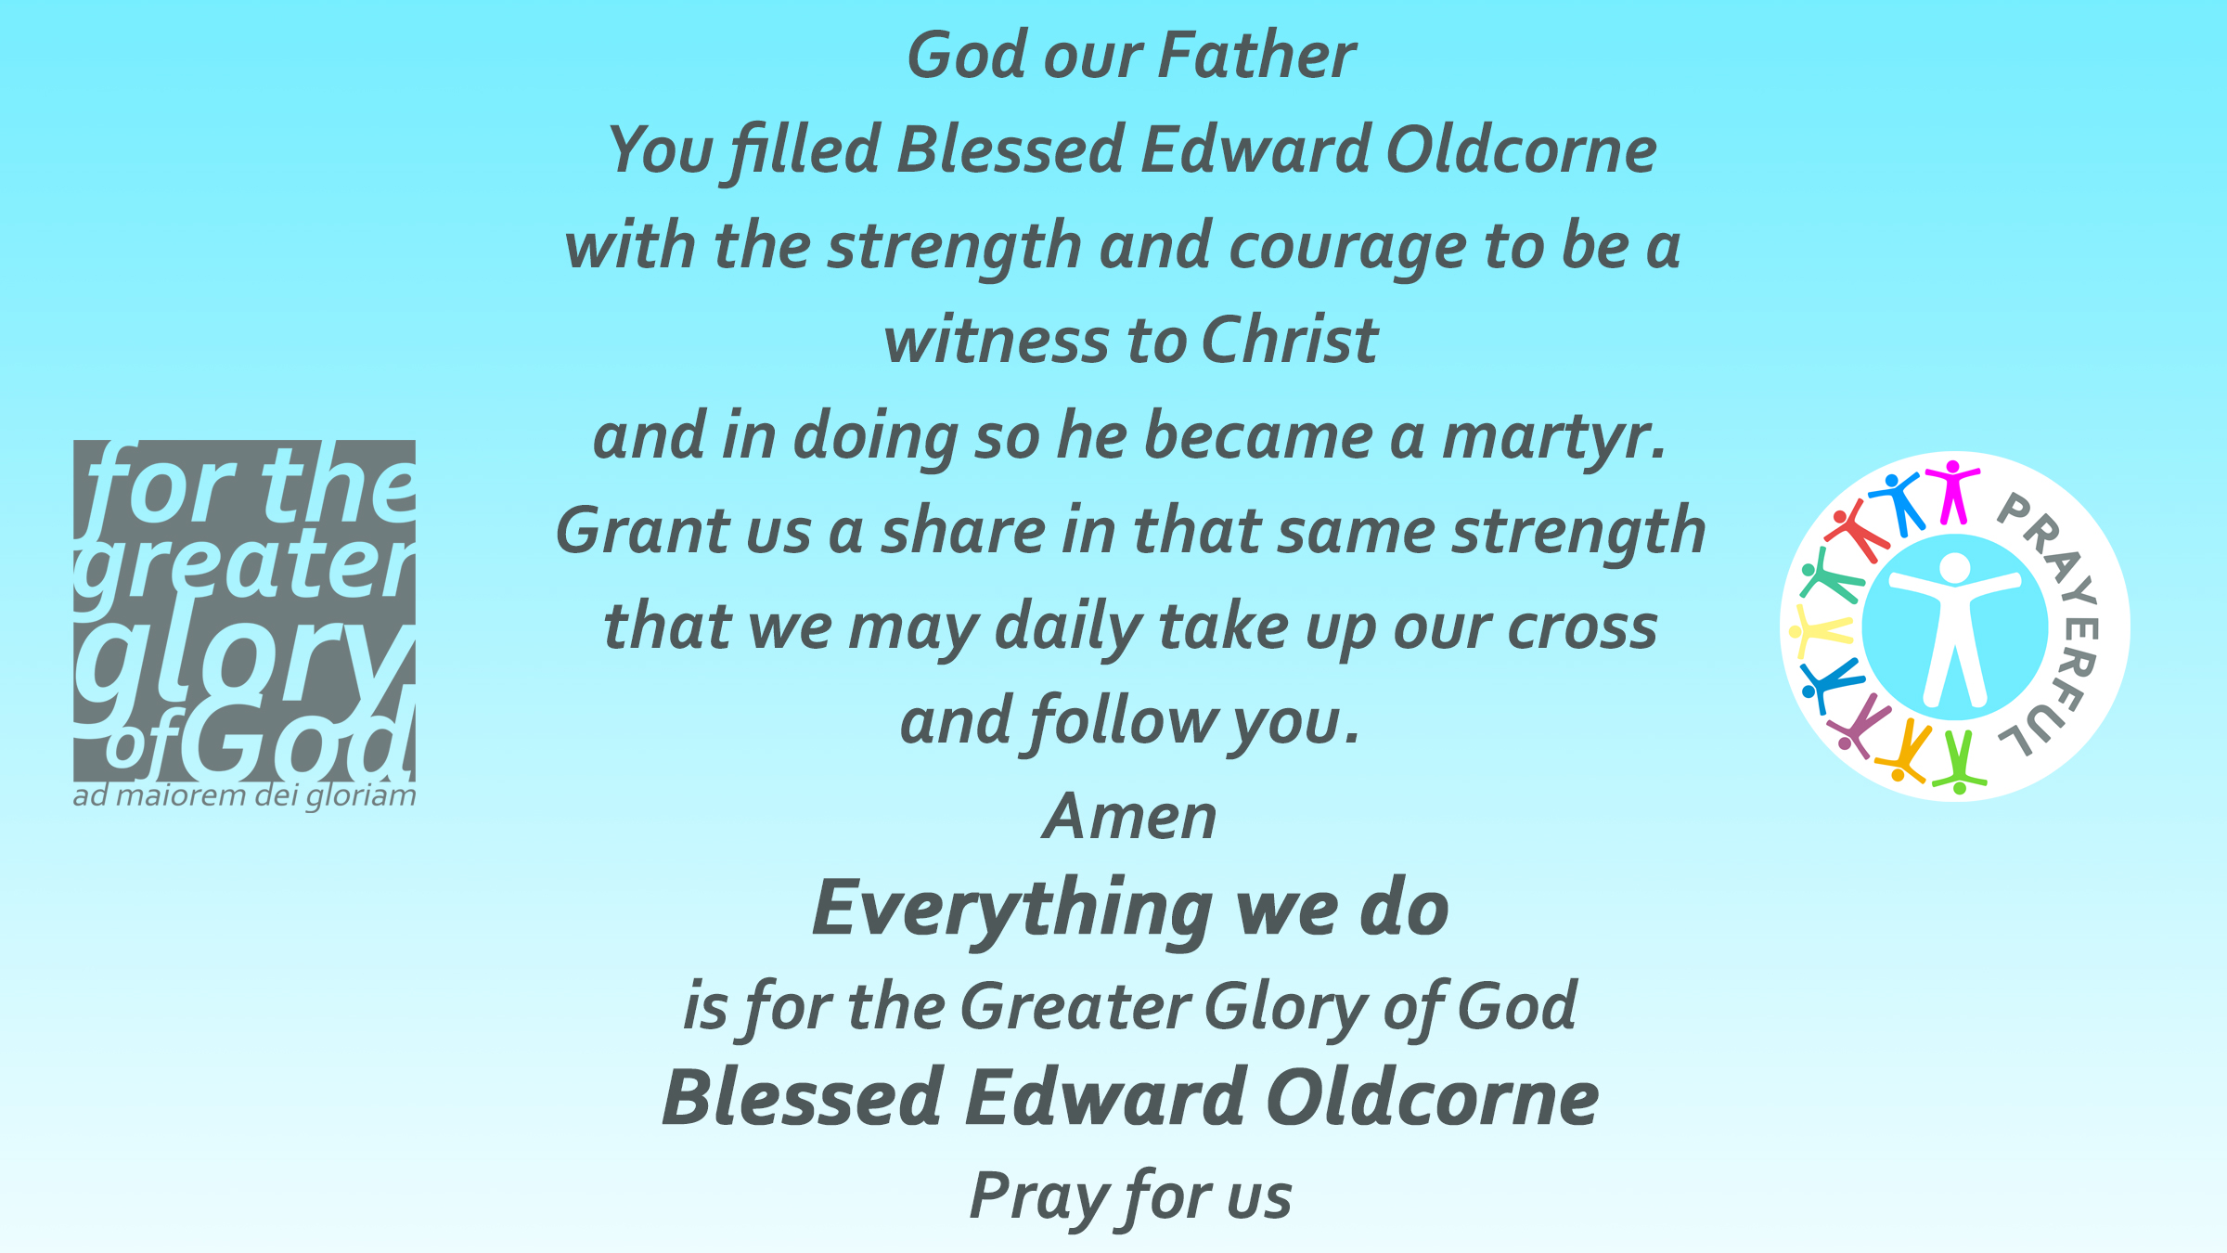
COLLEGE PRAYER

Slide 84

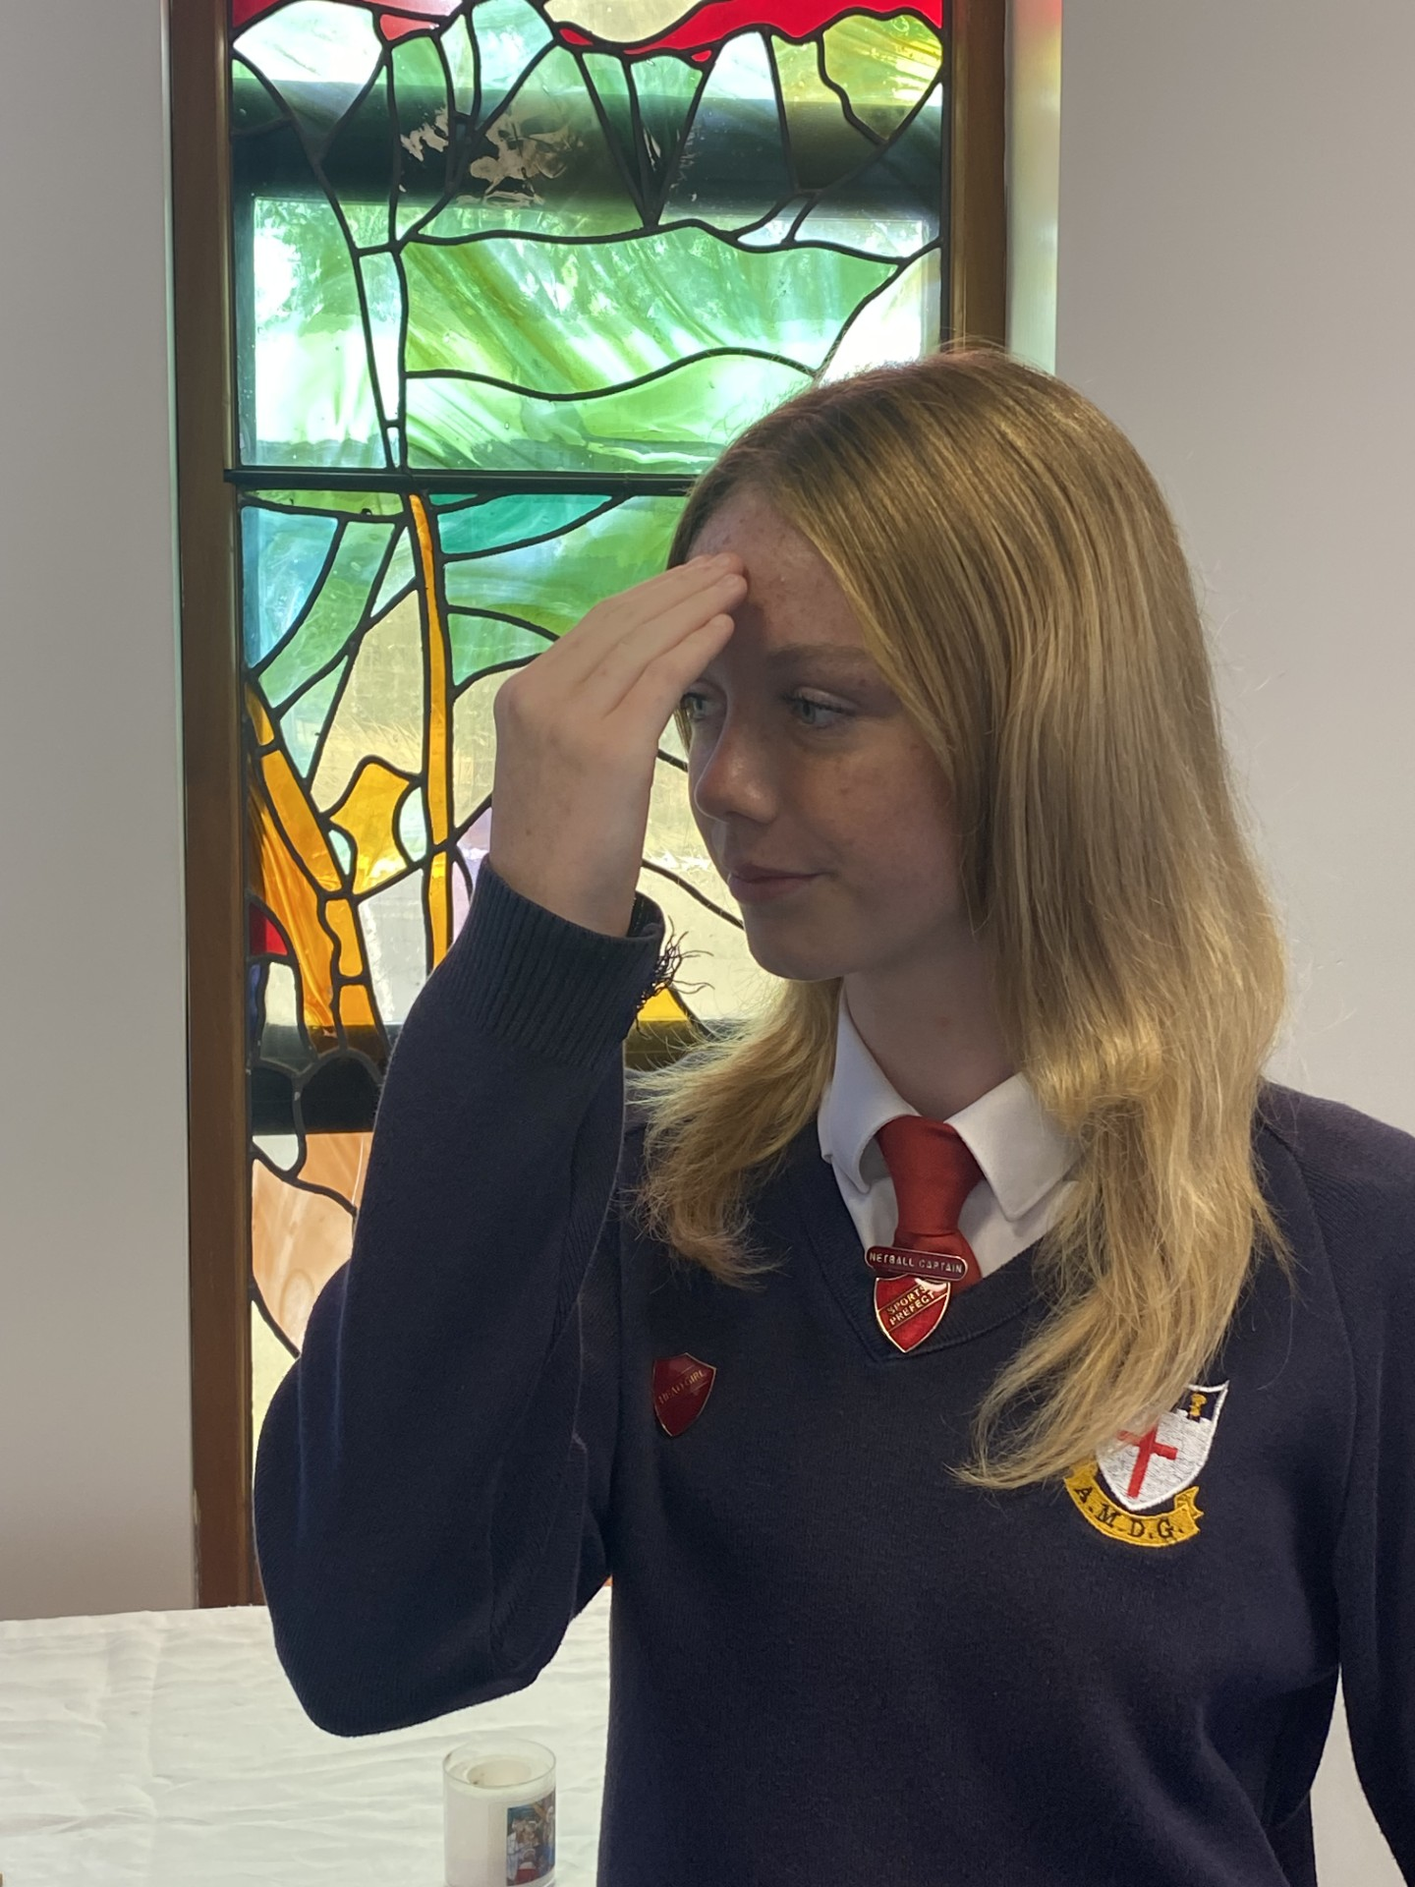
Olivia Owen - Head Girl
The Lord be with you.
AND WITH YOUR SPIRIT.
May almighty God bless you, the Father, and the Son, and the Holy Spirit.
AMEN.

Slide 85
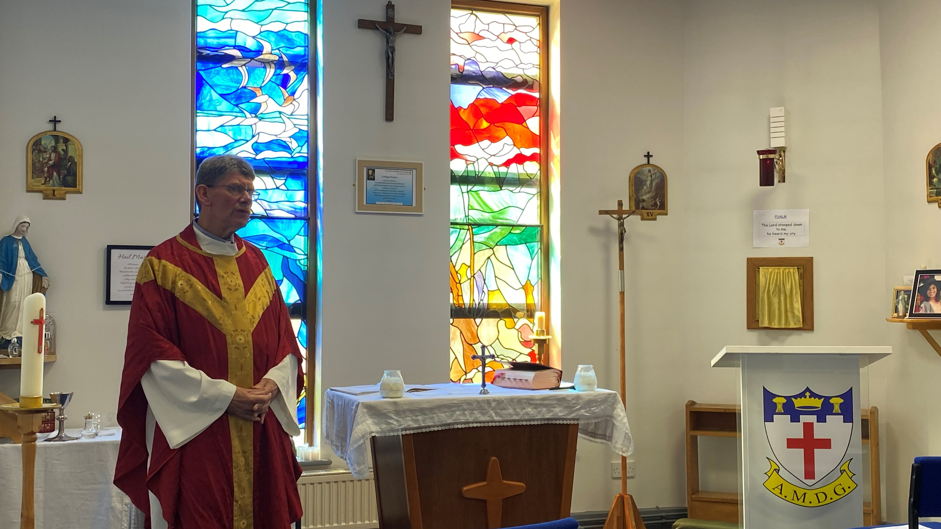
Go in peace, glorifying the Lord by your life.
THANKS BE TO GOD.

Slide 86
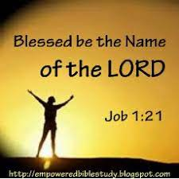
BLESSED BE THE NAME OF THE LORD
Blessed be your name in a land that is plentiful, where your streams of abundance flow, Blessed be your name.
Blessed be your name, when I’m found in the desert place, though I walk through wilderness, Blessed be your name.

Slide 87
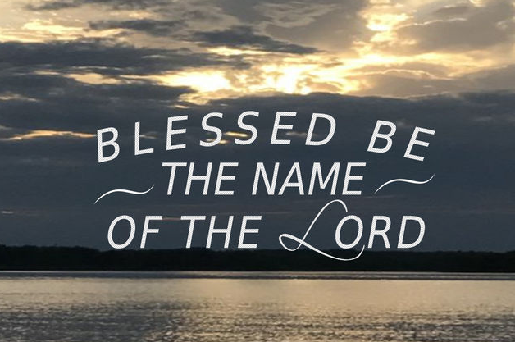
Every blessing you pour out I’ll turn back to praise. When the darkness closes in, Lord, still I will say,
Blessed be the name of the Lord, Blessed be your name Blessed be the name of the Lord Blessed be your glorious name.

Slide 88
Blessed be your name When the sun’s shining down on me When the world’s all as it should be Blessed be your name.
Blessed be your name On the road marked with suffering Though there’s pain in the offering Blessed be your name.

Slide 89
Every blessing you pour out I’ll turn back to praise. When the darkness closes in, Lord, still I will say,
Blessed be the name of the Lord, Blessed be your name Blessed be the name of the Lord Blessed be your glorious name.

Slide 90
You give and take away You give and take away My heart will choose to say Lord blessed be your name. x2
Blessed be the name of the Lord, Blessed be your name Blessed be the name of the Lord Blessed be your glorious name. x2

Slide 91
YEAR 7 WELCOME MASS
Friday 17th October 2025

Slide 92
AMAZING GRACE
All these pieces
Broken and scattered
In mercy gathered
Mended and whole.
Empty-handed
But not forsaken
I've been set free
I've been set free.
Amazing grace
How sweet the sound
That saved a wretch like me,
I once was lost
But now I'm found
Was blind but now I see.
You take our failure
You take our weakness
You set Your treasure
In jars of clay.
So take this heart, Lord
I'll be Your vessel
The world to see
Your life in me.
Oh, I can see it now
Oh, I can see the love in Your eyes
Laying yourself down
Raising up the broken to life.

