Slide 1




WELCOME BACK MASS
Friday 12th September 2025

Slide 2
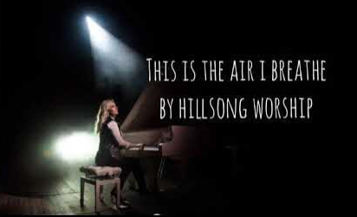

GATHERING HYMN
THIS IS THE AIR I BREATHE
This is the air I breathe.
This is the air I breathe.
Your holy presence
living in me.
This is my daily bread.
This is my daily bread.
Your very word,
spoken to me.
And I ... I'm desperate for you
And I ... I'm lost without you.
A.M.D.G. – For the Greater Glory of God

Slide 3




Slide 4


WE GATHER
Welcome to our Mass, as we prepare ourselves to get closer to God.
As we gather in worship, we are reminded of our unity as God’s chosen people.
We praise and thank God as we celebrate the life of our vibrant community.
We pray that our school will continue to flourish helping to develop people of good character.
A.M.D.G. – For the Greater Glory of God

Slide 5
WE GATHER
We also gather today, to begin the New School Year.
We celebrate the uniqueness and vitality of all children and pray that Jesus, our Lord, will guide and protect us throughout the coming academic year.
May God’s blessings fall upon all who are part of our school community as we celebrate this Eucharist.
A.M.D.G. – For the Greater Glory of God

Slide 6
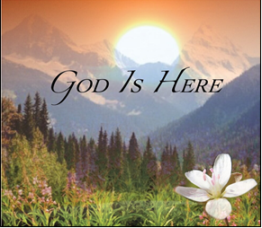
PLEASE STAND
OUR GOD IS HERE
Here in this time, here in this place,
here we are standing face to face.
Here in our hearts, here in our lives,
our God is here.

Slide 7
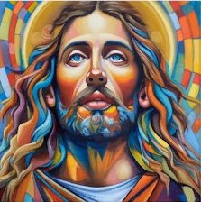
Here for the broken, here for the strong,
here in this temple we belong.
Here in our hearts, here in our lives,
our God is here.
And we cry:
“Holy! Holy! Holy are you!”
We cry: “Holy! Holy! Holy and true!”
Amen, we do believe our God is here.
Our God is here.

Slide 8
Here in the Word, God is revealed,
here where the wounded can be healed.
Here in our hearts, here in our lives,
our God is here.
Here we become what we receive,
here in this Eucharistic feast.
We are his body, living as one;
our God is here.

Slide 9
And we cry:
“Holy! Holy! Holy are you!”
We cry: “Holy! Holy! Holy and true!”
Amen, we do believe our God is here.
Our God is here.

Slide 10
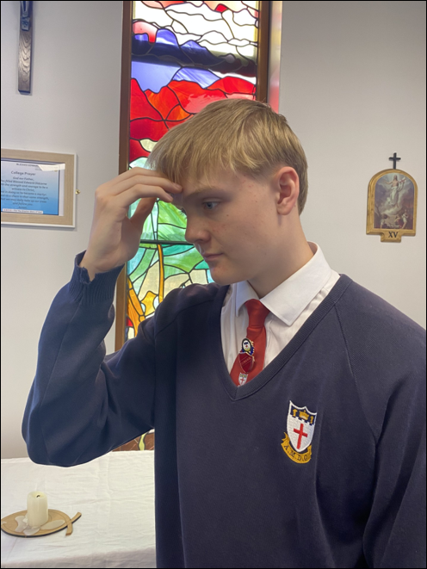

Ronan Guppy - Head Boy
In the name of the Father, and of the Son, and of the Holy Spirit,
AMEN.

Slide 11
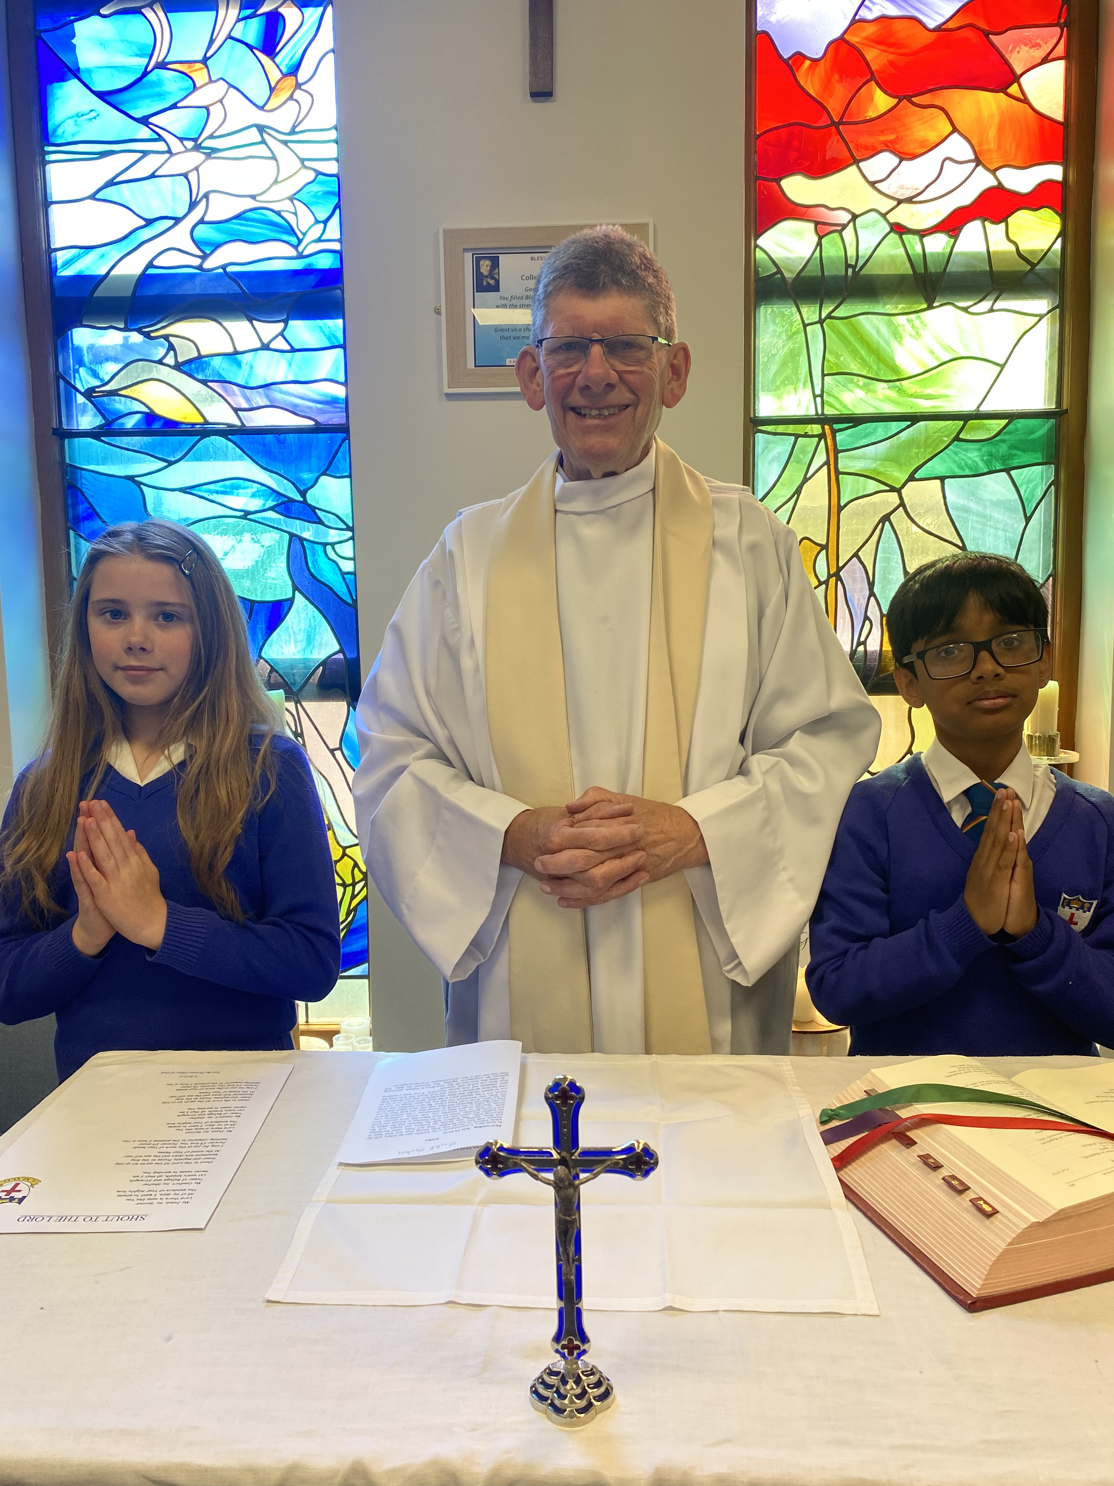

The grace of our Lord Jesus Christ and the Love of God and the communion of the Holy Spirit be with you all.
AND WITH
YOUR SPIRIT.

Slide 12



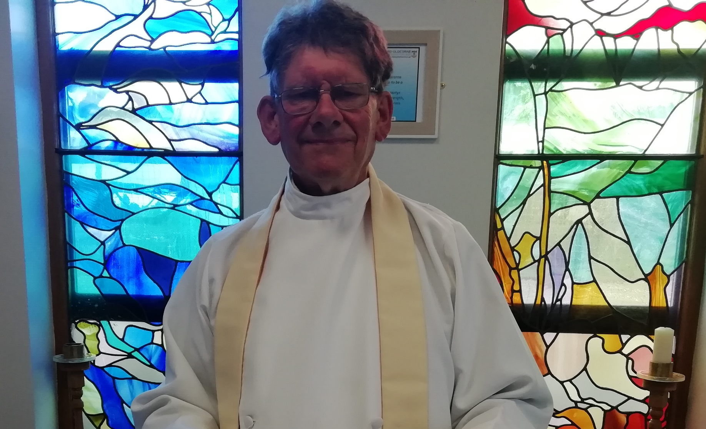
BLESSED EDWARD OLDCORNE CATHOLIC COLLEGE
WELCOME BACK
PLEASE SIT DOWN
A.M.D.G. – For the Greater Glory of God

Slide 13

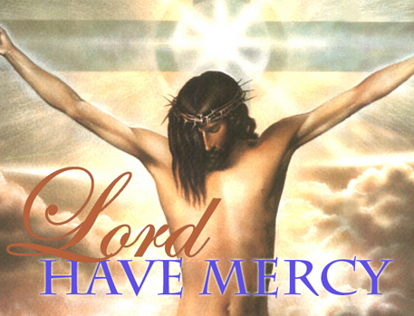
Show mercy to us loving Father.
We have sinned against you, please make us anew.
In your love and your grace, you forgive us.
Lord have mercy,
Lord have mercy.
Look not on our failings, Lord Jesus.
We have sinned against you, please make us anew.
By your life and your death, you redeem us,
Christ have mercy,
Christ have mercy.
Come fill our hearts, Holy Spirit.
We have sinned against you, please make us anew.
Forgive us and heal us and save us,
Lord have mercy,
Lord have mercy.
PENITENTIAL ACT

Slide 14
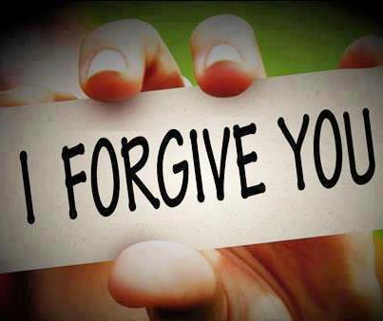
MAY ALMIGHTY GOD HAVE MERCY ON US, FORGIVE US OUR SINS AND BRING US TO EVERLASTING LIFE.
AMEN.

Slide 15
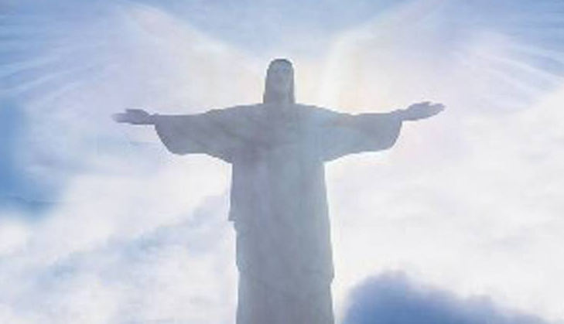
LET US PRAY

Slide 16
THE WORD
WE LISTEN
During the Liturgy of the Word we hear the proclamation of Sacred scripture.
These are not presented as recollections of past events, but as moments in the continuing love story of God and his people.
Our Lord did not just speak then, but also speaks to us now.
A.M.D.G. – For the Greater Glory of God

Slide 17
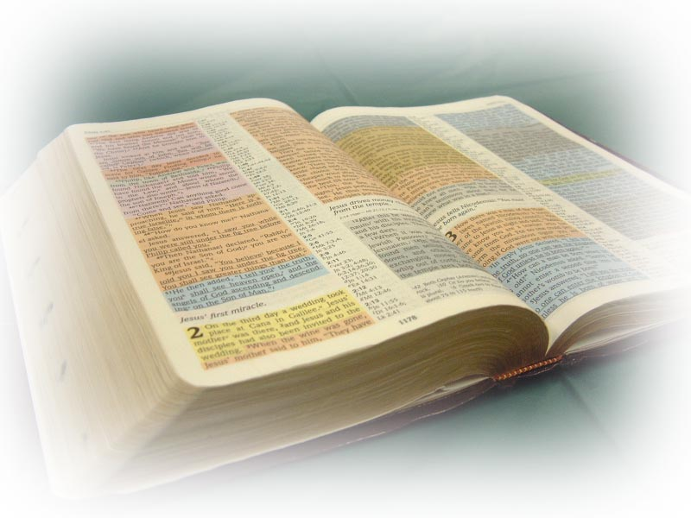
THE LITURGY OF THE WORD
A reading from the prophet Isaiah.

Slide 18

I want to tell the whole wide world - ‘God has been good to me!’ I want to tell the whole wide world- ‘God is wonderful!’ I want to sing and to shout because I am so happy, for God has come to me and he is great!
The word of the Lord.
THANKS BE TO GOD.

Slide 19
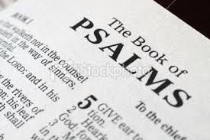
PSALM
Lord, teach me your ways.

Slide 20
The Lord guides us in the way we should go,
and protects those who please him.
Lord, teach me your ways.

Slide 21
2. If we fall, we will not stay down
because the Lord will help us up.
Lord, teach me your ways.

Slide 22
3. Good people’s words are wise and are always fair.
They keep the law of God in their heart
and never depart from it.
Lord, teach me your ways.

Slide 23

PLEASE STAND TO GREET THE GOSPEL
Sing Alleluia to the Lord
Sing Alleluia to the Lord
Sing Alleluia
Sing Alleluia
Sing Alleluia to the Lord. x2

Slide 24
Alleluia, Alleluia!
I thank you, Lord, with all my heart,
for you have heard my prayer.
Alleluia.

Slide 25
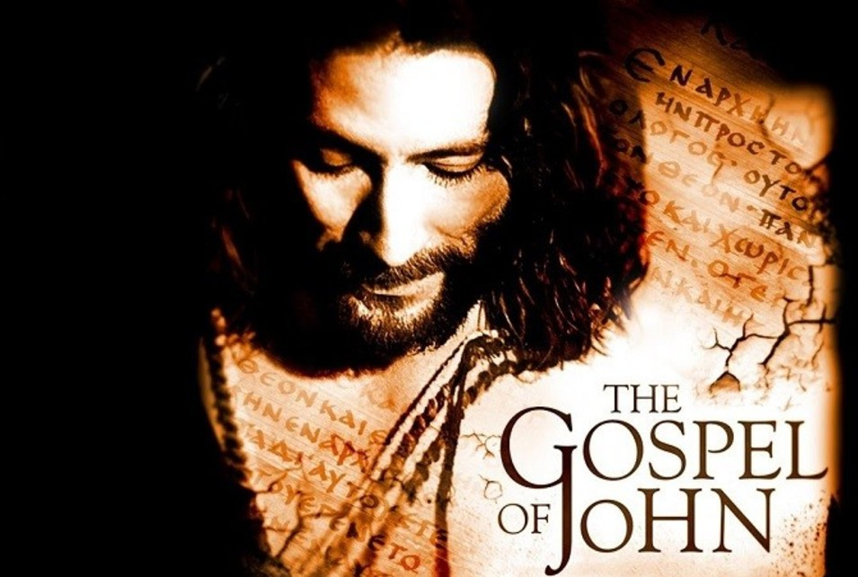
The Lord be with you.
AND WITH YOUR SPIRIT.
A reading from the Holy Gospel according to John.
GLORY TO YOU, O LORD.

Slide 26
One day Jesus said:
‘I don’t want you just to work for me and do as you’re told. I want you to be my friends and be happy with me.
‘But remember, you did not choose me; I chose you to be my friends, and I want you to be friends with each other.
The Gospel of the Lord.
PRAISE TO YOU, LORD JESUS CHRIST.

Slide 27
Sing Alleluia to the Lord
Sing Alleluia to the Lord
Sing Alleluia
Sing Alleluia
Sing Alleluia to the Lord. x1

Slide 28
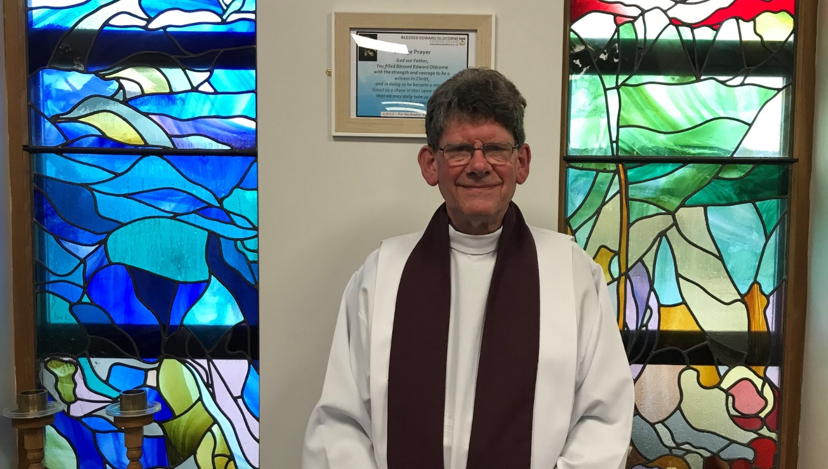
PLEASE SIT DOWN
HOMILY Fr. Stephen
Notes:
28

Slide 29
WE RESPOND
We respond by having a few moments of stillness, reflecting on what we have just heard and how it relates to us.
We sit silently as we prepare to listen to our Prayers of Intention.
We focus on the words of each prayer and ask God to come into our lives.
A.M.D.G. – For the Greater Glory of God

Slide 30
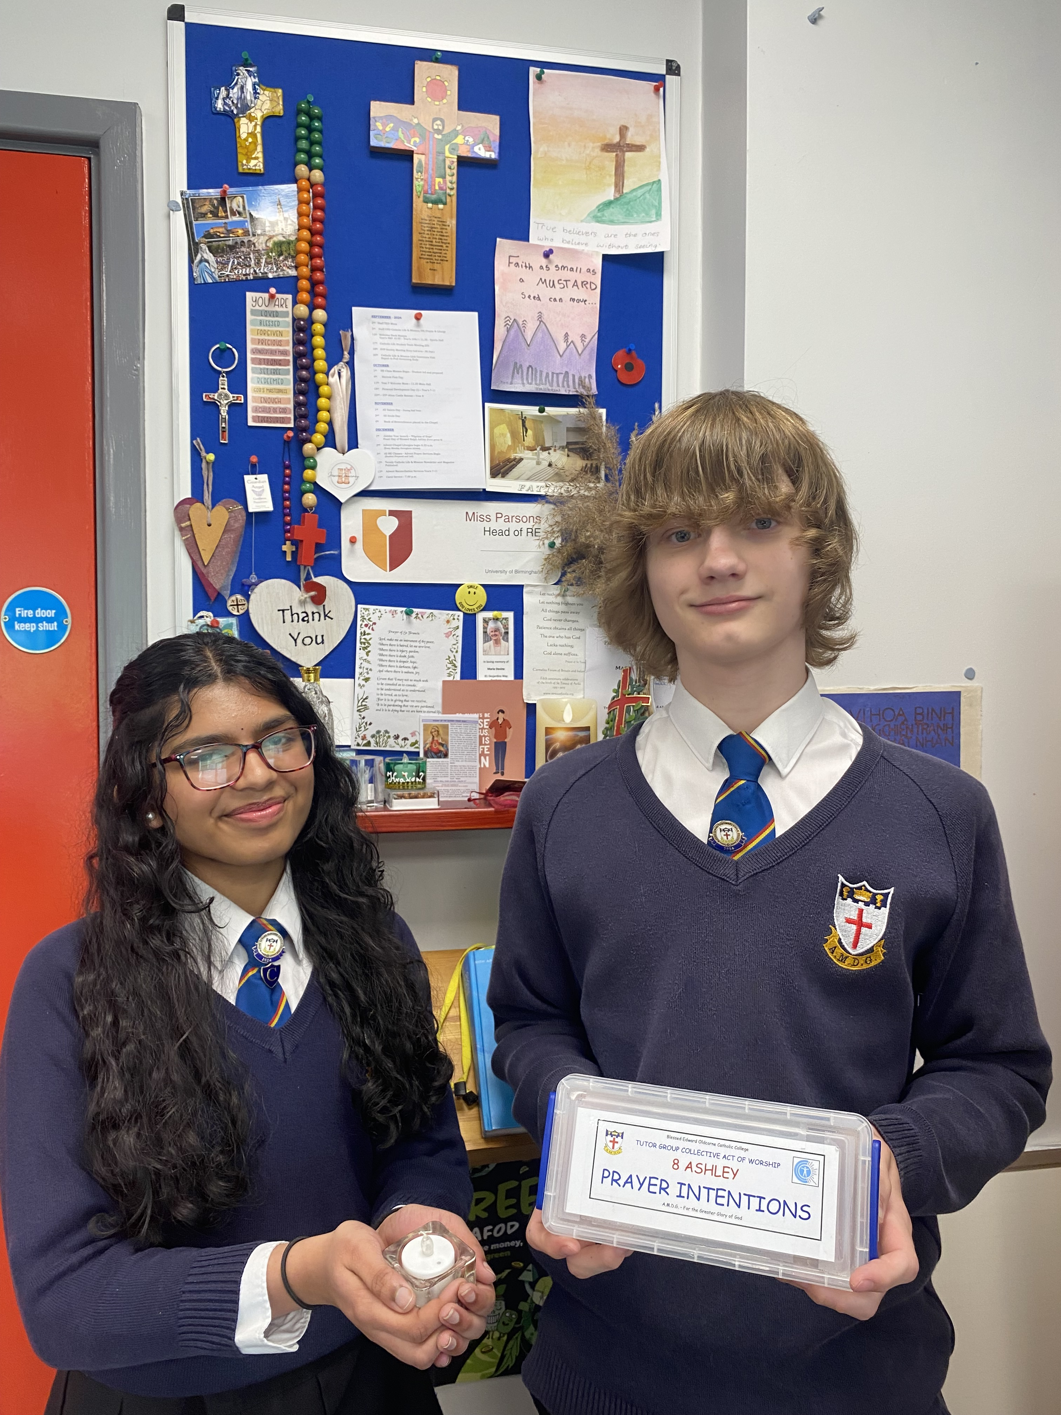
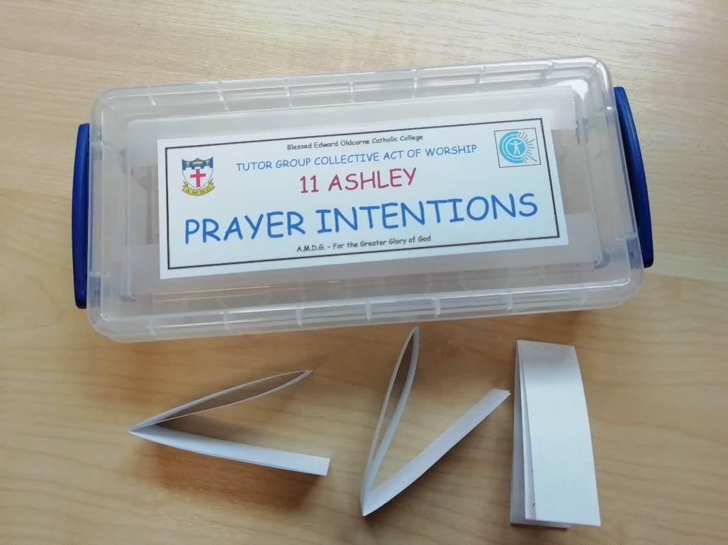
PRAYERS OF INTENTION
BIDDING PRAYERS

Slide 31

We pray for those who lead the Church, especially our Pope, Leo, whom you chose as successor of St. Peter and shepherd of your flock.
We also pray for Bernard our Archbishop and Fr. Stephen our college chaplain.
Lord hear us
LORD GRACIOUSLY HEAR US

Slide 32

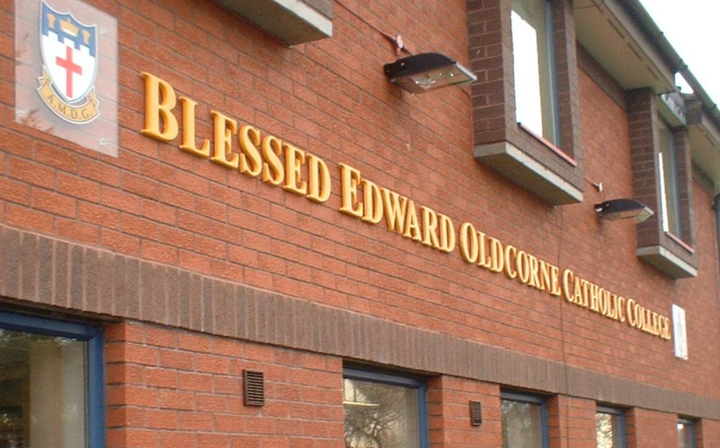
2.
We pray for all our new Year 7 students and any new members of staff who have joined our community this academic year.
May they all continue to grow in faith and follow Jesus’ command to love one another.
Lord in your mercy
HEAR OUR PRAYER.

Slide 33
3. We pray to our Father in heaven, that in this Jubilee Year, we may be inspired to renew our faith, increase our hope and ignite our love.
Encourage us to become Pilgrims of Hope, bringing joy and peace to the world.
Lord hear us
LORD GRACIOUSLY HEAR US

Slide 34
4. We pray for the weak and vulnerable, for those who depend on others to care for them.
We pray for the sick and those in despair, especially those caught up in regions of the world experiencing war and unrest.
Help us to be encouragers and advocates for those who can’t speak up for themselves.
Lord hear us
LORD GRACIOUSLY HEAR US

Slide 35
5. We pray for our college community,
and that Jesus Christ,
and the teachings of his Church, may always be at the centre of our school.
We pray that we will be inspired to continue to give witness to our faith and remember that everything we do is for ‘The Greater Glory of God.’
Lord hear us
LORD GRACIOUSLY HEAR US

Slide 36

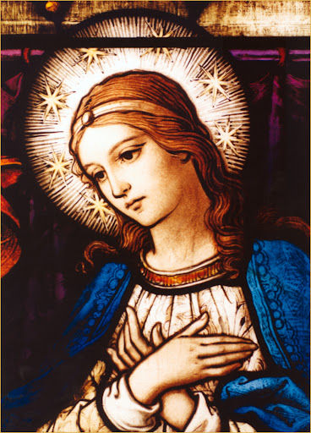
6. We pray for Mary, the Mother of God. Let us never fail to acknowledge the unconditional love that she bestows upon us as we all say together -
Hail Mary, full of grace, The Lord is with thee. Blessed art thou among women, and blessed is the fruit of thy womb, Jesus. Holy Mary, Mother of God, Pray for us sinners, Now and at the hour of our death. Amen.

Slide 37

WELCOME BACK MASS

Slide 38
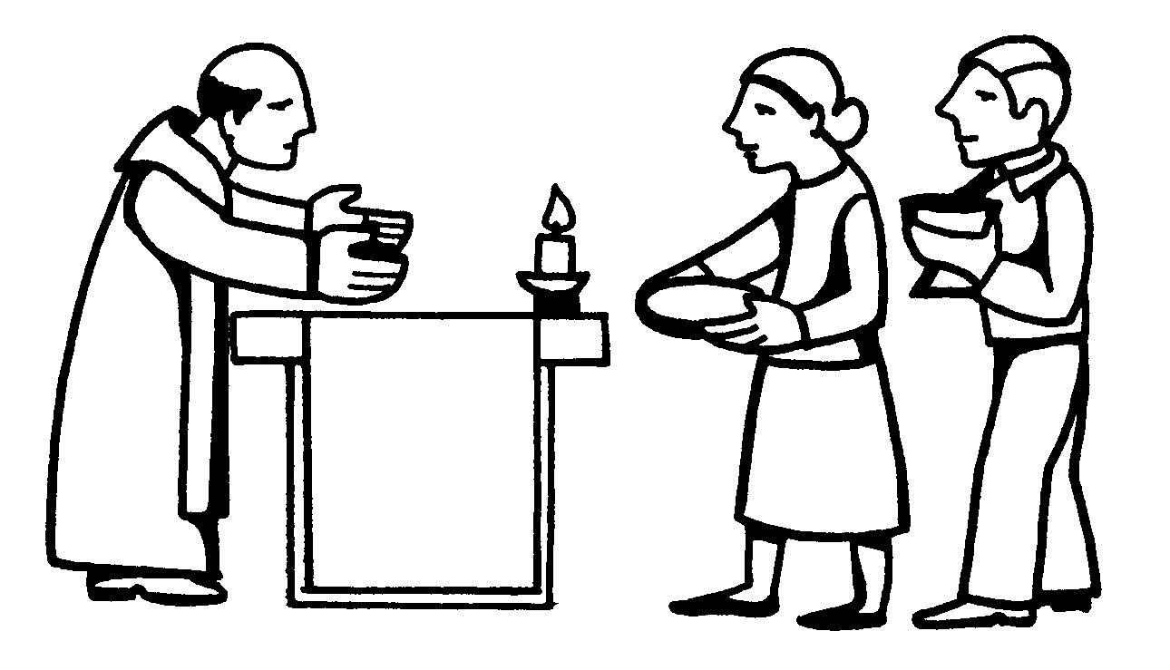
THE OFFERTORY

Slide 39
THE OFFERTORY
The gifts of bread and wine are brought to the altar.
The Priest blesses the bread and wine so that they become the body and blood of Jesus.
Together, we approach Calvary and the Upper Room, we come to Christ’s Real Presence, as he comes to us.
A.M.D.G. – For the Greater Glory of God

Slide 40

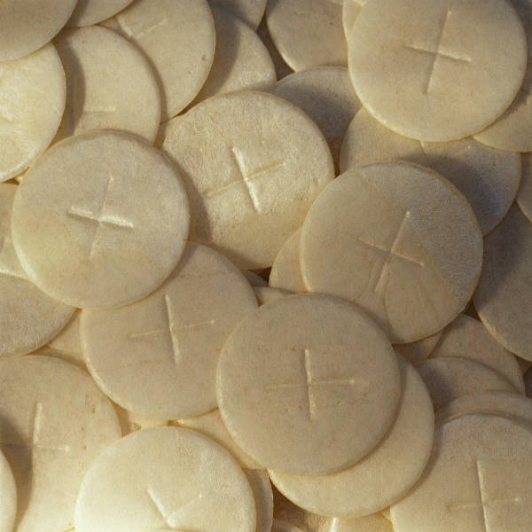
OFFERTORY HYMN
REMEMBRANCE
I take the bread of life
Broken for all my sin
Your body crucified
To make me whole again.
A.M.D.G. – For the Greater Glory of God

Slide 41
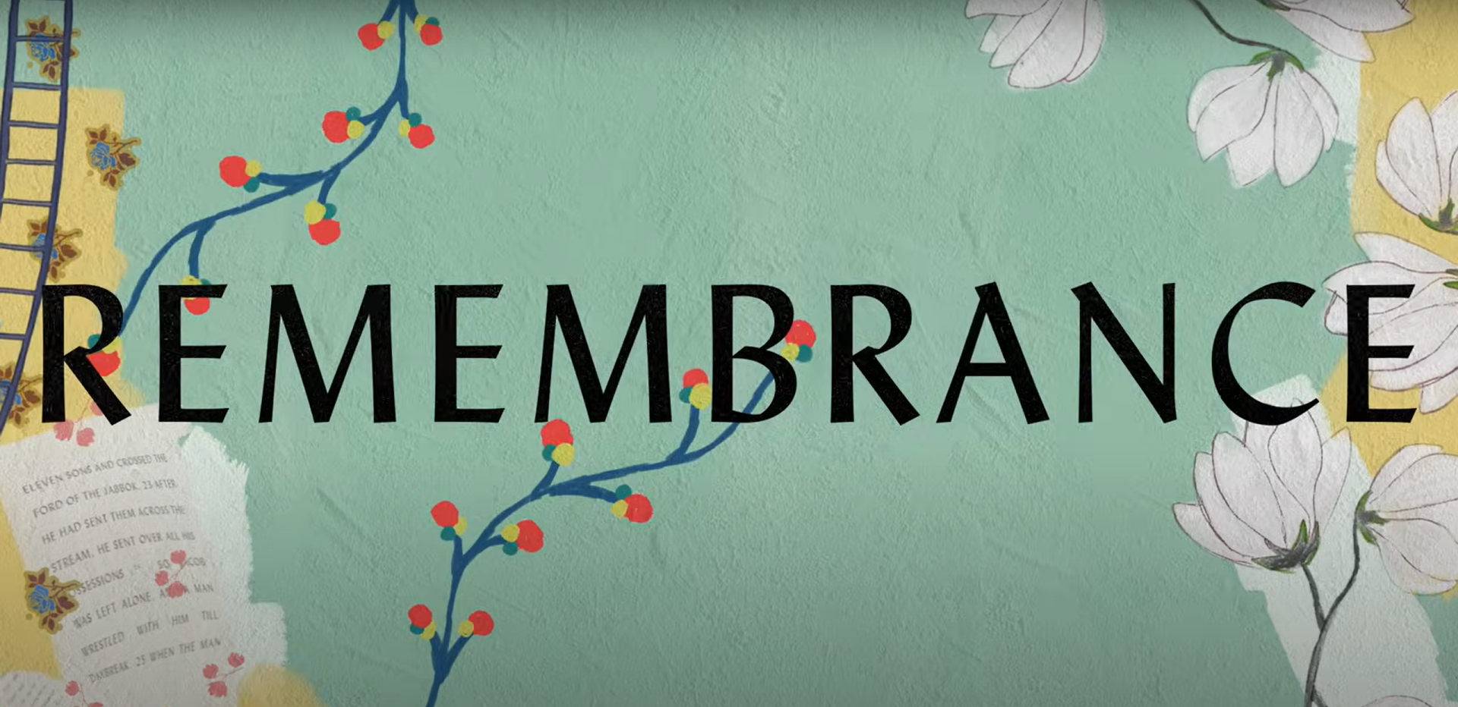
I will recall the cup
Poured out in sacrifice
To trade this sinner's end
For Your new covenant.
A.M.D.G. – For the Greater Glory of God

Slide 42
REMEMBRANCE
Hallelujah
I'll live my life in remembrance
Hallelujah,
Your promise I won't forget.
A.M.D.G. – For the Greater Glory of God

Slide 43
I'll walk salvation's road
With fear and trembling
Your way borne as my own
As Christ is formed in me.
A.M.D.G. – For the Greater Glory of God

Slide 44
REMEMBRANCE
Hallelujah
I'll live my life in remembrance
Hallelujah,
Your promise I won't forget.
A.M.D.G. – For the Greater Glory of God

Slide 45
If ever I should lose my way
If ever I deny Your grace
Remind me of the price You paid
Hallelujah,
I'll live in remembrance.
A.M.D.G. – For the Greater Glory of God

Slide 46
REMEMBRANCE
You've been so, so good to me
You've been so, so good to me
Oh to think where I would be
If not for You
If not for You.
x3
A.M.D.G. – For the Greater Glory of God

Slide 47
As far as heights reach from the depths
As far as east is from the west
So far Your grace has carried me.
A.M.D.G. – For the Greater Glory of God

Slide 48
REMEMBRANCE
Until I see You face to face
Until at last I've won my race
Remind me You're not finished yet.
A.M.D.G. – For the Greater Glory of God

Slide 49
Hallelujah,
Hallelujah,
Hallelujah,
I'll live in remembrance.
A.M.D.G. – For the Greater Glory of God

Slide 50
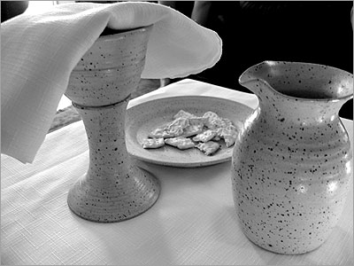
LITURGY OF THE EUCHARIST

Slide 51
Pray my brothers and sisters that my sacrifice and yours may be acceptable to God, the almighty Father.
May the Lord accept the sacrifice at your hands, for the praise and glory of his name, for our good and the good of all his holy Church.

Slide 52

WELCOME BACK MASS

Slide 53
THE EUCHARISTIC PRAYER
The Lord be with you. And with your spirit
Lift up your hearts. We lift them up to the Lord.
Let us give thanks to the Lord our God. It is right and just.

Slide 54
WELCOME BACK MASS
A.M.D.G. For the Greater Glory of God

Slide 55
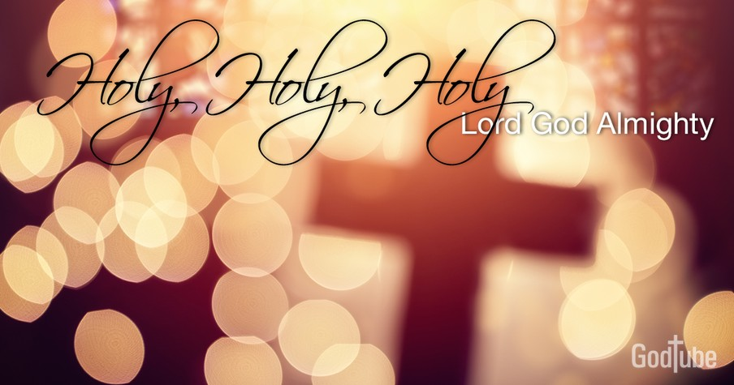
HOLY, HOLY, HOLY IS THE LORD
Holy, holy, holy is the Lord, holy is the Lord God almighty! Holy, holy, holy is the Lord, holy is the Lord God almighty! Who was and is, and is to come; holy, holy, holy is the Lord.

Slide 56
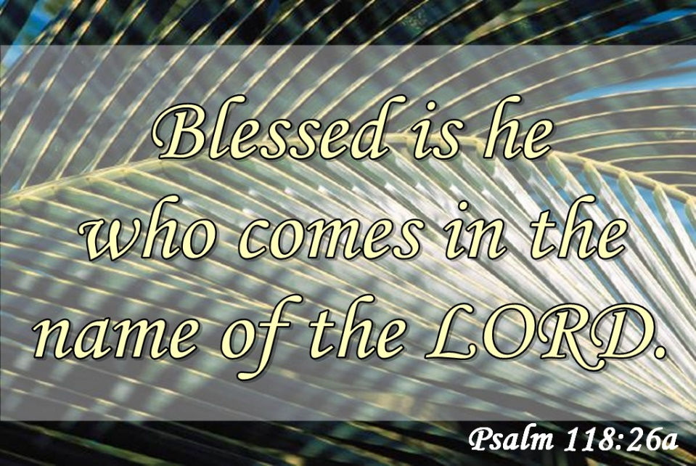
Blessed, blessed, blest is he who comes, Blest is he who comes in the Lord’s name.
Blessed, blessed, blest is he who comes, Blest is he who comes in the Lord’s name.
Hosanna in the heights of heav’n. Blessed, blessed, blessed is the Lord.

Slide 57
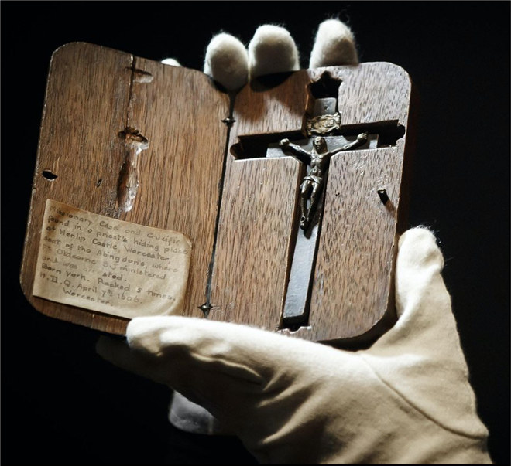
WELCOME BACK MASS

Slide 58
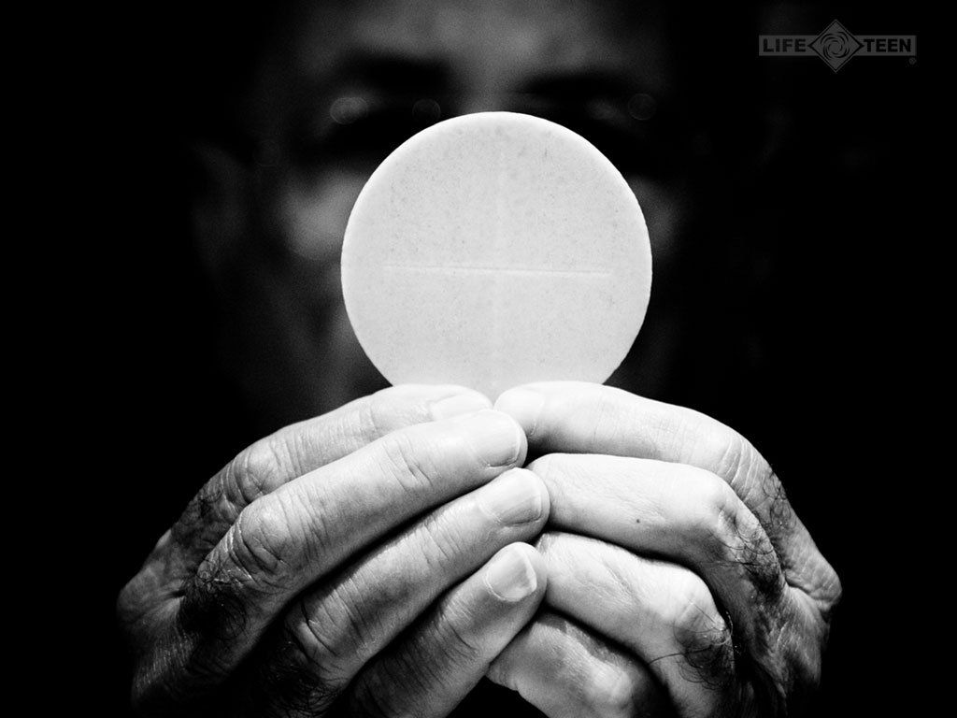
TAKE THIS ALL OF YOU AND EAT OF IT:
FOR THIS IS MY BODY WHICH WILL BE GIVEN UP FOR YOU.

Slide 59
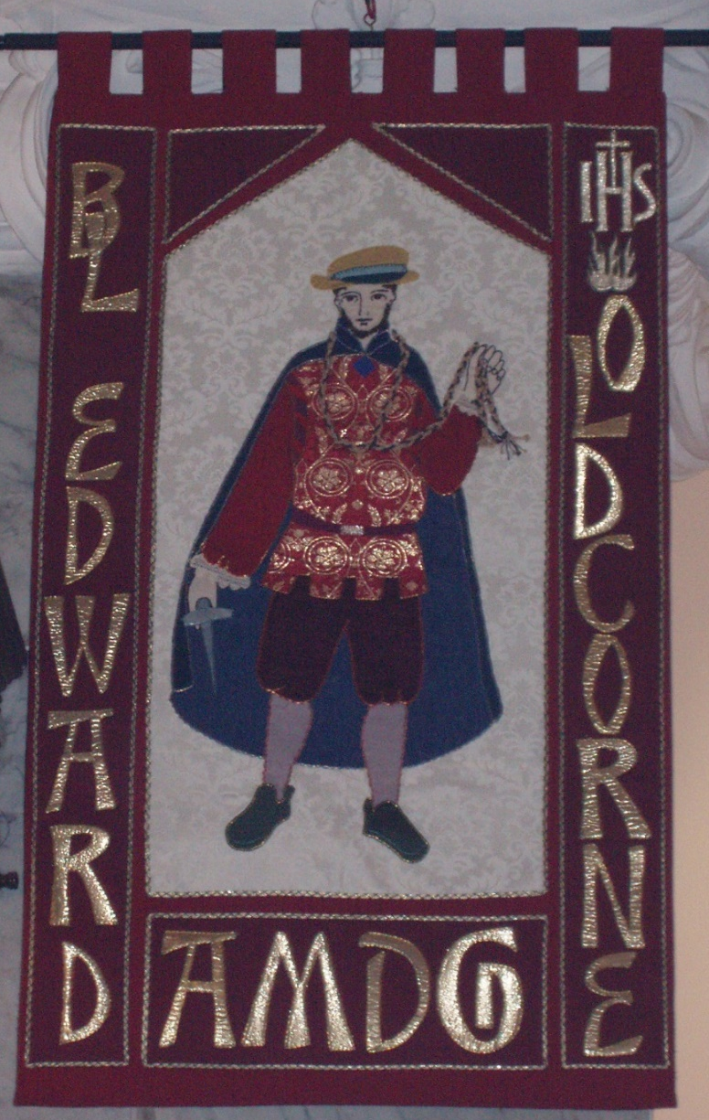
WELCOME BACK MASS
A.M.D.G. - For the Greater Glory of God

Slide 60

Take this all of you and drink from it: For this is the chalice of my blood, the blood of the new and eternal covenant, which will be poured out for you and for many for the forgiveness of sins.
Do this in memory of me.

Slide 61
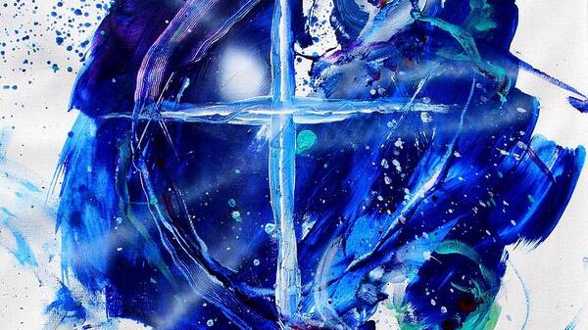
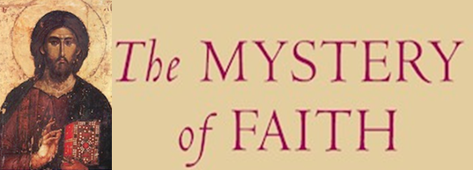
We proclaim your death O Lord and profess your resurrection until you come again, until you come again.
(Repeat)
We proclaim your death O Lord and profess your resurrection until you come again, until you come again.
First verse = solo

Slide 62
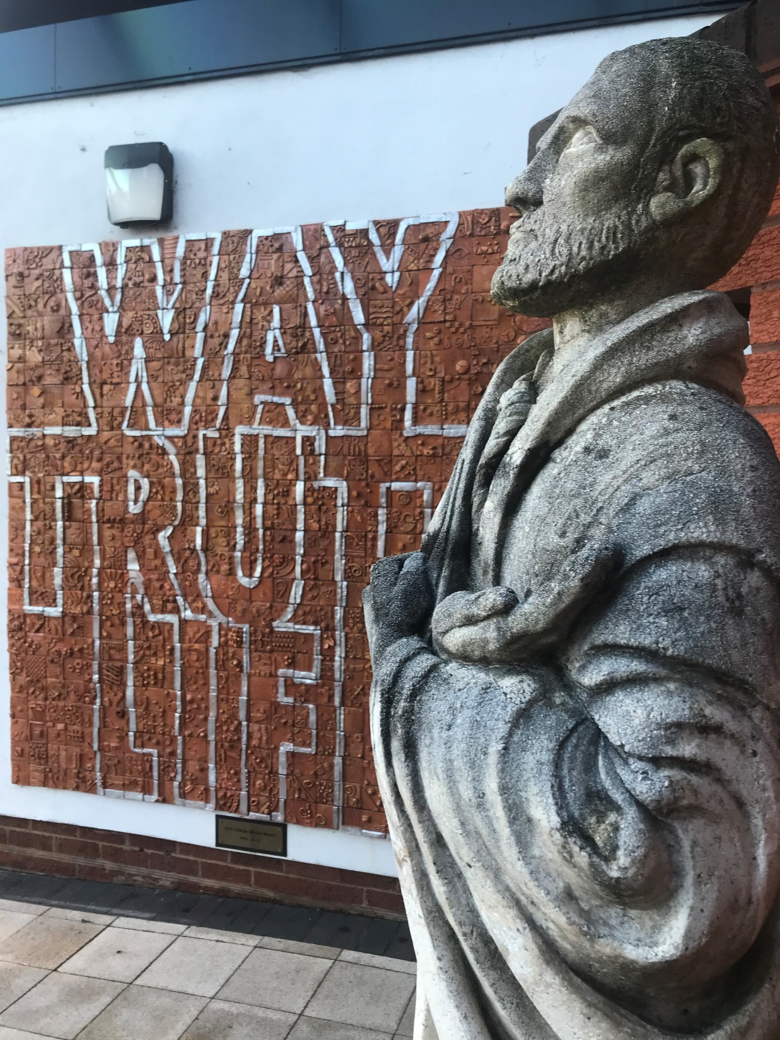
WELCOME BACK MASS
A.M.D.G. - For the Greater Glory of God

Slide 63
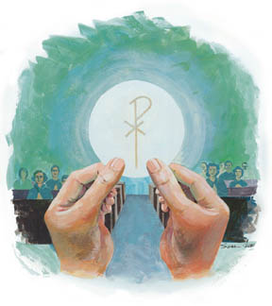
Through him, and with him, and in him, O God, almighty Father, in the unity of the Holy Spirit, all glory and honour is yours, for ever and ever.
SUNG
Amen. We lift our hearts and voices to you, as we sing, Amen, so shall it be forever Amen. (Repeat)

Slide 64
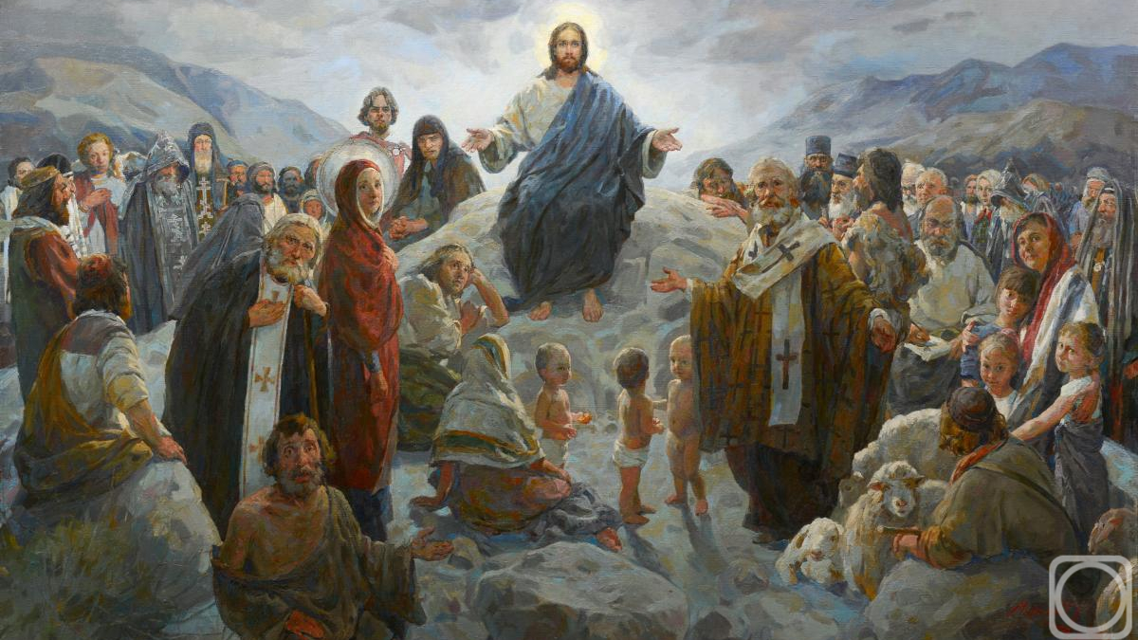
PLEASE STAND
At the Saviour’s command and formed by divine teaching, we dare to say:
Our Father, who art in heaven, hallowed be thy name; thy Kingdom come; thy will be done on earth as it is in heaven. Give us this day our daily bread, and forgive us our trespasses as we forgive those who trespass against us, and lead us not into temptation, but deliver us from evil.

Slide 65

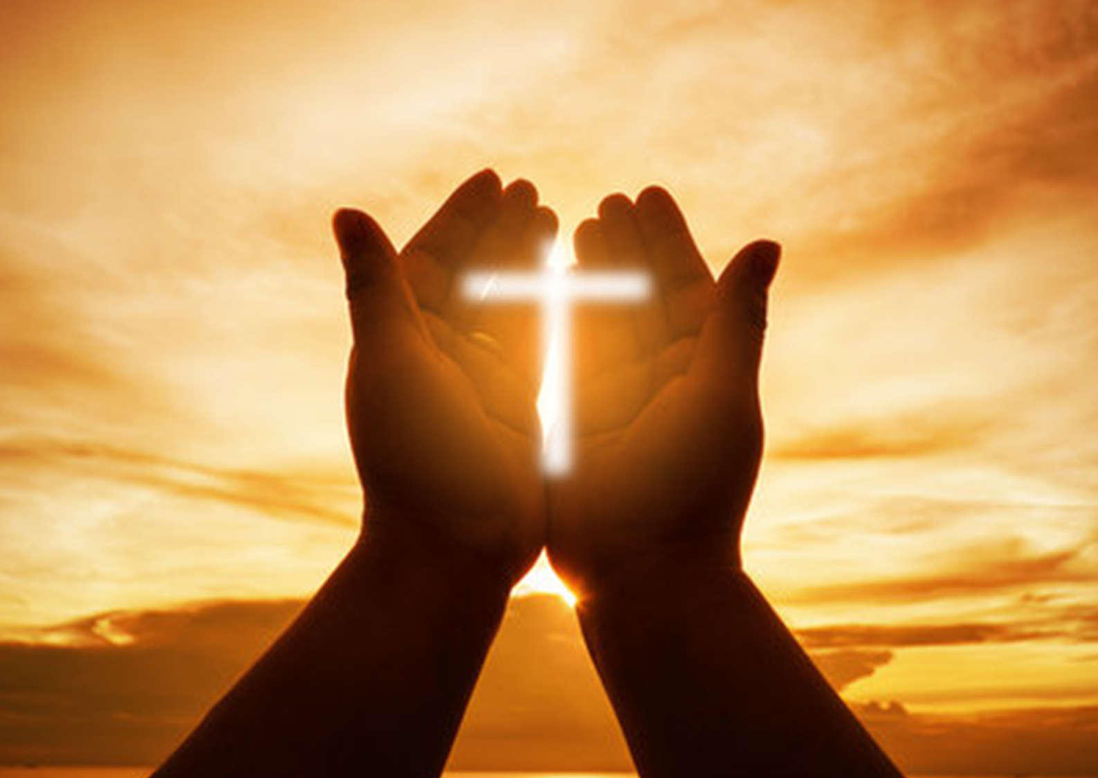
Deliver us Lord, we pray, from every evil, graciously grant peace in our days, that, by the help of your mercy, we may be always free from sin and safe from all distress as we await the blessed hope and the coming of our Saviour, Jesus Christ.
FOR THE KINGDOM,THE POWER AND THE GLORY ARE YOURS, NOW AND FOREVER.

Slide 66

Lord Jesus Christ, who said to your apostles: Peace I leave you, my peace I give you; look not on our sins, but on the faith of your Church and graciously grant her peace and unity in accordance with your will. Who live and reign for ever and ever.
AMEN.

Slide 67

The peace of the Lord be with you always.
AND WITH YOUR SPIRIT.

Slide 68
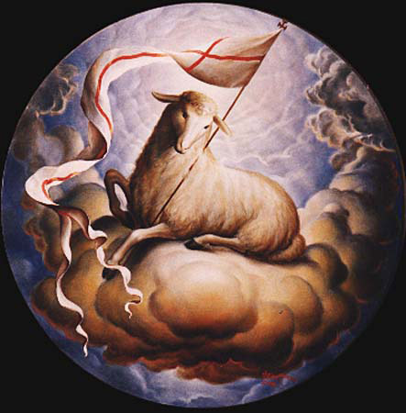
LAMB OF GOD
Lamb of God, Lamb of God,
you take away, you take away,
the sins of all, the sins of all,
the world, the world,
Miserere nobis, miserere nobis.

Slide 69
LAMB OF GOD
Lamb of God, Lamb of God,
you take away, you take away,
the sins of all, the sins of all,
the world, the world,
Miserere nobis, miserere nobis.

Slide 70
LAMB OF GOD
Lamb of God, Lamb of God,
you take away, you take away,
the sins of all, the sins of all,
the world, the world,
Dona Nobis Pacem, Dona Nobis Pacem.

Slide 71
Behold the Lamb of God, behold him who takes away the sins of the world. Blessed are those called to the supper of the Lamb.
Lord, I am not worthy that you should enter under my roof but only say the word and my soul shall be healed.

Slide 72
COMMUNION
We will now share communion together by either receiving the Body of Jesus or a blessing.
This symbolises spiritual nourishment and forgiveness of sins through Christ’s sacrifice.
Mr. McCormack will now outline the arrangements and how we should respond during communion.
PLEASE SIT DOWN
A.M.D.G. – For the Greater Glory of God

Slide 73
Everyone is invited to come forward and receive either Holy Communion or a blessing.

Slide 74
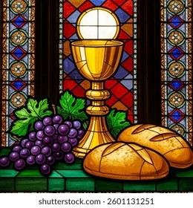
COMMUNION HYMNS
MAKE ME HOLY LORD
THIS COMMUNION

Slide 75
MAKE ME HOLY
Prepare my mind, prepare my soul, prepare my heart and make me whole, prepare me for the awesomeness of you.
Renew in me a spirit strong, remind me Lord of all that’s wrong, create in me complete desire for you.

Slide 76
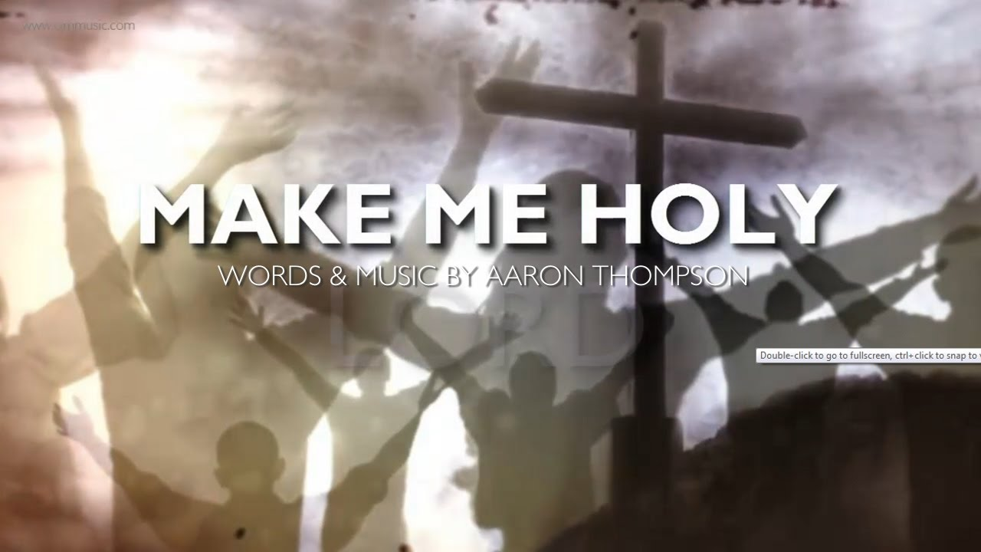
Make me Holy Lord, Make me Holy Lord, Make me Holy Lord, Like you.

Slide 77

Consume my mind, consume my soul, consume my heart and make me whole, consume me with the awesomeness of you.
Destroy the pride, destroy the hate, destroy the things that separate and keep me from returning back to you.

Slide 78
Make me Holy Lord, Make me Holy Lord, Make me Holy Lord, Like you.

Slide 79
Restore my mind Restore my soul, restore my heart and make it whole, restore me with the awesomeness of you.
Redecorate me from within, refurnish me with sacredness, rebuild me with a yearning love for you.

Slide 80
Make me Holy Lord, Make me Holy Lord, Make me Holy Lord, Like you. x2

Slide 81
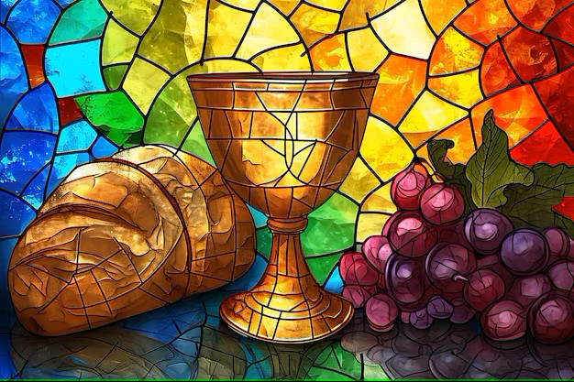
THIS IS COMMUNION
This is communion, Your body broken
The cup we're drinking is bittersweet
The gift of friendship, truest salvation
Borne of Your suffering on Calvary.
We remember the sacrifice of love
We remember the blood poured out for us
We remember the only Son of God upon the cross.

Slide 82
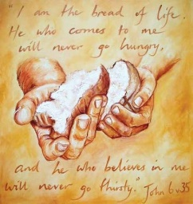
From stained to spotless, from wrath to favour
Through You our Saviour, the work complete.
In full repentance, led by Your kindness
Partake of presence as we receive.
We remember the sacrifice of love
We remember the blood poured out for us
We remember the only Son of God upon the cross
We remember the price You had to pay
We remember the wounds that made a way
We remember the Lamb for all was slain upon the cross.

Slide 83
How can it be, there is a table
For all who would come, for all who would come
Taste now and see, there is a table
For all who would come, for all who would come
How can it be, there is a table (Take of the bread, receive the cup)
For all who would come (For His mercy is enough)
For all who would come (For the many and the one)
(This is communion)

Slide 84
Taste now and see, there is a table (Take it as often as you will)
For all who would come (For His blood has power still)
For all who would come (By His wounds we shall be healed)
This is communion
x3

Slide 85
We remember the sacrifice of love
We remember the blood poured out for us
We remember the only Son of God upon the cross
We remember the price You had to pay
We remember the wounds that made a way
We remember the Lamb for all was slain upon the cross.

Slide 86
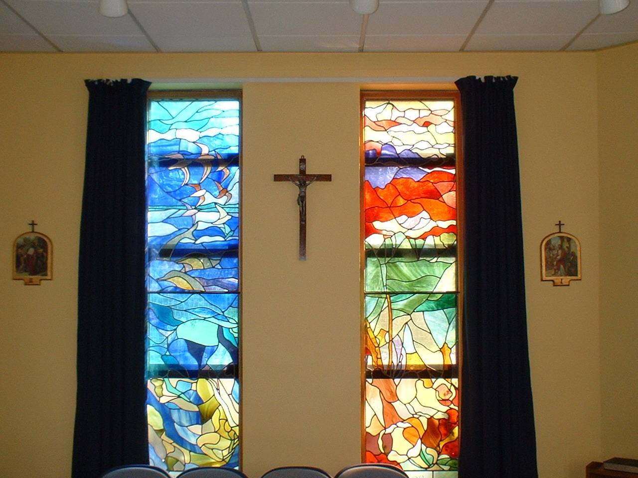
Sit still and pray for your own private intentions
Think of one thing or one person that you would like to pray for…
Notes:
86

Slide 87
MISSION
WE GO FORTH
We thank you Lord for watching over us during the summer holidays.
During this academic year, gift us with open hearts to seek you and proclaim your word.
We are sent forth from this Mass, taking Christ and his blessing with us into every encounter.
A.M.D.G. – For the Greater Glory of God

Slide 88
PLEASE STAND
LET US PRAY

Slide 89
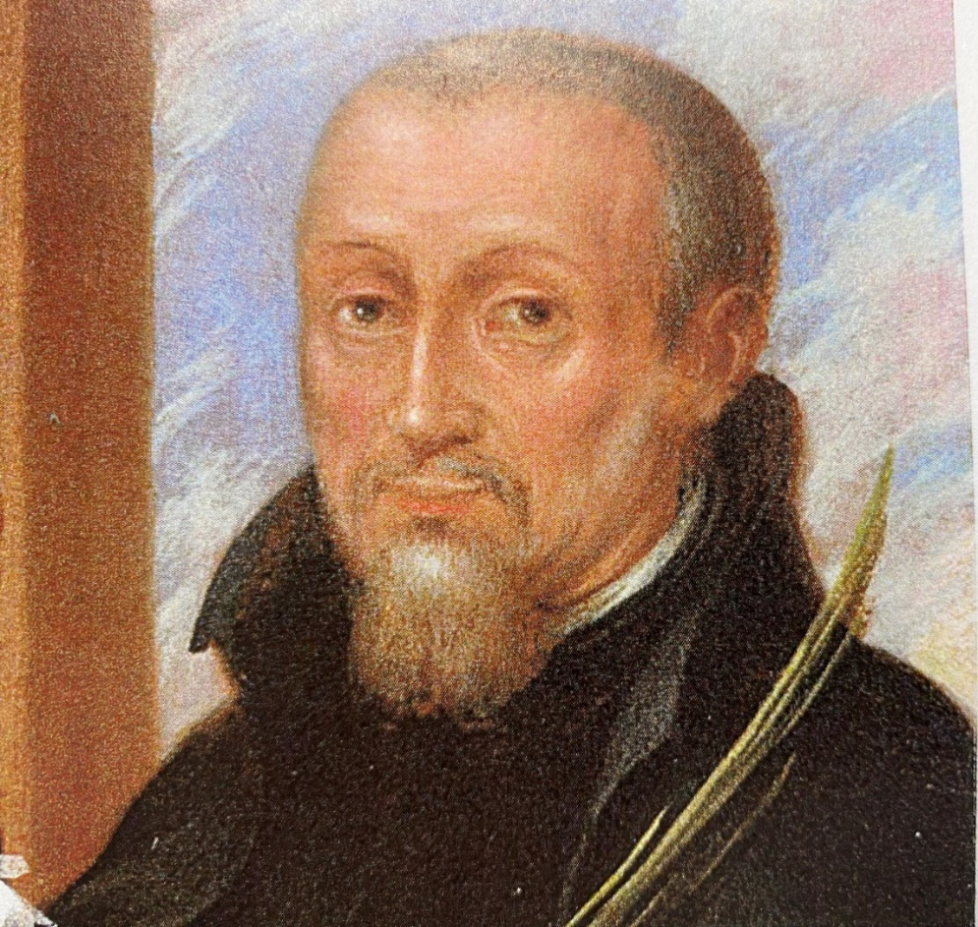
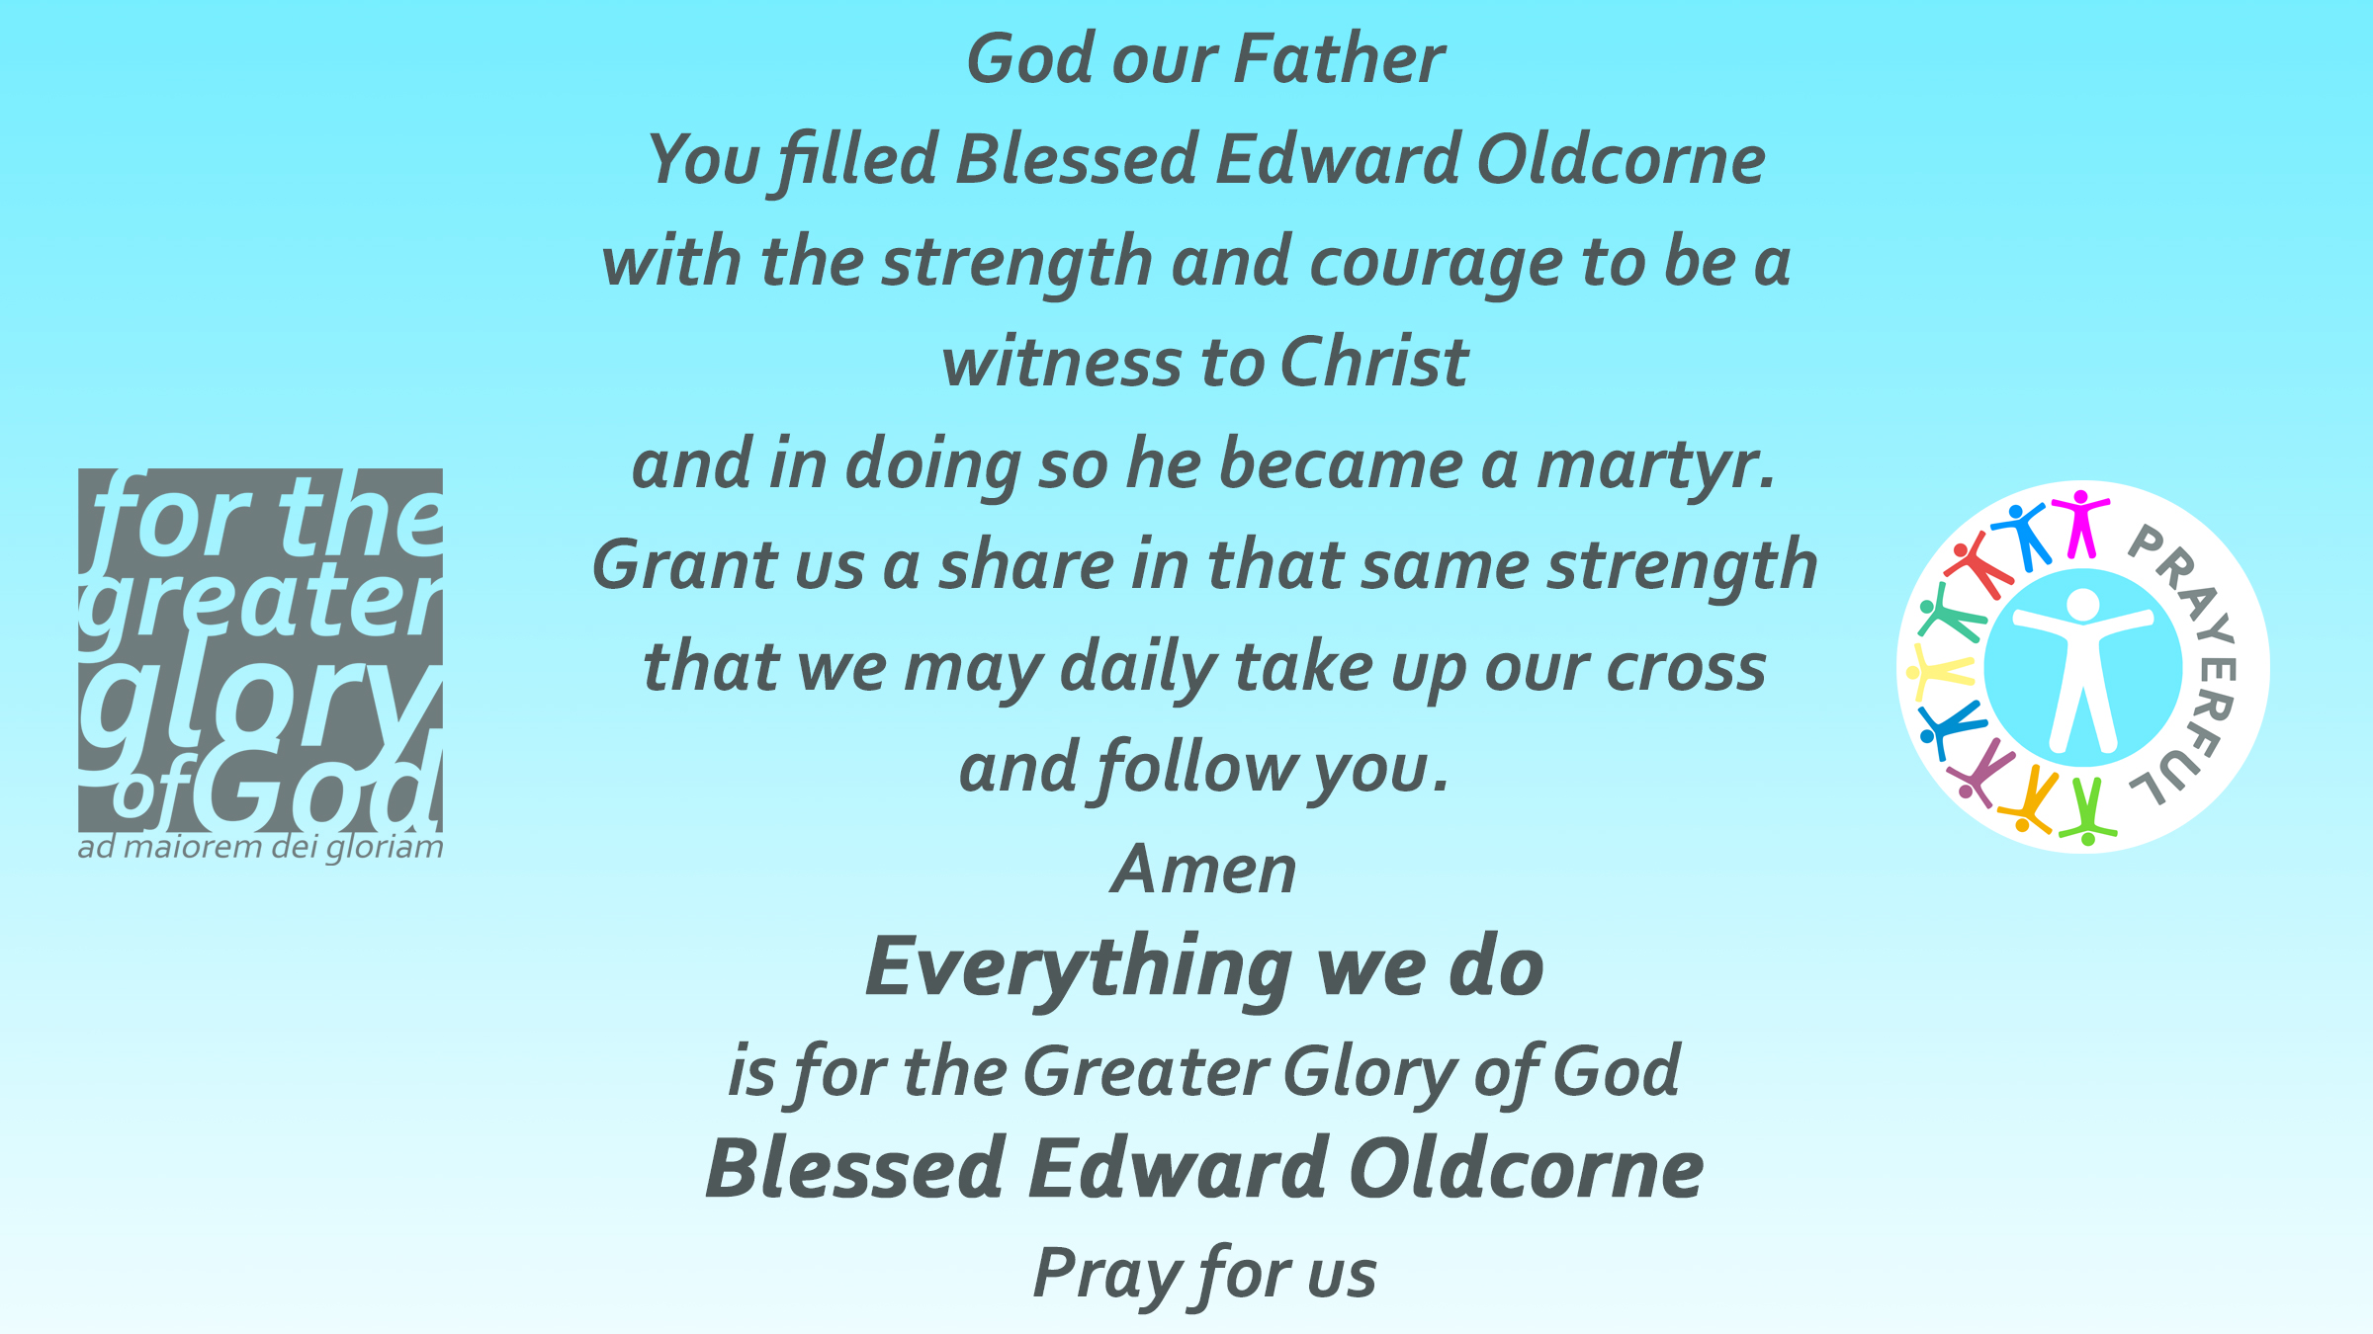
COLLEGE PRAYER

Slide 90

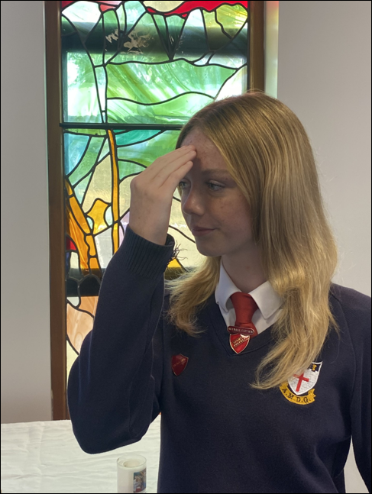
Olivia Owen - Head Girl
The Lord be with you.
AND WITH YOUR SPIRIT.
May almighty God bless you, the Father, and the Son, and the Holy Spirit.
AMEN.

Slide 91
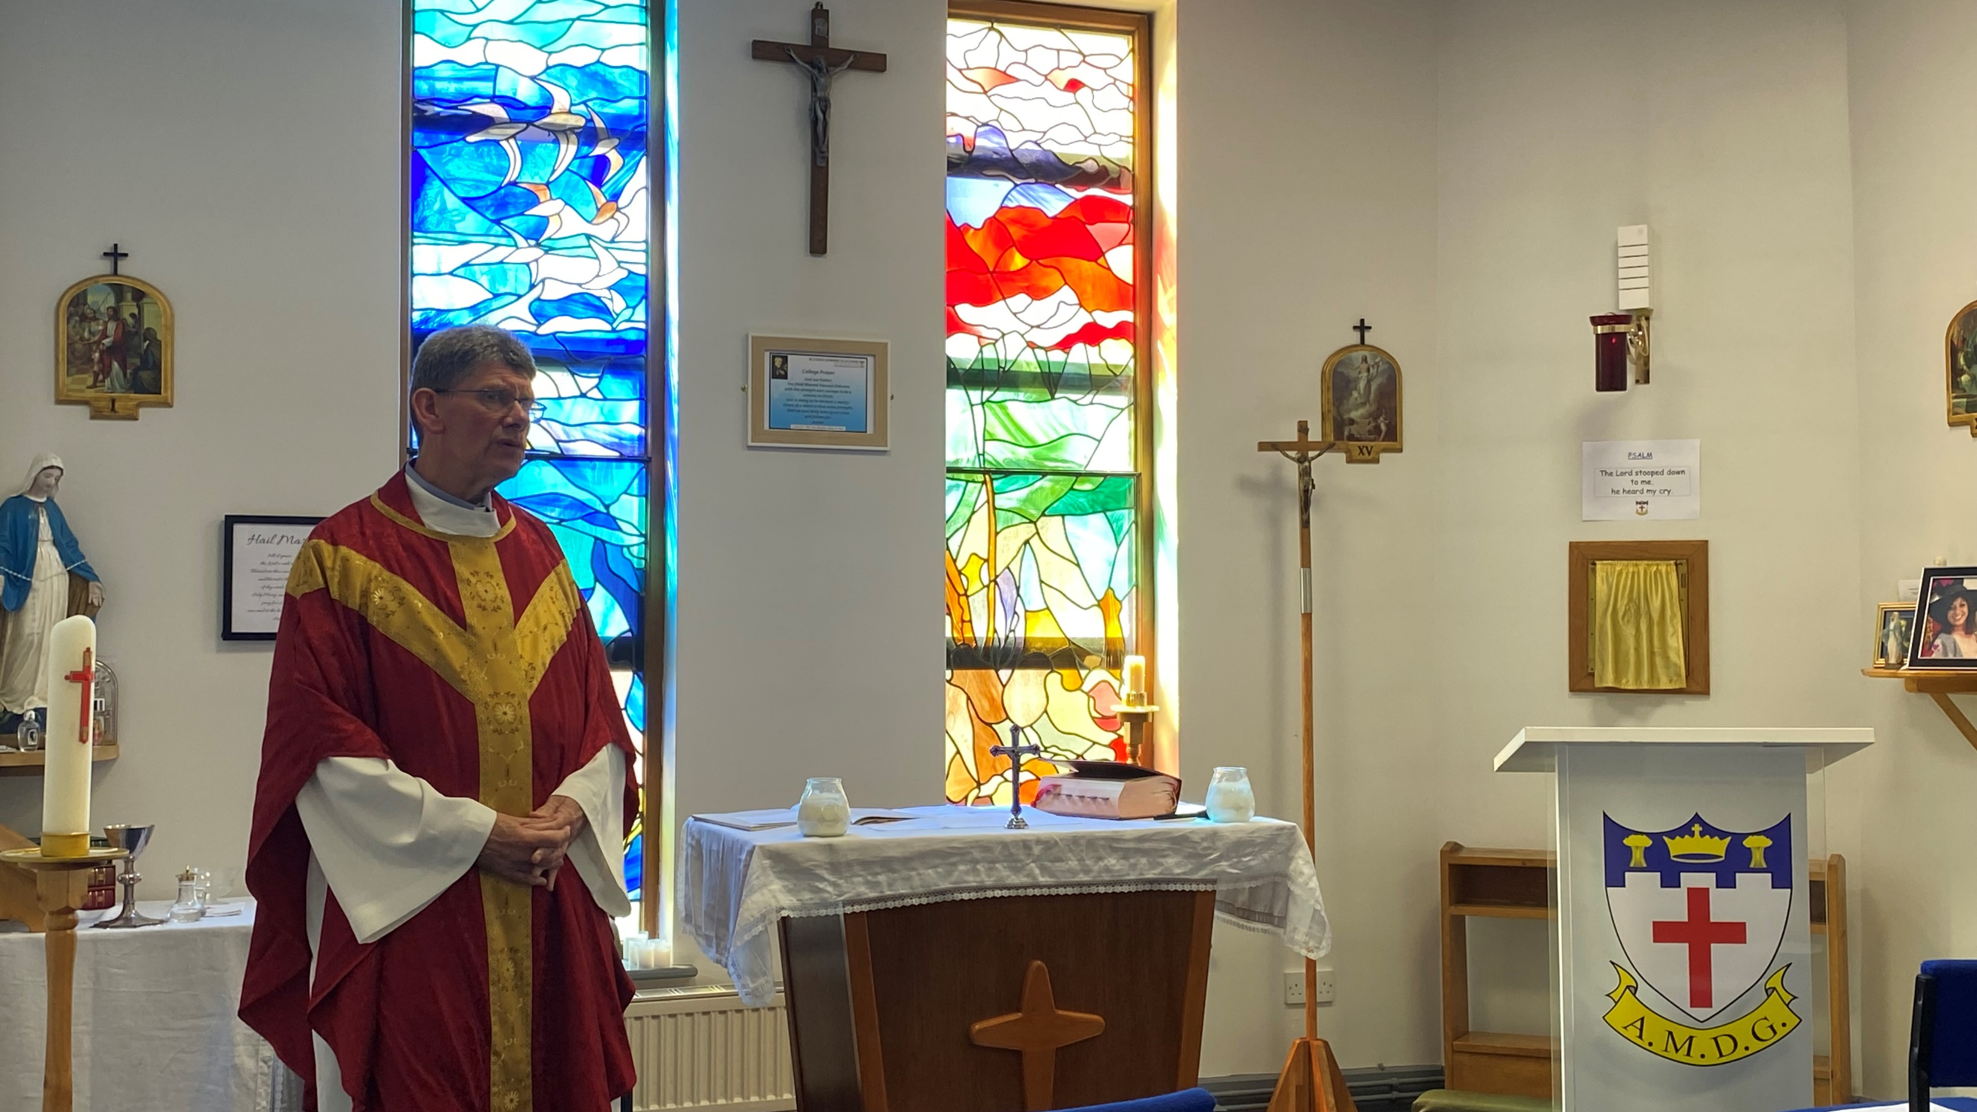
Go in peace, glorifying the Lord by your life.
THANKS BE TO GOD.

Slide 92
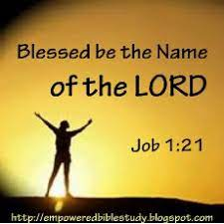
BLESSED BE THE NAME OF THE LORD
Blessed be your name in a land that is plentiful, where your streams of abundance flow, Blessed be your name.
Blessed be your name, when I’m found in the desert place, though I walk through wilderness, Blessed be your name.

Slide 93
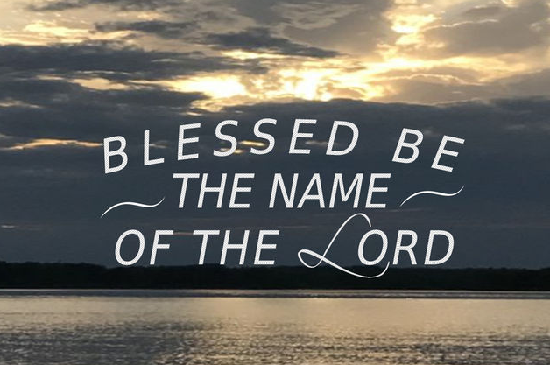
Every blessing you pour out I’ll turn back to praise. When the darkness closes in, Lord, still I will say,
Blessed be the name of the Lord, Blessed be your name Blessed be the name of the Lord Blessed be your glorious name.

Slide 94
Blessed be your name When the sun’s shining down on me When the world’s all as it should be Blessed be your name.
Blessed be your name On the road marked with suffering Though there’s pain in the offering Blessed be your name.

Slide 95
Every blessing you pour out I’ll turn back to praise. When the darkness closes in, Lord, still I will say,
Blessed be the name of the Lord, Blessed be your name Blessed be the name of the Lord Blessed be your glorious name.

Slide 96
You give and take away You give and take away My heart will choose to say Lord blessed be your name. x2
Blessed be the name of the Lord, Blessed be your name Blessed be the name of the Lord Blessed be your glorious name. x2

Slide 97
WELCOME BACK MASS
Friday 12th September 2025

Slide 98
AMAZING GRACE
CHOIR
SING AMAZING GRACE
ON EXIT
All these pieces
Broken and scattered
In mercy gathered
Mended and whole.
Empty-handed
But not forsaken
I've been set free
I've been set free.
Amazing grace
How sweet the sound
That saved a wretch like me,
I once was lost
But now I'm found
Was blind but now I see.
You take our failure
You take our weakness
You set Your treasure
In jars of clay.
So take this heart, Lord
I'll be Your vessel
The world to see
Your life in me.
Oh, I can see it now
Oh, I can see the love in Your eyes
Laying yourself down
Raising up the broken to life.

