Slide 1



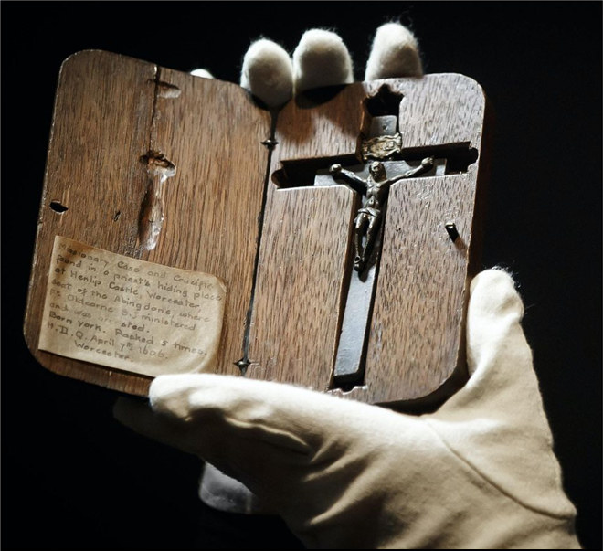
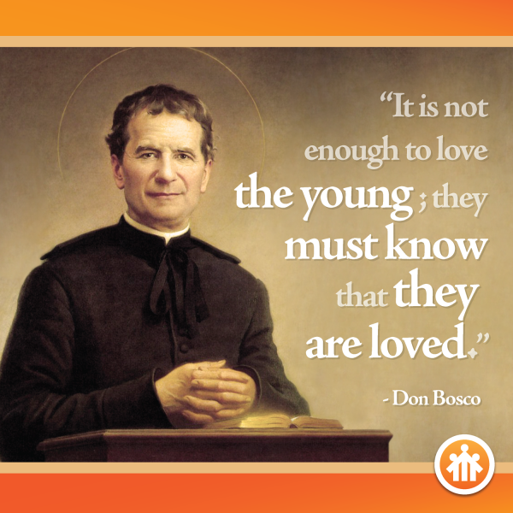
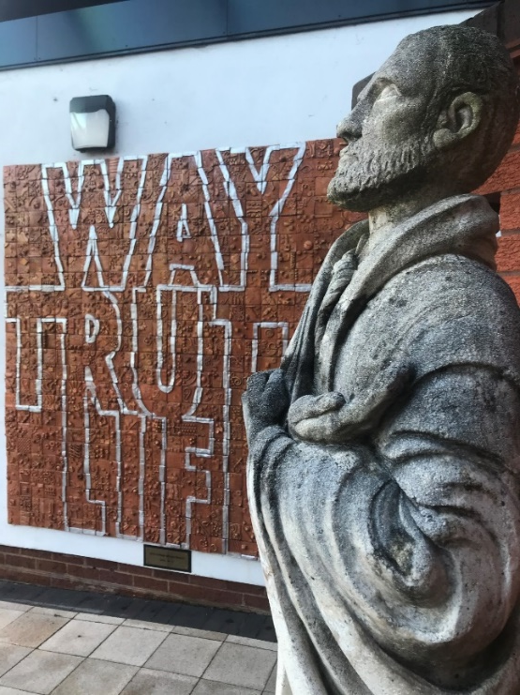
BLESSED EDWARD OLDCORNE FEAST DAY MASS
Friday 23rd January 2026
St. John Bosco Feast Day
January 31st
A.M.D.G. – For the Greater Glory of God
Notes:
1

Slide 2

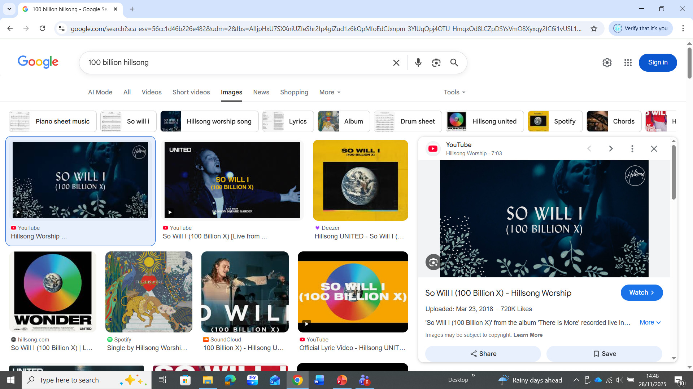

GATHERING HYMN
A.M.D.G. – For the Greater Glory of God

Slide 3
God of creation, There at the start Before the beginning of time
With no point of reference, You spoke to the dark And fleshed out the wonder of light.

Slide 4
And as you speak, A hundred billion galaxies are born, In the vapour of your breath the planets form,
If the stars were made to worship so will I,
I can see your heart in everything you’ve made, Every burning star, a signal fire of grace,
If creation sings your praises so will I.

Slide 5
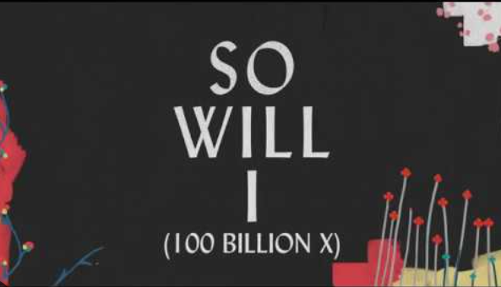
God of your promise You don’t speak in vain No syllable empty or void.
For you have spoken All nature and science Follow the sound of your voice.

Slide 6
And as you speak, A hundred billion creatures catch their breath. Evolving in pursuit of what you said, If it all reveals your nature so will I.
I can see your heart in everything you say, Every painted sky a canvas of your grace, If creation still obeys you so will I, so will I, so will I…

Slide 7
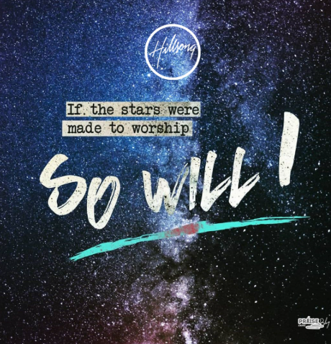
If the stars were made to worship so will I, If the mountains bow in reverence so will I, If the oceans roar your greatness so will I, For if everything exists to lift you high, so will I.
If the wind goes where you send it so will I, If the rocks cry out in silence, so will I, If the sum of all our praises still fall shy, Then we’ll sing again a hundred billion times.

Slide 8
God of salvation, You chased down my heart, through all of my failure and pride.
On a hill you created the light of the world abandoned in darkness to die.

Slide 9
And as you speak, A hundred billion failures disappear, Where you lost your life so I could find it here, If you left the grave behind you, so will I.
I can see your heart in everything you’ve done, every part designed in a work of art called love, if you gladly chose surrender so will I.

Slide 10
I can see your heart eight billion different ways, each precious one a child you died to save, if you gave your life to love them so will I.
Like you would again a hundred billion times but what measure could amount to your desire
You’re the one who never leaves the one behind. x3

Slide 11
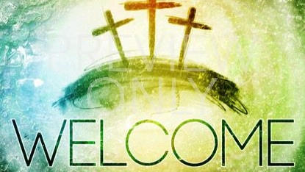
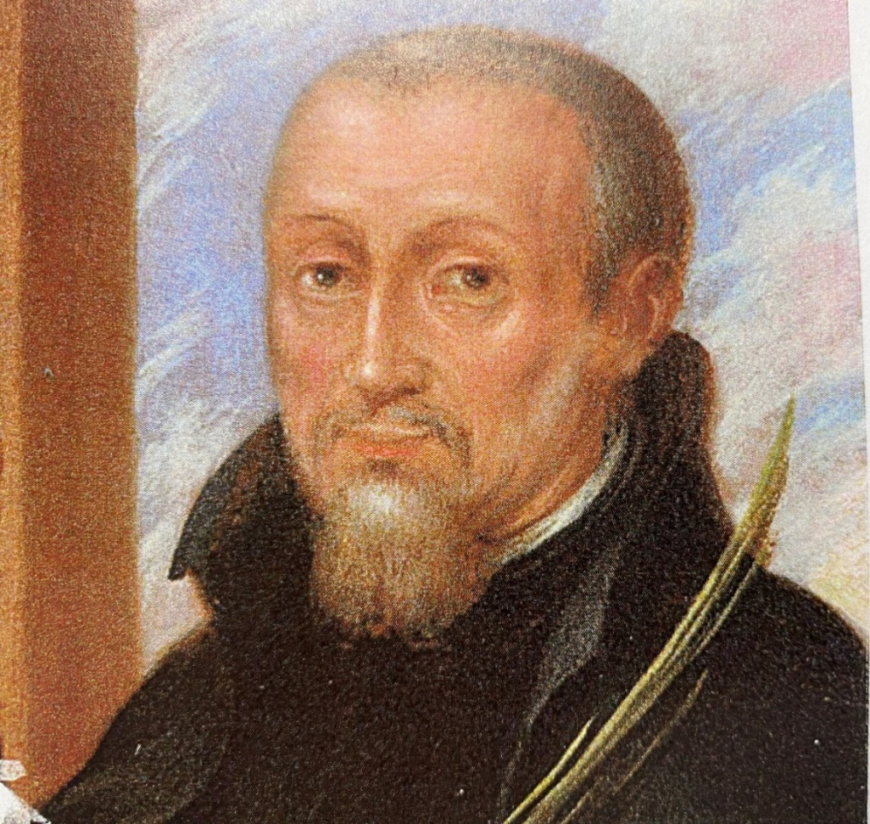


Slide 12

WE GATHER
Welcome to our Feast Day Mass, as we prepare ourselves to get closer to God.
As we gather in worship, we are reminded of our unity as God’s chosen people.
We praise and thank God as we celebrate the life of our vibrant community.
We pray that our school will continue to flourish helping to develop people of good character.
A.M.D.G. – For the Greater Glory of God

Slide 13
WE GATHER
We also gather together today to remember and celebrate the life of Blessed Edward Oldcorne
Father Edward was filled with the strength and courage to be a witness to Christ and in doing so he became a martyr.
May God’s blessings fall upon all who are part of our school community as we celebrate this Eucharist.
A.M.D.G. – For the Greater Glory of God

Slide 14
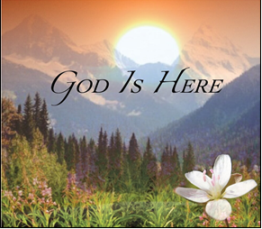
PLEASE STAND
OUR GOD IS HERE
Here in this time, here in this place, here we are standing face to face.
Here in our hearts, here in our lives, our God is here.

Slide 15
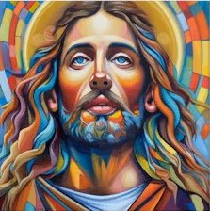
Here for the broken, here for the strong, here in this temple we belong.
Here in our hearts, here in our lives, our God is here.
And we cry:
“Holy! Holy! Holy are you!” We cry: “Holy! Holy! Holy and true!”
Amen, we do believe our God is here. Our God is here.

Slide 16
Here in the Word, God is revealed, here where the wounded can be healed.
Here in our hearts, here in our lives, our God is here.
Here we become what we receive, here in this Eucharistic feast.
We are his body, living as one; our God is here.

Slide 17
And we cry:
“Holy! Holy! Holy are you!” We cry: “Holy! Holy! Holy and true!”
Amen, we do believe our God is here. Our God is here.

Slide 18
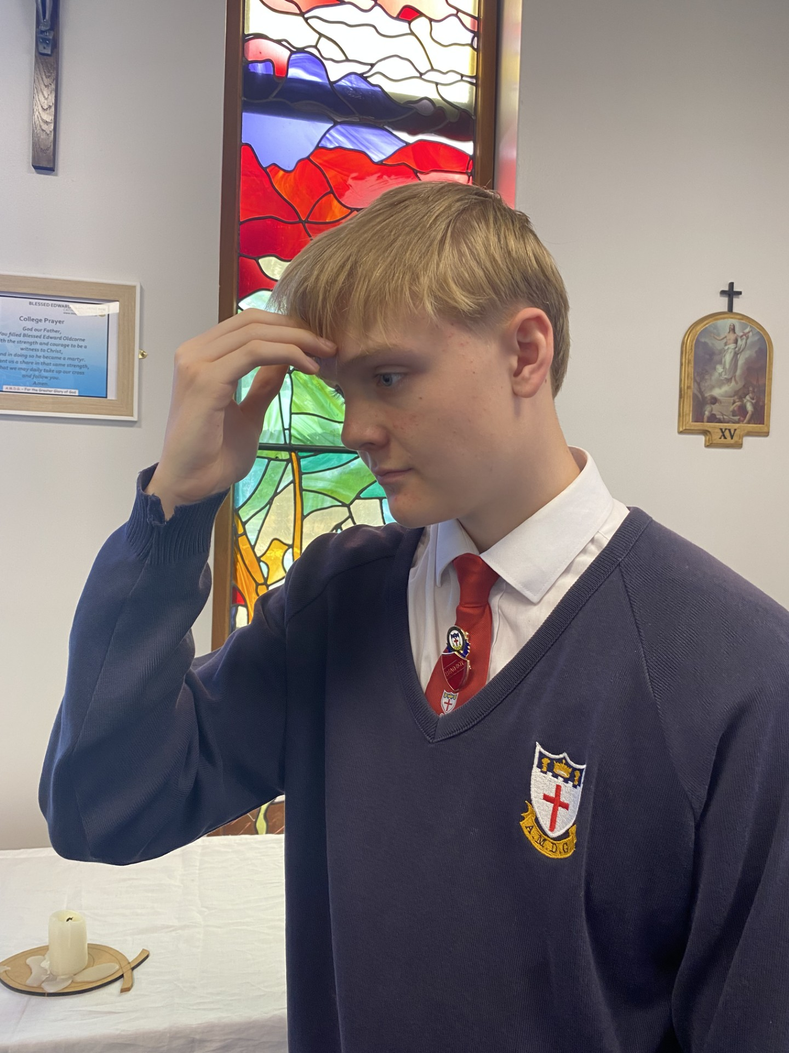

Ronan Guppy - Head Boy
In the name of the Father, and of the Son, and of the Holy Spirit,
AMEN.

Slide 19
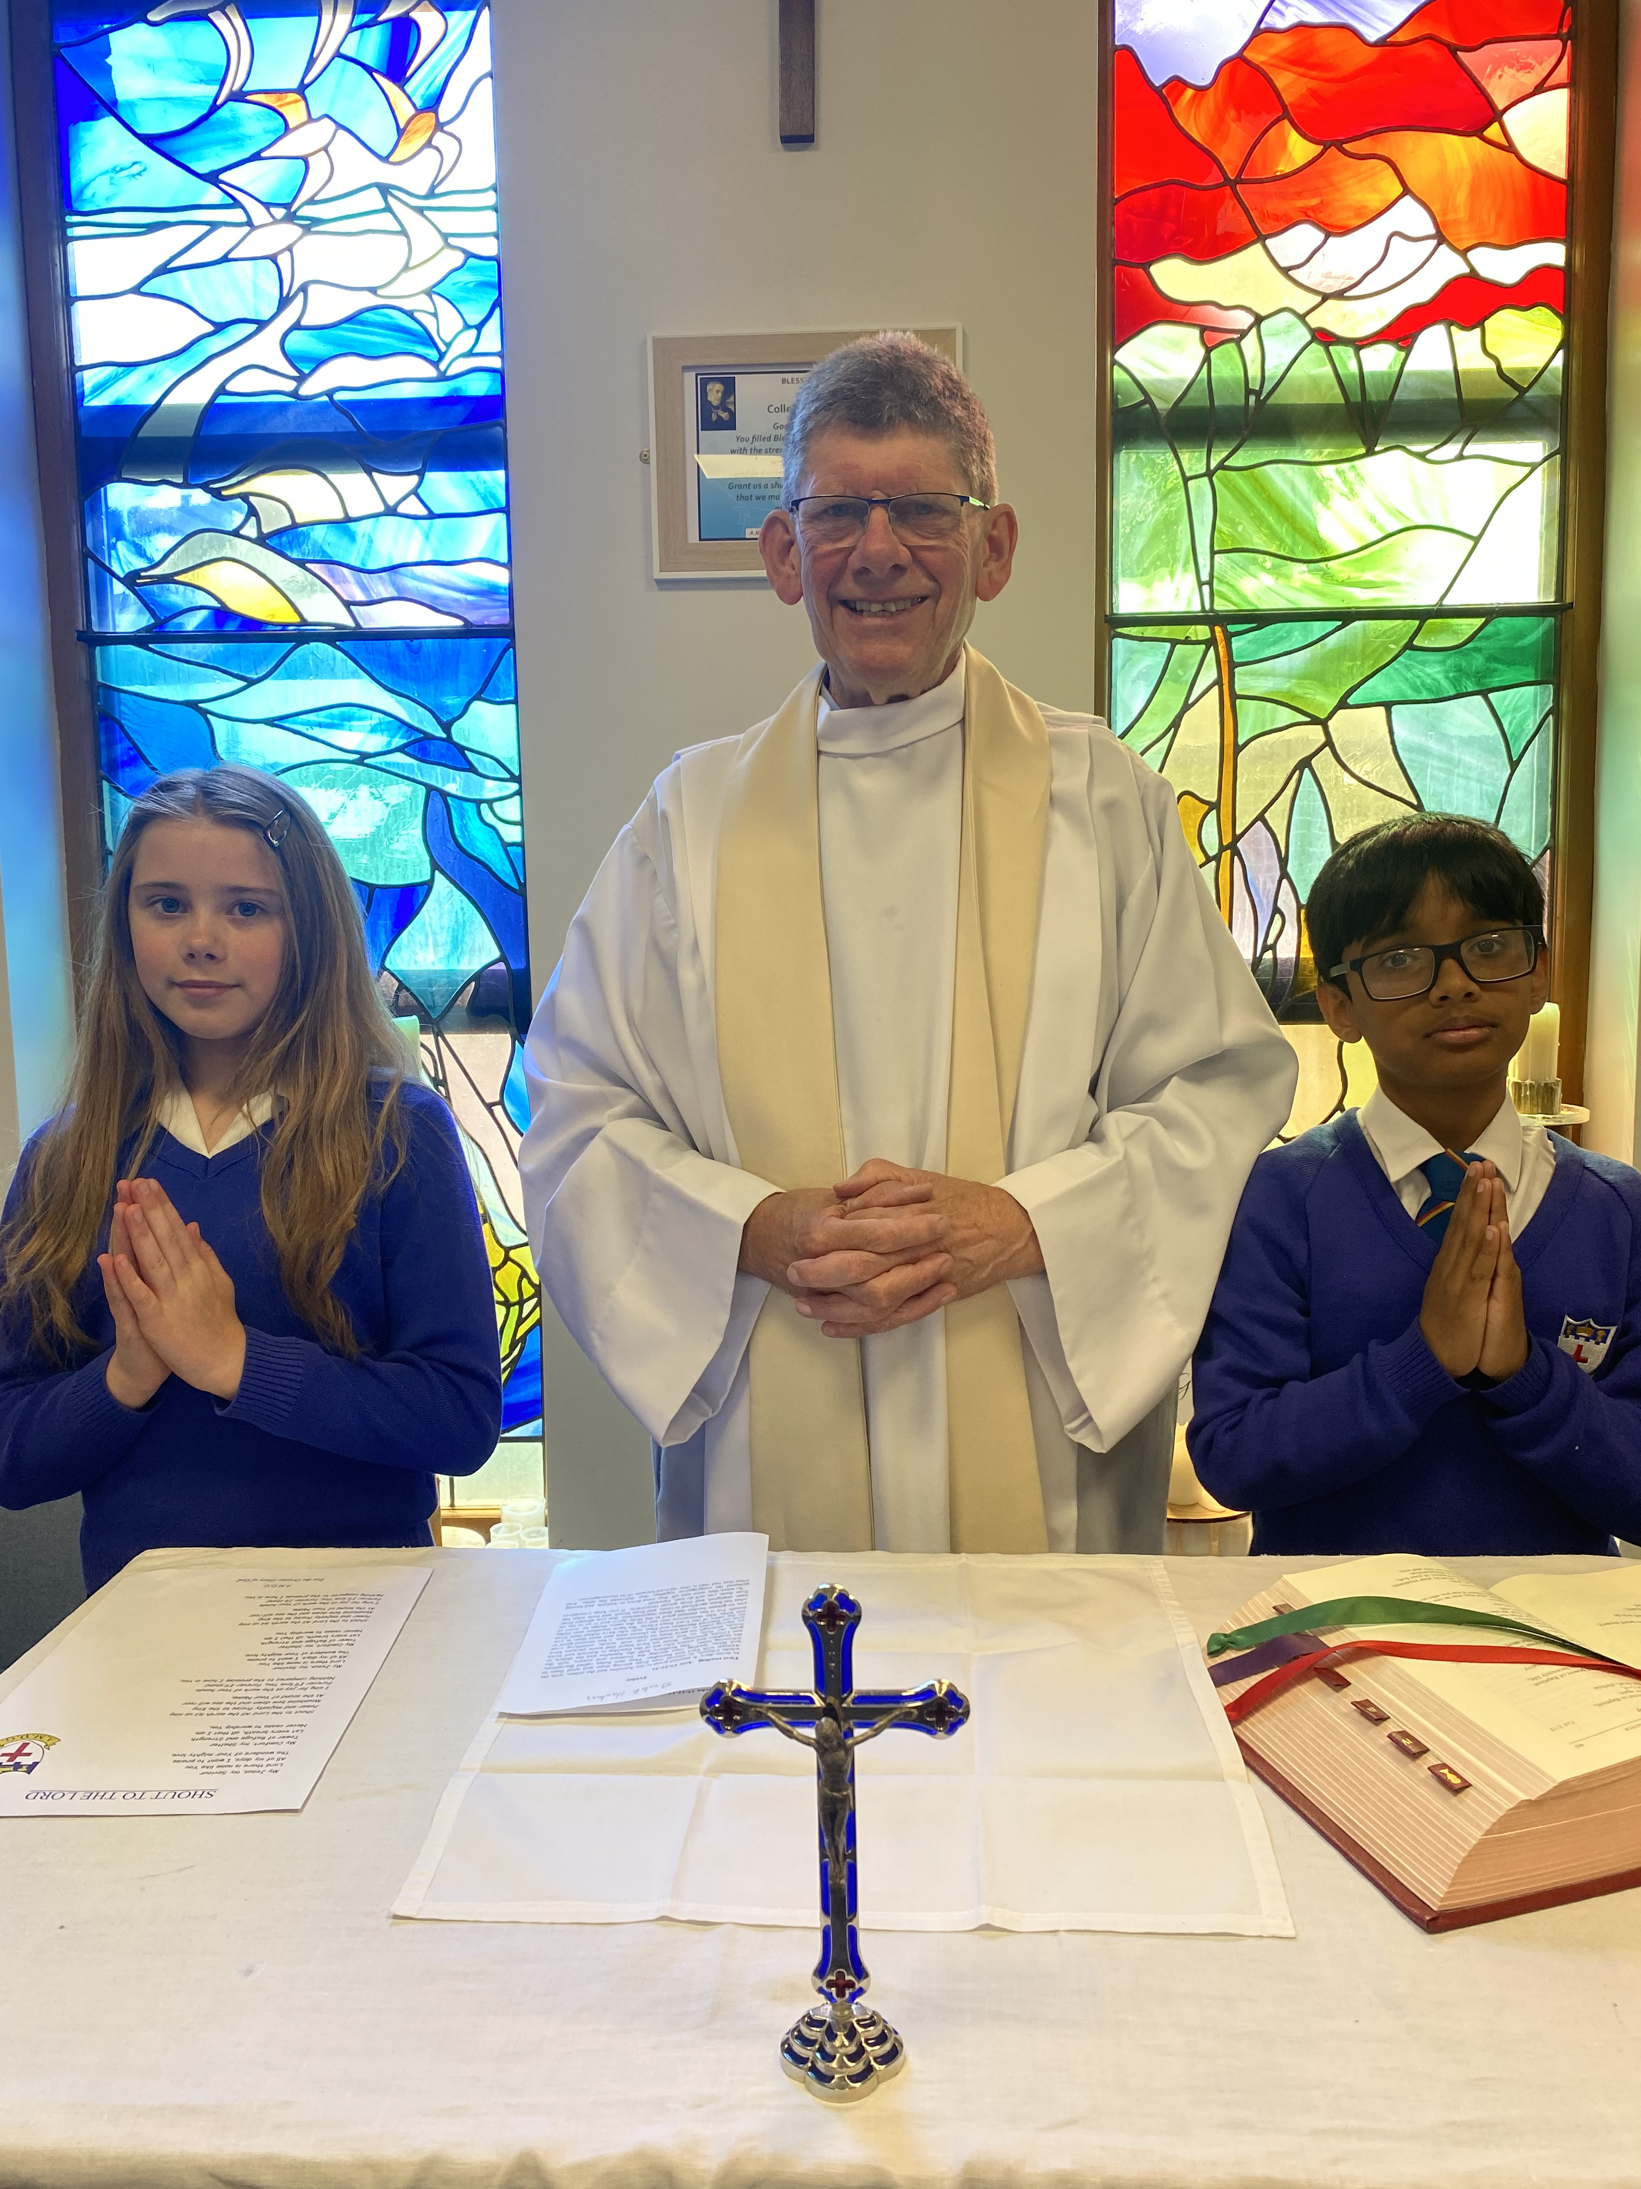

The grace of our Lord Jesus Christ and the Love of God and the communion of the Holy Spirit be with you all.
AND WITH
YOUR SPIRIT.

Slide 20
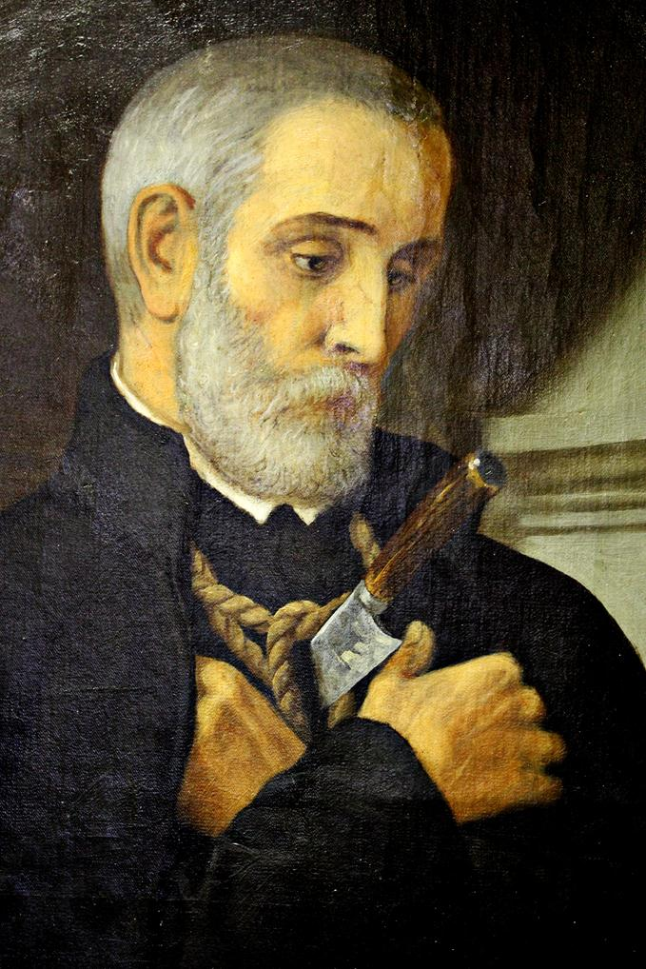

WELCOME
PLEASE SIT DOWN

Slide 21
BLESSED EDWARD OLDCORNE FEAST DAY MASS
Friday 23rd January 2026
St. John Bosco Feast Day
January 31st
A.M.D.G. – For the Greater Glory of God
Notes:
21

Slide 22

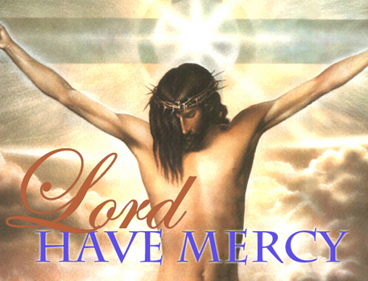
Show mercy to us loving Father.
We have sinned against you, please make us anew.
In your love and your grace, you forgive us.
Lord have mercy,
Lord have mercy.
Look not on our failings, Lord Jesus.
We have sinned against you, please make us anew.
By your life and your death, you redeem us,
Christ have mercy,
Christ have mercy.
Come fill our hearts, Holy Spirit.
We have sinned against you, please make us anew.
Forgive us and heal us and save us,
Lord have mercy,
Lord have mercy.
PENITENTIAL ACT

Slide 23
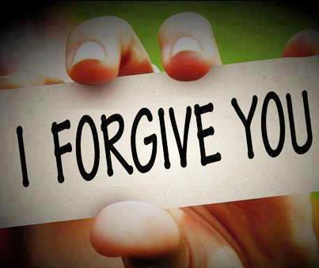
MAY ALMIGHTY GOD HAVE MERCY ON US, FORGIVE US OUR SINS AND BRING US TO EVERLASTING LIFE.
AMEN.

Slide 24
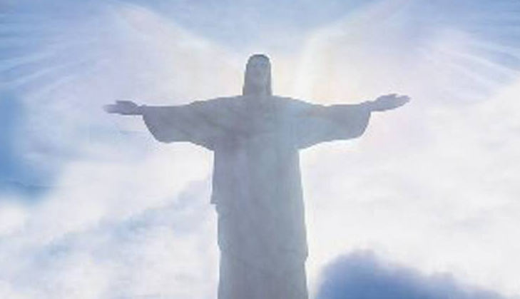
LET US PRAY

Slide 25
THE WORD
WE LISTEN
During the Liturgy of the Word we hear the proclamation of Sacred scripture.
These are not presented as recollections of past events, but as moments in the continuing love story of God and his people.
Our Lord did not just speak then, but also speaks to us now.
A.M.D.G. – For the Greater Glory of God

Slide 26
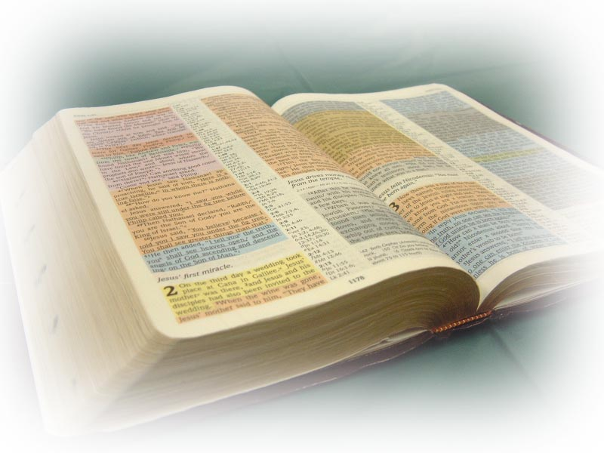
THE LITURGY OF THE WORD
A reading from the Second Letter of St. Paul to the Corinthians.
(2 Corinthians 6: 4-10)

Slide 27

In everything we prove ourselves authentic servants of God; by resolute perseverance in times of hardships, difficulties and distress; when we are flogged or sent to prison or mobbed; labouring sleepless, starving; in purity, in knowledge, in patience, in kindness; in the Holy Spirit;

Slide 28

In a love free of affectation; in the word of truth and in the power of God; by using the weapons of uprightness for attack and for defence; in times of honour or disgrace; blame or praise;

Slide 29

Taken for imposters and yet we are genuine; unknown and yet we are acknowledged; dying, and yet here we are, alive; scourged but not executed; in pain yet always full of joy; poor and yet making many people rich; having nothing, and yet owning everything.
The word of the Lord.
THANKS BE TO GOD.

Slide 30
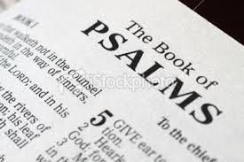
PSALM
The Lord stooped down to me, he heard my cry.

Slide 31
1. O Lord, you will not withhold
your compassion from me.
Your merciful love and your truth
will always guard me.
The Lord stooped down to me, he heard my cry.

Slide 32
2. O Lord, come to my rescue,
Lord, come to my aid.
O let there be shame and confusion
on those who seek my life.
The Lord stooped down to me, he heard my cry.

Slide 33
3. O let there be rejoicing and gladness
for all who seek you.
Let them always say ‘The Lord is great’.
The Lord stooped down to me, he heard my cry.

Slide 34
4. As for me, wretched and poor,
the Lord thinks of me.
You are my rescuer, my help,
O God, do not delay.
The Lord stooped down to me, he heard my cry.

Slide 35

PLEASE STAND TO GREET THE GOSPEL
Sing Alleluia to the Lord
Sing Alleluia to the Lord
Sing Alleluia
Sing Alleluia
Sing Alleluia to the Lord. x2

Slide 36
Happy the one who stands firm when trials come. He has proved himself and will win the crown of life.

Slide 37
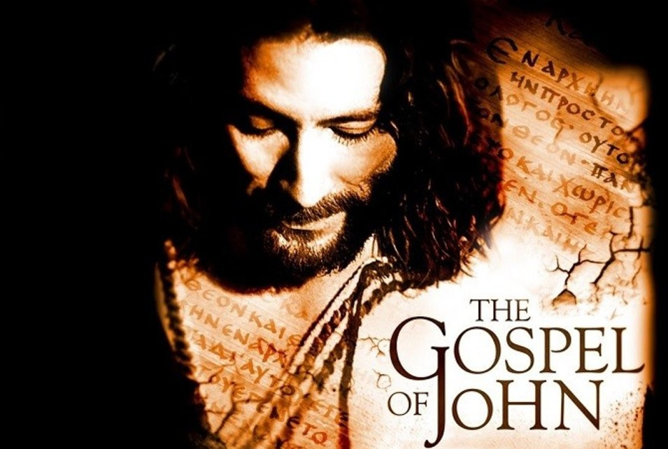
The Lord be with you.
AND WITH YOUR SPIRIT.
A reading from the Holy Gospel according to John.
GLORY TO YOU, O LORD.

Slide 38

Jesus said, ‘The hour has come for the Son of Man to be glorified. I tell you the truth, unless a grain of wheat falls to the ground and dies, it remains only a single seed. But if it dies, it produces many seeds.
The man who loves his life will lose it, while the man who hates his life in this world will keep it for eternal life.
Whoever serves me must follow me; and where I am, my servant also will be. My Father will honour the one who serves me.

Slide 39
Now my heart is troubled, and what shall I say? ‘Father, save me from this hour?’
No, it was for this very reason I came to this hour. Father, glorify your name!’
Then a voice came from heaven, ‘I have glorified it, and will glorify it again.’
The Gospel of the Lord.
PRAISE TO YOU, LORD JESUS CHRIST.

Slide 40
Sing Alleluia to the Lord
Sing Alleluia to the Lord
Sing Alleluia
Sing Alleluia
Sing Alleluia to the Lord. x1

Slide 41
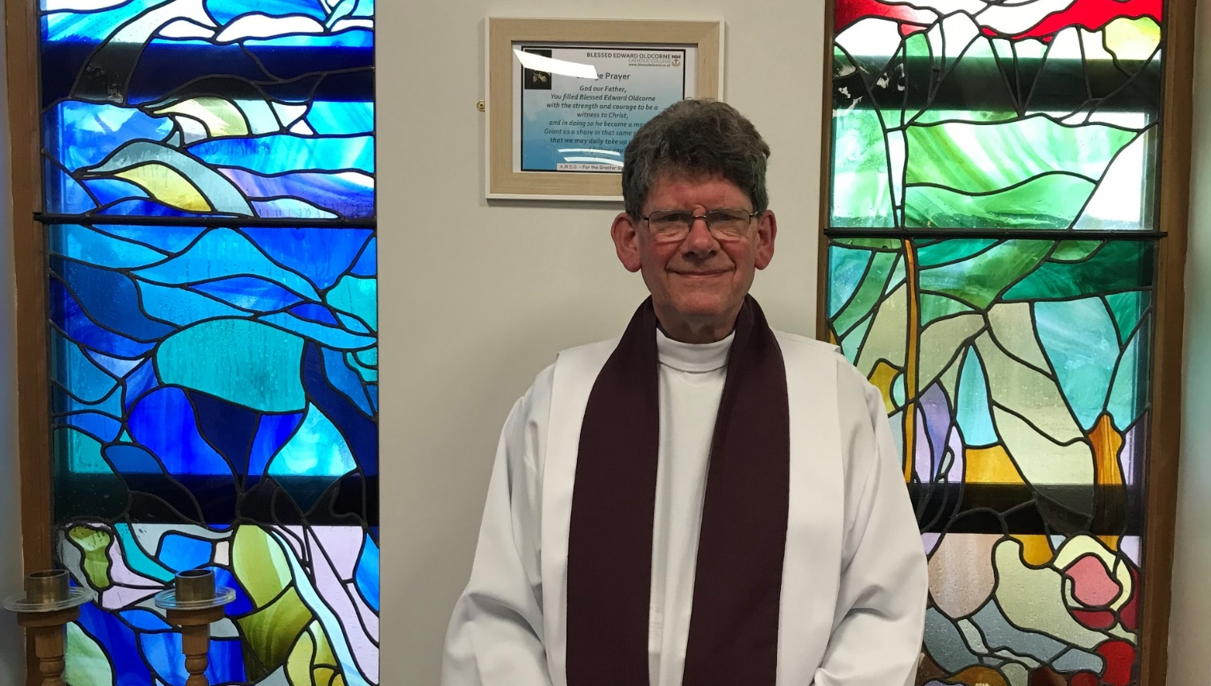
PLEASE SIT DOWN
HOMILY Fr. Stephen
Notes:
41

Slide 42
Jesus said, ‘The hour has come for the Son of Man to be glorified. I tell you the truth, unless a grain of wheat falls to the ground and dies, it remains only a single seed. But if it dies, it produces many seeds.
The man who loves his life will lose it, while the man who hates his life in this world will keep it for eternal life.
Whoever serves me must follow me; and where I am, my servant also will be. My Father will honour the one who serves me.

Slide 43
Father Edward was filled with the strength and courage to be a witness to Christ and in doing so he became a martyr .
The liturgical colour for martyrdom is red.
A.M.D.G. – For the Greater Glory of God

Slide 44
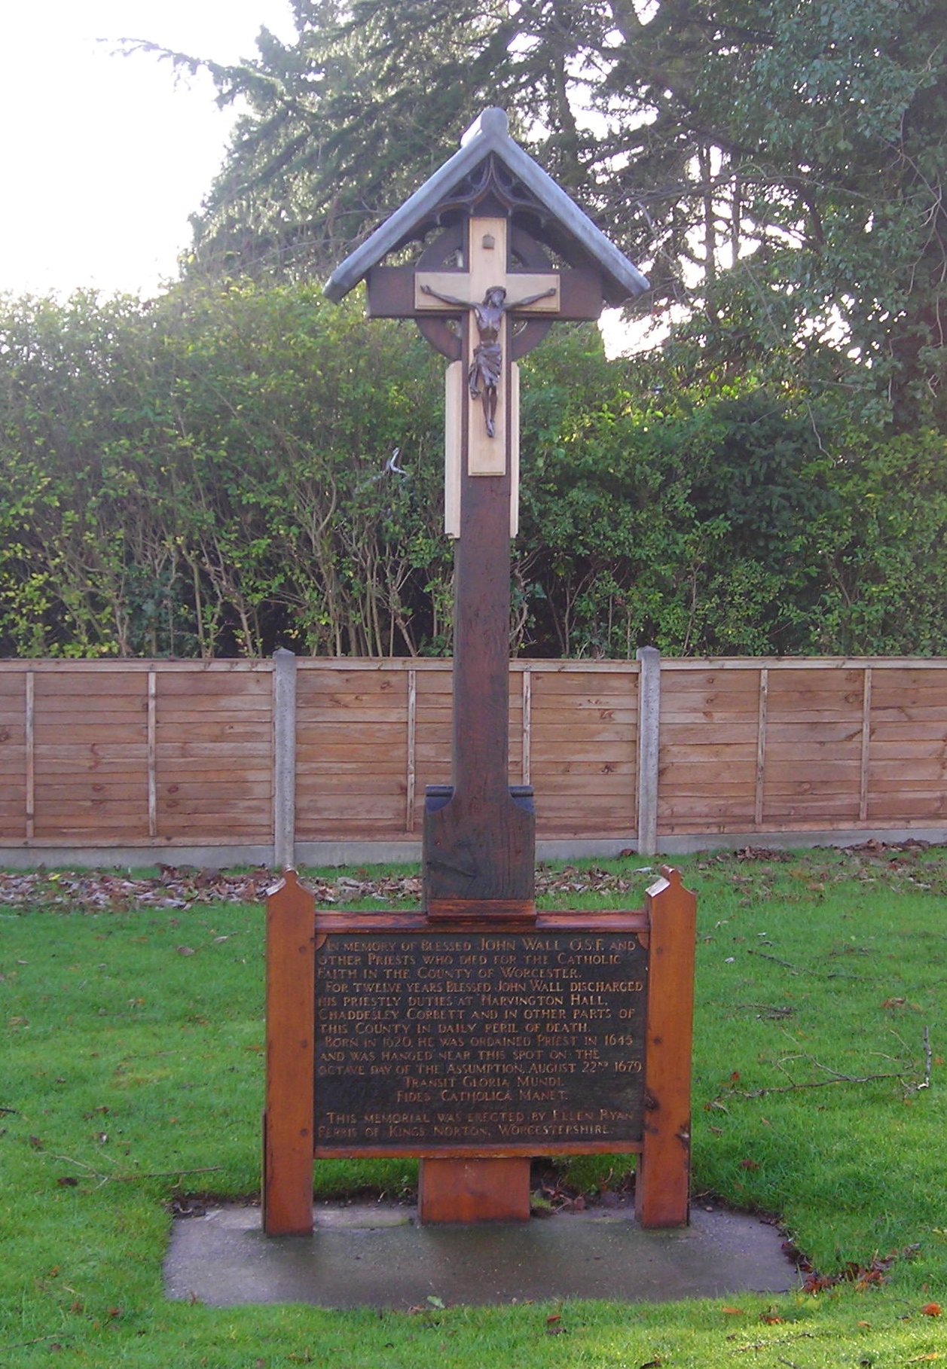
THE MARTYRS SHRINE AT THE TOP OF REDHILL MARKING THE SPOT WHERE FR. EDWARD WAS EXECUTED
A.M.D.G. For the Greater Glory of God

Slide 45

The personal crucifix of Fr. Edward Oldcorne
A.M.D.G. For the Greater Glory of God

Slide 46
WE RESPOND
We respond by having a few moments of stillness, reflecting on what we have just heard and how it relates to us.
We sit silently as we prepare to listen to our Prayers of Intention.
We focus on the words of each prayer and ask God to come into our lives.
A.M.D.G. – For the Greater Glory of God

Slide 47
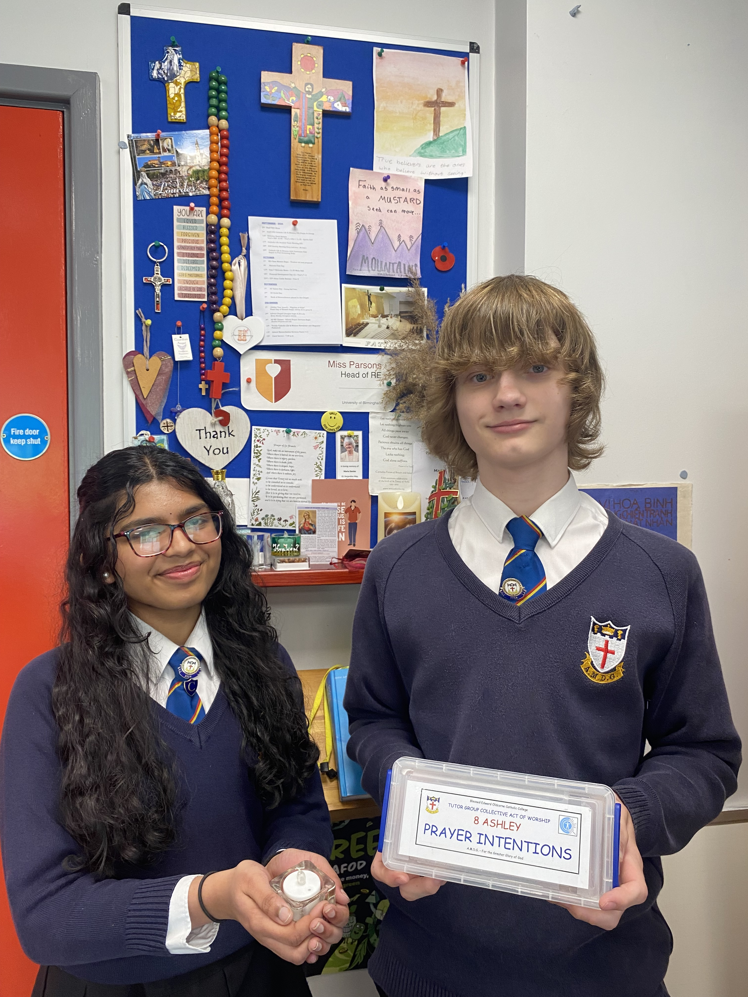
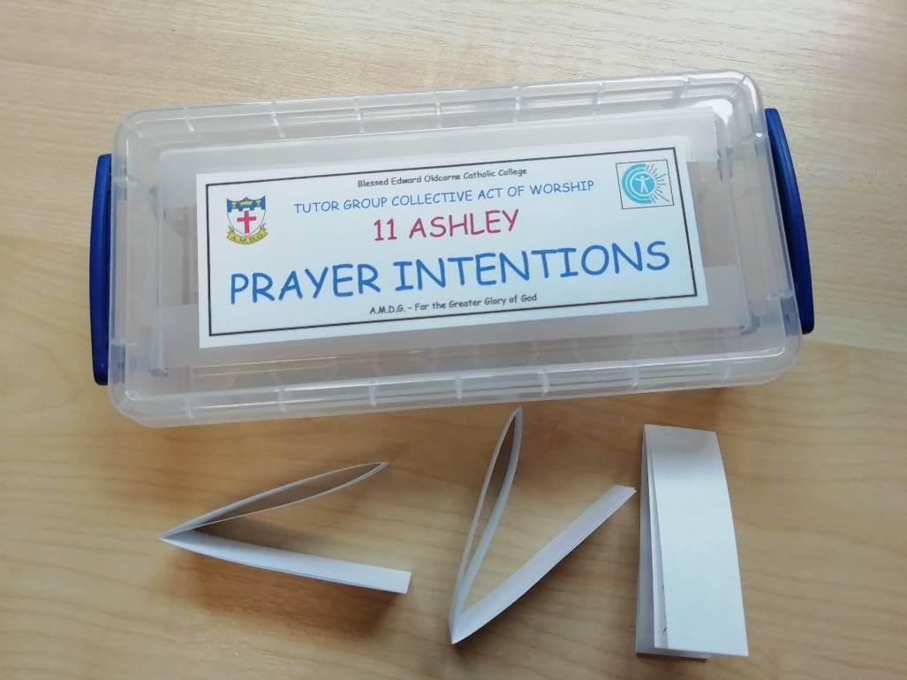
PRAYERS OF INTENTION
BIDDING PRAYERS

Slide 48

We pray for those who lead the Church, especially our Pope, Leo, whom you chose as successor of St. Peter and shepherd of your flock.
We also pray for Bernard our Archbishop and Fr. Stephen our college chaplain.
Lord hear us
LORD GRACIOUSLY HEAR US

Slide 49
2. We pray that we will be encouraged and
inspired by the life of Blessed Edward
Oldcorne and all our college martyrs and saints.
May all who dedicate their lives to sharing and living the Gospel of Love find their reward in the Kingdom of God.
Lord hear us
LORD GRACIOUSLY HEAR US

Slide 50
3. We pray for St. John Bosco, patron saint of
children , whose feast day it is on 31st January.
May we always be inspired to continue to give witness to our faith and remember that everything we do is for ‘The Greater Glory of God.’
Lord hear us
LORD GRACIOUSLY HEAR US

Slide 51
4. We pray for the weak and vulnerable, for those who depend on others to care for them.
We pray for the sick and those in despair, especially those caught up in regions of the world experiencing war and unrest.
Inspire us to promote the signs of your kingdom on earth, through justice, peace and reconciliation.
Lord hear us
LORD GRACIOUSLY HEAR US

Slide 52

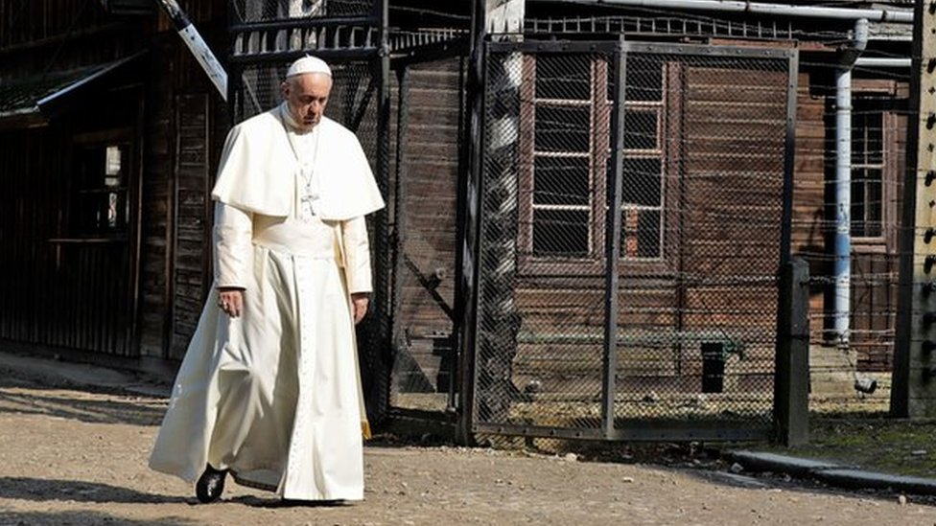
5. Next Tuesday is Holocaust Memorial Day
and we remember with sorrow the six million Jewish
people who died under Nazi oppression
during World War Two.
We can never expect to understand this horror
and look towards a future free from hatred
and genocide.
Lord hear us
LORD GRACIOUSLY HEAR US

Slide 53
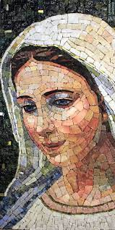
6. We pray for Mary, the Mother of God. Let us never fail to acknowledge the unconditional love that she bestows upon us as we all say together -
Hail Mary, full of grace, The Lord is with thee. Blessed art thou among women, and blessed is the fruit of thy womb, Jesus. Holy Mary, Mother of God, Pray for us sinners, Now and at the hour of our death. Amen.

Slide 54
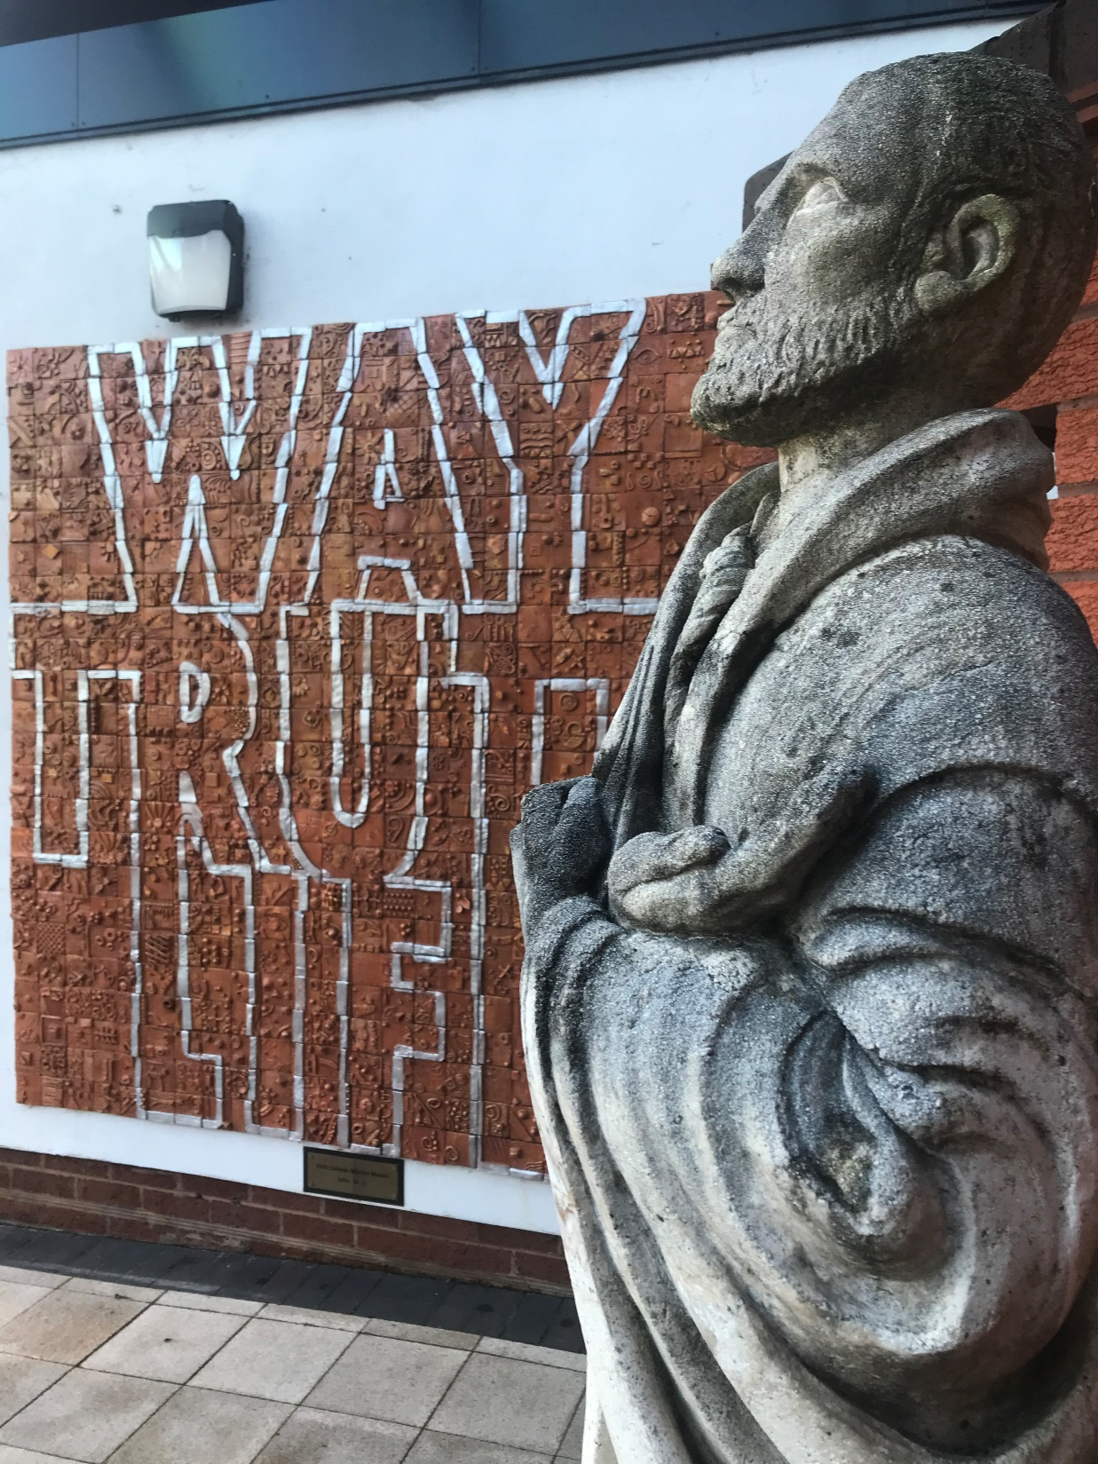
FEAST DAY MASS
A.M.D.G. – For the Greater Glory of God

Slide 55
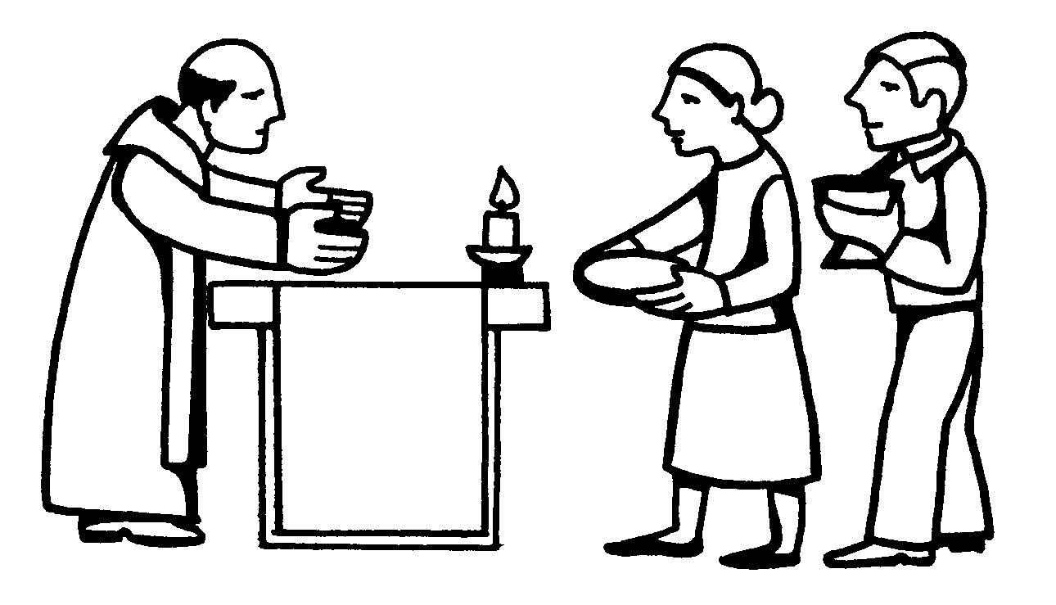

THE OFFERTORY

Slide 56
THE OFFERTORY
The gifts of bread and wine are brought to the altar.
The Priest blesses the bread and wine so that they become the body and blood of Jesus.
Together, we approach Calvary and the Upper Room, we come to Christ’s Real Presence, as he comes to us.
A.M.D.G. – For the Greater Glory of God

Slide 57
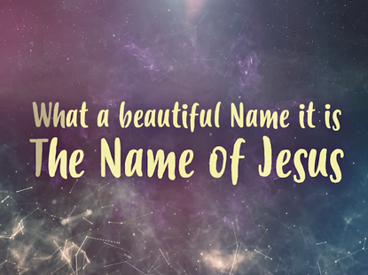
OFFERTORY HYMN
What a beautiful Name it is, what a beautiful Name it is. The Name of Jesus Christ my King. What a beautiful Name it is, nothing compares to this, What a beautiful Name it is, the Name of Jesus.
You were the Word at the beginning. One with God the Lord Most High. Your hidden glory in creation, Now, revealed in You our Christ.
A.M.D.G. – For the Greater Glory of God

Slide 58
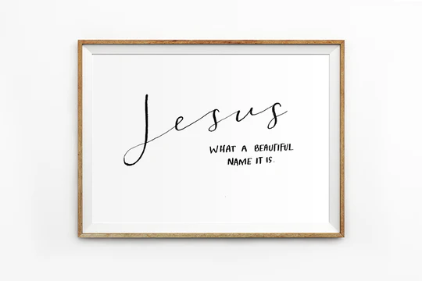
You didn't want heaven without us So, Jesus, You brought heaven down. My sin was great, Your love was greater What could separate us now?
What a wonderful Name it is, what a wonderful Name it is. The Name of Jesus Christ my King. What a wonderful Name it is, nothing compares to this, What a wonderful Name it is, the Name of Jesus.

Slide 59
Death could not hold You, the veil tore before You, You silenced the boast of sin and grave The Heavens are roaring, the praise of Your glory For You are raised to life again.
You have no rival; You have no equal Now and forever, God, You reign Yours is the Kingdom, Yours is the Glory Yours is the Name above all names.

Slide 60
What a powerful Name it is, what a powerful Name it is. The Name of Jesus Christ my King. What a powerful Name it is, nothing can stand against,
What a powerful Name it is, the Name of Jesus. x2

Slide 61
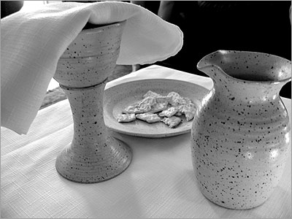
LITURGY OF THE EUCHARIST

Slide 62
Pray my brothers and sisters that my sacrifice and yours may be acceptable to God, the almighty Father.
May the Lord accept the sacrifice at your hands, for the praise and glory of his name, for our good and the good of all his holy Church.

Slide 63

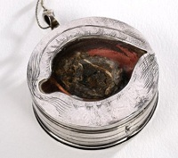
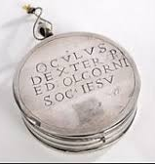
FEAST DAY MASS
A.M.D.G. – For the Greater Glory of God

Slide 64
THE EUCHARISTIC PRAYER
The Lord be with you. And with your spirit
Lift up your hearts. We lift them up to the Lord.
Let us give thanks to the Lord our God. It is right and just.

Slide 65
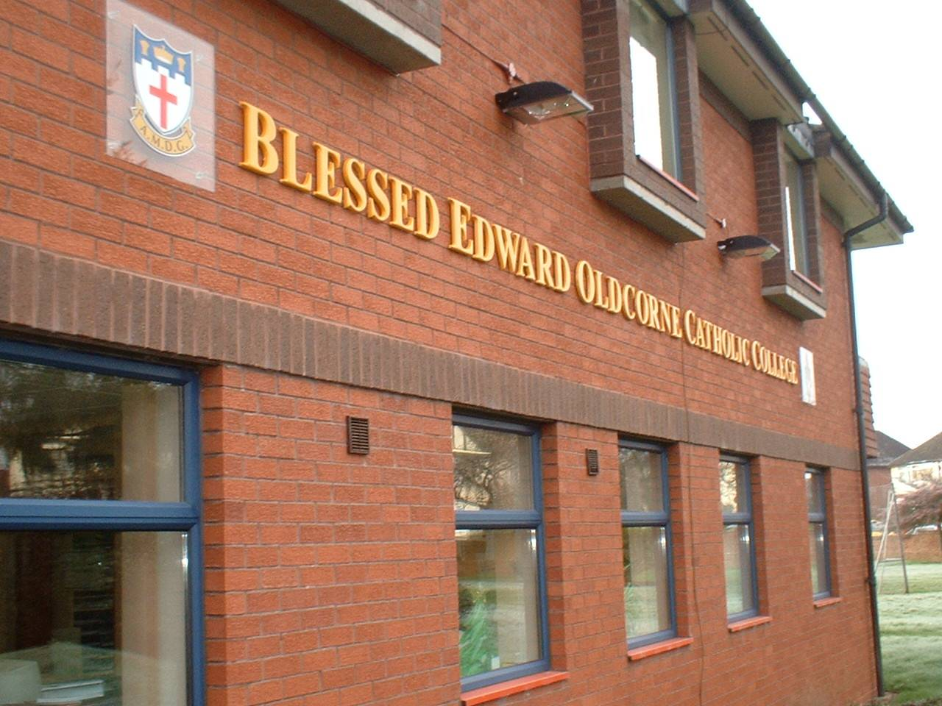
FEAST DAY MASS
A.M.D.G. – For the Greater Glory of God

Slide 66
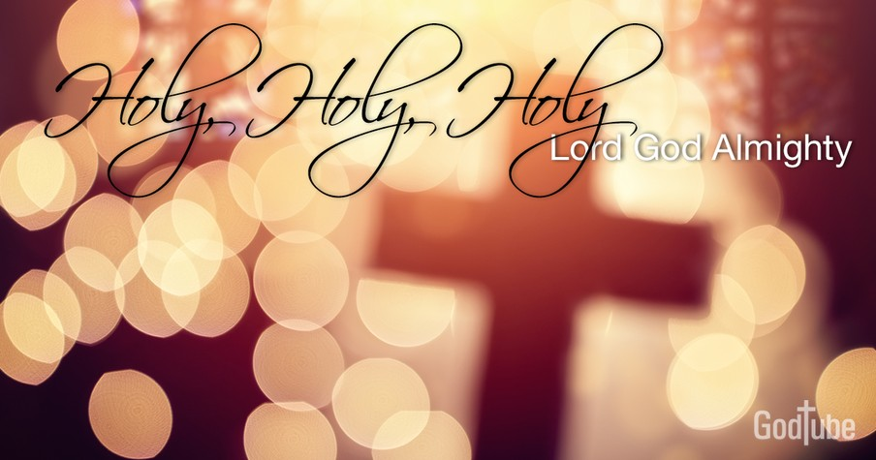
HOLY, HOLY, HOLY IS THE LORD
Holy, holy, holy is the Lord, holy is the Lord God almighty! Holy, holy, holy is the Lord, holy is the Lord God almighty! Who was and is, and is to come; holy, holy, holy is the Lord.

Slide 67
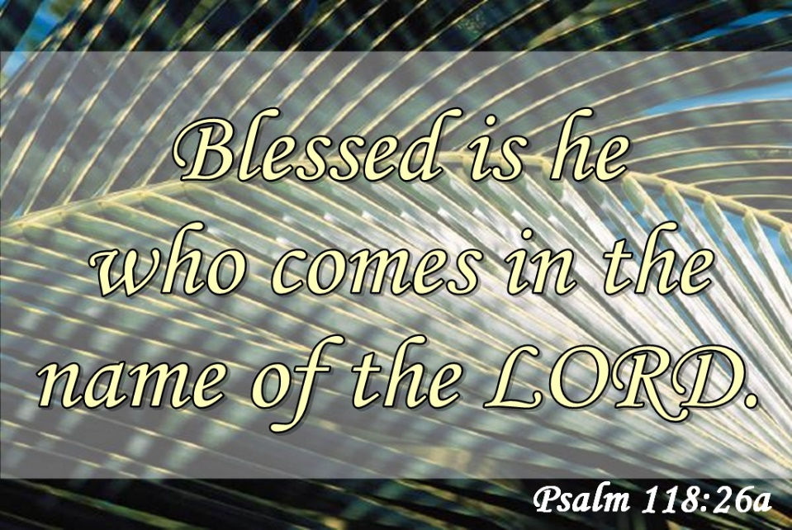
Blessed, blessed, blest is he who comes, Blest is he who comes in the Lord’s name.
Blessed, blessed, blest is he who comes, Blest is he who comes in the Lord’s name.
Hosanna in the heights of heav’n. Blessed, blessed, blessed is the Lord.

Slide 68
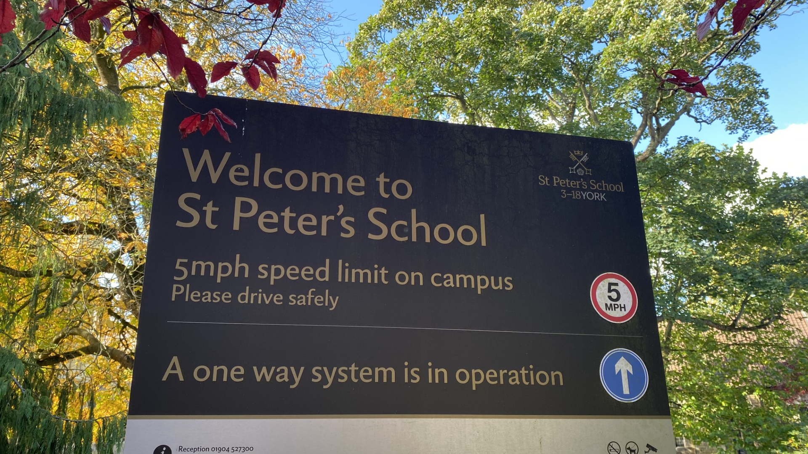
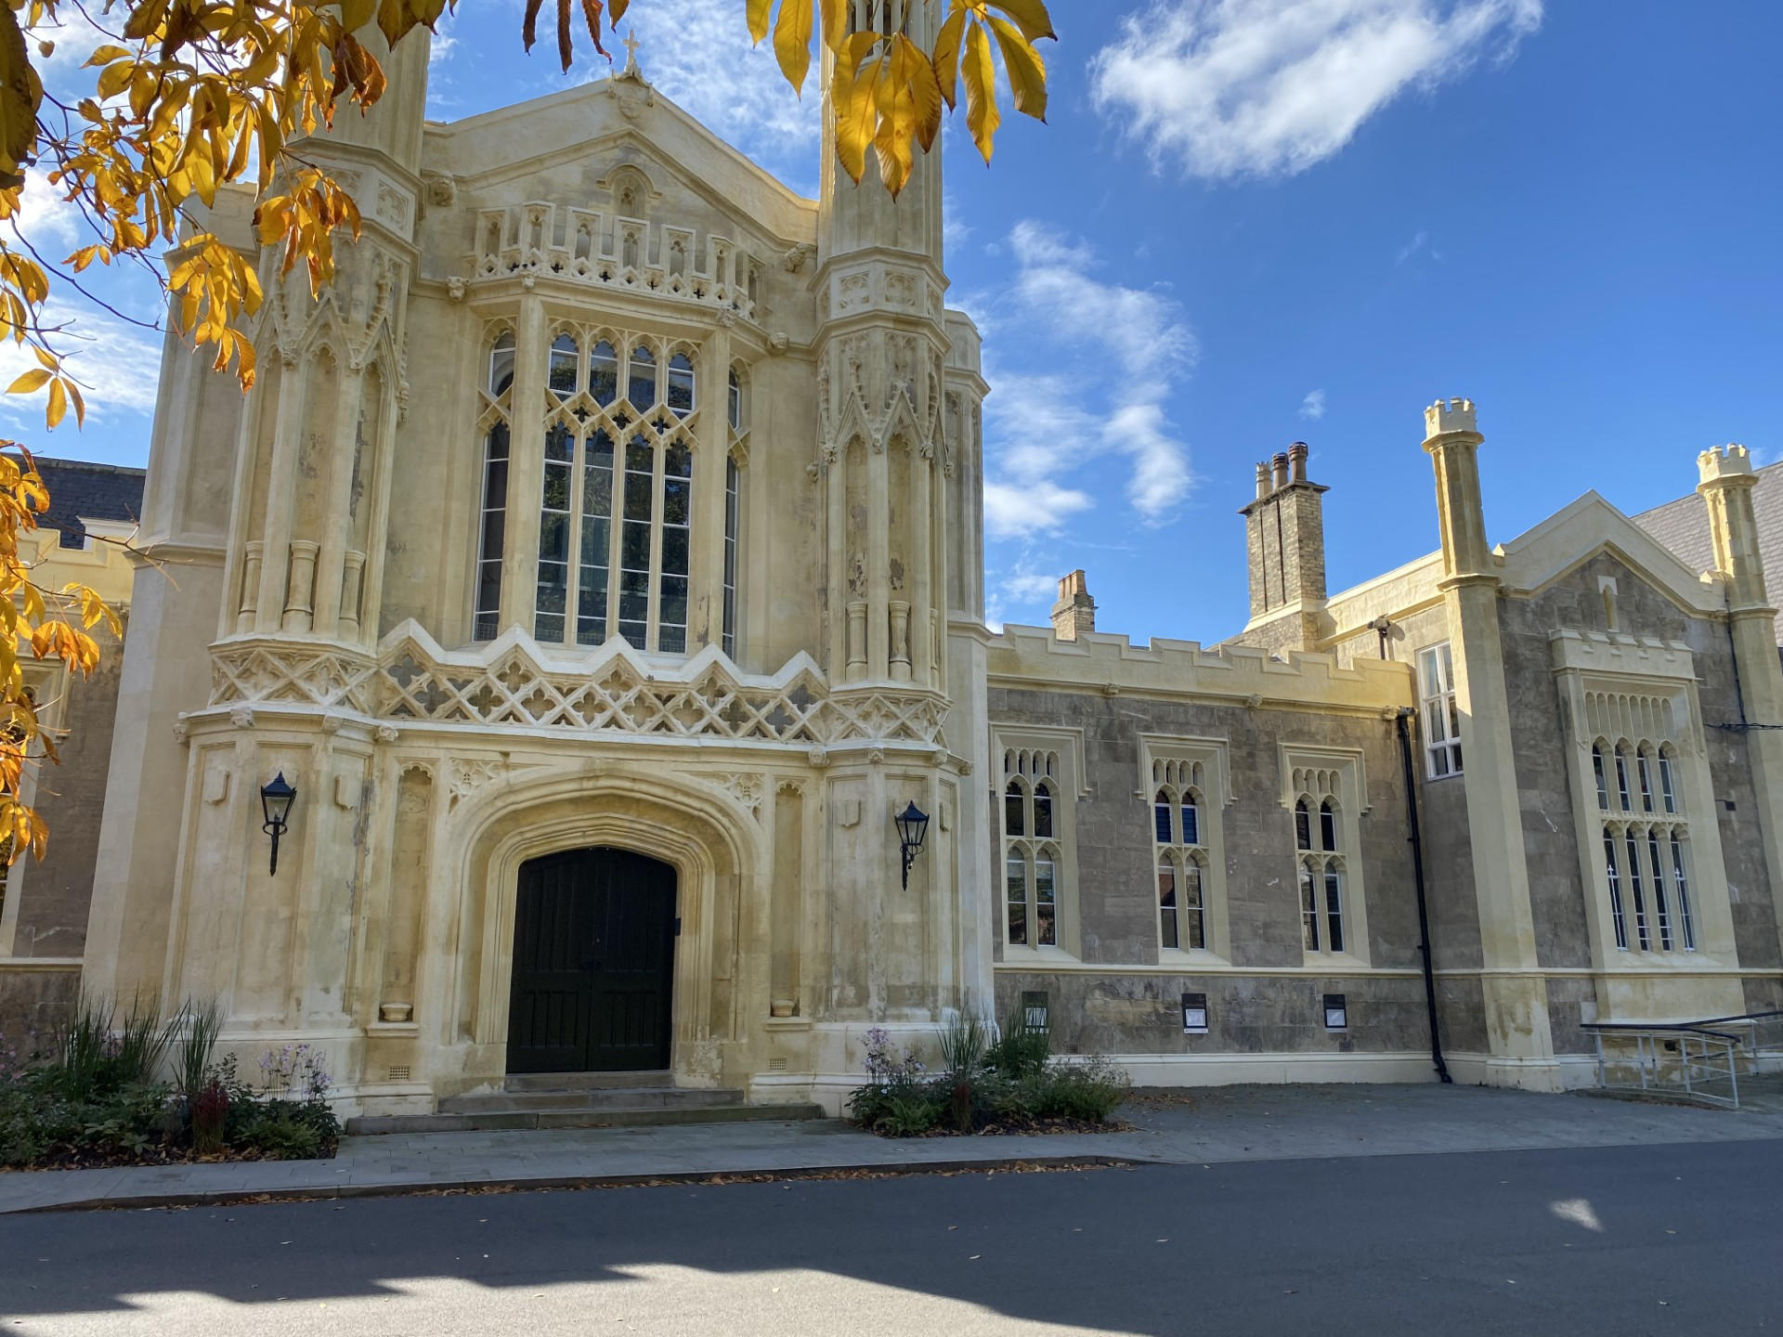
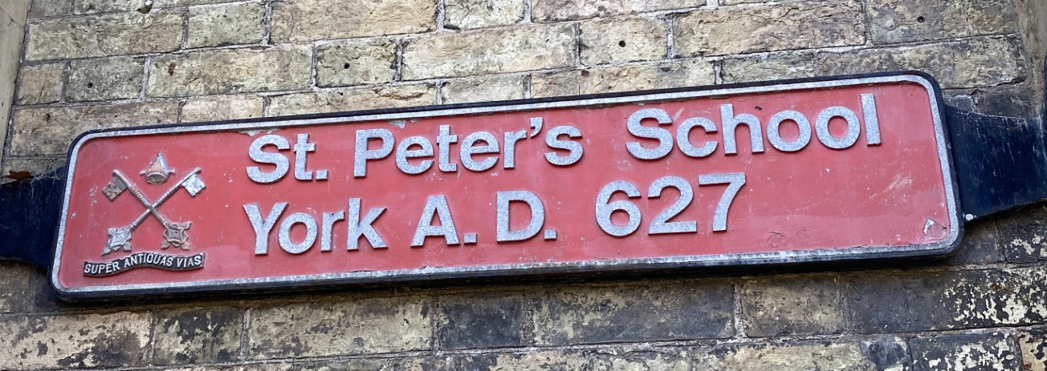
FEAST DAY MASS
A.M.D.G. – For the Greater Glory of God
THE SCHOOL THAT BLESSED EDWARD ATTENDED

Slide 69
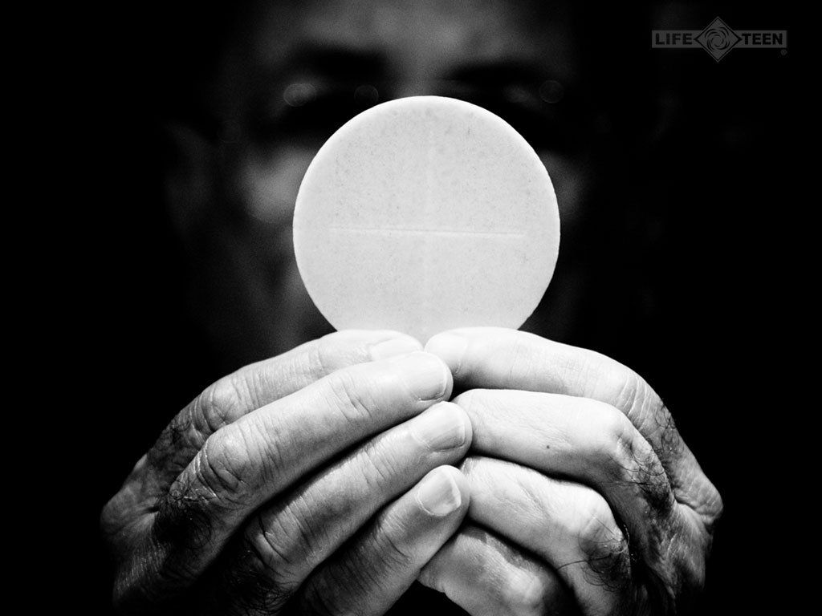
TAKE THIS ALL OF YOU AND EAT OF IT:
FOR THIS IS MY BODY WHICH WILL BE GIVEN UP FOR YOU.

Slide 70
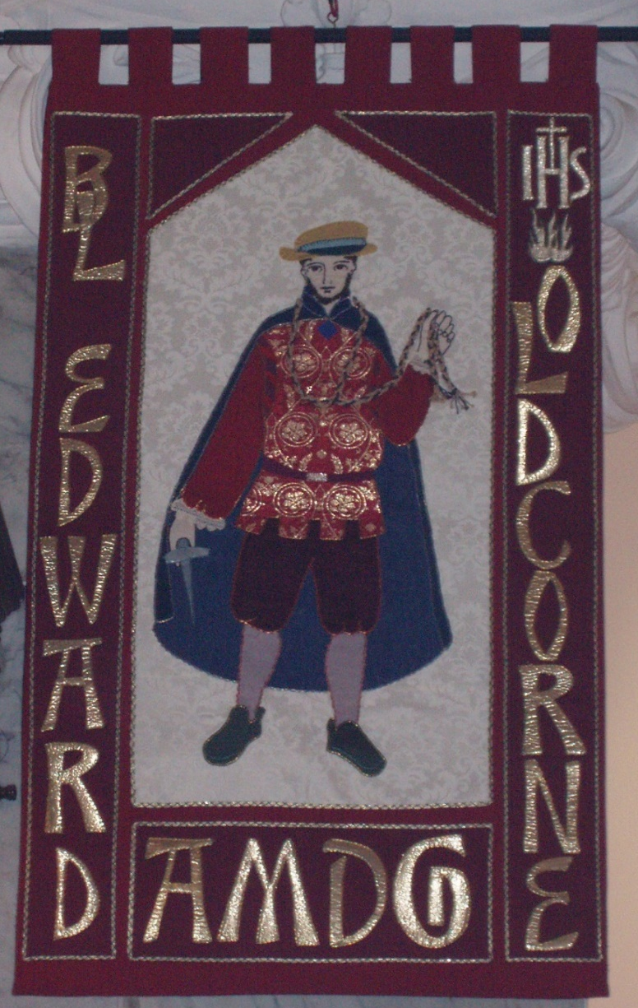
FEAST DAY MASS
A.M.D.G. – For the Greater Glory of God

Slide 71

Take this all of you and drink from it: For this is the chalice of my blood, the blood of the new and eternal covenant, which will be poured out for you and for many for the forgiveness of sins.
Do this in memory of me.

Slide 72
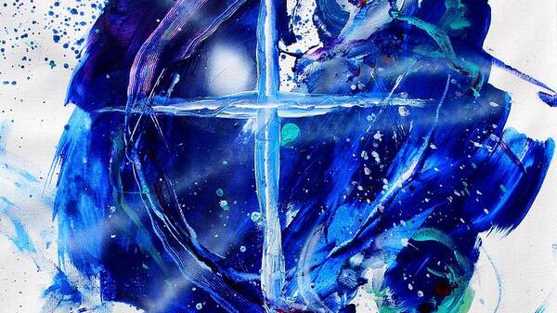
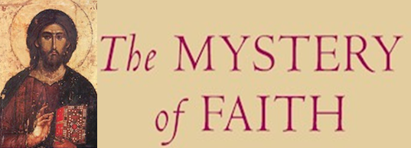
We proclaim your death O Lord and profess your resurrection until you come again, until you come again.
(Repeat)
We proclaim your death O Lord and profess your resurrection until you come again, until you come again.
First verse = solo

Slide 73
FEAST DAY MASS
A.M.D.G. – For the Greater Glory of God

Slide 74
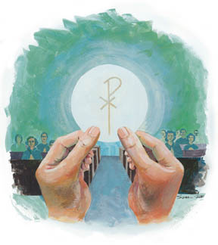
Through him, and with him, and in him, O God, almighty Father, in the unity of the Holy Spirit, all glory and honour is yours, for ever and ever.
SUNG
Amen. We lift our hearts and voices to you, as we sing, Amen, so shall it be forever Amen. (Repeat)

Slide 75
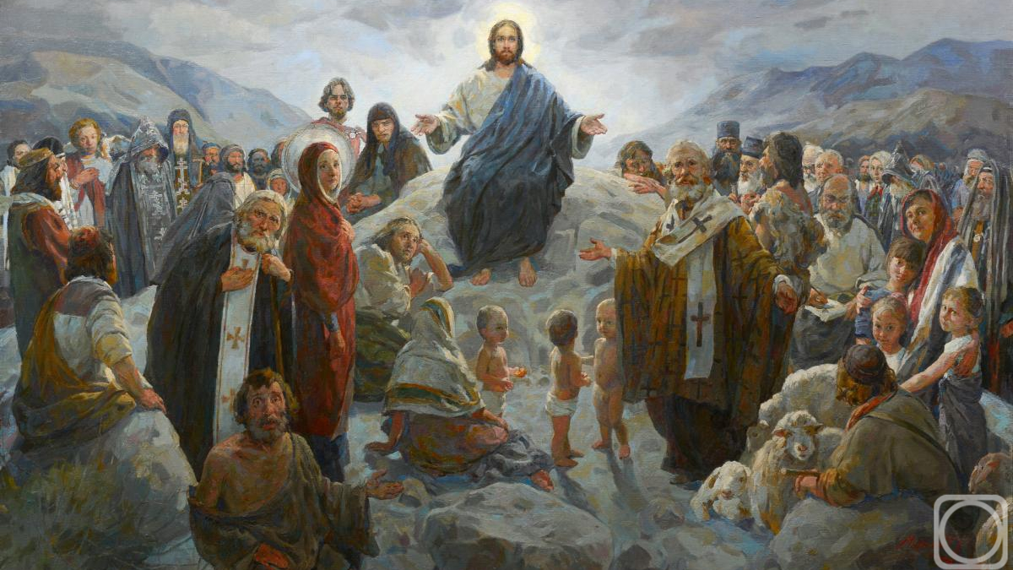
PLEASE STAND
At the Saviour’s command and formed by divine teaching, we dare to say:
Our Father, who art in heaven, hallowed be thy name; thy Kingdom come; thy will be done on earth as it is in heaven. Give us this day our daily bread, and forgive us our trespasses as we forgive those who trespass against us, and lead us not into temptation, but deliver us from evil.

Slide 76

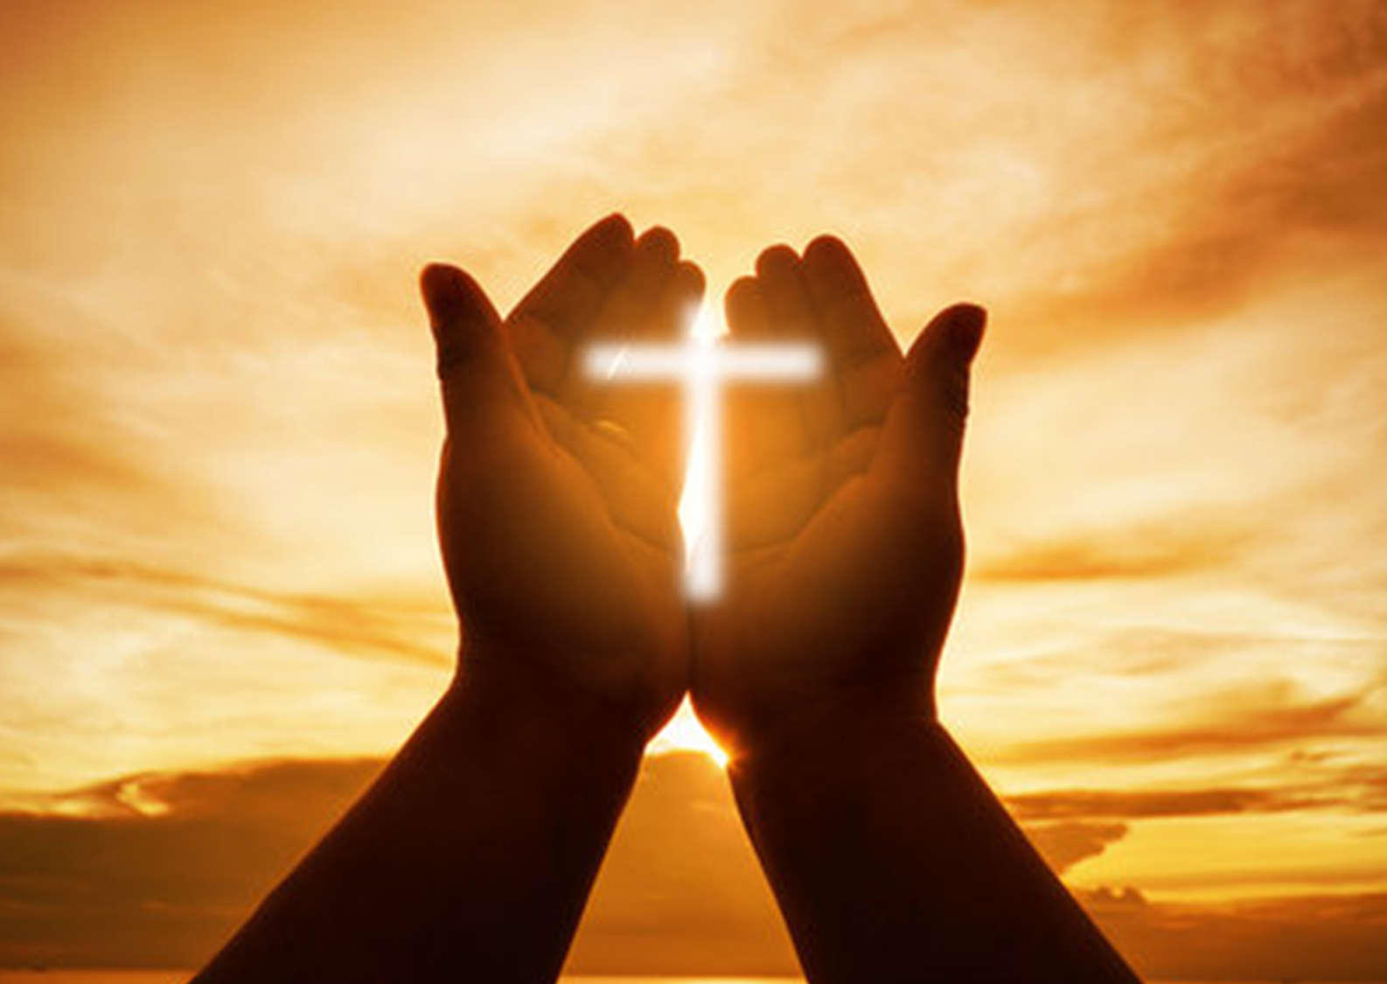
Deliver us Lord, we pray, from every evil, graciously grant peace in our days, that, by the help of your mercy, we may be always free from sin and safe from all distress as we await the blessed hope and the coming of our Saviour, Jesus Christ.
FOR THE KINGDOM,THE POWER AND THE GLORY ARE YOURS, NOW AND FOREVER.

Slide 77

Lord Jesus Christ, who said to your apostles: Peace I leave you, my peace I give you; look not on our sins, but on the faith of your Church and graciously grant her peace and unity in accordance with your will. Who live and reign for ever and ever.
AMEN.

Slide 78

The peace of the Lord be with you always.
AND WITH YOUR SPIRIT.

Slide 79
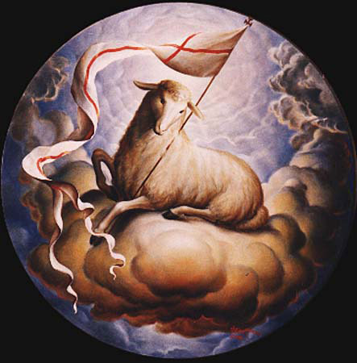
LAMB OF GOD
Lamb of God, Lamb of God,
you take away, you take away,
the sins of all, the sins of all,
the world, the world,
Miserere nobis, miserere nobis.

Slide 80

LAMB OF GOD
Lamb of God, Lamb of God,
you take away, you take away,
the sins of all, the sins of all,
the world, the world,
Miserere nobis, miserere nobis.

Slide 81
LAMB OF GOD
Lamb of God, Lamb of God,
you take away, you take away,
the sins of all, the sins of all,
the world, the world,
Dona Nobis Pacem, Dona Nobis Pacem, Dona Nobis Pacem.

Slide 82
Behold the Lamb of God, behold him who takes away the sins of the world. Blessed are those called to the supper of the Lamb.
Lord, I am not worthy that you should enter under my roof but only say the word and my soul shall be healed.

Slide 83
COMMUNION
We will now share communion together by either receiving the Body of Jesus or a blessing.
This symbolises spiritual nourishment and forgiveness of sins through Christ’s sacrifice.
Mr. McCormack will now outline the arrangements and how we should respond during communion.
PLEASE SIT DOWN
A.M.D.G. – For the Greater Glory of God

Slide 84
Everyone is invited to come forward and receive either Holy Communion or a blessing.

Slide 85
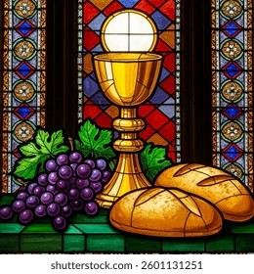
COMMUNION HYMNS
MAKE ME HOLY LORD
OCEANS

Slide 86
MAKE ME HOLY
Prepare my mind, prepare my soul, prepare my heart and make me whole, prepare me for the awesomeness of you.
Renew in me a spirit strong, remind me Lord of all that’s wrong, create in me complete desire for you.

Slide 87
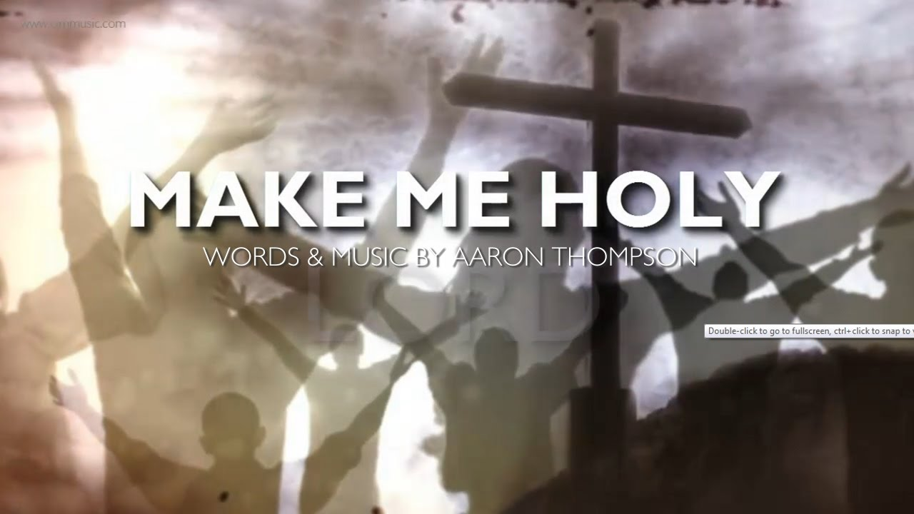
Make me Holy Lord, Make me Holy Lord, Make me Holy Lord, Like you.

Slide 88

Consume my mind, consume my soul, consume my heart and make me whole, consume me with the awesomeness of you.
Destroy the pride, destroy the hate, destroy the things that separate and keep me from returning back to you.

Slide 89
Make me Holy Lord, Make me Holy Lord, Make me Holy Lord, Like you.

Slide 90
Restore my mind Restore my soul, restore my heart and make it whole, restore me with the awesomeness of you.
Redecorate me from within, refurnish me with sacredness, rebuild me with a yearning love for you.

Slide 91
Make me Holy Lord, Make me Holy Lord, Make me Holy Lord, Like you. x2

Slide 92

You call me out upon the waters, the great unknown where feet may fail.
And there I find you in the mystery, in Oceans deep, my faith will stand.

Slide 93
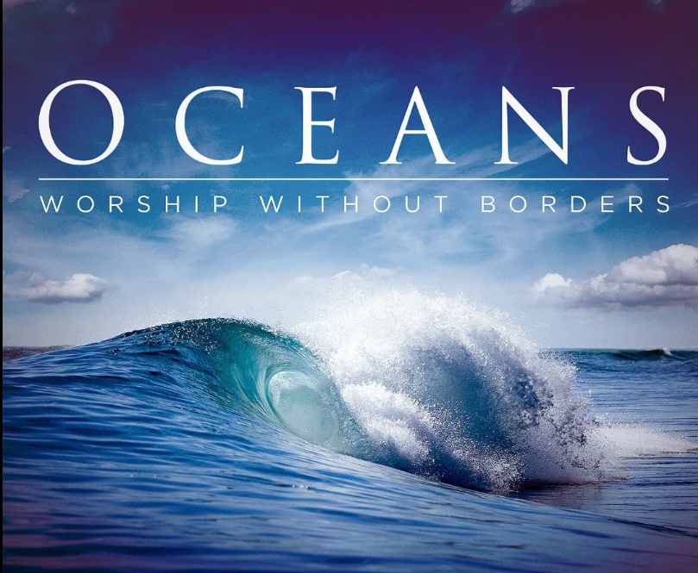
And I will call upon your name, and keep my eyes above the waves,
When oceans rise, my soul will rest in your embrace, for I am yours, and you are mine.

Slide 94
Your grace abounds in deepest waters, your sovereign hand will be my guide.
Where feet may fail and fear surrounds me, you never failed, and you won’t start now.

Slide 95
So I will call upon your name, and keep my eyes above the waves,
When oceans rise, my soul will rest in your embrace, for I am yours, and you are mine.

Slide 96
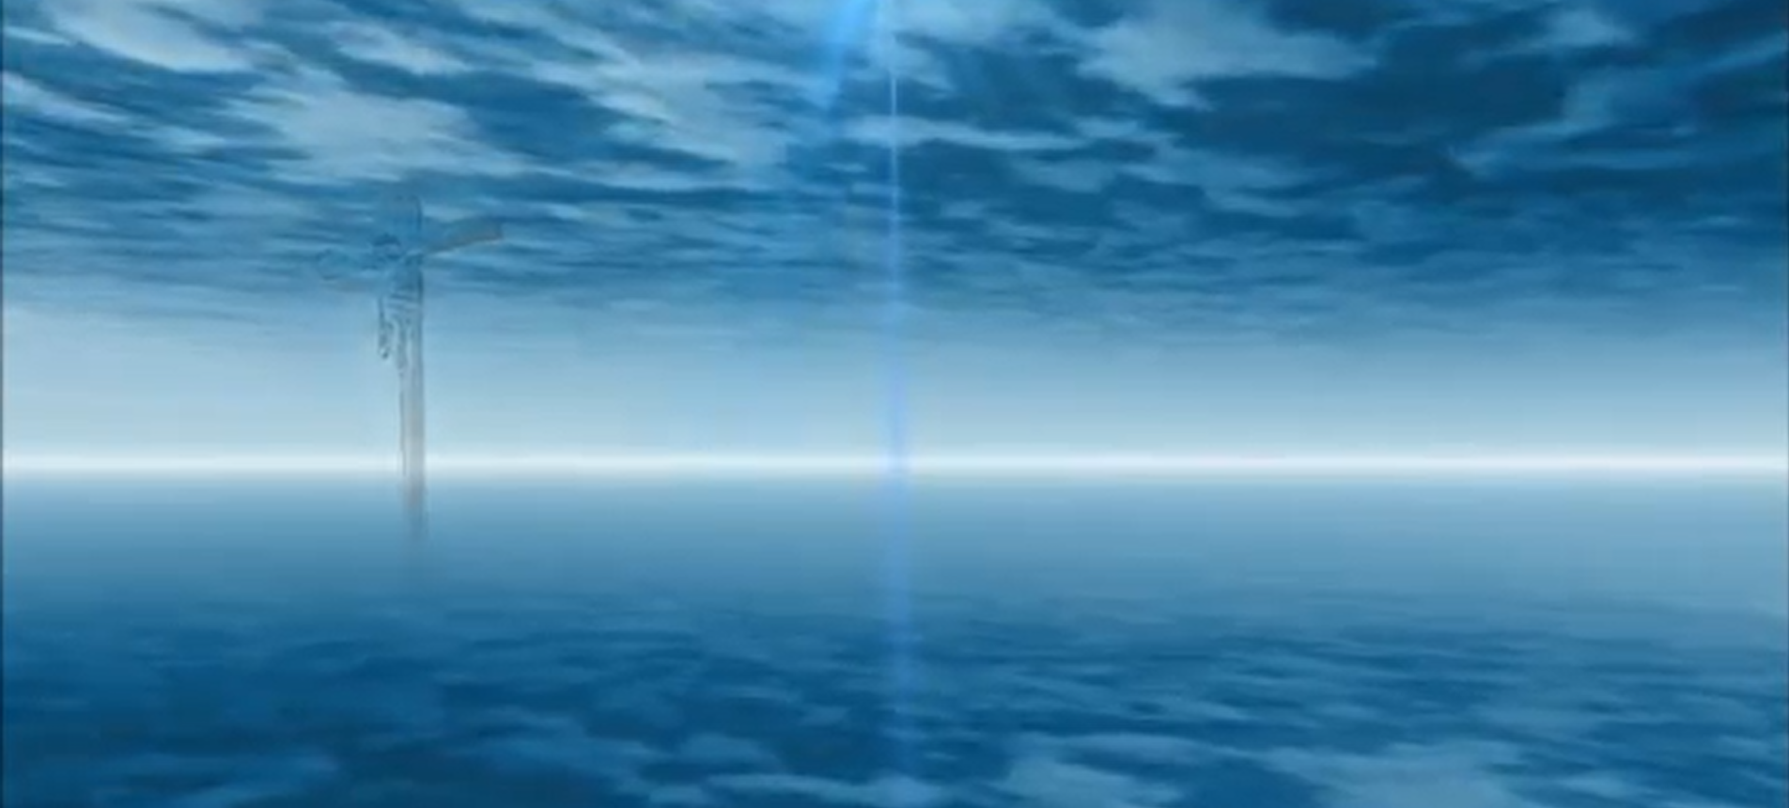
Spirit lead me where my trust is without borders, let me walk upon the waters wherever you would call me.
Take me deeper than my feet could ever wander, and my faith will be made stronger, in the presence of my saviour. x6

Slide 97
And I will call upon your name, and keep my eyes above the waves,
When oceans rise, my soul will rest in your embrace, for I am yours, and you are mine.

Slide 98

Sit still and pray for your own private intentions
Think of one thing or one person that you would like to pray for…
Notes:
98

Slide 99
MISSION
WE GO FORTH
As we conclude our Feast Day Mass we remind ourselves that everything we do is for the Greater Glory of God.
During the rest of this academic year, gift us with open hearts to seek you and proclaim your word.
We are sent forth from this Mass, taking Christ and his blessing with us into every encounter.
A.M.D.G. – For the Greater Glory of God

Slide 100
PLEASE STAND
LET US PRAY

Slide 101

COLLEGE PRAYER

Slide 102


Olivia Owen - Head Girl
The Lord be with you.
AND WITH YOUR SPIRIT.
May almighty God bless you, the Father, and the Son, and the Holy Spirit.
AMEN.

Slide 103

Go in peace, glorifying the Lord by your life.
THANKS BE TO GOD.

Slide 104

BLESSED BE THE NAME OF THE LORD
Blessed be your name in a land that is plentiful, where your streams of abundance flow, Blessed be your name.
Blessed be your name, when I’m found in the desert place, though I walk through wilderness, Blessed be your name.

Slide 105

Every blessing you pour out I’ll turn back to praise. When the darkness closes in, Lord, still I will say,
Blessed be the name of the Lord, Blessed be your name Blessed be the name of the Lord Blessed be your glorious name.

Slide 106
Blessed be your name When the sun’s shining down on me When the world’s all as it should be Blessed be your name.
Blessed be your name On the road marked with suffering Though there’s pain in the offering Blessed be your name.

Slide 107
Every blessing you pour out I’ll turn back to praise. When the darkness closes in, Lord, still I will say,
Blessed be the name of the Lord, Blessed be your name Blessed be the name of the Lord Blessed be your glorious name.

Slide 108
You give and take away You give and take away My heart will choose to say Lord blessed be your name. x2
Blessed be the name of the Lord, Blessed be your name Blessed be the name of the Lord Blessed be your glorious name. x2

Slide 109
BLESSED EDWARD OLDCORNE FEAST DAY MASS
Friday 23rd January 2026
St. John Bosco Feast Day
January 31st
A.M.D.G. – For the Greater Glory of God
Notes:
109

Slide 110
AMAZING GRACE
All these pieces Broken and scattered In mercy gathered Mended and whole. Empty-handed But not forsaken I've been set free I've been set free.
Amazing grace How sweet the sound That saved a wretch like me, I once was lost But now I'm found Was blind but now I see.
You take our failure You take our weakness You set Your treasure In jars of clay. So take this heart, Lord I'll be Your vessel The world to see Your life in me.
Oh, I can see it now Oh, I can see the love in Your eyes Laying yourself down Raising up the broken to life.

Slide 111

CHOIR
SING AMAZING GRACE
ON EXIT

