Slide 1




RECONCILIATION SERVICE
Friday 12th December
ADVENT 2025
HOLY SPIRIT HELP ME SEE,
WHERE THERE IS
NINEVEH IN ME.
A.M.D.G. – For the Greater Glory of God

Slide 2

NINEVEH
FOLLOW THE LYRICS

Slide 3
RECONCILIATION SERVICE
Friday 12th December
ADVENT 2025
HOLY SPIRIT HELP ME SEE,
WHERE THERE IS
NINEVEH IN ME.
A.M.D.G. – For the Greater Glory of God

Slide 4
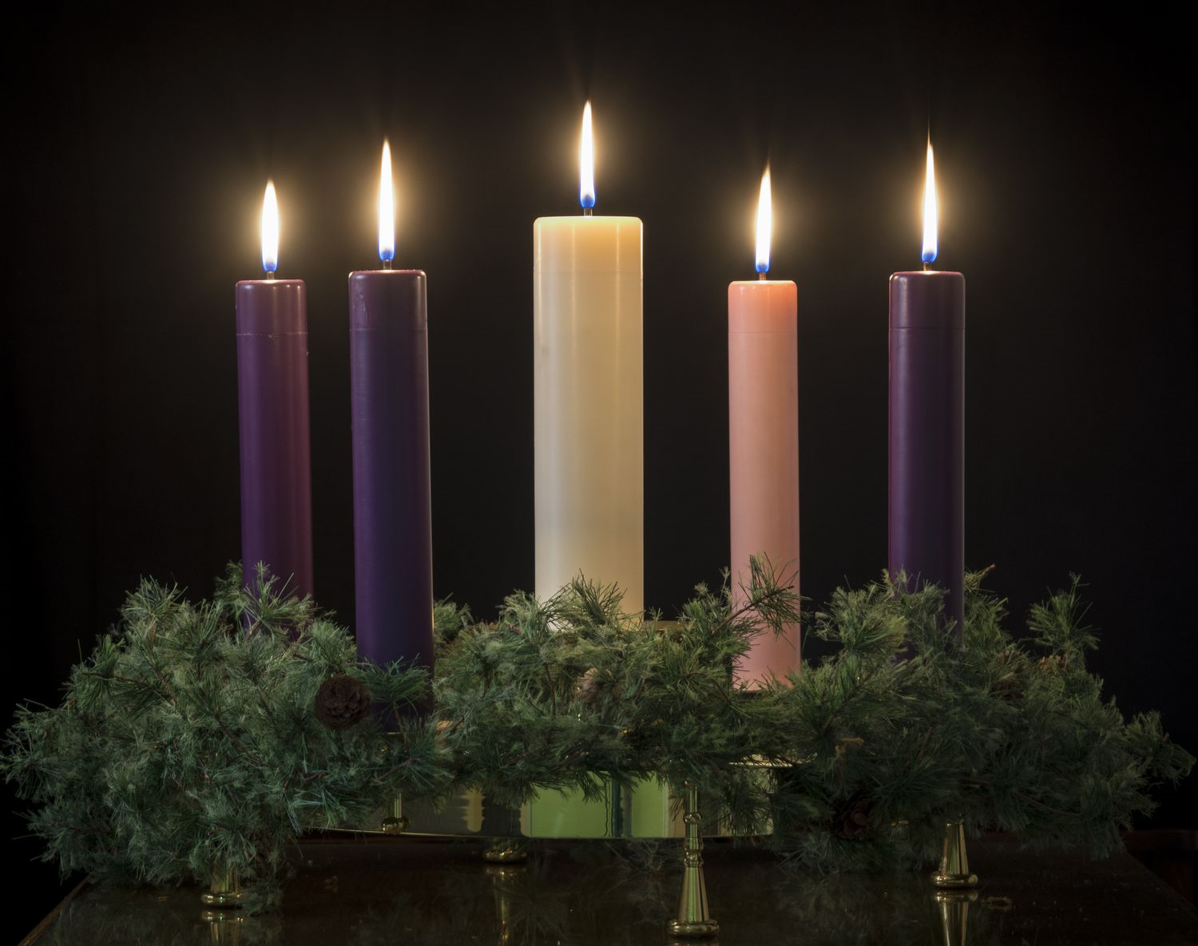

Christmas Day
2nd Sunday of Advent
3rd Sunday of Advent
Sunday before Christmas
1st Sunday of Advent
Purity
Joy
Love
Peace
Hope
We light our Advent Wreath
Notes:
4

Slide 5
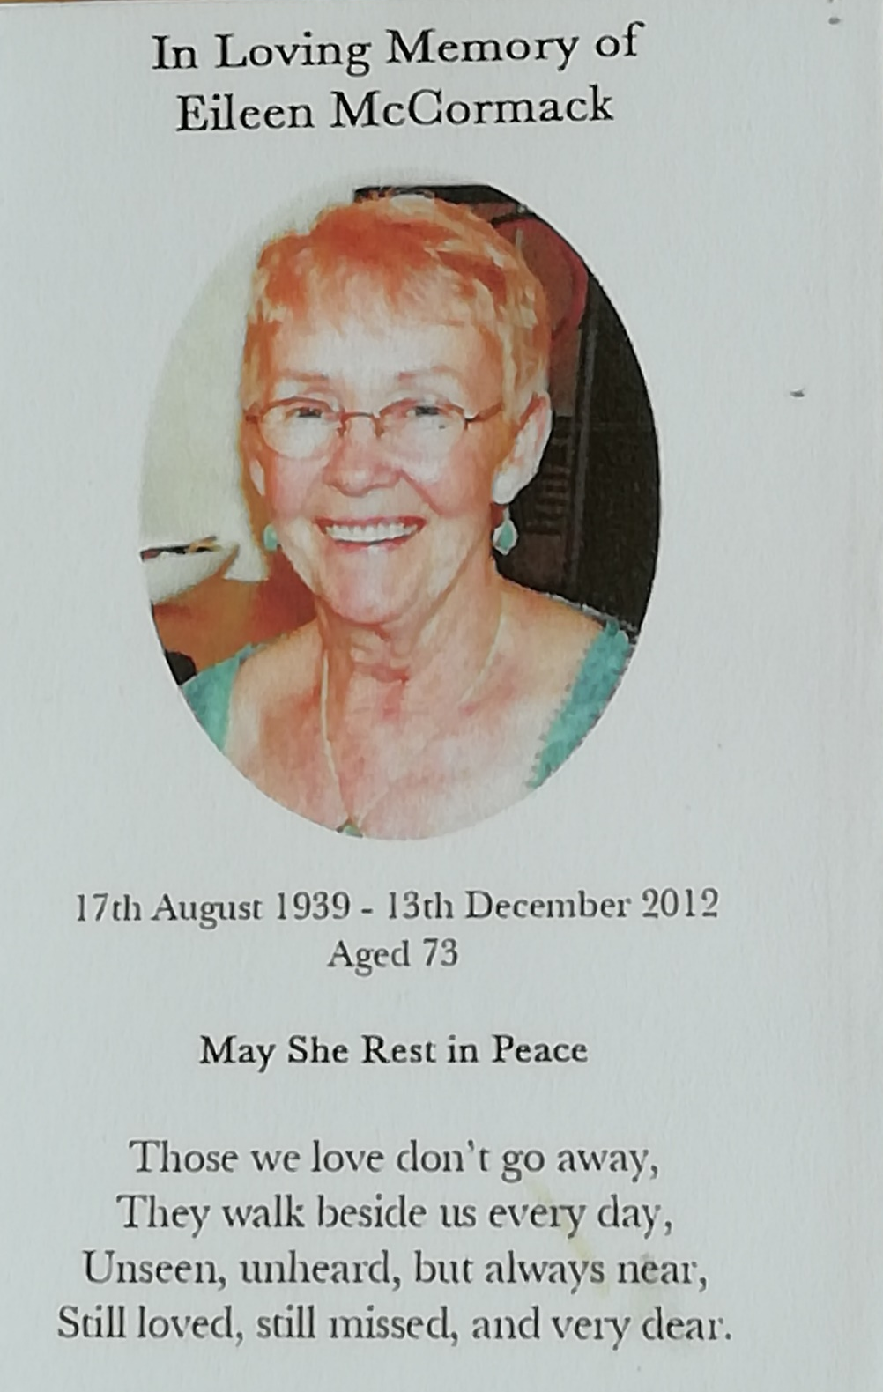
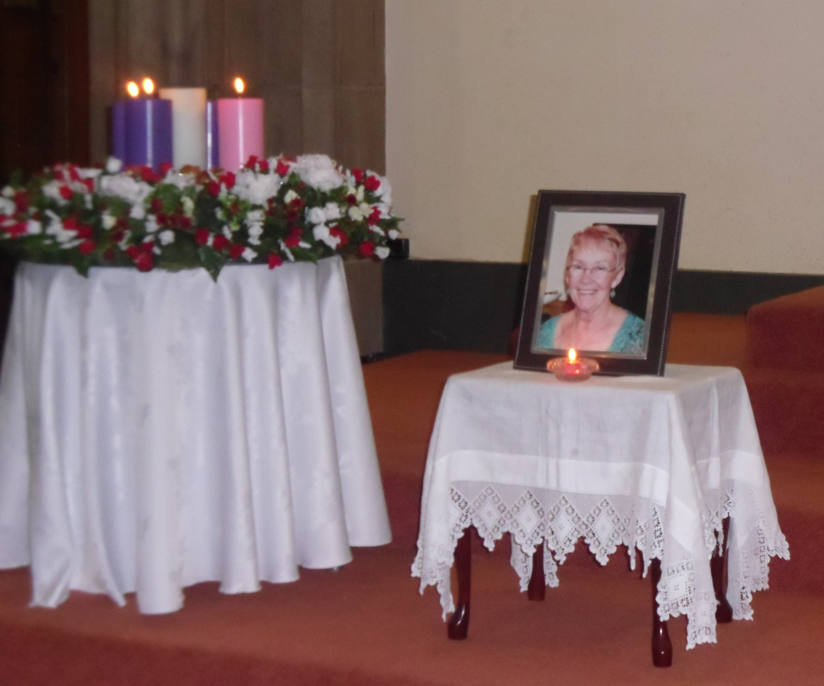

Slide 6


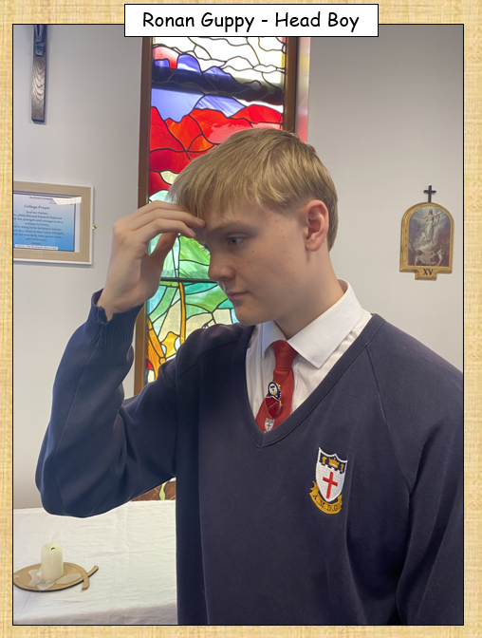

LET US BEGIN OUR RECONCILIATION SERVICE
I invite you all to say and make the Sign of the Cross
In the name of the Father and of the Son and of the Holy Spirit Amen.
A.M.D.G. – For the Greater Glory of God

Slide 7
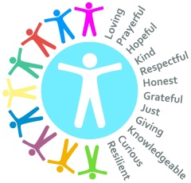
WE GATHER
Welcome to our Reconciliation Service.
We gather today to continue our ADVENT JOURNEY towards the joyous events of Christmas, when, through the Incarnation, God himself came to earth.
Today, as part of our preparation, we have an opportunity to
Say SORRY and ask for FORGIVENESS
for any bad things that we may have done.
A.M.D.G. – For the Greater Glory of God
Notes:
7

Slide 8
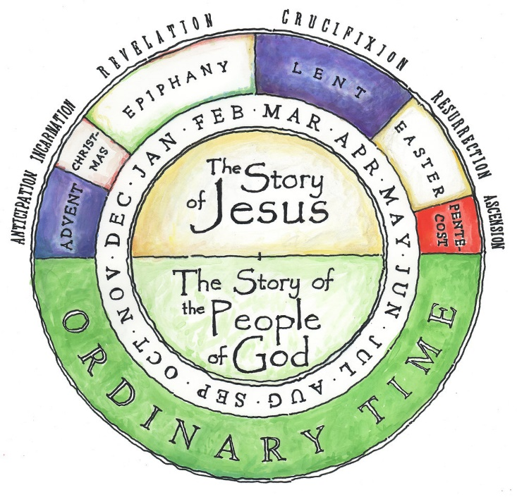
LITURGICAL SEASONS
PURPLE
This Service of Reconciliation offers us
GOD’S GIFT OF
FORGIVENESS
THE SEASON OF ADVENT
A.M.D.G. – For the Greater Glory of God
Notes:
8

Slide 9
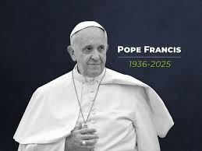
The 2025 Jubilee Year of Hope in the Catholic Church ends on January 6th, 2026, which is the Feast of the Epiphany.
The concept of “Jubilee”
has its origins in the Book of Leviticus as a special year of pilgrimage,
coming home,
and
RECONCILIATION

Slide 10
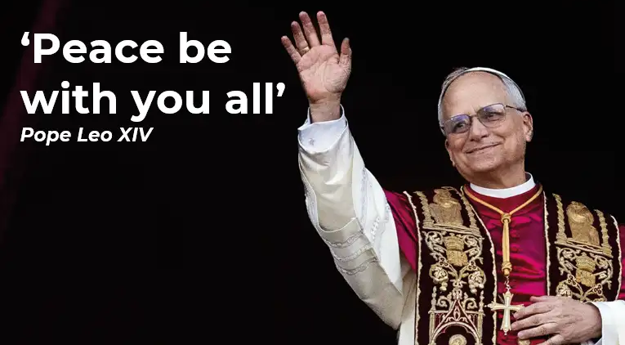
HOW CAN YOU ACHIEVE PEACE?
THROUGH – RECONCILIATION.

Slide 11
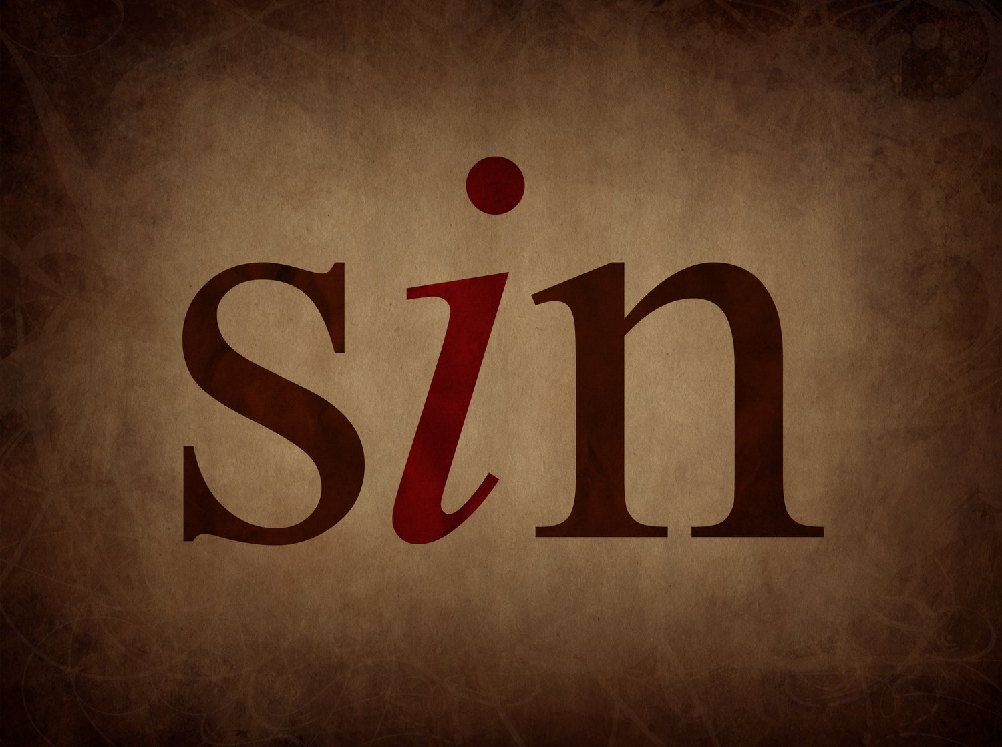
ONE BARRIER TO PEACE IS SIN

Slide 12
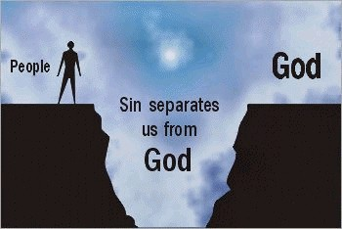

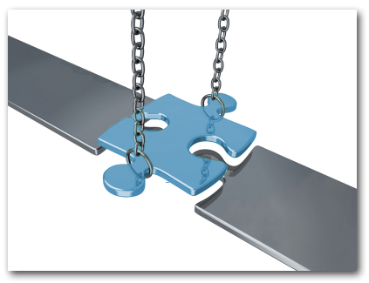
POPE LEO HAS ALSO ASKED US TO BE BRIDGE BUILDERS…

Slide 13
So - Sin is personal
Blind to our sin
On purpose/accidental
Ownership/acceptance/Not perfect!
Say sorry/reconciliation
Ask for forgiveness/mercy…

Slide 14
NINEVEH
The hymn that was playing as you entered the hall is called NINEVEH, the name of an ancient city.
It’s a song based on the book of Jonah in the Old Testament.
Nineveh was an evil place where people were very cruel, they worshipped pagan Gods and false idols..
The lyrics call us to return to God in repentance.
Today we are going to ask the Holy Spirit to help us see, where there is any aspect of ‘Nineveh’ within us.

Slide 15

RECONCILIATION SERVICE
Friday 12th December
ADVENT 2025
HOLY SPIRIT HELP ME SEE,
WHERE THERE
NINEVEH IN ME.
A.M.D.G. – For the Greater Glory of God

Slide 16

To help us continue with this service -
LET US CALL TO MIND OUR SINS…

Slide 17

PENITENTIAL ACT
You were sent to heal the contrite of heart: Lord have mercy.
LORD HAVE MERCY.
You came to call sinners:
Christ have mercy.
CHRIST HAVE MERCY.
You are seated at the right hand of the Father to intercede for us:
Lord have mercy.
LORD HAVE MERCY.

Slide 18
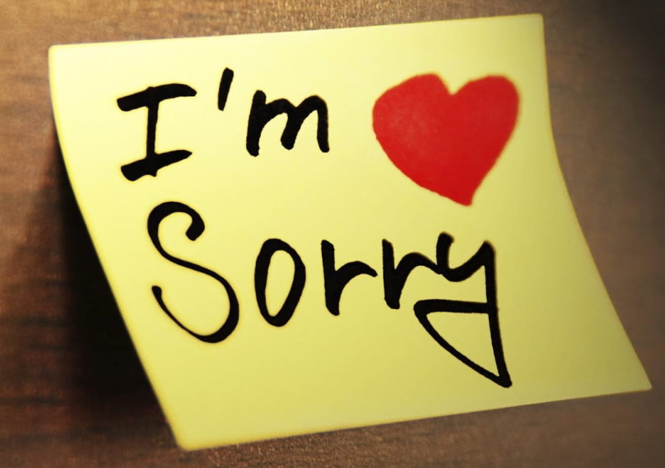
SORRY
Is there anyone in your life that you need to say sorry to?
Think of one thing
or
one person…

Slide 19
THE WORD WE LISTEN
We reflect upon the wonderful gift of forgiveness.
At times we may find it hard to forgive someone who has hurt or offended us in anyway.
Today we will learn about the ancient city of NINEVEH, a place where people openly rebelled against God, indeed, its very foundation was set in opposition to the commandments to God.
This is a tale of Gods patience and mercy and of personal and national repentance.
A.M.D.G. – For the Greater Glory of God
Notes:
19

Slide 20
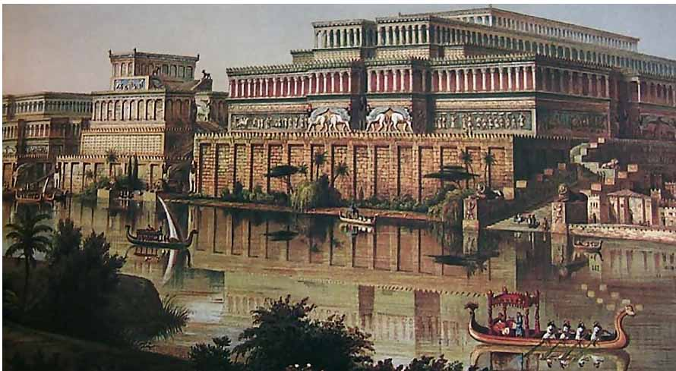
NINEVEH
The ruins of this ancient city are located near the modern-day city of Mosul in northern Iraq.
It was so big it took 3 days to walk across the it.
Archaeologists uncovered the city in 1847.

Slide 21
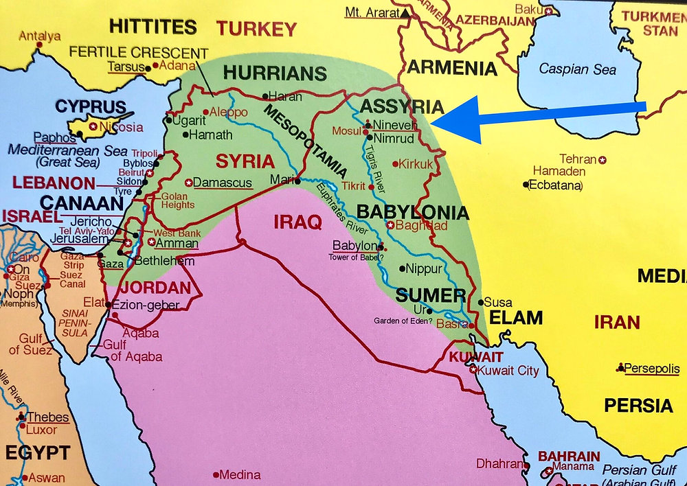

Slide 22
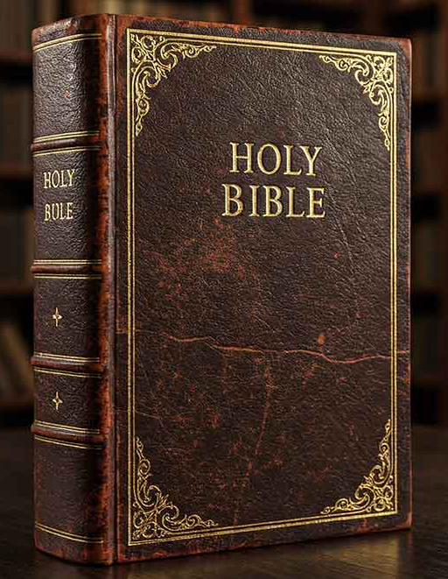
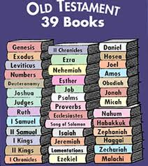
NINEVEH

Slide 23

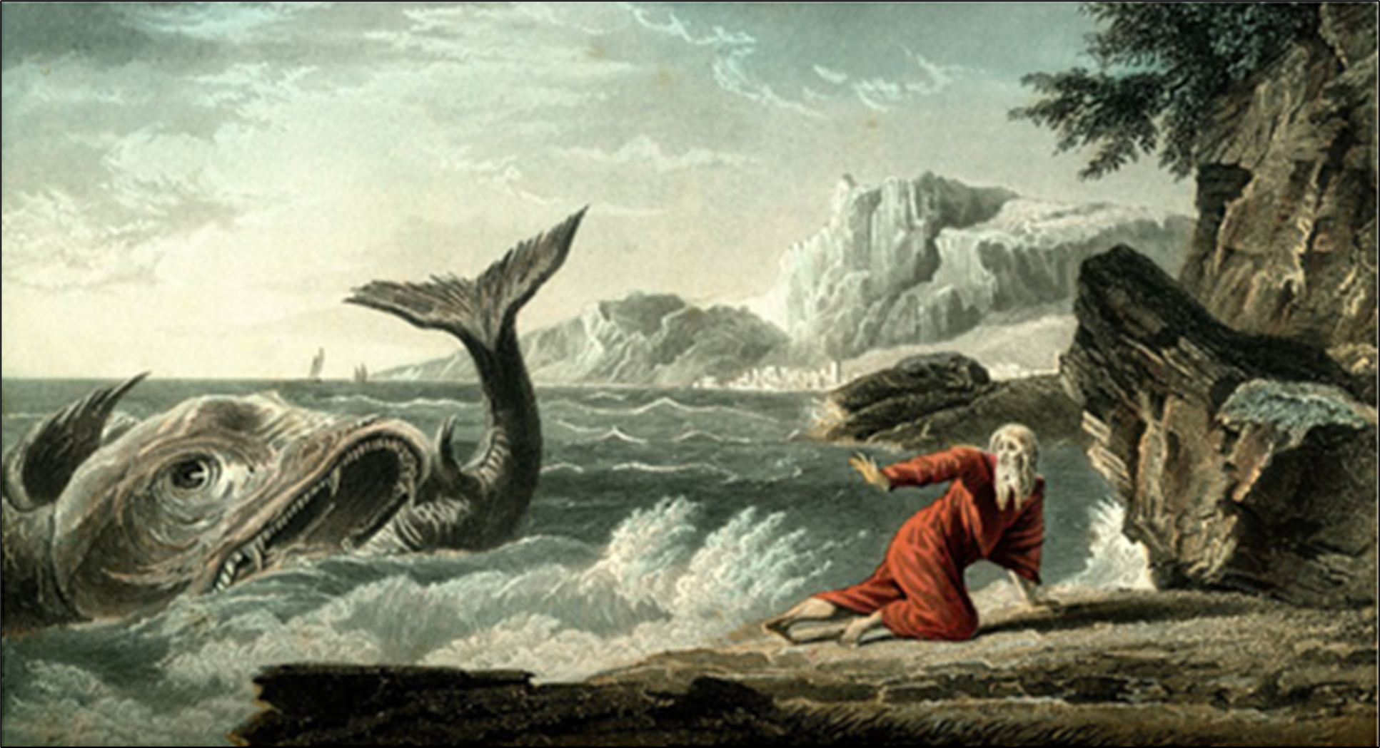
This book tells the story of Jonah, a prophet who was sent by God to Nineveh.
Nineveh was full of people living in a way that dishonoured God.
Jonah would not accept his personal sin and ended up in the belly of a whale.

Slide 24
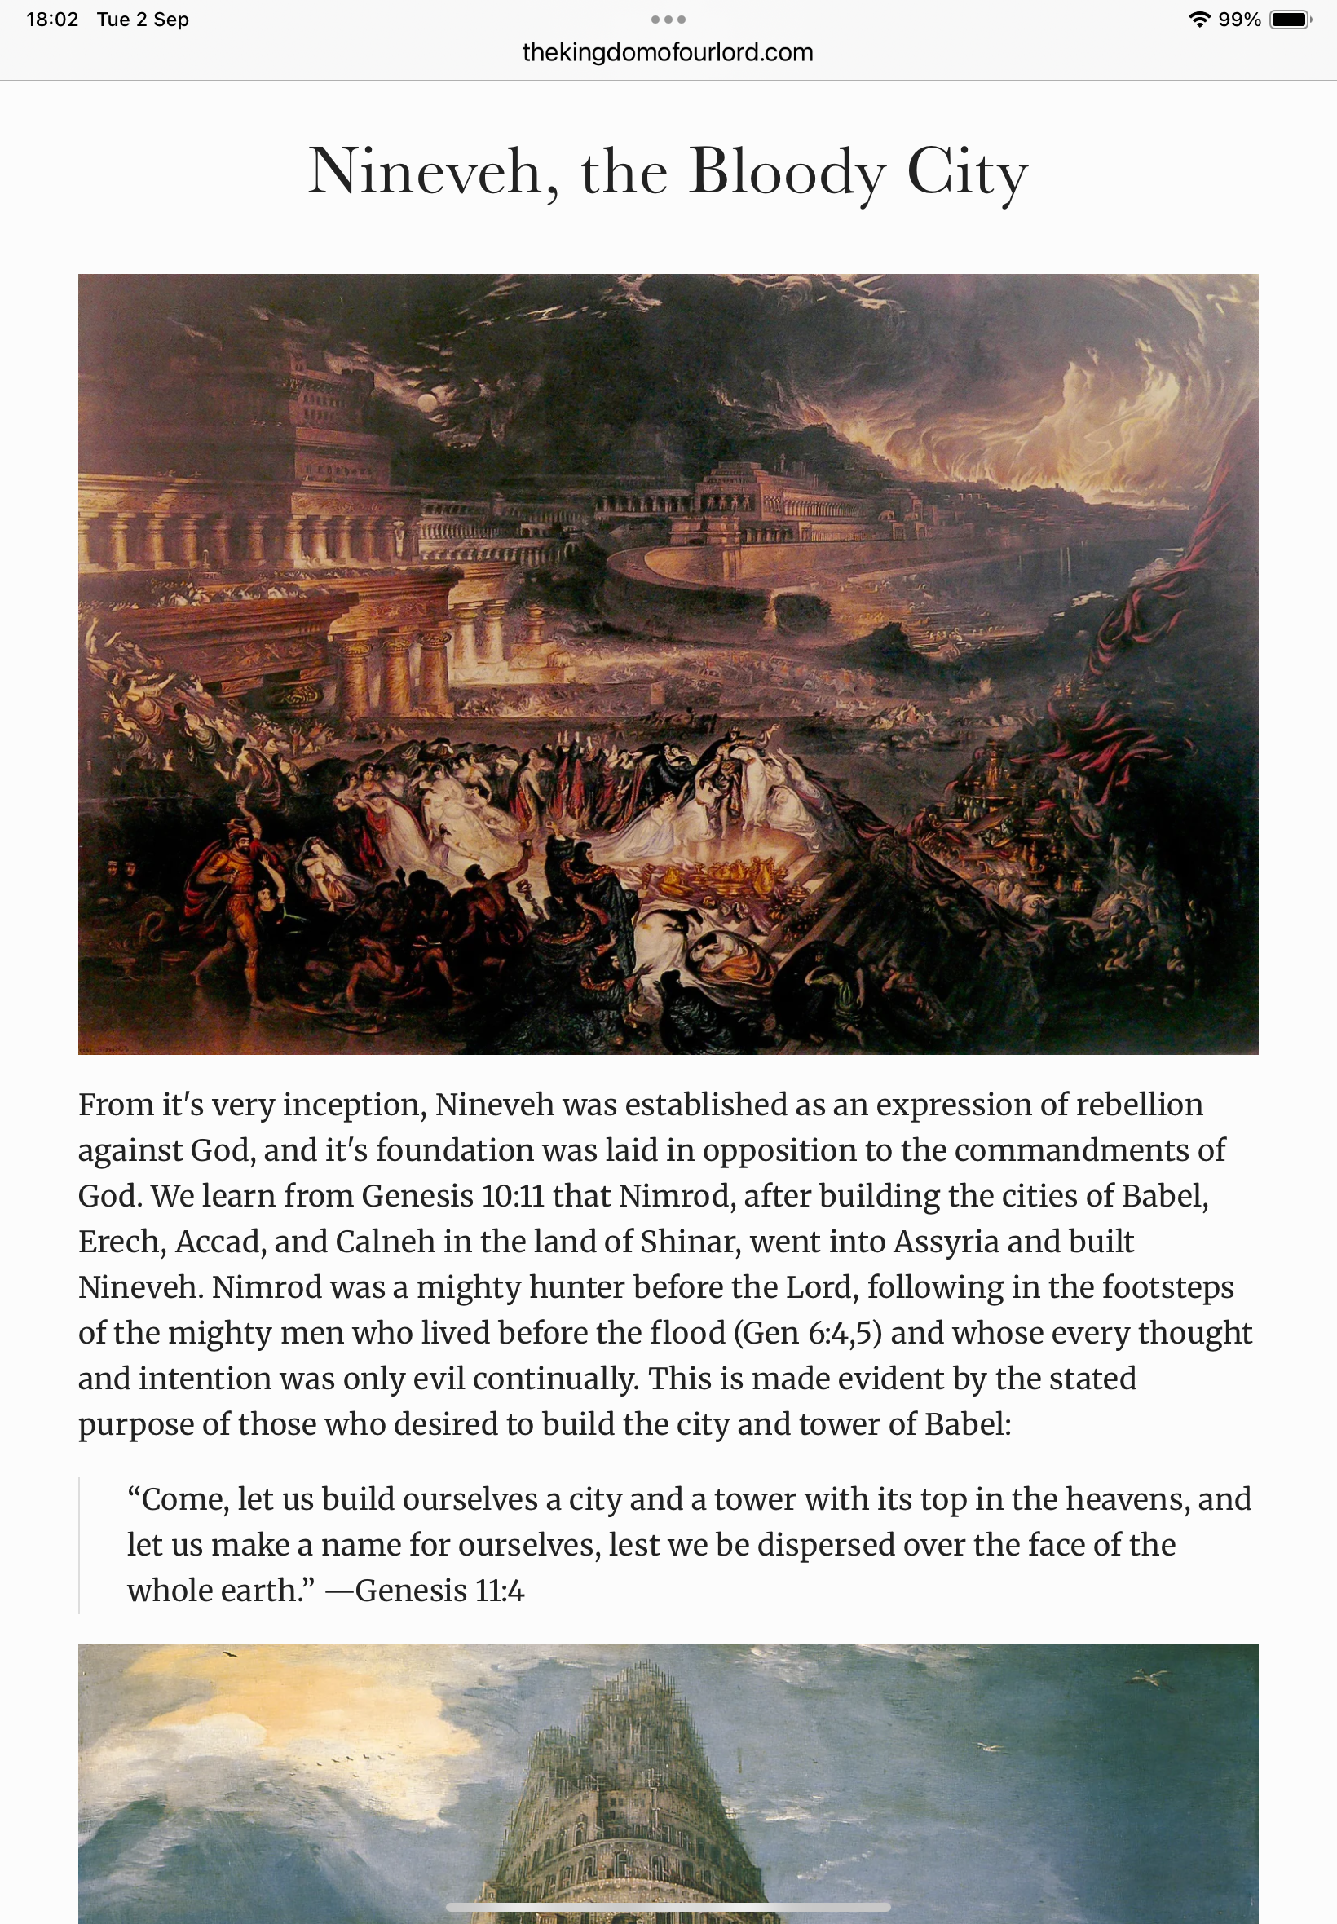
NINEVEH, THE SINFUL CITY

Slide 25
NINEVEH
A Symbol of Wickedness
Nineveh, the capital of the Assyrian empire,
was known for its arrogance, violence, and cruelty..

Slide 26
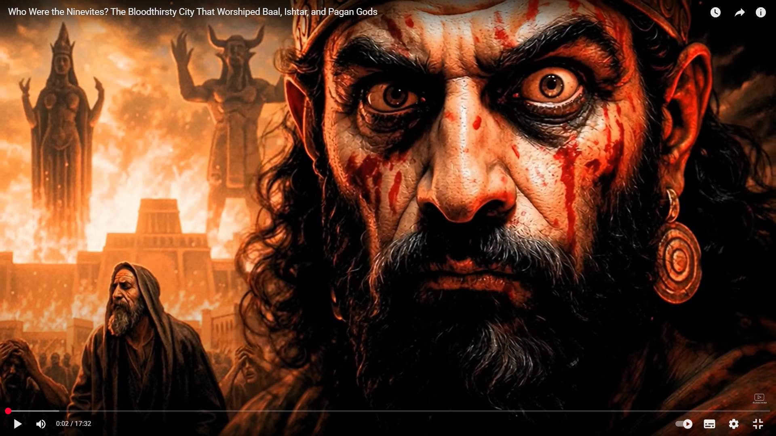
Wickedness

Slide 27
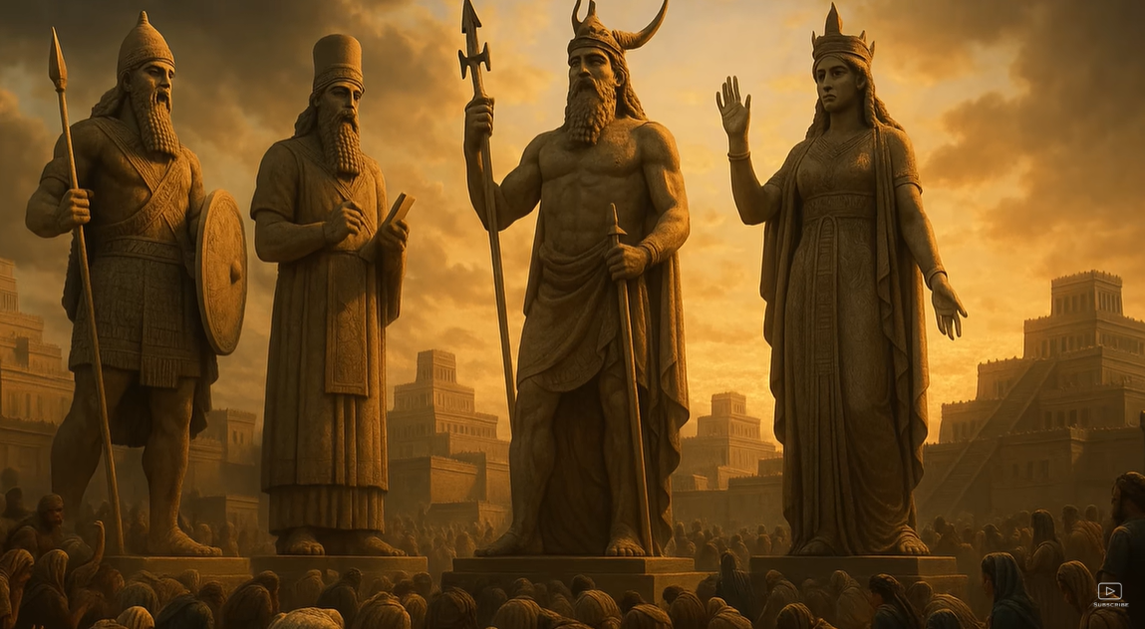
Worshipping False Gods

Slide 28
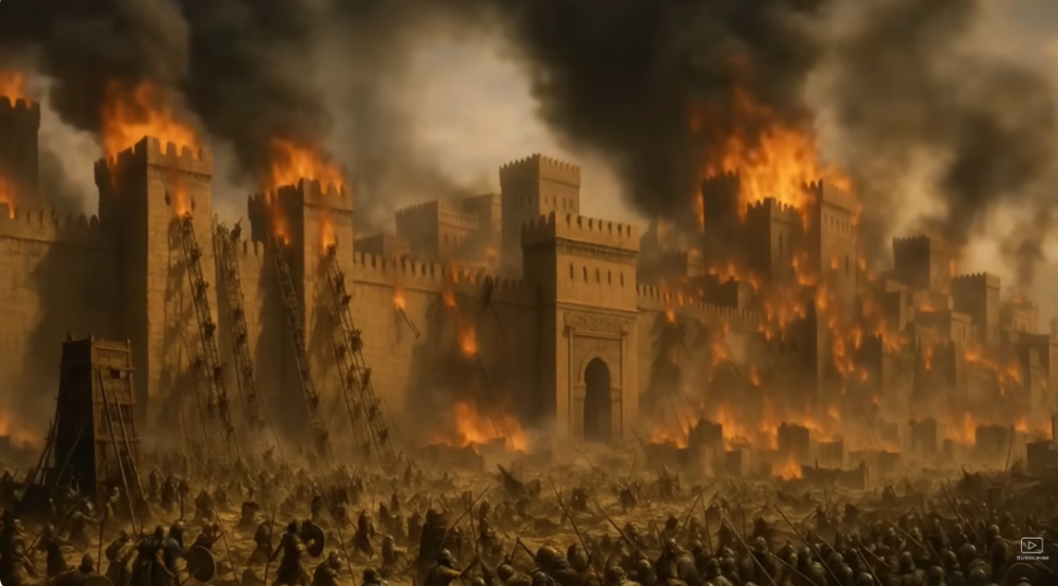
Attacking other cities

Slide 29
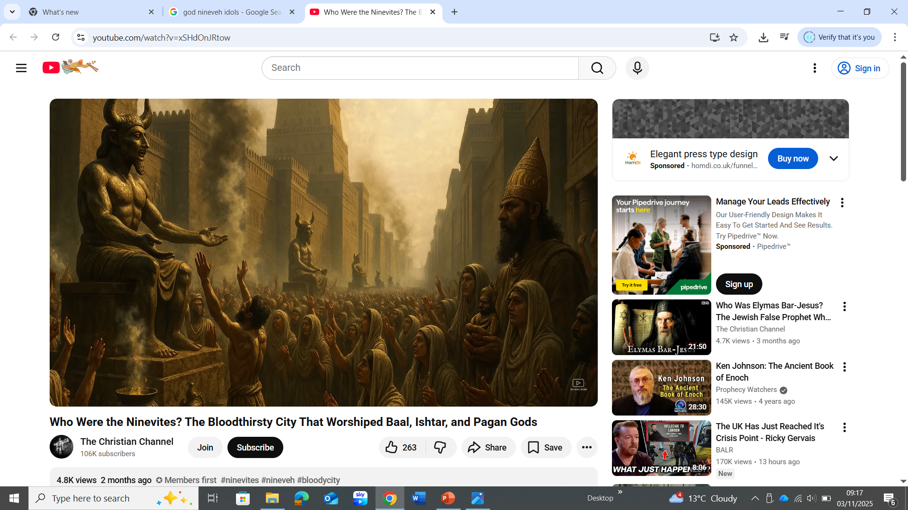
Pagan Gods

Slide 30
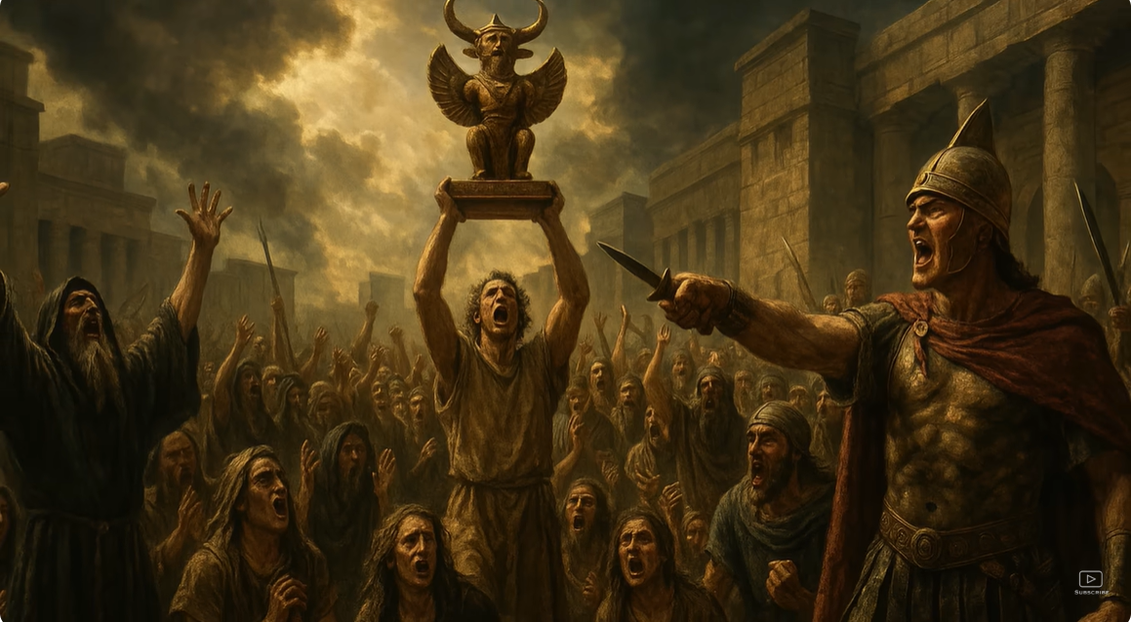
Worshipping False Gods

Slide 31
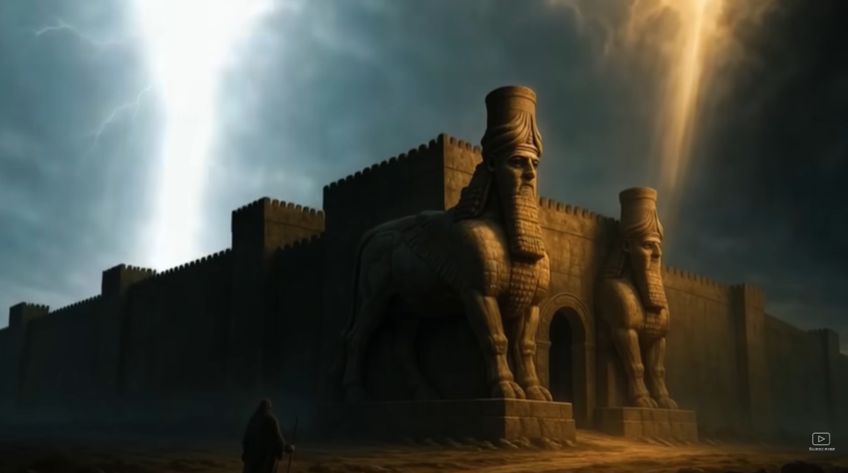
A Sinful City

Slide 32
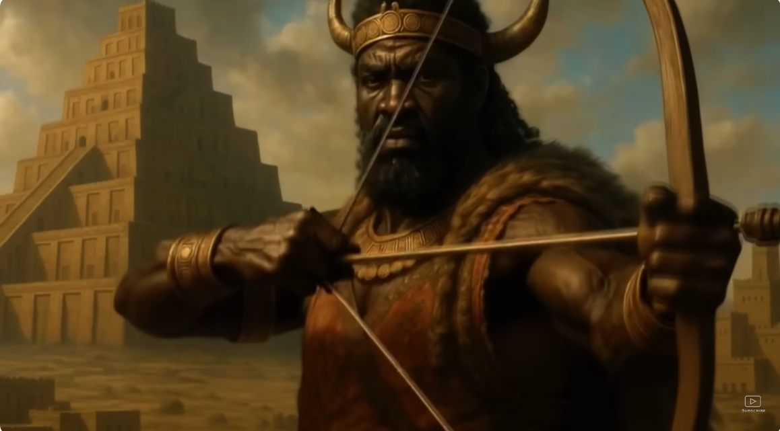
A cruel people

Slide 33
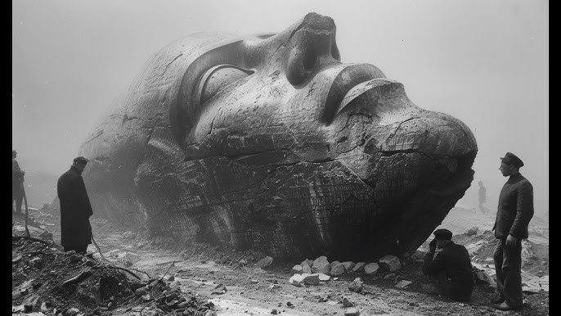
City excavated in 1847

Slide 34
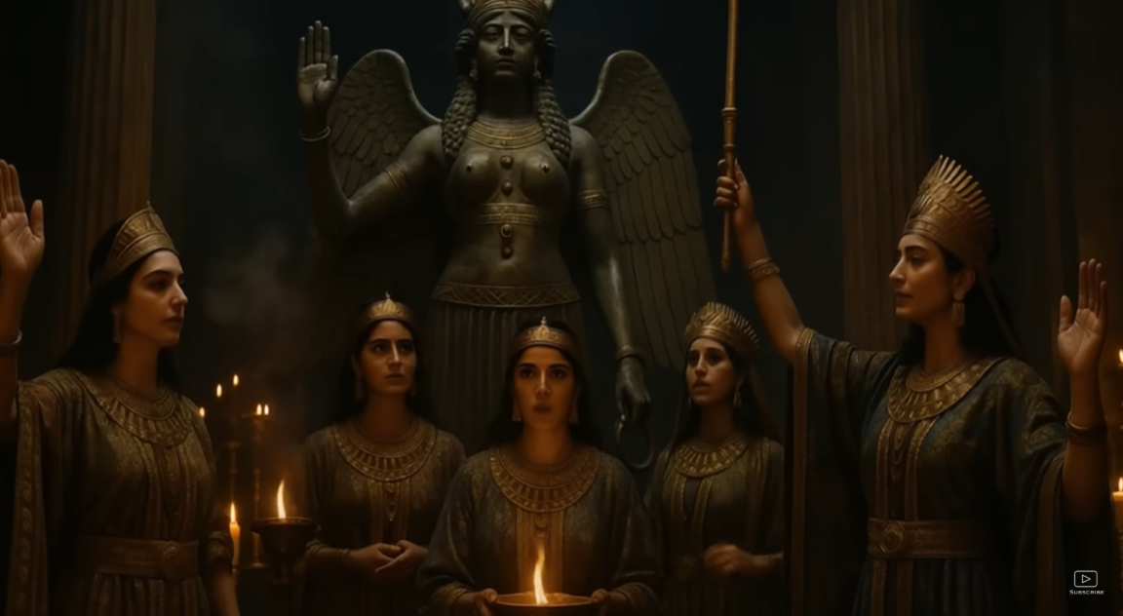
Openly rejecting God’s commandments

Slide 35
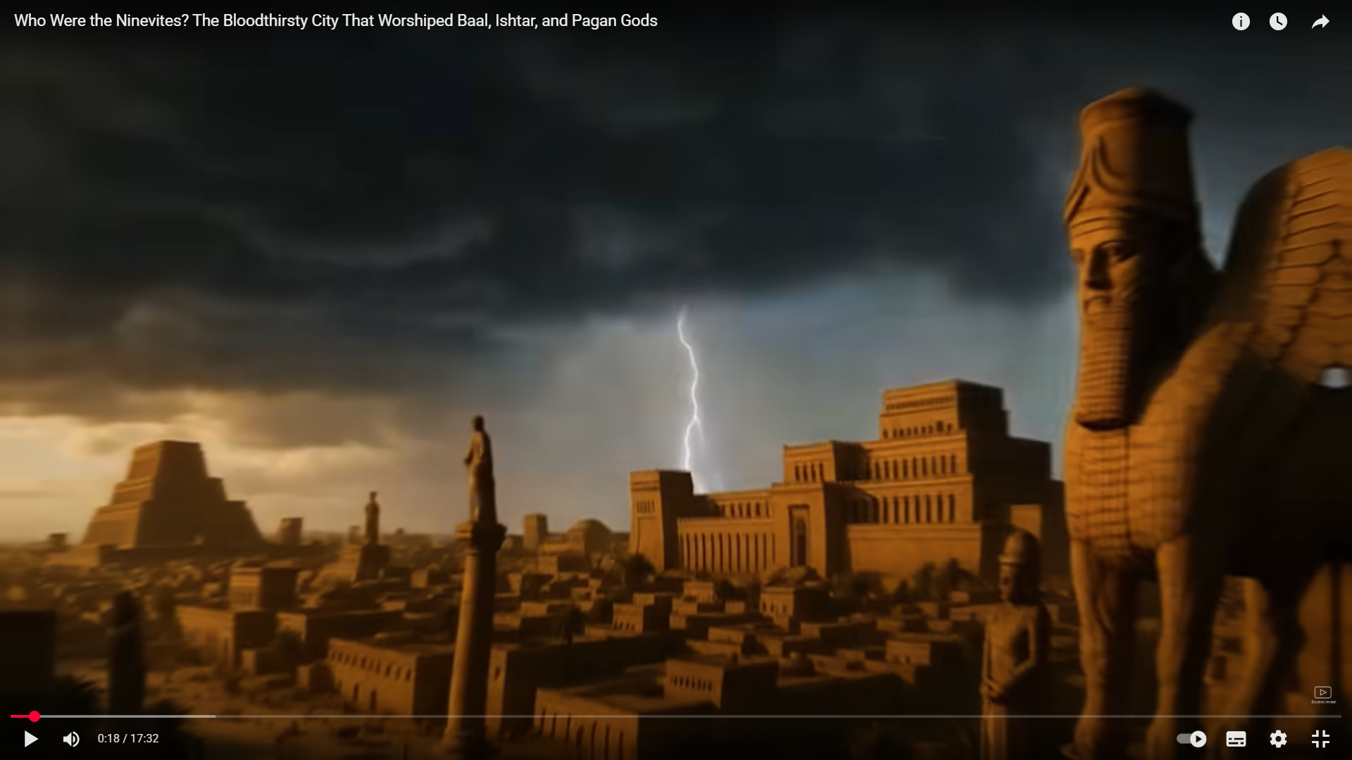
Defied God’s Commandments

Slide 36
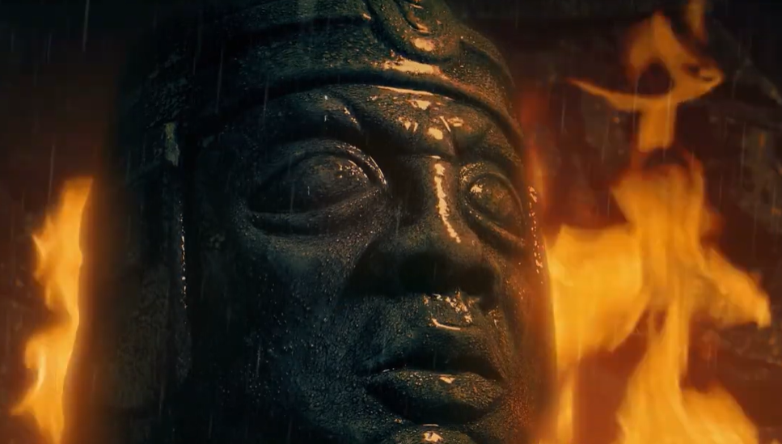
Struck Fear into their Enemies

Slide 37
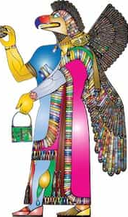
False Idols

Slide 38
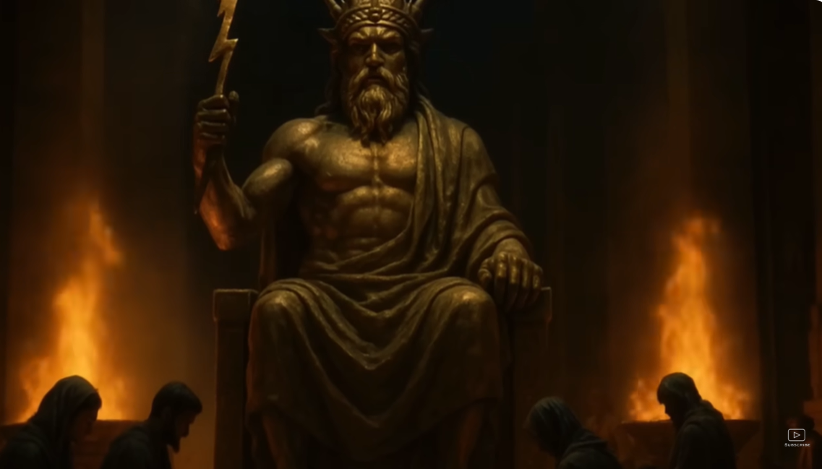
Pagan Gods

Slide 39
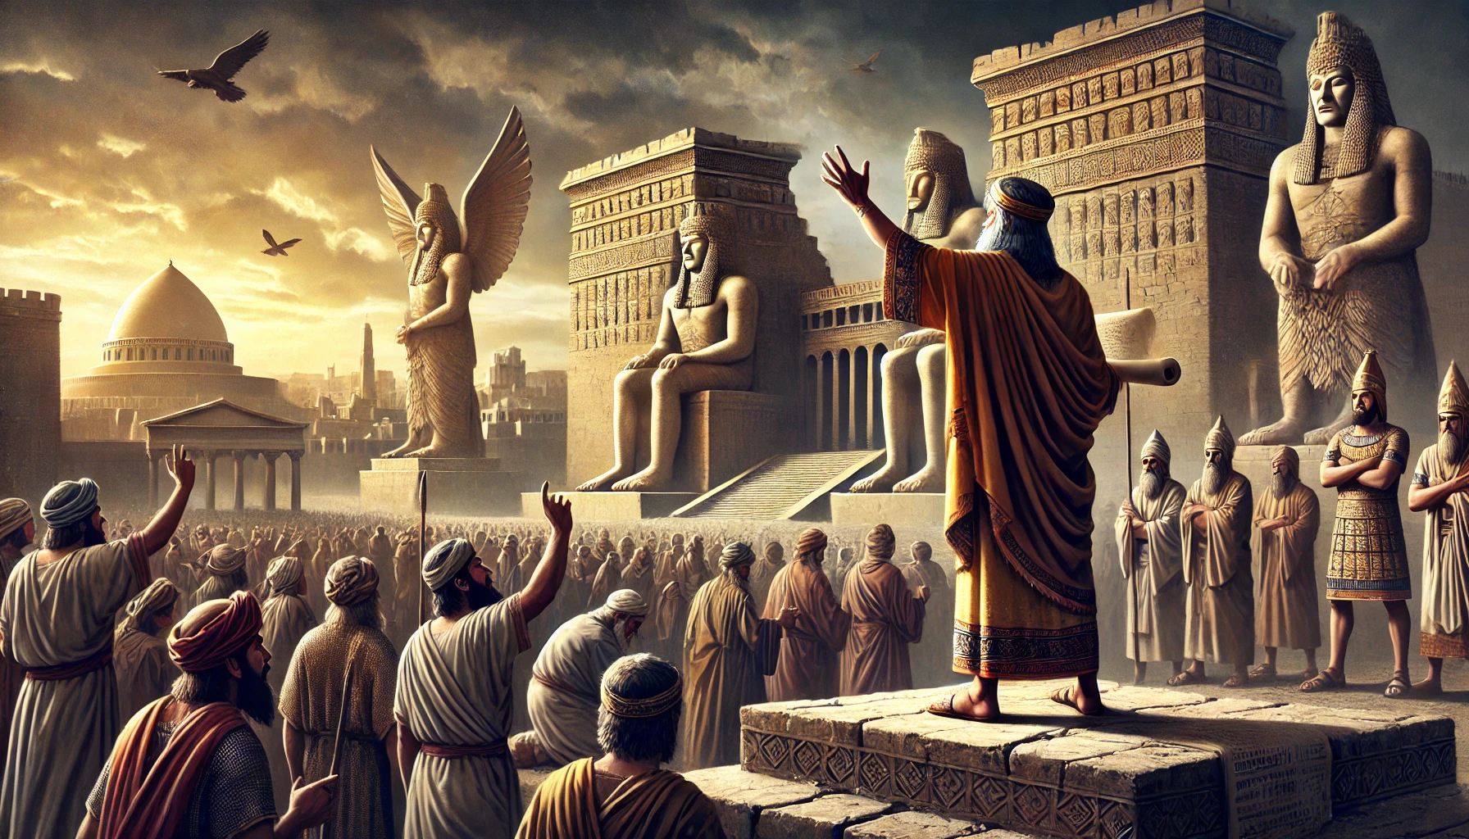
Open Rebellion against God

Slide 40
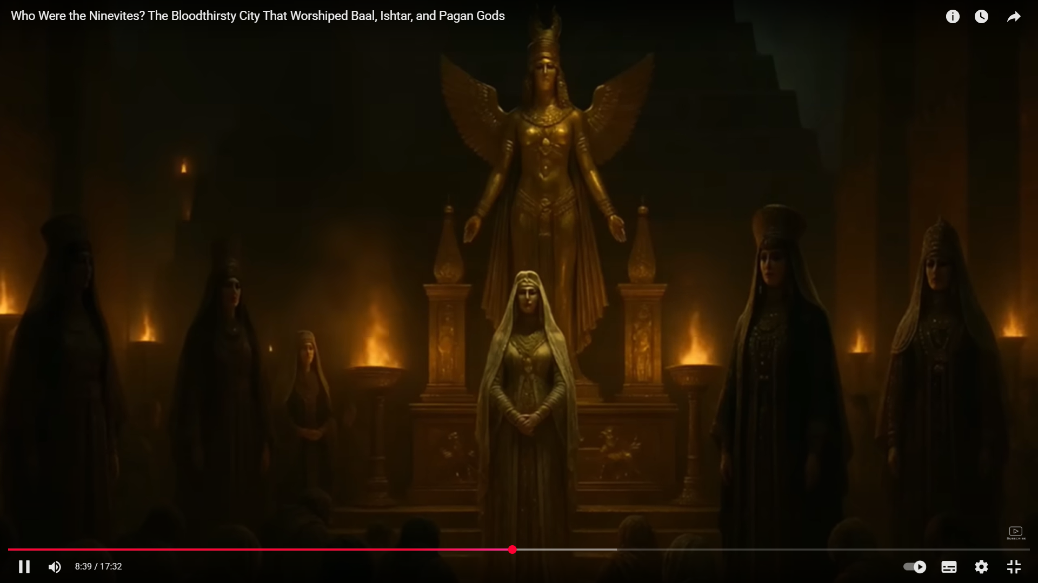
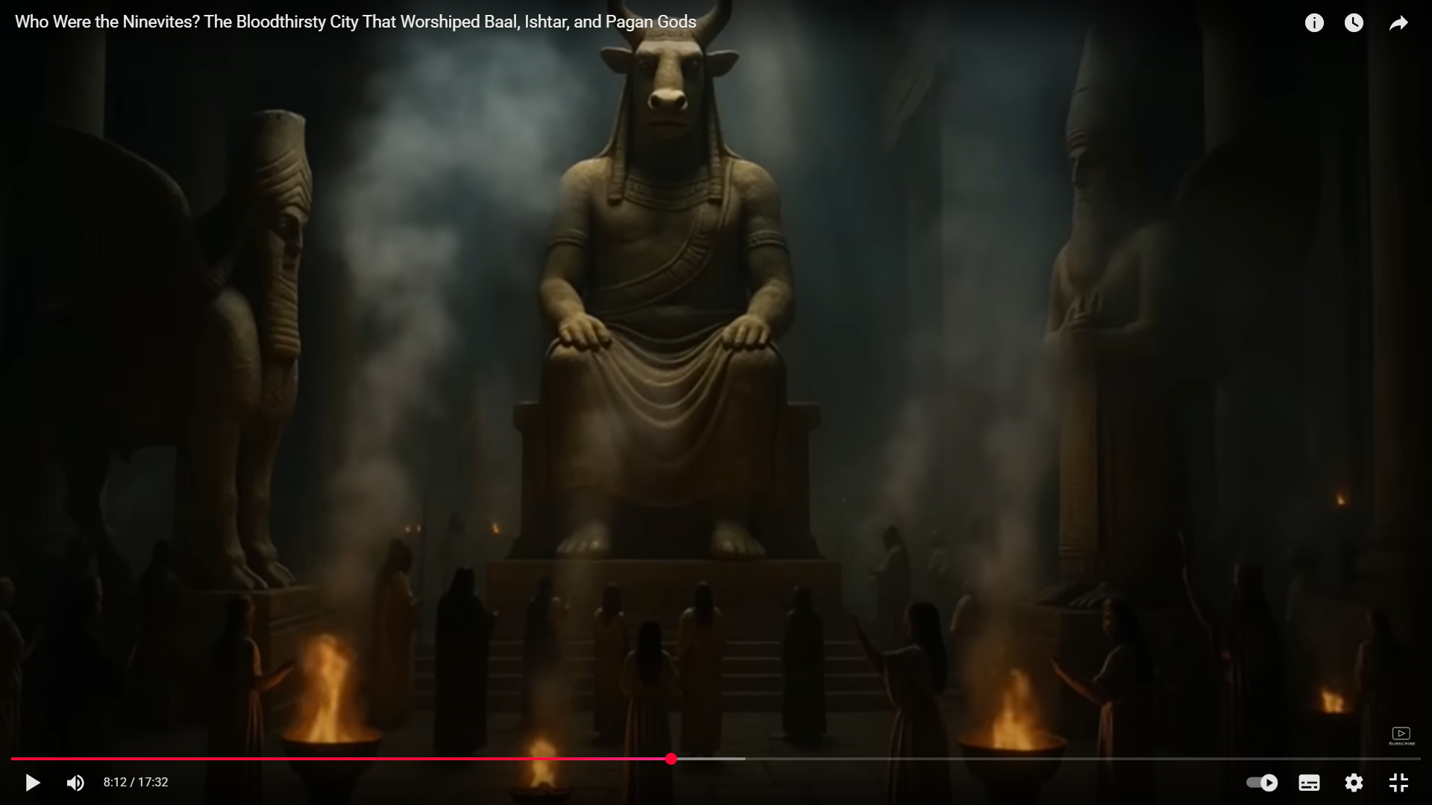
Worshipping False Idols

Slide 41
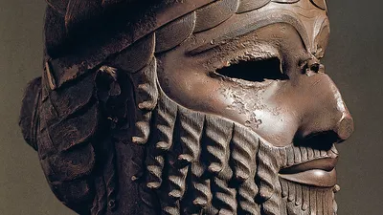
No Mercy Shown

Slide 42
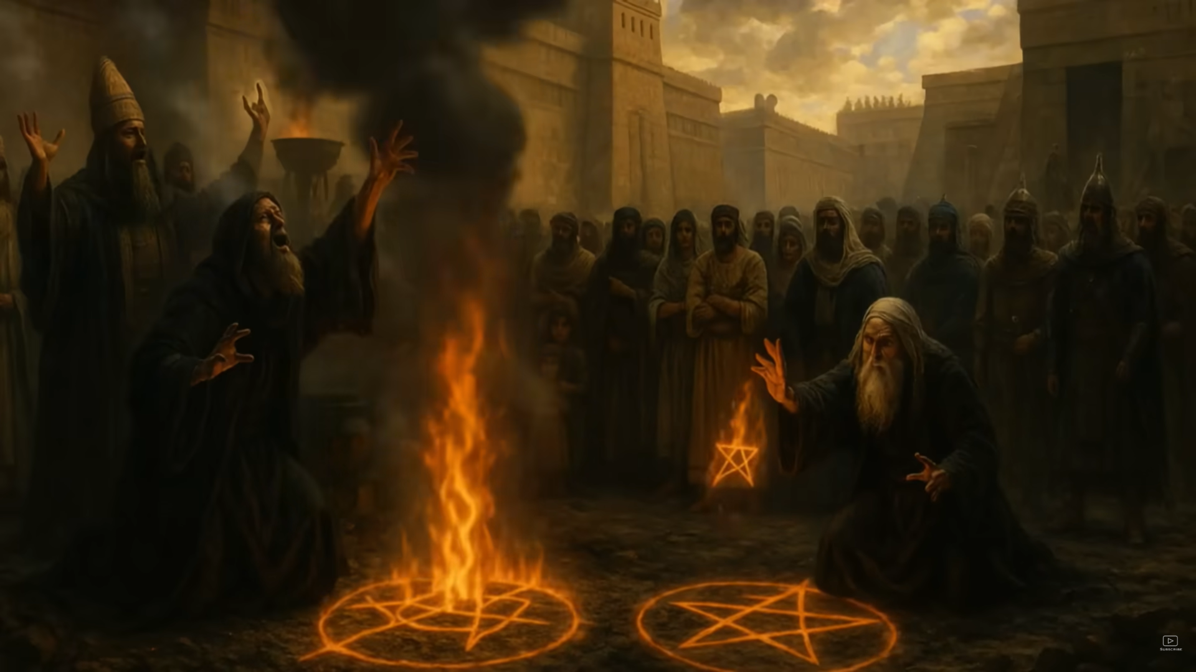
Open defiance towards God

Slide 43
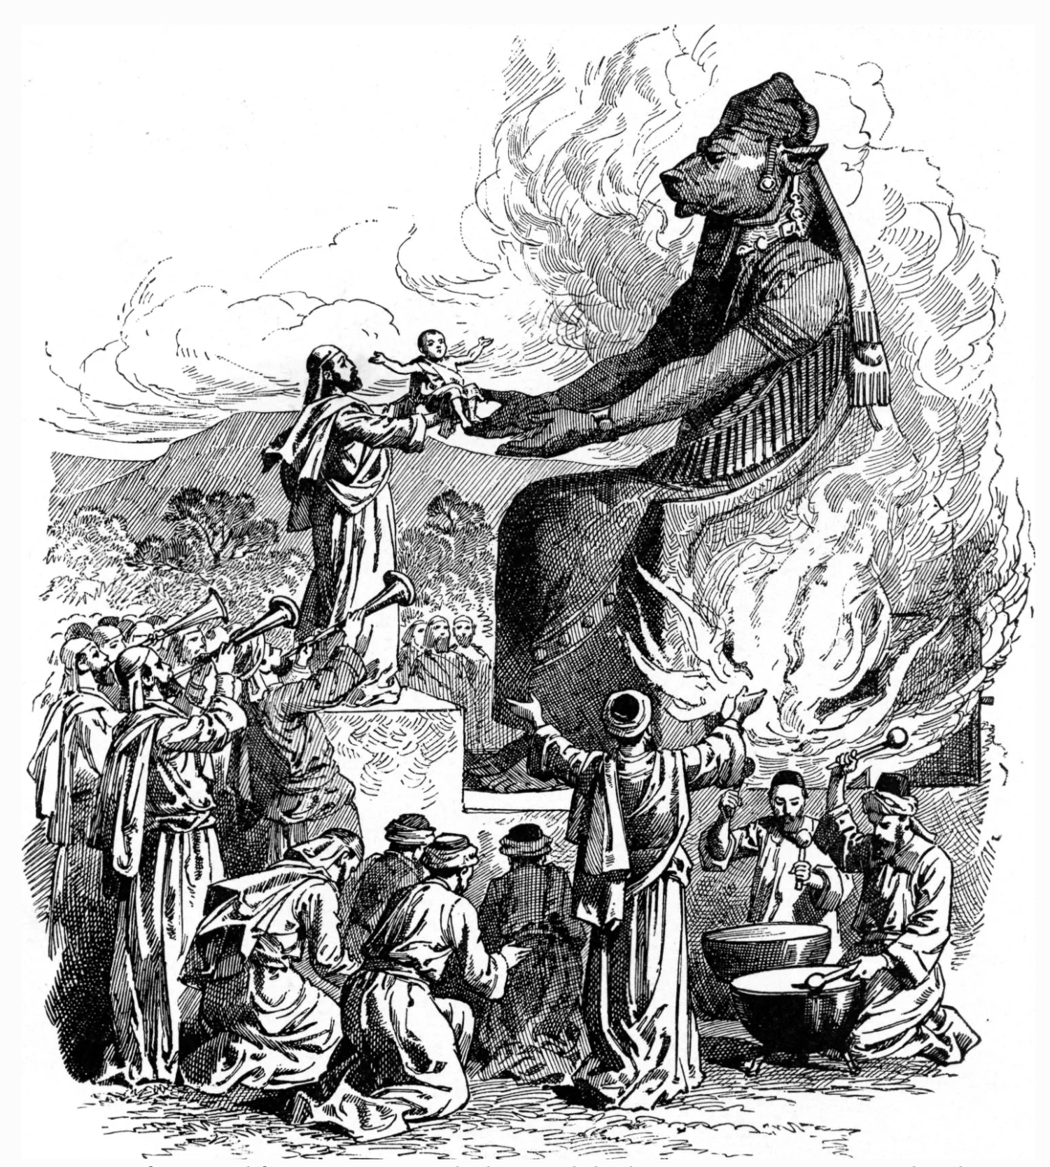
Human Sacrifices

Slide 44
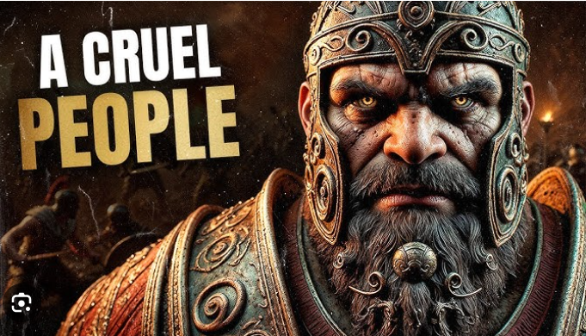

Slide 45
NINEVEH
THE SINFUL CITY

Slide 46
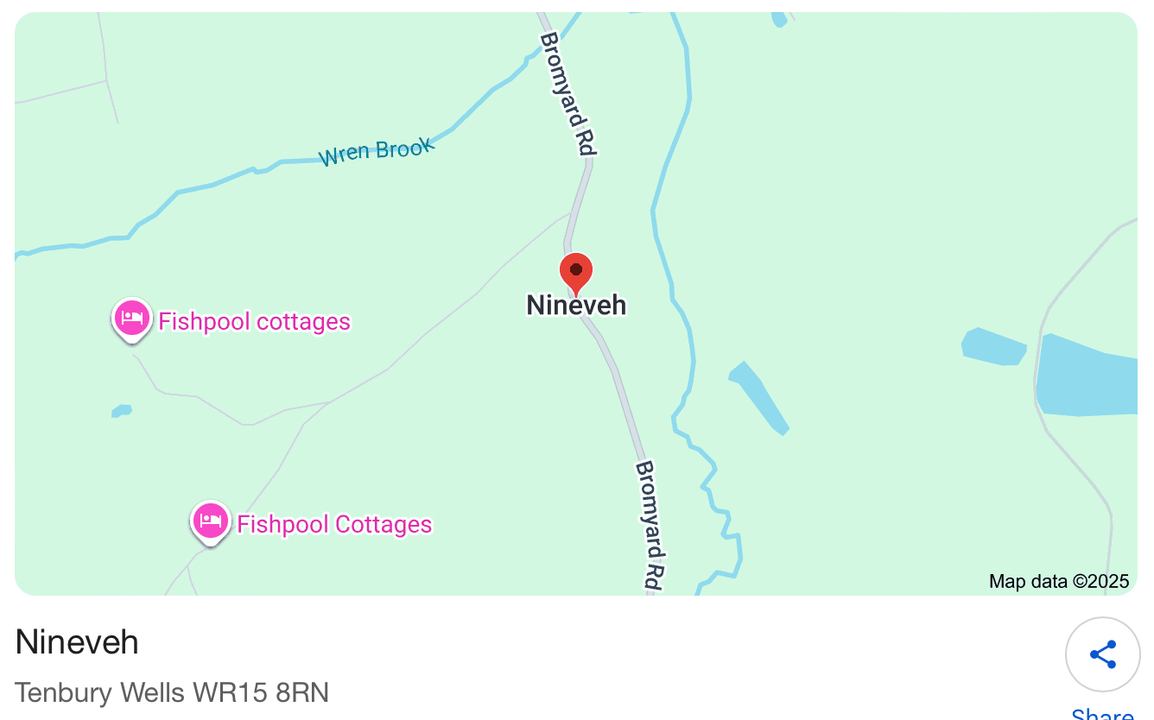
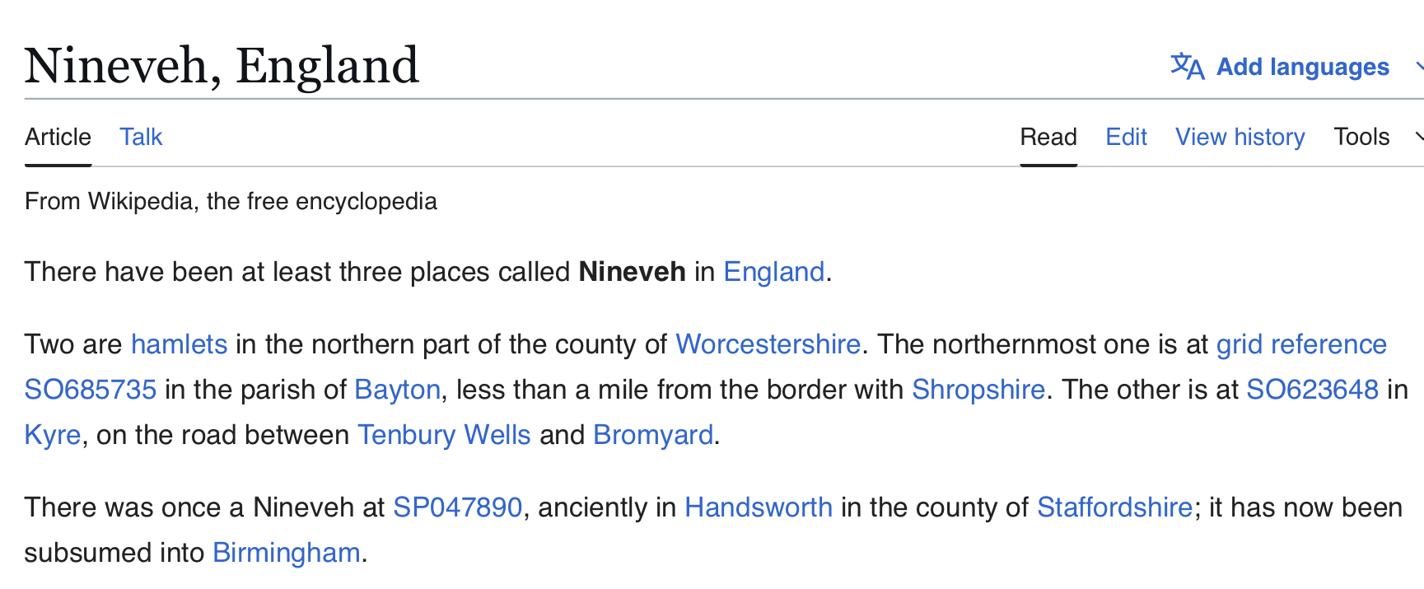
TENBURY WELLS
SHROPSHIRE
HANDSWORTH

Slide 47
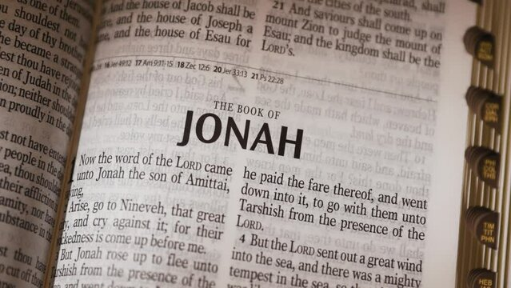
THE GOOD NEWS
The story ends by Jonah eventually reaching Nineveh.

Slide 48
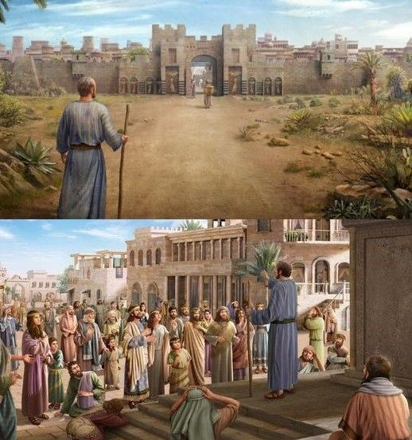
He delivers God’s message to the people of Nineveh.

Slide 49
Subsequently, they turn away from their sin and God has mercy on them.
= RECONCILIATION

Slide 50
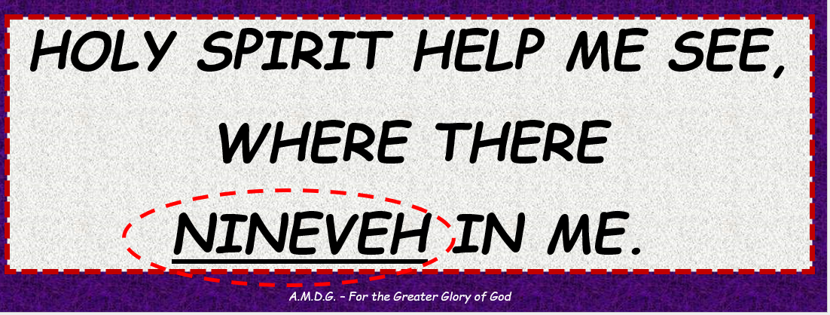
THE BIG QUESTION!
Do we accept that we too have aspects
of NINEVEH in us?
Do we need cleaning up – inside and out.
Are we honest and brave enough to recognise our faults?

Slide 51
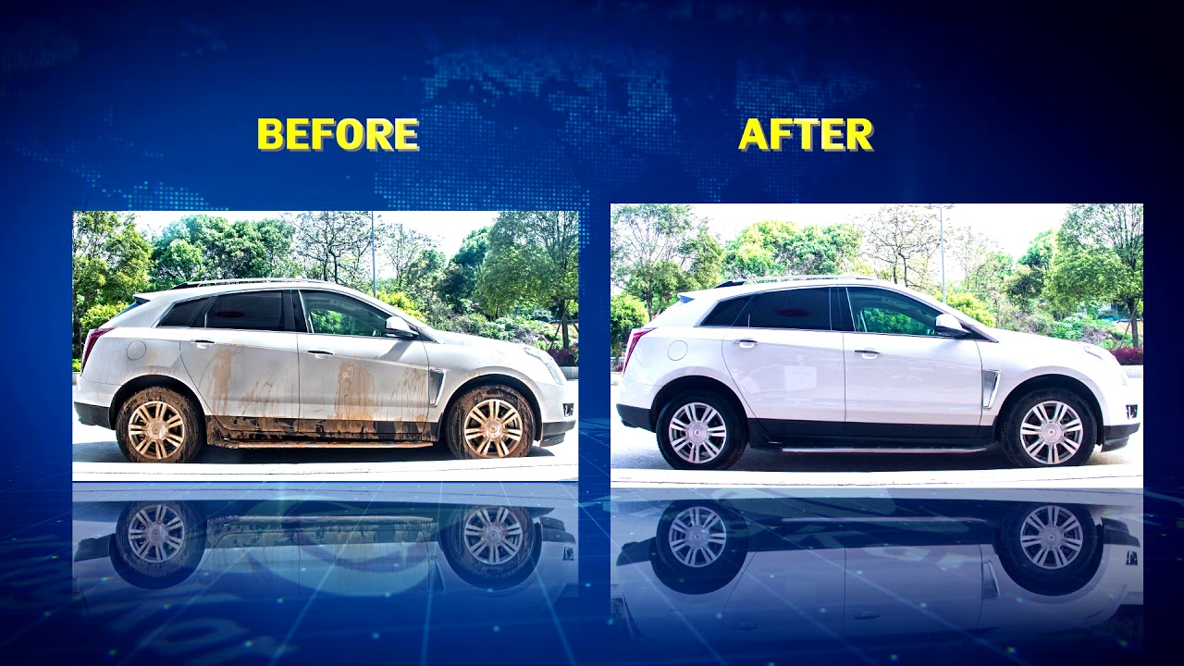
BEFORE

Slide 52
AFTER
But - what are you like when no ones looking?

Slide 53
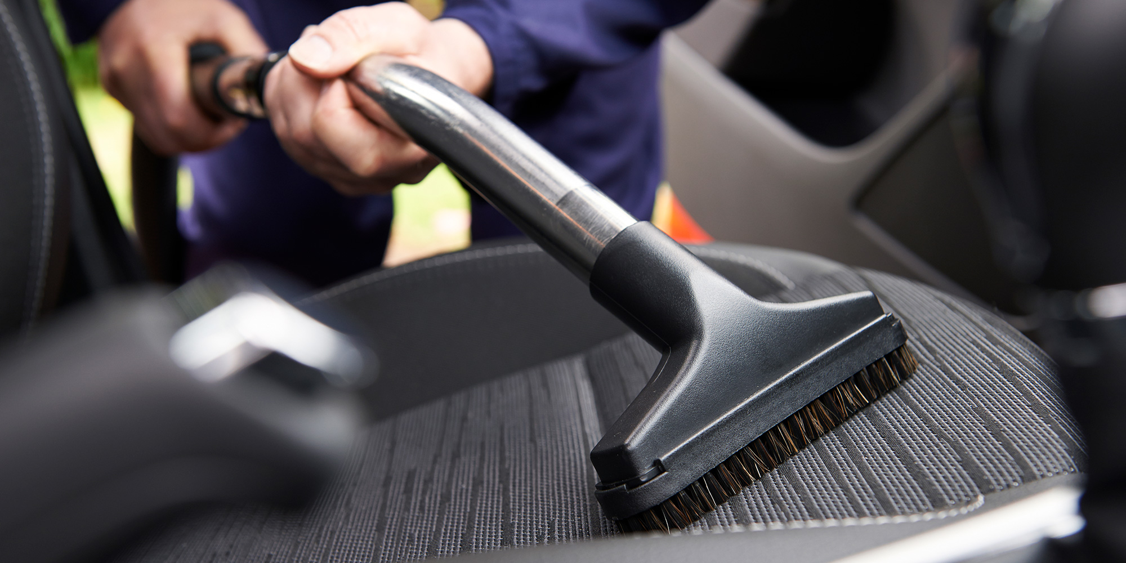
ARE YOU CLEAN ON THE INSIDE!!
DO YOU NEED A FULL VALET?

Slide 54
RECONCILIATION SERVICE
Friday 12th December
ADVENT 2025
HOLY SPIRIT HELP ME SEE,
WHERE THERE
NINEVEH IN ME.
A.M.D.G. – For the Greater Glory of God

Slide 55
WE RESPOND
To ‘see where there is Nineveh in me’ means to allow the Holy Spirit to reveal the hidden, wicked or sinful aspects of our lives that are resistant to God’s will.
Just like this ancient city, we too are called to repentance, seeking reconciliation with God, leading to spiritual awakening and transformation.
We respond by Examining our Conscience.
A.M.D.G. – For the Greater Glory of God
Notes:
55

Slide 56
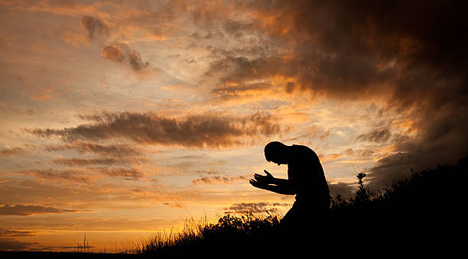
EXAMINATION OF CONSCIENCE
We now take a few moments to think if there are any aspects of Nineveh in us and ask for forgiveness.

Slide 57
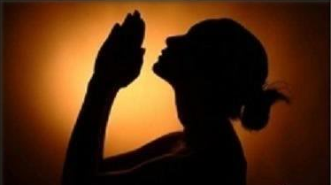
FORGIVENESS Is there anything that you need to ask God to forgive you for?

Slide 58
NINEVEH
NINEVEH Holy Spirit help me see, where there is Nineveh in me!
REBELLION Is your heart open to God, or do you run away from him?

Slide 59
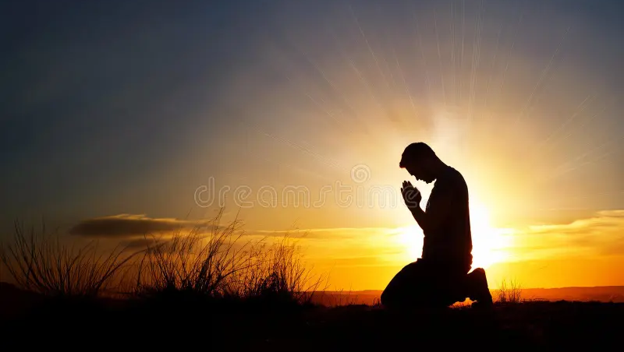
RESPECT
Are you respectful to your parents and teachers?
KINDNESS
Do you show kindness towards other people?
HONESTY
Are you always honest about things or do you sometimes tell lies?

Slide 60

NOBODY IS PERFECT Do you need ‘cleaning up’ on the outside and the inside?
FALSE IDOLS Do you place too much value on material possessions?

Slide 61
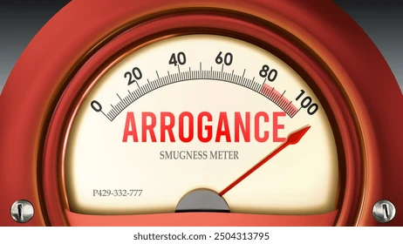
ARE YOU A PERSON OF GOOD CHARACTER
What are you like when no ones looking?
ARROGANCE Do you think that sinfulness and weakness are just found in ‘other’ people?

Slide 62

SIN Have you done anything that would offend God?
FEAR Have you ever upset someone so much that they are scared of you?
SUFFER Have you ever deliberately hurt someone?

Slide 63
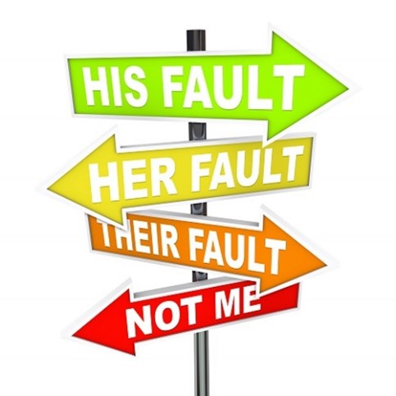
FAULT FINDER Do you find it easy to point out faults in other people always blaming someone else?
FRIEND Are you a bridge builder, helping to bring people back together?

Slide 64

COMPASSION Do you help people in need, or do you just ignore them?
MERCY Do you give people a second chance?

Slide 65

DIVIDED Do you ever gossip or try to split up friends?
PARDON Are you willing to forgive others or do you hold grudges?

Slide 66
IF THE ANSWER WAS YES TO ANY OF THOSE QUESTIONS, THEN -
HOLY SPIRIT HELP ME SEE, WHERE THERE IS NINEVEH IN ME.

Slide 67
Think again of the one thing or one person that you thought of at the start of the service.
In the silence of your heart say sorry and ask for forgiveness.

Slide 68

GOD HAVE MERCY
REMEMBER
BECAUSE THERE IS A BIT OF NINEVEH IN ALL OF US!

Slide 69



COLLEGE PRAYER

Slide 70



COLLEGE CHAPLAINS
FR. STEPHEN
FR. BALA
CONFESSIONS WILL TAKE PLACE TODAY AT LUNCHTIME
Notes:
70

Slide 71

PENANCE IN THE CHAPEL
LUNCHTIME

Slide 72

MISSION WE GO FORTH
We go forth, asking for God to Forgive Us for any bad things that we may have done.
The book of Jonah recounts how the prophet was sent to Nineveh to preach against wickedness, leading the people to repent and prompting God to spare them.
Help us to see the areas of our own lives that are resistant to the ways of God as we humbly repent and return to the Father.
A.M.D.G. – For the Greater Glory of God

Slide 73

LET US FINISH OUR RECONCILIATION SERVICE
I invite you all to say and make the Sign of the Cross
In the name of the Father and of the Son and of the Holy Spirit Amen.
A.M.D.G. – For the Greater Glory of God

Slide 74
RECONCILIATION SERVICE
Friday 12th December
ADVENT 2025
HOLY SPIRIT HELP ME SEE,
WHERE THERE IS
NINEVEH IN ME.
A.M.D.G. – For the Greater Glory of God

